Slide 1
9/11 Presentation
學生:林奇鋒

Slide 2

Outline
1.Data Processing
2.Model
3.Result

Slide 3
Data Processing

Slide 4
Data Processing
Experiment Data
 | Training | Testing
APPLE Computer Inc. | 02/10/2003~09/10/2004 | 09/13/2004~01/21/2005
IBM Corporation. | 02/10/2003~09/10/2004 | 09/13/2004~01/21/2005
Dell Inc. | 02/10/2003~09/10/2004 | 09/13/2004~01/21/2005
Microsoft Inc. | 02/10/2003~09/10/2004 | 09/13/2004~01/21/2005
433
59

Slide 5

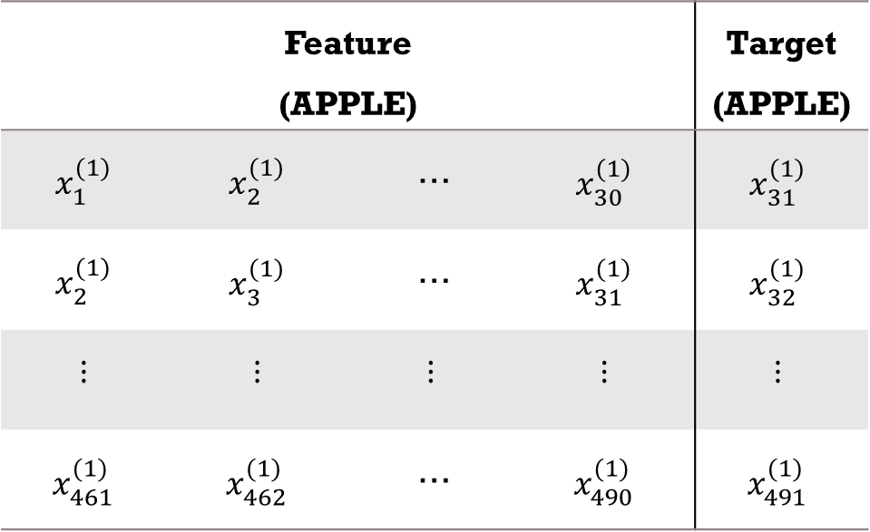


Data Processing
$1^{st}$difference
$$d_{i+1}^{(1)}−d_{i}^{(1)}=x_{i}^{(1)},i=1,2,…,491$$
Number Of Data:492
Feature (APPLE) |  |  |  | Target (APPLE)
$$x_{1}^{(1)}$$ | $$x_{2}^{(1)}$$ | … | $$x_{30}^{(1)}$$ | $$x_{31}^{(1)}$$
$$x_{2}^{(1)}$$ | $$x_{3}^{(1)}$$ | … | $$x_{31}^{(1)}$$ | $$x_{32}^{(1)}$$
$$⋮$$ | $$⋮$$ | $$⋮$$ | $$⋮$$ | $$⋮$$
$$x_{461}^{(1)}$$ | $$x_{462}^{(1)}$$ | … | $$x_{490}^{(1)}$$ | $$x_{491}^{(1)}$$
$1^{st}$difference
Number Of Data:491
Number Of Feature:30

Slide 6
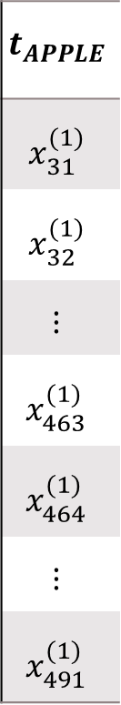
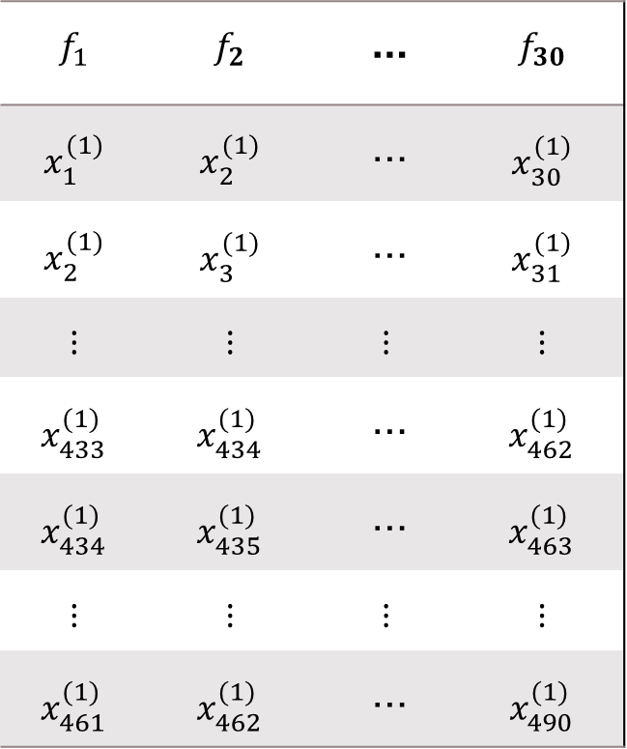
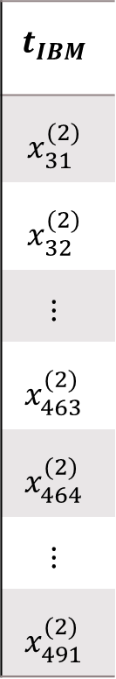
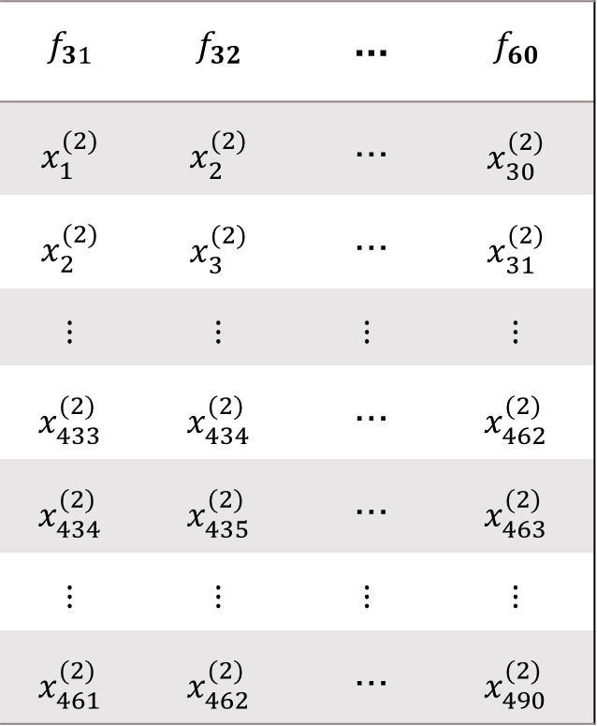
Data Processing
$$f_{1}$$ | $$f_{2}$$ | … | $$f_{30}$$
$$x_{1}^{(1)}$$ | $$x_{2}^{(1)}$$ | … | $$x_{30}^{(1)}$$
$$x_{2}^{(1)}$$ | $$x_{3}^{(1)}$$ | … | $$x_{31}^{(1)}$$
$$⋮$$ | $$⋮$$ | $$⋮$$ | $$⋮$$
$$x_{433}^{(1)}$$ | $$x_{434}^{(1)}$$ | … | $$x_{462}^{(1)}$$
$$x_{434}^{(1)}$$ | $$x_{435}^{(1)}$$ | … | $$x_{463}^{(1)}$$
$$⋮$$ | $$⋮$$ | $$⋮$$ | $$⋮$$
$$x_{461}^{(1)}$$ | $$x_{462}^{(1)}$$ | … | $$x_{490}^{(1)}$$
$$f_{31}$$ | $$f_{32}$$ | … | $$f_{60}$$
$$x_{1}^{(2)}$$ | $$x_{2}^{(2)}$$ | … | $$x_{30}^{(2)}$$
$$x_{2}^{(2)}$$ | $$x_{3}^{(2)}$$ | … | $$x_{31}^{(2)}$$
$$⋮$$ | $$⋮$$ | $$⋮$$ | $$⋮$$
$$x_{433}^{(2)}$$ | $$x_{434}^{(2)}$$ | … | $$x_{462}^{(2)}$$
$$x_{434}^{(2)}$$ | $$x_{435}^{(2)}$$ | … | $$x_{463}^{(2)}$$
$$⋮$$ | $$⋮$$ | $$⋮$$ | $$⋮$$
$$x_{461}^{(2)}$$ | $$x_{462}^{(2)}$$ | … | $$x_{490}^{(2)}$$
$$t_{APPLE}$$
$$x_{31}^{(1)}$$
$$x_{32}^{(1)}$$
$$⋮$$
$$x_{463}^{(1)}$$
$$x_{464}^{(1)}$$
$$⋮$$
$$x_{491}^{(1)}$$
$$t_{IBM}$$
$$x_{31}^{(2)}$$
$$x_{32}^{(2)}$$
$$⋮$$
$$x_{463}^{(2)}$$
$$x_{464}^{(2)}$$
$$⋮$$
$$x_{491}^{(2)}$$
Training
(433)
…
…
Testing
(59)
APPLE
IBM
DELL
Microsoft

Slide 7
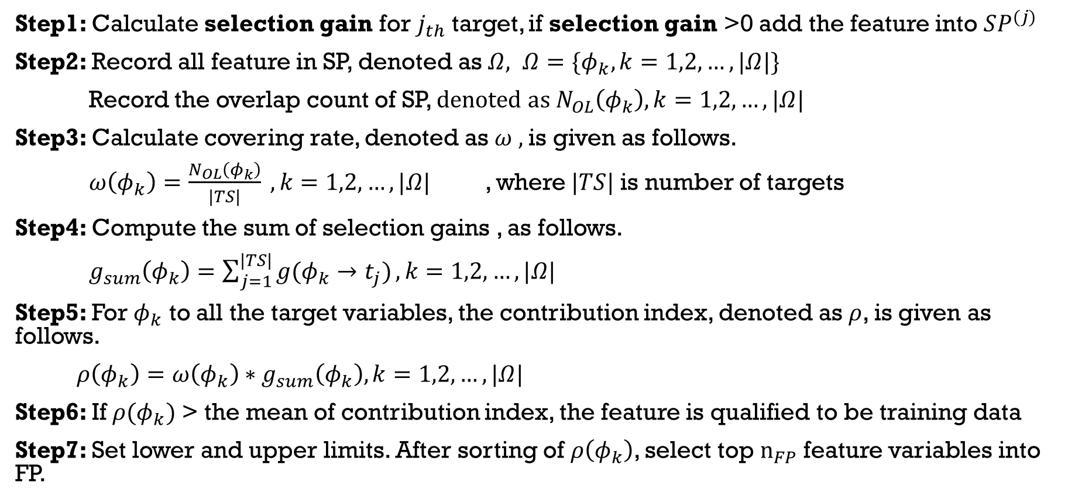
Multi-Target Feature Selection
Step1: Calculate selection gain for $j_{th}$ target, if selection gain >0 add the feature into $SP^{(j)}$
Step2: Record all feature in SP, denoted as $Ω, Ω=\{φ_{k},k=1,2,…,|Ω|\}$
Record the overlap count of SP, $denoted as N_{OL}\left(φ_{k}\right),k=1,2,…,|Ω|$
Step3: Calculate covering rate, denoted as $ω ,$is given as follows.
$ω\left(φ_{k}\right)=\frac{N_{OL}\left(φ_{k}\right)}{|TS|} ,k=1,2,…,|Ω|$ , where$|TS|$ is number of targets
Step4: Compute the sum of selection gains , as follows.
$g_{sum}\left(φ_{k}\right)=\sum_{j=1}^{|TS|}{g(φ_{k}→t_{j})},k=1,2,…,|Ω|$
Step5: For $φ_{k}$ to all the target variables, the contribution index, denoted as $ρ$, is given as follows.
$ρ\left(φ_{k}\right)=ω\left(φ_{k}\right)∗g_{sum}\left(φ_{k}\right),k=1,2,…,|Ω|$
Step6: If $ρ(φ_{k})$ > the mean of contribution index, the feature is qualified to be training data
Step7: Set lower and upper limits. After sorting of $ρ\left(φ_{k}\right)$, select top $n_{FP}$feature variables into FP.

Slide 8
Model

Slide 9















Model
M:Number of inputs K:Number of premises
Q:Number of Consequence N:Number of outputs
$$\overset{⃑}{μ }$$
$${\overset{⃑}{β }}^{(1)}$$
$${\overset{⃑}{λ}}^{(1)}$$
$${\overset{⃑}{\hat{y}}}^{(1)}$$
A1
1
1
A2
$${\overset{⃑}{λ}}^{(2)}$$
$$h_{1}$$
2
$${\overset{⃑}{β }}^{(2)}$$
$${\overset{⃑}{\hat{y}}}^{(2)}$$
2
A3
$$\overset{⃑}{\hat{y}}$$
+
$$⋮$$
$$⋮$$
B1
$$h_{2}$$
B2
$${\overset{⃑}{β }}^{(K)}$$
$${\overset{⃑}{λ}}^{(Q)}$$
$${\overset{⃑}{\hat{y}}}^{(Q)}$$
B3
K
Q
Layer1
(Inputs)
Layer2
(Fuzzy-set)
Layer3
(Premises)
Layer4
(Aim Object)
Layer5
(Consequences)
Layer6
(Outputs)

Slide 10
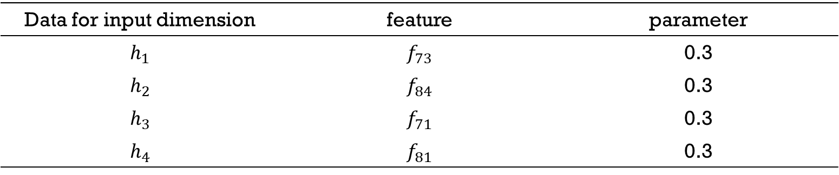
Parameter Setting of Subtractive clustering : subclust()
Data for input dimension | feature | parameter
$$h_{1}$$ | $$f_{73}$$ | 0.3
$$h_{2}$$ | $$f_{84}$$ | 0.3
$$h_{3}$$ | $$f_{71}$$ | 0.3
$$h_{4}$$ | $$f_{81}$$ | 0.3

Slide 11



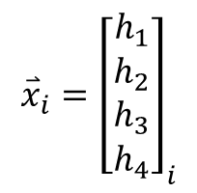

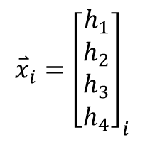
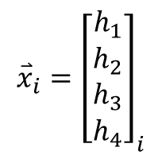


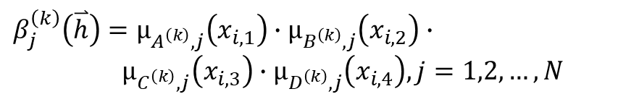


Premises(IF-Parts)
$$\overset{⃑}{h}=\left[\begin{matrix}x_{i,1} \\ \begin{aligned}x_{i,2} \\ x_{i,3} \\ x_{i,4}\end{aligned}\end{matrix}\right]$$
$$β_{j}^{\left(k\right)}\left(\overset{⃑}{h}\right)=μ_{A^{\left(k\right)},j}\left(x_{i,1}\right)∙μ_{B^{\left(k\right)},j}\left(x_{i,2}\right)∙$$
$μ_{C^{\left(k\right)},j}\left(x_{i,3}\right)∙μ_{D^{\left(k\right)},j}\left(x_{i,4}\right),j=1,2,…,N$
$$TD=\{\left({\overset{⃑}{x}}_{i},{\overset{⃑}{t}}_{i}\right),i=1,2,…,200\}$$
$${\overset{⃑}{x}}_{i}={\left[\begin{matrix}h_{1} \\ \begin{aligned}h_{2} \\ h_{3} \\ h_{4}\end{aligned}\end{matrix}\right]}_{i}$$
IF-Part
1
$${\overset{⃑}{β}}_{j}^{\left(1\right)}$$
$${\overset{⃑}{x}}_{i}={\left[\begin{matrix}h_{1} \\ \begin{aligned}h_{2} \\ h_{3} \\ h_{4}\end{aligned}\end{matrix}\right]}_{i}$$
IF-Part
2
$${\overset{⃑}{β}}_{j}^{\left(2\right)}$$
$$⋮$$
$${\overset{⃑}{x}}_{i}={\left[\begin{matrix}h_{1} \\ \begin{aligned}h_{2} \\ h_{3} \\ h_{4}\end{aligned}\end{matrix}\right]}_{i}$$
IF-Part
$$K$$
$${\overset{⃑}{β}}_{j}^{\left(K\right)}$$
$K$=9

Slide 12




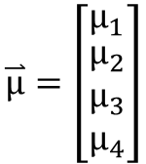







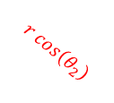




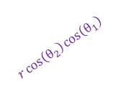

Sphere Complex Fuzzy Sets(SCFS)
$$X_{3}$$
$$u_{x_{1}}=r∙\cos\left(θ_{2}\right)∙\cos\left(θ_{1}\right)$$
$$u_{x_{2}}=r∙\cos\left(θ_{2}\right)∙\sin\left(θ_{1}\right)$$
$$u_{x_{3}}=r∙\sin\left(θ_{2}\right)$$
1
$$(u_{x_{1}},u_{x_{2}},u_{x_{3}})$$
$$r$$
where $r=\exp\left(\frac{−{\left(h−c\right)}^{2}}{2σ^{2}}\right)$ 、$θ_{1}=\frac{dr}{dx}∙λ_{1}$ 、$θ_{2}=\frac{d^{2}r}{dx^{2}}∙λ_{2}$
$$r\sin\left(θ_{2}\right)$$
保維法
$$μ_{1}=r∗exp(j(θ_{1}+θ_{2}))$$
$$θ_{2}$$
$$X_{2}$$
$$θ_{1}$$
$$r\cos\left(θ_{2}\right)$$
$$μ_{2}=u_{x_{1}}+u_{x_{2}}∙j$$
$$r\cos\left(θ_{2}\right)\sin\left(θ_{1}\right)$$
$$r\cos\left(θ_{2}\right)\cos\left(θ_{1}\right)$$
降維法
$$μ_{3}=u_{x_{2}}+u_{x_{3}}∙j$$
$$X_{1}$$
$$μ_{4}=u_{x_{3}}+u_{x_{1}}∙j$$
$$\overset{⃑}{μ}=\left[\begin{matrix}μ_{1} \\ \begin{aligned}μ_{2} \\ μ_{3} \\ μ_{4}\end{aligned}\end{matrix}\right]$$

Slide 13












Sphere Complex Fuzzy Sets(SCFS)
Membership
degrees
OUTPUT
TARGET
$$μ_{1}=r∗exp(j(θ_{1}+θ_{2}))$$
${\hat{y}}_{i}^{\left(1\right)}$
$$t_{i}^{(1)}=APPLE+IBM∗j$$
$$μ_{2}=u_{x_{1}}+u_{x_{2}}∗j$$
${\hat{y}}_{i}^{\left(2\right)}$
$$t_{i}^{(2)}=DELL+Microsoft∗j$$
$$μ_{3}=u_{x_{2}}+u_{x_{3}}∗j$$
${\hat{y}}_{i}^{\left(3\right)}$
$$t_{i}^{(3)}=target5+target6∗j$$
$$μ_{4}=u_{x_{3}}+u_{x_{1}}∗j$$
${\hat{y}}_{i}^{\left(4\right)}$
$$t_{i}^{(4)}=target7+target8∗j$$

Slide 14

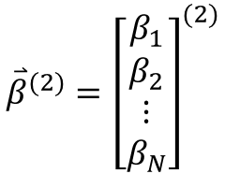

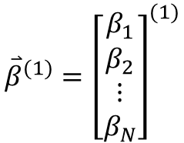





Aim Objects
N layers
aim objects
$${\overset{⃑}{β}}^{(1)}={\left[\begin{matrix}β_{1} \\ β_{2} \\ ⋮ \\ β_{N}\end{matrix}\right]}^{(1)}$$
(1)
$${\overset{⃑}{λ}}^{(1)}$$
THEN-part
(2)
$${\overset{⃑}{β}}^{(2)}={\left[\begin{matrix}β_{1} \\ β_{2} \\ ⋮ \\ β_{N}\end{matrix}\right]}^{(2)}$$
$${\overset{⃑}{λ}}^{(2)}$$
THEN-part
$$⋮$$
$$⋮$$
$$⋮$$
$${\overset{⃑}{β}}^{(K)}={\left[\begin{matrix}β_{1} \\ β_{2} \\ ⋮ \\ β_{N}\end{matrix}\right]}^{(K)}$$
(Q)
$${\overset{⃑}{λ}}^{(Q)}$$
THEN-part

Slide 15

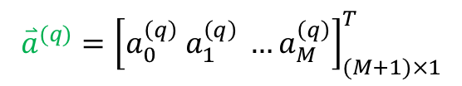


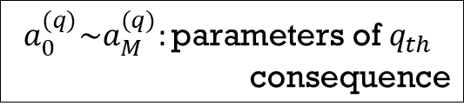




Consequence (THEN-parts)
$$B={\left[{\overset{⃑}{β}}^{\left(1\right)} {\overset{⃑}{β}}^{\left(2\right)}…{\overset{⃑}{β}}^{\left(K\right)}\right]}_{N×K}$$
$${{\overset{⃑}{\hat{y} }}^{(q)}}^{ }=φ^{(q)}×{\overset{⃑}{a}}^{(q)}$$
$${\overset{⃑}{β}}^{\left(k\right)}={\left[β_{1}^{\left(k\right)}β_{2}^{\left(k\right)} …β_{N}^{\left(k\right)}\right]}^{T}$$
$${\overset{⃑}{a}}^{(q)}={\left[a_{0}^{\left(q\right)} a_{1}^{\left(q\right)} …a_{M}^{\left(q\right)}\right]}_{(M+1)×1}^{T}$$
$B_{N}^{(k)}:$ the firing strength of $K_{th}$ premise for the $N_{th}$ target
$$a_{0}^{(q)}\sim a_{M}^{(q)}:\text{parameters} \text{of} q_{th}$$
$$\text{consequence}$$
$$L^{(q)}={\left[\begin{aligned}\begin{matrix}{{\overset{⃑}{λ}}^{\left(1→q\right)}}^{T} \\ {{\overset{⃑}{λ}}^{\left(2→q\right)}}^{T} \\ \begin{aligned}⋮ \\ {{\overset{⃑}{λ}}^{\left(K→q\right)}}^{T}\end{aligned}\end{matrix}\end{aligned}\right]}_{K×N}$$
$$H={\left[\begin{aligned}\begin{matrix}{\left({\overset{⃑}{h}}_{a}\right)}^{T} \\ {\left({\overset{⃑}{h}}_{a}\right)}^{T} \\ \begin{aligned}⋮ \\ {\left({\overset{⃑}{h}}_{a}\right)}^{T}\end{aligned}\end{matrix}\end{aligned}\right]}_{N×(M+1)}$$
$${\overset{⃑}{h}}_{a}={\left[1 (\overset{⃑}{h})\right]}^{T}$$
$$φ^{(q)}=B∙L∙H$$

Slide 16
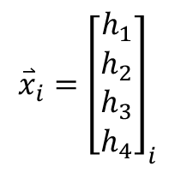



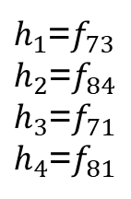


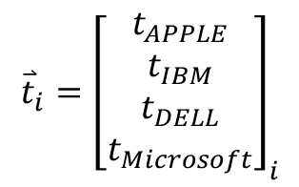
PSO
RLSE
Premises
(IF-Parts)
Consequences
(THEN-Parts)
-
+
$${\overset{⃑}{\hat{y}}}_{i}$$
+
$${\overset{⃑}{t}}_{i}$$
$${\overset{⃑}{x}}_{i}$$
Model Output
Target
$${\overset{⃑}{e}}_{i}={\overset{⃑}{t}}_{i}−{\overset{⃑}{\hat{y}}}_{i}$$
$${\overset{⃑}{x}}_{i}={\left[\begin{matrix}h_{1} \\ h_{2} \\ h_{3} \\ h_{4}\end{matrix}\right]}_{i}$$
$h_{1}$=$f_{73}$
$h_{2}$=$f_{84}$
$h_{3}$=$f_{71}$
$h_{4}$=$f_{81}$
$${\overset{⃑}{t}}_{i}={\left[\begin{aligned}t_{APPLE} \\ t_{IBM} \\ t_{DELL} \\ t_{Microsoft}\end{aligned}\right]}_{i}$$
$$TD=\{\left({\overset{⃑}{x}}_{i},{\overset{⃑}{t}}_{i}\right),i=1,2,…,433\}$$

Slide 17
Result

Slide 18
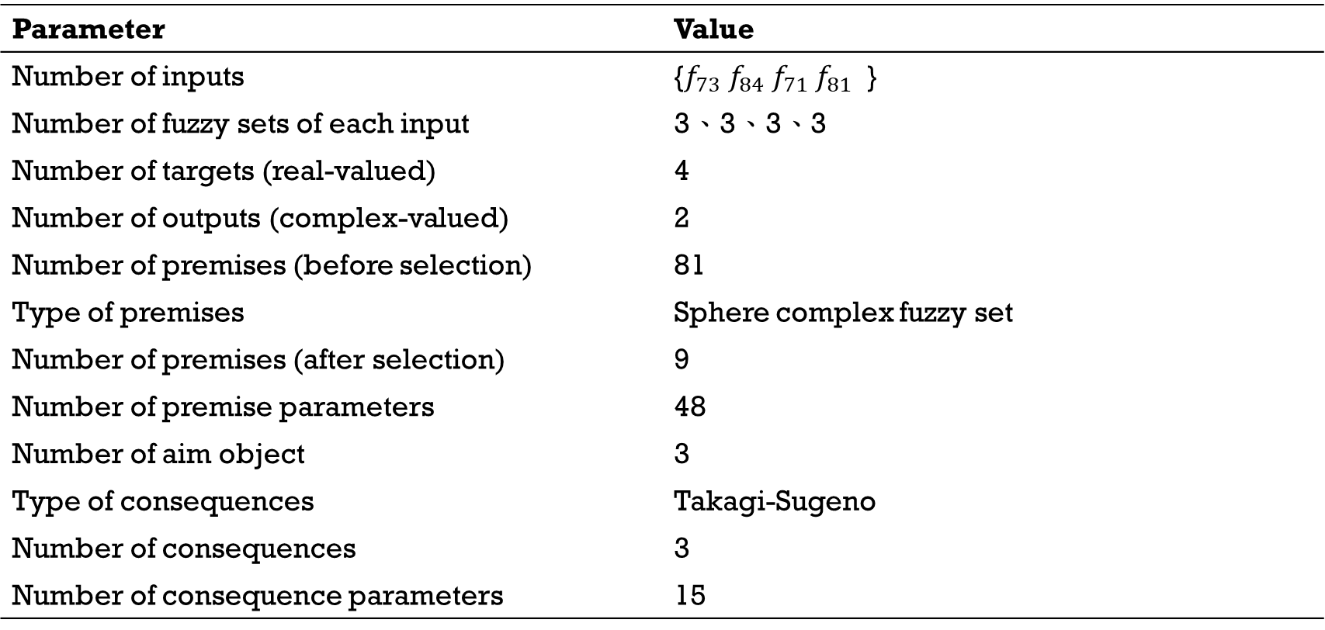
Result
Parameter | Value
Number of inputs | {$f_{73} f_{84} f_{71} f_{81}$ }
Number of fuzzy sets of each input | 3、3、3、3
Number of targets (real-valued) | 4
Number of outputs (complex-valued) | 2
Number of premises (before selection) | 81
Type of premises | Sphere complex fuzzy set
Number of premises (after selection) | 9
Number of premise parameters | 48
Number of aim object | 3
Type of consequences | Takagi-Sugeno
Number of consequences | 3
Number of consequence parameters | 15

Slide 19
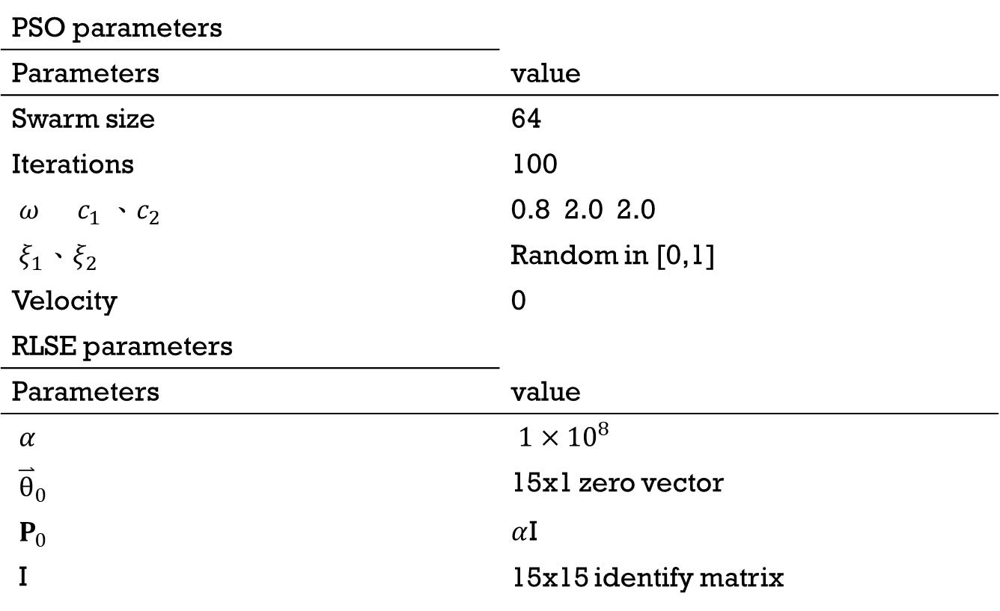
Parameters
PSO parameters
Parameters | value
Swarm size | 64
Iterations | 100
$ω c_{1} 、c_{2}$ | 0.8 2.0 2.0
$ξ_{1}、ξ_{2}$ | Random in [0,1]
Velocity | 0
RLSE parameters
Parameters | value
$α$ | ${1×10}^{8}$
${\overset{⃑}{\text{θ}}}_{0}$ | 15x1 zero vector
$P_{0}$ | $α$I
I | 15x15 identify matrix

Slide 20
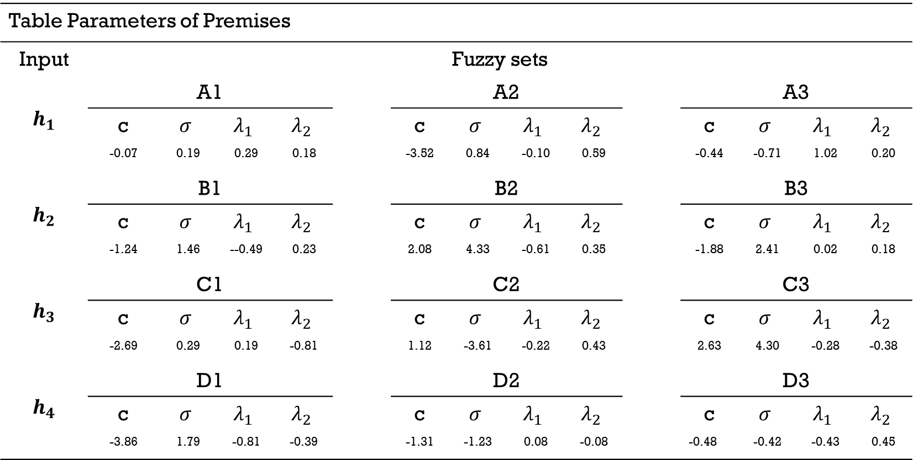
Premises Parameters (after learning)
Table Parameters of Premises
Input | Fuzzy sets
$$h_{1}$$ | A1 |  |  |  |  | A2 |  |  |  |  | A3
 | c | $$σ$$ | $$λ_{1}$$ | $$λ_{2}$$ |  | c | $$σ$$ | $$λ_{1}$$ | $$λ_{2}$$ |  | c | $$σ$$ | $$λ_{1}$$ | $$λ_{2}$$
 | -0.07 | 0.19 | 0.29 | 0.18 |  | -3.52 | 0.84 | -0.10 | 0.59 |  | -0.44 | -0.71 | 1.02 | 0.20
$$h_{2}$$ | B1 |  |  |  |  | B2 |  |  |  |  | B3
 | c | $$σ$$ | $$λ_{1}$$ | $$λ_{2}$$ |  | c | $$σ$$ | $$λ_{1}$$ | $$λ_{2}$$ |  | c | $$σ$$ | $$λ_{1}$$ | $$λ_{2}$$
 | -1.24 | 1.46 | --0.49 | 0.23 |  | 2.08 | 4.33 | -0.61 | 0.35 |  | -1.88 | 2.41 | 0.02 | 0.18
$$h_{3}$$ | C1 |  |  |  |  | C2 |  |  |  |  | C3
 | c | $$σ$$ | $$λ_{1}$$ | $$λ_{2}$$ |  | c | $$σ$$ | $$λ_{1}$$ | $$λ_{2}$$ |  | c | $$σ$$ | $$λ_{1}$$ | $$λ_{2}$$
 | -2.69 | 0.29 | 0.19 | -0.81 |  | 1.12 | -3.61 | -0.22 | 0.43 |  | 2.63 | 4.30 | -0.28 | -0.38
$$h_{4}$$ | D1 |  |  |  |  | D2 |  |  |  |  | D3
 | c | $$σ$$ | $$λ_{1}$$ | $$λ_{2}$$ |  | c | $$σ$$ | $$λ_{1}$$ | $$λ_{2}$$ |  | c | $$σ$$ | $$λ_{1}$$ | $$λ_{2}$$
 | -3.86 | 1.79 | -0.81 | -0.39 |  | -1.31 | -1.23 | 0.08 | -0.08 |  | -0.48 | -0.42 | -0.43 | 0.45

Slide 21
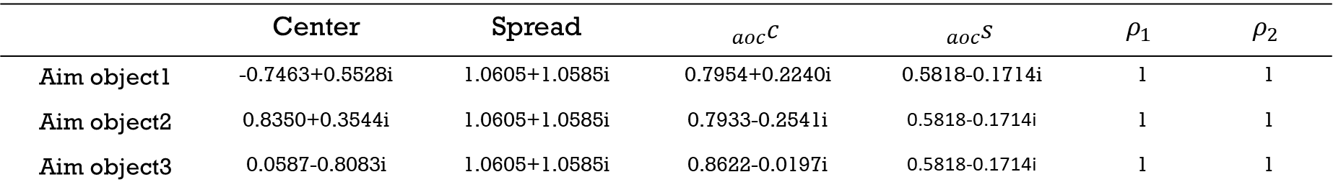
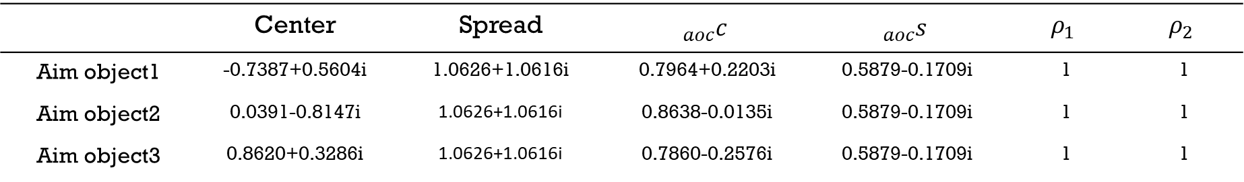
Aim Object Parameters
Layer1 of Aim Object
 | Center | Spread | $${}_{aoc}^{}c$$ | $${}_{aoc}^{}s$$ | $$ρ_{1}$$ | $$ρ_{2}$$
Aim object1 | -0.7387+0.5604i | 1.0626+1.0616i | 0.7964+0.2203i | 0.5879-0.1709i | 1 | 1
Aim object2 | 0.0391-0.8147i | 1.0626+1.0616i | 0.8638-0.0135i | 0.5879-0.1709i | 1 | 1
Aim object3 | 0.8620+0.3286i | 1.0626+1.0616i | 0.7860-0.2576i | 0.5879-0.1709i | 1 | 1
Layer2 of Aim Object
 | Center | Spread | $${}_{aoc}^{}c$$ | $${}_{aoc}^{}s$$ | $$ρ_{1}$$ | $$ρ_{2}$$
Aim object1 | -0.7463+0.5528i | 1.0605+1.0585i | 0.7954+0.2240i | 0.5818-0.1714i | 1 | 1
Aim object2 | 0.8350+0.3544i | 1.0605+1.0585i | 0.7933-0.2541i | 0.5818-0.1714i | 1 | 1
Aim object3 | 0.0587-0.8083i | 1.0605+1.0585i | 0.8622-0.0197i | 0.5818-0.1714i | 1 | 1

Slide 22
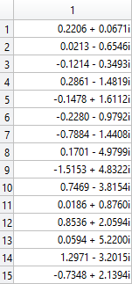
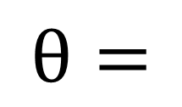
Consequences Parameters
$$\text{θ}=$$

Slide 23
Learning Curve

Slide 25
Comparison
Performance comparison in MAPE
 | APPLE | IBM | DELL
HiMMI | 2.8373 | 1.2186 | 1.0117
ANN-GA-HMM-Interpolation | 2.1649 | 1.0555 | 0.8446
ANN-GA-HMM-WA | 1.9247 | 0.8487 | 0.6992
ARIMA | 1.8009 | 0.9723 | 0.6604
SCNFS (proposed) | 0.6760 | 0.6563 | 0.6507

