Slide 1
10/23 Presentation
學生:林奇鋒

Slide 2

Outline
1.Data Processing
2.Model
3.Result

Slide 3
Data Processing

Slide 4
Data Processing
Experimentation2_2002
 | Training | Testing
TAIEX | 01/01/2002~9/30/2002 | 10/01/2002~12/31/2002
DJIA | 01/07/2002~9/30/2002 | 10/01/2002~01/03/2003
NASDAQ | 01/07/2002~9/30/2002 | 10/01/2002~01/03/2003
S&P500 | 01/07/2002~9/30/2002 | 10/01/2002~01/03/2003
184
64

Slide 5

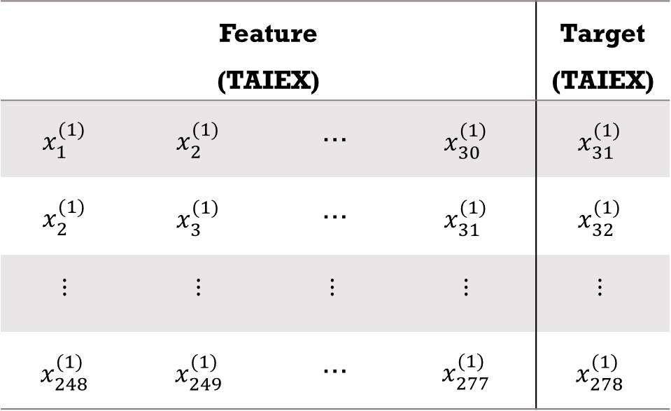


Data Processing
$1^{st}$difference
$d_{i+1}^{(1)}−d_{i}^{(1)}=x_{i}^{(1)},i=1,2,…,2$48
Number Of Data: 279
Feature (TAIEX) |  |  |  | Target (TAIEX)
$$x_{1}^{(1)}$$ | $$x_{2}^{(1)}$$ | … | $$x_{30}^{(1)}$$ | $$x_{31}^{(1)}$$
$$x_{2}^{(1)}$$ | $$x_{3}^{(1)}$$ | … | $$x_{31}^{(1)}$$ | $$x_{32}^{(1)}$$
$$⋮$$ | $$⋮$$ | $$⋮$$ | $$⋮$$ | $$⋮$$
$$x_{248}^{(1)}$$ | $$x_{249}^{(1)}$$ | … | $$x_{277}^{(1)}$$ | $$x_{278}^{(1)}$$
$1^{st}$difference
Number Of Data: 278
Number Of Feature:30

Slide 6
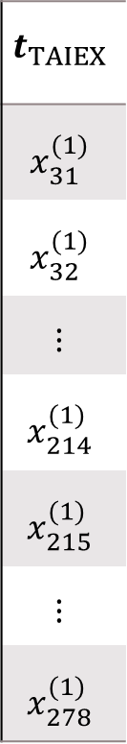
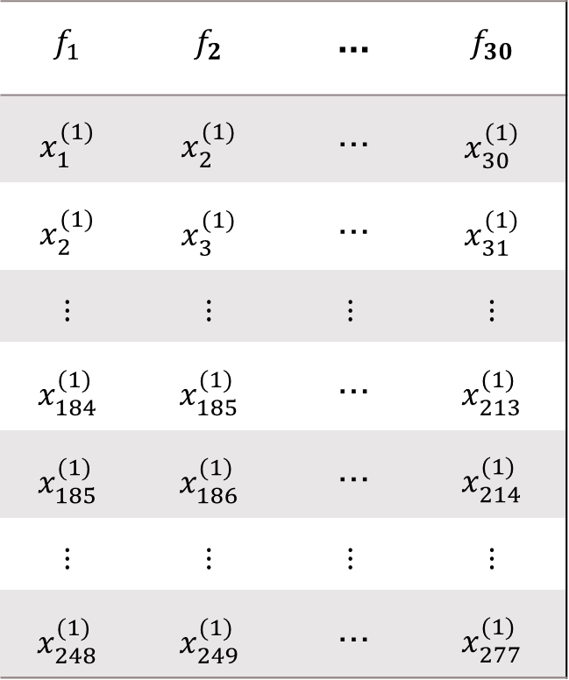
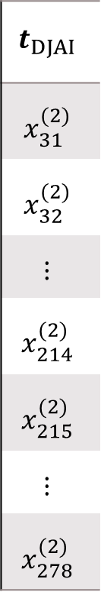
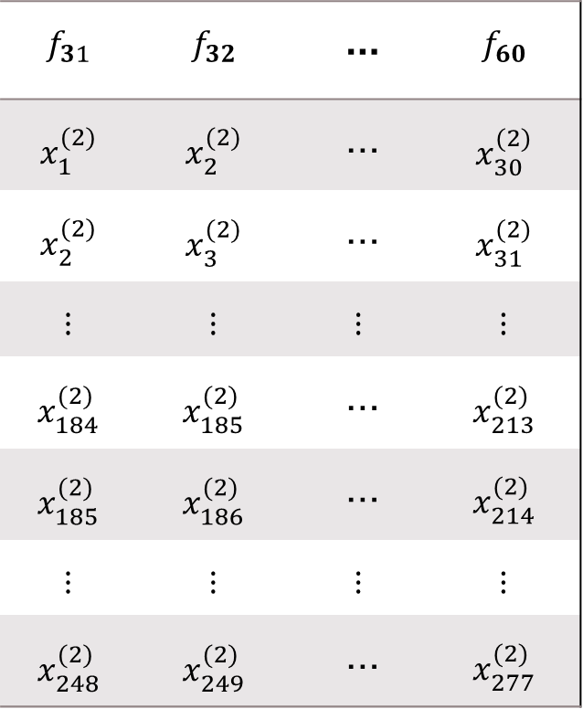
Data Processing
$$f_{1}$$ | $$f_{2}$$ | … | $$f_{30}$$
$$x_{1}^{(1)}$$ | $$x_{2}^{(1)}$$ | … | $$x_{30}^{(1)}$$
$$x_{2}^{(1)}$$ | $$x_{3}^{(1)}$$ | … | $$x_{31}^{(1)}$$
$$⋮$$ | $$⋮$$ | $$⋮$$ | $$⋮$$
$$x_{184}^{(1)}$$ | $$x_{185}^{(1)}$$ | … | $$x_{213}^{(1)}$$
$$x_{185}^{(1)}$$ | $$x_{186}^{(1)}$$ | … | $$x_{214}^{(1)}$$
$$⋮$$ | $$⋮$$ | $$⋮$$ | $$⋮$$
$$x_{248}^{(1)}$$ | $$x_{249}^{(1)}$$ | … | $$x_{277}^{(1)}$$
$$f_{31}$$ | $$f_{32}$$ | … | $$f_{60}$$
$$x_{1}^{(2)}$$ | $$x_{2}^{(2)}$$ | … | $$x_{30}^{(2)}$$
$$x_{2}^{(2)}$$ | $$x_{3}^{(2)}$$ | … | $$x_{31}^{(2)}$$
$$⋮$$ | $$⋮$$ | $$⋮$$ | $$⋮$$
$$x_{184}^{(2)}$$ | $$x_{185}^{(2)}$$ | … | $$x_{213}^{(2)}$$
$$x_{185}^{(2)}$$ | $$x_{186}^{(2)}$$ | … | $$x_{214}^{(2)}$$
$$⋮$$ | $$⋮$$ | $$⋮$$ | $$⋮$$
$$x_{248}^{(2)}$$ | $$x_{249}^{(2)}$$ | … | $$x_{277}^{(2)}$$
$$t_{TAIEX}$$
$$x_{31}^{(1)}$$
$$x_{32}^{(1)}$$
$$⋮$$
$$x_{214}^{(1)}$$
$$x_{215}^{(1)}$$
$$⋮$$
$$x_{278}^{(1)}$$
$$t_{DJAI}$$
$$x_{31}^{(2)}$$
$$x_{32}^{(2)}$$
$$⋮$$
$$x_{214}^{(2)}$$
$$x_{215}^{(2)}$$
$$⋮$$
$$x_{278}^{(2)}$$
Training
(184)
…
…
Testing
(64)
Sequence: TAIEX, DJIA, NASDAQ, S&P500

Slide 7
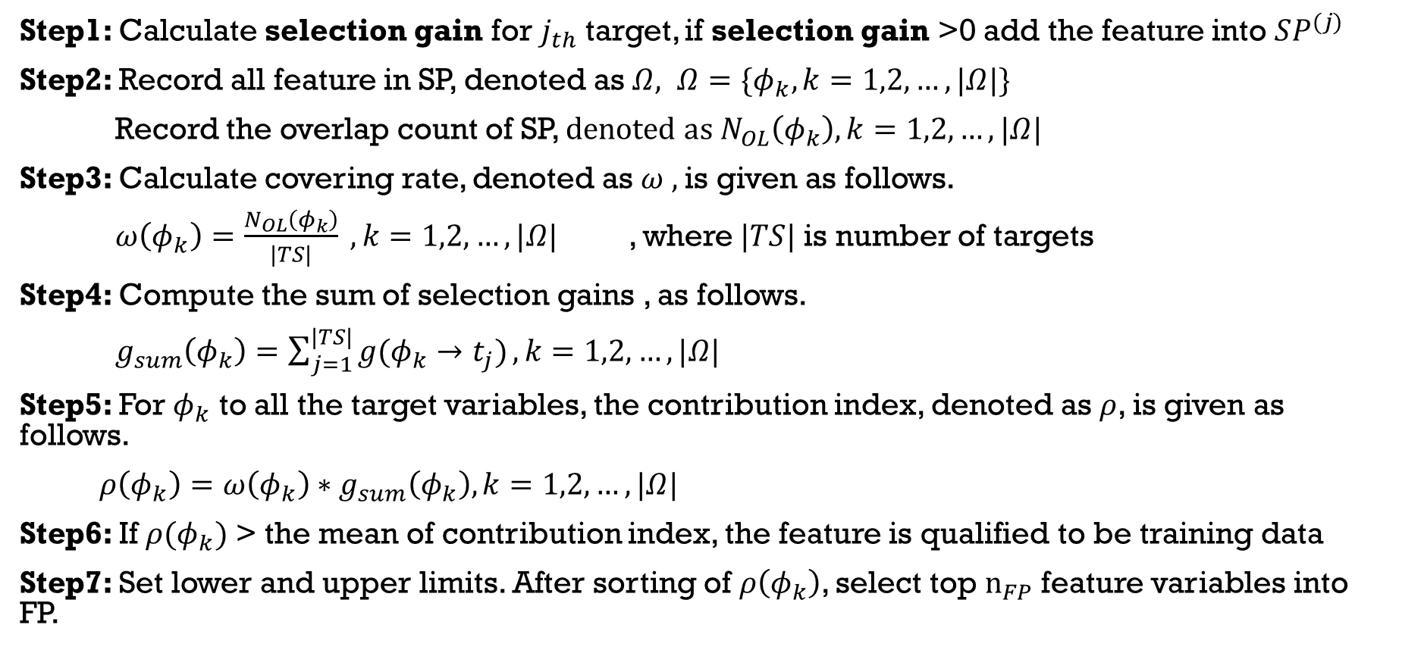
Multi-Target Feature Selection
Step1: Calculate selection gain for $j_{th}$ target, if selection gain >0 add the feature into $SP^{(j)}$
Step2: Record all feature in SP, denoted as $Ω, Ω=\{φ_{k},k=1,2,…,|Ω|\}$
Record the overlap count of SP, $denoted as N_{OL}\left(φ_{k}\right),k=1,2,…,|Ω|$
Step3: Calculate covering rate, denoted as $ω ,$is given as follows.
$ω\left(φ_{k}\right)=\frac{N_{OL}\left(φ_{k}\right)}{|TS|} ,k=1,2,…,|Ω|$ , where$|TS|$ is number of targets
Step4: Compute the sum of selection gains , as follows.
$g_{sum}\left(φ_{k}\right)=\sum_{j=1}^{|TS|}{g(φ_{k}→t_{j})},k=1,2,…,|Ω|$
Step5: For $φ_{k}$ to all the target variables, the contribution index, denoted as $ρ$, is given as follows.
$ρ\left(φ_{k}\right)=ω\left(φ_{k}\right)∗g_{sum}\left(φ_{k}\right),k=1,2,…,|Ω|$
Step6: If $ρ(φ_{k})$ > the mean of contribution index, the feature is qualified to be training data
Step7: Set lower and upper limits. After sorting of $ρ\left(φ_{k}\right)$, select top $n_{FP}$feature variables into FP.

Slide 8













$$f_{1}$$
$$f_{2}$$
$$f_{62}$$
$$g(f_{1}→t_{TAIEX})=I_{f_{1}→t_{TAIEX}}−\frac{I_{f_{1}→f_{62}}+I_{{f_{62}→f}_{1}}}{2}$$
$$f_{2}$$
.
.
.
$$f_{65}$$
$$g\left(f_{1}→t_{TAIEX}\right)<0$$
$$f_{3}$$
$$g(f_{2}→t_{TAIEX})=I_{f_{2}→t_{TAIEX}}−\frac{I_{f_{2}→f_{62}}+I_{{f_{62}→f}_{2}}}{2}$$
$$f_{24}$$
$$f_{19}$$
$$g\left(f_{2}→t_{TAIEX}\right)>0$$
$$f_{120}$$
Features
Selected Pool (target1)

Slide 9

















$$f_{62}$$
$$f_{2}$$
$$f_{65}$$
$$ρ\left(f_{62}\right)=ω\left(f_{62}\right)∗g_{sum}\left(f_{62}\right)$$
$$f_{3}$$
Covering rate
Contribution index
$$f_{24}$$
$$f_{19}$$
$$f_{62}$$
Selected Pool (target1)
$$f_{65}$$
$$f_{62}$$
$$f_{2}$$
$$f_{2}$$
$$f_{65}$$
$$f_{79}$$
$$f_{24}$$
$$f_{53}$$
.
.
.
$$f_{24}$$
9
Selected Pool (target2)
Notes:
主動->現在分詞
被動->過去分詞

Slide 10
Model

Slide 11









































M: Number of Inputs K: Number of Premises
Q: Number of Consequence N: Number of Outputs
$$\overset{⃑}{μ }$$
$${\overset{⃑}{β }}^{(1)}$$
$${\overset{⃑}{γ}}^{(1)}$$
$${\overset{⃑}{λ}}^{(1)}$$
$$A_{1}$$
$$1$$
$$1$$
$$1$$
$${\overset{⃑}{\hat{y}}}^{(1)}$$
$$h_{1}$$
$$A_{2}$$
$${\overset{⃑}{β }}^{(2)}$$
$${\overset{⃑}{γ}}^{(2)}$$
$${\overset{⃑}{λ}}^{(2)}$$
$$A_{3}$$
2
$$2$$
$$2$$
$${\overset{⃑}{\hat{y}}}^{(2)}$$
$$B_{1}$$
$$h_{2}$$
$$B_{2}$$
$$\overset{⃑}{\hat{y}}$$
$$B_{3}$$
$$⋮$$
$$⋮$$
$$⋮$$
$$⋮$$
$$⋮$$
$$⋮$$
$${\overset{⃑}{β }}^{(K)}$$
$${\overset{⃑}{γ}}^{(K)}$$
$${\overset{⃑}{λ}}^{(Q)}$$
$${\overset{⃑}{\hat{y}}}^{(Q)}$$
$$D_{1}$$
$$K$$
$$K$$
$$Q$$
$$h_{M}$$
$$D_{2}$$
$$D_{3}$$
Layer1
(Inputs)
Layer2
(Fuzzy-set)
Layer3
(Premises)
Layer4
(Normalization)
Layer5
(Aim Object)
Layer6
(Consequences)
Layer7
(Outputs)

Slide 12
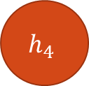

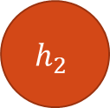
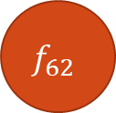

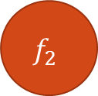
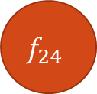
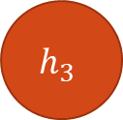
Input Layer
$$f_{62}$$
$$h_{1}$$
$$f_{65}$$
$$h_{2}$$
$$f_{2}$$
$$h_{3}$$
$$f_{24}$$
$$h_{4}$$

Slide 13
M: Number of Inputs K: Number of Premises
Q: Number of Consequence N: Number of Outputs
$$\overset{⃑}{μ }$$
$${\overset{⃑}{β }}^{(1)}$$
$${\overset{⃑}{γ}}^{(1)}$$
$${\overset{⃑}{λ}}^{(1)}$$
$$A_{1}$$
$$1$$
$$1$$
$$1$$
$${\overset{⃑}{\hat{y}}}^{(1)}$$
$$h_{1}$$
$$A_{2}$$
$${\overset{⃑}{β }}^{(2)}$$
$${\overset{⃑}{γ}}^{(2)}$$
$${\overset{⃑}{λ}}^{(2)}$$
$$A_{3}$$
2
$$2$$
$$2$$
$${\overset{⃑}{\hat{y}}}^{(2)}$$
$$B_{1}$$
$$h_{2}$$
$$B_{2}$$
$$\overset{⃑}{\hat{y}}$$
$$B_{3}$$
$$⋮$$
$$⋮$$
$$⋮$$
$$⋮$$
$$⋮$$
$$⋮$$
$${\overset{⃑}{β }}^{(K)}$$
$${\overset{⃑}{γ}}^{(K)}$$
$${\overset{⃑}{λ}}^{(Q)}$$
$${\overset{⃑}{\hat{y}}}^{(Q)}$$
$$D_{1}$$
$$K$$
$$K$$
$$Q$$
$$h_{M}$$
$$D_{2}$$
$$D_{3}$$
Layer1
(Inputs)
Layer2
(Fuzzy-set)
Layer3
(Premises)
Layer4
(Normalization)
Layer5
(Aim Object)
Layer6
(Consequences)
Layer7
(Outputs)
11

Slide 14
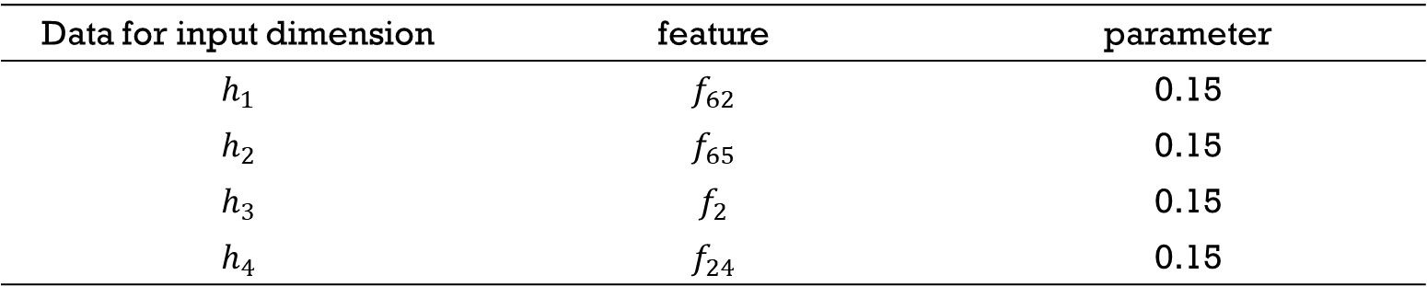
Parameter Setting of Subtractive clustering : subclust()
Data for input dimension | feature | parameter
$$h_{1}$$ | $$f_{62}$$ | 0.15
$$h_{2}$$ | $$f_{65}$$ | 0.15
$$h_{3}$$ | $$f_{2}$$ | 0.15
$$h_{4}$$ | $$f_{24}$$ | 0.15

Slide 15
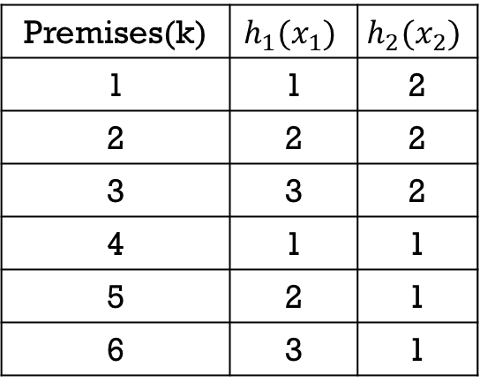
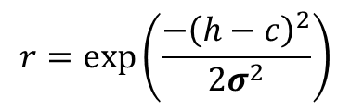



Selection of Premises
$$h_{2}(x_{2})$$
1
2
3
Premises(k) | $$h_{1}(x_{1})$$ | $$h_{2}(x_{2})$$
1 | 1 | 2
2 | 2 | 2
3 | 3 | 2
4 | 1 | 1
5 | 2 | 1
6 | 3 | 1
B2
4
5
6
B1
$$h_{1}(x_{1})$$
A1
A2
A3
Premise $k$ : IF $x_{1}=A^{(k)}$ and $x_{2}=B^{(k)}$
$$r=\exp\left(\frac{−{\left(h−c\right)}^{2}}{2σ^{2}}\right)$$
35

Slide 16




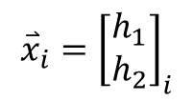


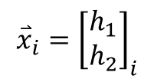

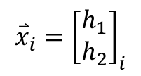

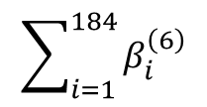


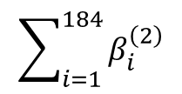

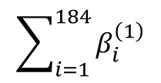


Selection of Premises
$$\overset{⃑}{h}=\left[\begin{matrix}x_{i,1} \\ x_{i,2}\end{matrix}\right]$$
$$β_{j}^{\left(k\right)}\left(\overset{⃑}{h}\right)=μ_{A^{\left(k\right)},j}\left(x_{i,1}\right){∙μ}_{B^{\left(k\right)},j}\left(x_{i,2}\right),j=1,2,…,N$$
$$TD=\{\left({\overset{⃑}{x}}_{i},{\overset{⃑}{t}}_{i}\right),i=1,2,…,184\}$$
$$\sum_{i=1}^{184}{β_{i}^{\left(1\right)}}$$
$${\overset{⃑}{x}}_{i}={\left[\begin{matrix}h_{1} \\ h_{2}\end{matrix}\right]}_{i}$$
1
$${\overset{⃑}{β}}_{}^{\left(1\right)}$$
$$β_{sum}^{\left(1\right)}$$
$$\sum_{i=1}^{184}{β_{i}^{\left(2\right)}}$$
$${\overset{⃑}{x}}_{i}={\left[\begin{matrix}h_{1} \\ h_{2}\end{matrix}\right]}_{i}$$
2
$${\overset{⃑}{β}}_{}^{\left(2\right)}$$
$$β_{sum}^{\left(2\right)}$$
$$⋮$$
$$⋮$$
$$⋮$$
$$\sum_{i=1}^{184}{β_{i}^{\left(6\right)}}$$
$${\overset{⃑}{x}}_{i}={\left[\begin{matrix}h_{1} \\ h_{2}\end{matrix}\right]}_{i}$$
6
$${\overset{⃑}{β}}_{}^{\left(6\right)}$$
$$β_{sum}^{\left(6\right)}$$
Threshold= ${mean(β}_{sum})+std(β_{sum})$

Slide 17



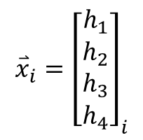

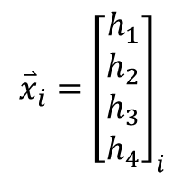
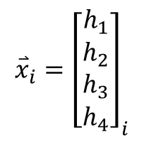


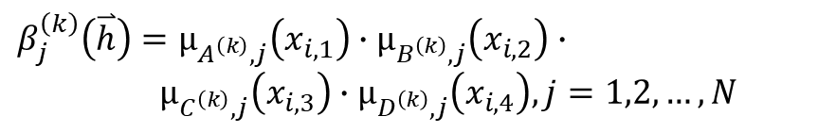

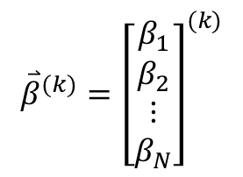
Premises(IF-Parts)
$$\overset{⃑}{h}=\left[\begin{matrix}x_{i,1} \\ \begin{aligned}x_{i,2} \\ x_{i,3} \\ x_{i,4}\end{aligned}\end{matrix}\right]$$
$$β_{j}^{\left(k\right)}\left(\overset{⃑}{h}\right)=μ_{A^{\left(k\right)},j}\left(x_{i,1}\right)∙μ_{B^{\left(k\right)},j}\left(x_{i,2}\right)∙$$
$μ_{C^{\left(k\right)},j}\left(x_{i,3}\right)∙μ_{D^{\left(k\right)},j}\left(x_{i,4}\right),j=1,2,…,N$
$$TD=\{\left({\overset{⃑}{x}}_{i},{\overset{⃑}{t}}_{i}\right),i=1,2,…,184\}$$
$${\overset{⃑}{x}}_{i}={\left[\begin{matrix}h_{1} \\ \begin{aligned}h_{2} \\ h_{3} \\ h_{4}\end{aligned}\end{matrix}\right]}_{i}$$
IF-Part
1
$${\overset{⃑}{β}}_{}^{\left(1\right)}$$
$${\overset{⃑}{x}}_{i}={\left[\begin{matrix}h_{1} \\ \begin{aligned}h_{2} \\ h_{3} \\ h_{4}\end{aligned}\end{matrix}\right]}_{i}$$
IF-Part
$${\overset{⃑}{β}}^{(k)}={\left[\begin{matrix}β_{1} \\ \begin{aligned}β_{2} \\ ⋮ \\ β_{N}\end{aligned}\end{matrix}\right]}^{(k)}$$
2
$${\overset{⃑}{β}}_{}^{\left(2\right)}$$
$$⋮$$
$${\overset{⃑}{x}}_{i}={\left[\begin{matrix}h_{1} \\ \begin{aligned}h_{2} \\ h_{3} \\ h_{4}\end{aligned}\end{matrix}\right]}_{i}$$
IF-Part
$$K$$
$${\overset{⃑}{β}}_{}^{\left(K\right)}$$
$K$=15

Slide 18




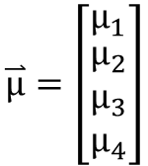







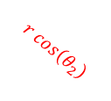




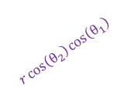

Sphere Complex Fuzzy Sets(SCFS)
$$X_{3}$$
$$u_{x_{1}}=r∙\cos\left(θ_{2}\right)∙\cos\left(θ_{1}\right)$$
$$u_{x_{2}}=r∙\cos\left(θ_{2}\right)∙\sin\left(θ_{1}\right)$$
$$u_{x_{3}}=r∙\sin\left(θ_{2}\right)$$
1
$$(u_{x_{1}},u_{x_{2}},u_{x_{3}})$$
$$r$$
where $r=\exp\left(\frac{−{\left(h−c\right)}^{2}}{2σ^{2}}\right)$ 、$θ_{1}=\frac{dr}{dx}∙λ_{1}$ 、$θ_{2}=\frac{d^{2}r}{dx^{2}}∙λ_{2}$
$$r\sin\left(θ_{2}\right)$$
保維法
$$μ_{1}=r∗exp(j(θ_{1}+θ_{2}))$$
$$θ_{2}$$
$$X_{2}$$
$$θ_{1}$$
$$r\cos\left(θ_{2}\right)$$
$$μ_{2}=u_{x_{1}}+u_{x_{2}}∙j$$
$$r\cos\left(θ_{2}\right)\sin\left(θ_{1}\right)$$
$$r\cos\left(θ_{2}\right)\cos\left(θ_{1}\right)$$
降維法
$$μ_{3}=u_{x_{2}}+u_{x_{3}}∙j$$
$$X_{1}$$
$$μ_{4}=u_{x_{3}}+u_{x_{1}}∙j$$
$$\overset{⃑}{μ}=\left[\begin{matrix}μ_{1} \\ \begin{aligned}μ_{2} \\ μ_{3} \\ μ_{4}\end{aligned}\end{matrix}\right]$$

Slide 19












Sphere Complex Fuzzy Sets(SCFS)
Membership
degrees
OUTPUT
TARGET
$$μ_{1}=r∗exp(j(θ_{1}+θ_{2}))$$
${\hat{y}}_{i}^{\left(1\right)}$
$$t_{i}^{(1)}=TAIEX+DJIA∗j$$
$$μ_{2}=u_{x_{1}}+u_{x_{2}}∗j$$
${\hat{y}}_{i}^{\left(2\right)}$
$$t_{i}^{(2)}=NASDAQ+S\&P500∗j$$
$$μ_{3}=u_{x_{2}}+u_{x_{3}}∗j$$
${\hat{y}}_{i}^{\left(3\right)}$
$$t_{i}^{(3)}=target5+target6∗j$$
$$μ_{4}=u_{x_{3}}+u_{x_{1}}∗j$$
${\hat{y}}_{i}^{\left(4\right)}$
$$t_{i}^{(4)}=target7+target8∗j$$

Slide 20
M: Number of Inputs K: Number of Premises
Q: Number of Consequence N: Number of Outputs
$$\overset{⃑}{μ }$$
$${\overset{⃑}{β }}^{(1)}$$
$${\overset{⃑}{γ}}^{(1)}$$
$${\overset{⃑}{λ}}^{(1)}$$
$$A_{1}$$
$$1$$
$$1$$
$$1$$
$${\overset{⃑}{\hat{y}}}^{(1)}$$
$$h_{1}$$
$$A_{2}$$
$${\overset{⃑}{β }}^{(2)}$$
$${\overset{⃑}{γ}}^{(2)}$$
$${\overset{⃑}{λ}}^{(2)}$$
$$A_{3}$$
2
$$2$$
$$2$$
$${\overset{⃑}{\hat{y}}}^{(2)}$$
$$B_{1}$$
$$h_{2}$$
$$B_{2}$$
$$\overset{⃑}{\hat{y}}$$
$$B_{3}$$
$$⋮$$
$$⋮$$
$$⋮$$
$$⋮$$
$$⋮$$
$$⋮$$
$${\overset{⃑}{β }}^{(K)}$$
$${\overset{⃑}{γ}}^{(K)}$$
$${\overset{⃑}{λ}}^{(Q)}$$
$${\overset{⃑}{\hat{y}}}^{(Q)}$$
$$D_{1}$$
$$K$$
$$K$$
$$Q$$
$$h_{M}$$
$$D_{2}$$
$$D_{3}$$
Layer1
(Inputs)
Layer2
(Fuzzy-set)
Layer3
(Premises)
Layer4
(Normalization)
Layer5
(Aim Object)
Layer6
(Consequences)
Layer7
(Outputs)
20

Slide 21
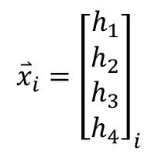
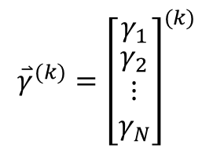
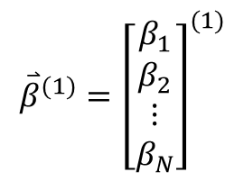


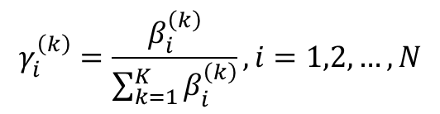









Normalization
K: Number of Premises
N: Number of Outputs
$${\overset{⃑}{x}}_{i}={\left[\begin{matrix}h_{1} \\ \begin{aligned}h_{2} \\ h_{3} \\ h_{4}\end{aligned}\end{matrix}\right]}_{i}$$
IF-Part
$${\overset{⃑}{β}}^{(1)}={\left[\begin{matrix}β_{1} \\ \begin{aligned}β_{2} \\ ⋮ \\ β_{N}\end{aligned}\end{matrix}\right]}^{(1)}$$
1
$${\overset{⃑}{β}}_{}^{\left(1\right)}$$
$$γ_{1}^{\left(k\right)}=\frac{β_{1}^{\left(k\right)}}{\sum_{k=1}^{K}{β_{1}^{\left(k\right)}}}$$
$${\overset{⃑}{x}}_{i}={\left[\begin{matrix}h_{1} \\ \begin{aligned}h_{2} \\ h_{3} \\ h_{4}\end{aligned}\end{matrix}\right]}_{i}$$
IF-Part
$${\overset{⃑}{β}}^{(2)}={\left[\begin{matrix}β_{1} \\ \begin{aligned}β_{2} \\ ⋮ \\ β_{N}\end{aligned}\end{matrix}\right]}^{(2)}$$
2
$${\overset{⃑}{β}}_{}^{\left(2\right)}$$
$$γ_{i}^{\left(k\right)}=\frac{β_{i}^{\left(k\right)}}{\sum_{k=1}^{K}{β_{i}^{\left(k\right)}}},i=1,2,…,N$$
$$⋮$$
$${\overset{⃑}{x}}_{i}={\left[\begin{matrix}h_{1} \\ \begin{aligned}h_{2} \\ h_{3} \\ h_{4}\end{aligned}\end{matrix}\right]}_{i}$$
IF-Part
$${\overset{⃑}{β}}^{(K)}={\left[\begin{matrix}β_{1} \\ \begin{aligned}β_{2} \\ ⋮ \\ β_{N}\end{aligned}\end{matrix}\right]}^{(K)}$$
$${\overset{⃑}{γ}}^{(k)}={\left[\begin{matrix}γ_{1} \\ \begin{aligned}γ_{2} \\ ⋮ \\ γ_{N}\end{aligned}\end{matrix}\right]}^{(k)}$$
$$K$$
$${\overset{⃑}{β}}_{}^{\left(K\right)}$$
$K$=15

Slide 22
M: Number of Inputs K: Number of Premises
Q: Number of Consequence N: Number of Outputs
$$\overset{⃑}{μ }$$
$${\overset{⃑}{β }}^{(1)}$$
$${\overset{⃑}{γ}}^{(1)}$$
$${\overset{⃑}{λ}}^{(1)}$$
$$A_{1}$$
$$1$$
$$1$$
$$1$$
$${\overset{⃑}{\hat{y}}}^{(1)}$$
$$h_{1}$$
$$A_{2}$$
$${\overset{⃑}{β }}^{(2)}$$
$${\overset{⃑}{γ}}^{(2)}$$
$${\overset{⃑}{λ}}^{(2)}$$
$$A_{3}$$
2
$$2$$
$$2$$
$${\overset{⃑}{\hat{y}}}^{(2)}$$
$$B_{1}$$
$$h_{2}$$
$$B_{2}$$
$$\overset{⃑}{\hat{y}}$$
$$B_{3}$$
$$⋮$$
$$⋮$$
$$⋮$$
$$⋮$$
$$⋮$$
$$⋮$$
$${\overset{⃑}{β }}^{(K)}$$
$${\overset{⃑}{γ}}^{(K)}$$
$${\overset{⃑}{λ}}^{(Q)}$$
$${\overset{⃑}{\hat{y}}}^{(Q)}$$
$$D_{1}$$
$$K$$
$$K$$
$$Q$$
$$h_{M}$$
$$D_{2}$$
$$D_{3}$$
Layer1
(Inputs)
Layer2
(Fuzzy-set)
Layer3
(Premises)
Layer4
(Normalization)
Layer5
(Aim Object)
Layer6
(Consequences)
Layer7
(Outputs)
22

Slide 23









Aim Objects
N layers
aim objects
$${\overset{⃑}{γ}}^{(1)}={\left[\begin{matrix}γ_{1} \\ γ_{2} \\ ⋮ \\ γ_{N}\end{matrix}\right]}^{(1)}$$
(1)
$${\overset{⃑}{λ}}^{(1)}$$
THEN-part
(2)
$${\overset{⃑}{γ}}^{(2)}={\left[\begin{matrix}γ_{1} \\ γ_{2} \\ ⋮ \\ γ_{N}\end{matrix}\right]}^{(2)}$$
$${\overset{⃑}{λ}}^{(2)}$$
THEN-part
$$⋮$$
$$⋮$$
$$⋮$$
$${\overset{⃑}{γ}}^{(K)}={\left[\begin{matrix}γ_{1} \\ γ_{2} \\ ⋮ \\ γ_{N}\end{matrix}\right]}^{(K)}$$
(Q)
$${\overset{⃑}{λ}}^{(Q)}$$
THEN-part

Slide 24








Aim Objects
$r_{1}\left(X_{c}\right)$的1次微分
$X_{c}=a variable for c_{i}^{(q)}$
$X_{s}=a variable for s_{i}^{(q)}$
$c_{i}^{(q)}$:第$i$個目標的第$q$個後鑑部中心
$s_{i}^{(q)}$:第$i$個目標的第$q$個後鑑部靶寬
${\overline{t}}_{i}$: mean of TD($y_{i}$)
$σ_{i}$: std of TD($y_{i}$)
$$λ_{i}^{(k→q)}=r_{1}\left(B_{i}^{(k)}\right)\exp\left(j∗ω\right)$$
$$r_{1}\left(B_{i}^{(k)}\right)=exp⁡(−\frac{\left(γ_{i}^{(k)}−{{}_{aoc}^{}c}_{i}^{(q)}\right)\left(γ_{i}^{(k)}−{{}_{aoc}^{}c}_{i}^{(q)}\right)′}{2\left({{}_{aoc}^{}s}_{i}^{(q)}\right)\left({{}_{aoc}^{}s}_{i}^{(q)}\right)′})$$
$${{}_{aoc}^{}c}_{i}^{(q)}=g_{2}=r_{2}exp\left(j∗ω_{2}\right)$$
$${{}_{aoc}^{}s}_{i}^{(q)}=g_{3}=r_{3}exp\left(j∗ω_{3}\right)$$
$$r_{2}=exp\left(−\frac{\left(X_{c}−{\overline{t}}_{i}\right){\left(X_{c}−{\overline{t}}_{i}\right)}^{′}}{2\left(σ_{i}\right){\left(σ_{i}\right)}^{′}}\right)$$
$$ω_{2}=real(\frac{dr_{2}}{dX_{c}})∙ρ_{1},where ρ_{1}=1$$
$$r_{3}=exp⁡(−\frac{\left(X_{s}\right)\left(X_{s}\right)′}{2(σ_{i})(σ_{i})′})$$
$$ω_{3}=real(\frac{dr_{2}}{dX_{s}})∙ρ_{2},where ρ_{2}=1$$

Slide 25
M: Number of Inputs K: Number of Premises
Q: Number of Consequence N: Number of Outputs
$$\overset{⃑}{μ }$$
$${\overset{⃑}{β }}^{(1)}$$
$${\overset{⃑}{γ}}^{(1)}$$
$${\overset{⃑}{λ}}^{(1)}$$
$$A_{1}$$
$$1$$
$$1$$
$$1$$
$${\overset{⃑}{\hat{y}}}^{(1)}$$
$$h_{1}$$
$$A_{2}$$
$${\overset{⃑}{β }}^{(2)}$$
$${\overset{⃑}{γ}}^{(2)}$$
$${\overset{⃑}{λ}}^{(2)}$$
$$A_{3}$$
2
$$2$$
$$2$$
$${\overset{⃑}{\hat{y}}}^{(2)}$$
$$B_{1}$$
$$h_{2}$$
$$B_{2}$$
$$\overset{⃑}{\hat{y}}$$
$$B_{3}$$
$$⋮$$
$$⋮$$
$$⋮$$
$$⋮$$
$$⋮$$
$$⋮$$
$${\overset{⃑}{β }}^{(K)}$$
$${\overset{⃑}{γ}}^{(K)}$$
$${\overset{⃑}{λ}}^{(Q)}$$
$${\overset{⃑}{\hat{y}}}^{(Q)}$$
$$D_{1}$$
$$K$$
$$K$$
$$Q$$
$$h_{M}$$
$$D_{2}$$
$$D_{3}$$
Layer1
(Inputs)
Layer2
(Fuzzy-set)
Layer3
(Premises)
Layer4
(Normalization)
Layer5
(Aim Object)
Layer6
(Consequences)
Layer7
(Outputs)
25

Slide 26









Consequence (THEN-parts)
$$B={\left[{\overset{⃑}{γ}}^{\left(1\right)} {\overset{⃑}{γ}}^{\left(2\right)}…{\overset{⃑}{γ}}^{\left(K\right)}\right]}_{N×K}$$
$${{\overset{⃑}{\hat{y} }}^{(q)}}^{ }=φ^{(q)}×{\overset{⃑}{a}}^{(q)}$$
$${\overset{⃑}{γ}}^{\left(k\right)}={\left[γ_{1}^{\left(k\right)}γ_{2}^{\left(k\right)} …γ_{N}^{\left(k\right)}\right]}^{T}$$
$${\overset{⃑}{a}}^{(q)}={\left[a_{0}^{\left(q\right)} a_{1}^{\left(q\right)} …a_{M}^{\left(q\right)}\right]}_{(M+1)×1}^{T}$$
$B_{N}^{(k)}:$ the firing strength of $K_{th}$ premise for the $N_{th}$ target
$$a_{0}^{(q)}\sim a_{M}^{(q)}:\text{parameters} \text{of} q_{th}$$
$$\text{consequence}$$
$$L^{(q)}={\left[\begin{aligned}\begin{matrix}{{\overset{⃑}{λ}}^{\left(1→q\right)}}^{T} \\ {{\overset{⃑}{λ}}^{\left(2→q\right)}}^{T} \\ \begin{aligned}⋮ \\ {{\overset{⃑}{λ}}^{\left(K→q\right)}}^{T}\end{aligned}\end{matrix}\end{aligned}\right]}_{K×N}$$
$$H={\left[\begin{aligned}\begin{matrix}{\left({\overset{⃑}{h}}_{a}\right)}^{T} \\ {\left({\overset{⃑}{h}}_{a}\right)}^{T} \\ \begin{aligned}⋮ \\ {\left({\overset{⃑}{h}}_{a}\right)}^{T}\end{aligned}\end{matrix}\end{aligned}\right]}_{N×(M+1)}$$
$${\overset{⃑}{h}}_{a}={\left[1 (\overset{⃑}{h})\right]}^{T}$$
$$φ^{(q)}=B∙L∙H$$

Slide 27








PSO
RLSE
Premises
(IF-Parts)
Consequences
(THEN-Parts)
-
+
$${\overset{⃑}{\hat{y}}}_{i}$$
+
$${\overset{⃑}{t}}_{i}$$
$${\overset{⃑}{x}}_{i}$$
Model Output
Target
$${\overset{⃑}{e}}_{i}={\overset{⃑}{t}}_{i}−{\overset{⃑}{\hat{y}}}_{i}$$
$${\overset{⃑}{x}}_{i}={\left[\begin{matrix}h_{1} \\ h_{2} \\ h_{3} \\ h_{4}\end{matrix}\right]}_{i}$$
$h_{1}$=$f_{62}$
$h_{2}$=$f_{65}$
$h_{3}$=$f_{2}$
$h_{4}$=$f_{24}$
$${\overset{⃑}{t}}_{i}={\left[\begin{aligned}t_{TAIEX} \\ t_{DJAI} \\ t_{NASDAQ} \\ t_{S\&P500}\end{aligned}\right]}_{i}$$
$$TD=\{\left({\overset{⃑}{x}}_{i},{\overset{⃑}{t}}_{i}\right),i=1,2,…,184\}$$

Slide 28
Result

Slide 29

Result
Parameter | Value
Number of inputs | {$f_{62} f_{65} f_{2} f_{24}$ }
Number of fuzzy sets of each input | 6、6、5、5
Number of fuzzy sets of each input | 3、3、3、3
Number of targets (real-valued) | 4
Number of outputs (complex-valued) | 2
Number of premises (before selection) | 900
Type of premises | Sphere complex fuzzy set
Number of premises (after selection) | 15
Number of premise parameters | 48
Number of aim object | 3
Type of consequences | Takagi-Sugeno
Number of consequences | 3
Number of consequence parameters | 15

Slide 30

Parameters
PSO parameters
Parameters | value
Swarm size | 64
Iterations | 100
$ω c_{1} 、c_{2}$ | 0.8 2.0 2.0
$ξ_{1}、ξ_{2}$ | Random in [0,1]
Velocity | 0
RLSE parameters
Parameters | value
$α$ | ${1×10}^{8}$
${\overset{⃑}{\text{θ}}}_{0}$ | 15x1 zero vector
$P_{0}$ | $α$I
I | 15x15 identify matrix

Slide 31

Premises Parameters (after learning)
Table Parameters of Premises
Input | Fuzzy sets
$$h_{1}$$ | A1 |  |  |  |  | A2 |  |  |  |  | A3
 | c | $$σ$$ | $$λ_{1}$$ | $$λ_{2}$$ |  | c | $$σ$$ | $$λ_{1}$$ | $$λ_{2}$$ |  | c | $$σ$$ | $$λ_{1}$$ | $$λ_{2}$$
 | -32.97 | 31.33 | 0.98 | -0.48 |  | -12.73 | 34.09 | -0.76 | 0.94 |  | 10.01 | 31.90 | 0.81 | -1.42
$$h_{2}$$ | B1 |  |  |  |  | B2 |  |  |  |  | B3
 | c | $$σ$$ | $$λ_{1}$$ | $$λ_{2}$$ |  | c | $$σ$$ | $$λ_{1}$$ | $$λ_{2}$$ |  | c | $$σ$$ | $$λ_{1}$$ | $$λ_{2}$$
 | -35.31 | 34.39 | 0.16 | -2.98 |  | -11.76 | 37.03 | 0.5641 | -1.25 |  | 10.88 | 35.76 | -0.19 | -1.58
$$h_{3}$$ | C1 |  |  |  |  | C2 |  |  |  |  | C3
 | c | $$σ$$ | $$λ_{1}$$ | $$λ_{2}$$ |  | c | $$σ$$ | $$λ_{1}$$ | $$λ_{2}$$ |  | c | $$σ$$ | $$λ_{1}$$ | $$λ_{2}$$
 | -9356 | 104.28 | -1.26 | -0.42 |  | -8.91 | 103.36 | 0.42 | -0.35 |  | 70.79 | 102.51 | 1.79 | -1.56
$$h_{4}$$ | D1 |  |  |  |  | D2 |  |  |  |  | D3
 | c | $$σ$$ | $$λ_{1}$$ | $$λ_{2}$$ |  | c | $$σ$$ | $$λ_{1}$$ | $$λ_{2}$$ |  | c | $$σ$$ | $$λ_{1}$$ | $$λ_{2}$$
 | -87.15 | 98.49 | -0.05 | -0.44 |  | -11.09 | 99.62 | 0.32 | -0.22 |  | 67.19 | 101.09 | -1.48 | 1.19

Slide 32


Aim Object Parameters
Layer1 of Aim Object
 | Center | Spread | $${}_{aoc}^{}c$$ | $${}_{aoc}^{}s$$ | $$ρ_{1}$$ | $$ρ_{2}$$
Aim object1 | -29.8245+92.3646i | 101.34+99.235i | 0.7786+0.0008i | 0.6065-0.0019i | 1 | 1
Aim object2 | 109.83-13.159i | 101.34+99.235i | 0.7308-0.003i | 0.6065-0.0019i | 1 | 1
Aim object3 | -56.4634-69.1889i | 101.34+99.235i | 0.8363+0.0019i | 0.6065-0.0019i | 1 | 1
Layer2 of Aim Object
 | Center | Spread | $${}_{aoc}^{}c$$ | $${}_{aoc}^{}s$$ | $$ρ_{1}$$ | $$ρ_{2}$$
Aim object1 | -28.9002+94.1934i | 98.9420+99.4697i | 0.7726+0.0007i | 1.0605+1.0585i | 1 | 1
Aim object2 | -59.4205-67.9143 | 98.9420+99.4697i | 0.8334+0.0019i | 1.0605+1.0585i | 1 | 1
Aim object3 | 102.87-16.888i | 98.9420+99.4697i | 0.7434-0.0030i | 1.0605+1.0585i | 1 | 1

Slide 33


Consequences Parameters
$$\text{θ}=$$

Slide 34
Learning Curve

Slide 35
Training phase
Testing phase
Training phase
Testing phase
Training phase
Testing phase
Training phase
Testing phase

Slide 36
Comparison
Method | TAIEX | DJIA
SVR (two models, each with single output) | 67.72 | 117.95
ANFIS (two models, each with single output) | 70.17 | 111.69
ANFIS (one model with two outputs) | 78.27 | 142.05
RBF (two models, each with single output) | 65.15 | 131.24
RBF (one model with two outputs) | 78.54 | 136.28
CNFS(5)-ARIMA (one model with two outputs) | 64.34 | 103.42
SCNFS(proposed) training phase | 100.93 | 98.41
SCNFS(proposed) testing phase | 87.25 | 89.52

Slide 37
Comparison
 | Performance (RMSE)
triers | Normalized | Unnormalized
1 | 279.40 | 279.93
2 | 279.35 | 286.02
3 | 279.59 | 280.34
4 | 280.96 | 280.56
5 | 279.61 | 281.85
6 | 280.91 | 282.00
7 | 280.50 | 279.46
8 | 280.10 | 282.35
9 | 280.76 | 282.11
10 | 282.01 | 280.93

