Slide 1
RLSE

Slide 2
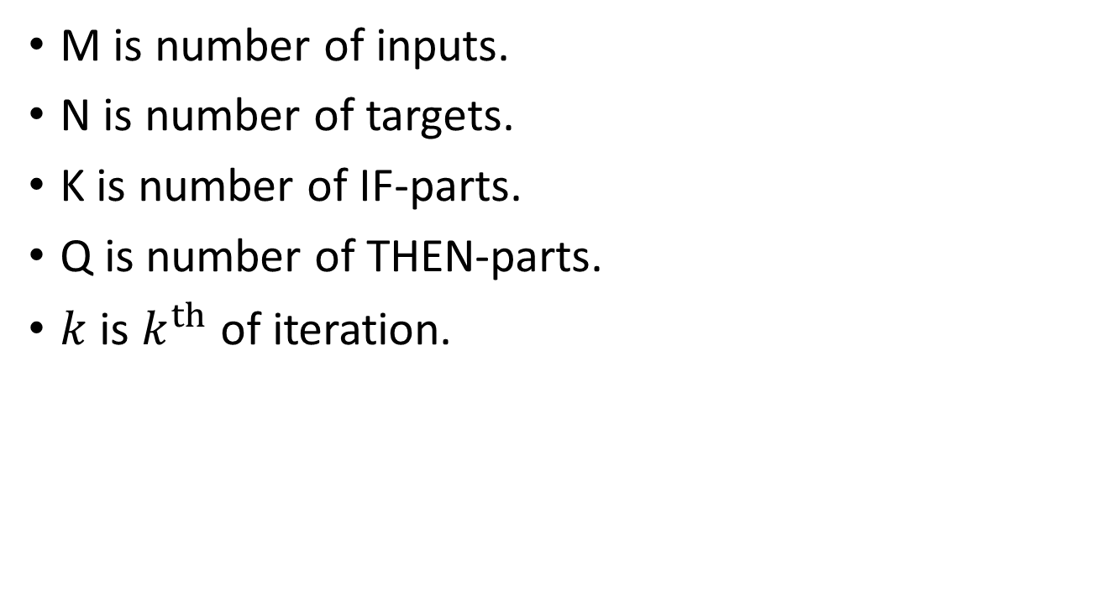
Variable definitions
M is number of inputs.
N is number of targets.
K is number of IF-parts.
Q is number of THEN-parts.
$k$ is $k^{th}$ of iteration.

Slide 3

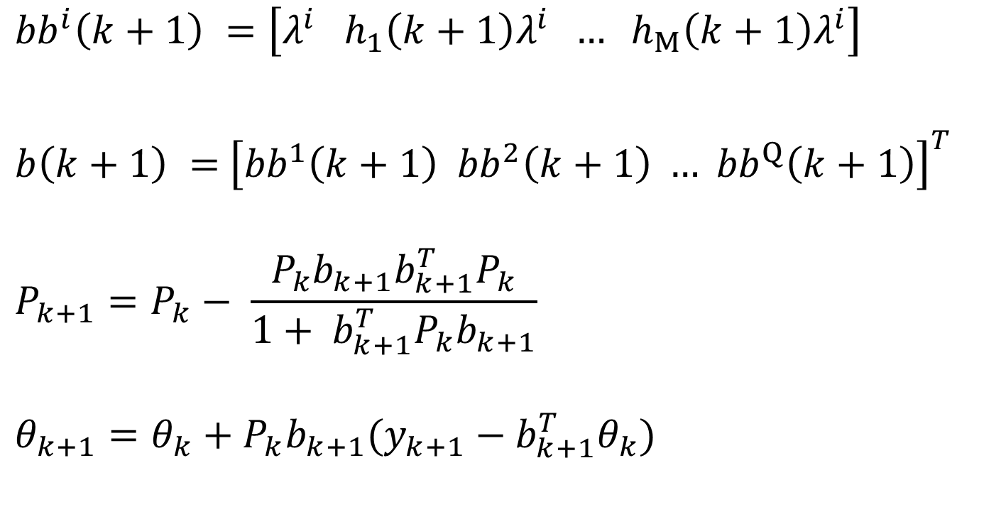







Original(單輸入單輸出)
$$i^{th} , i=1,2,…, Q$$
$${bb}^{i}\left(k+1\right) =\left[λ^{i} h_{1}\left(k+1\right)λ^{i} … h_{M}\left(k+1\right)λ^{i}\right]$$
$b\left(k+1\right) =$ ${\left[{bb}^{1}\left(k+1\right) {bb}^{2}\left(k+1\right) … {bb}^{Q}\left(k+1\right)\right]}^{T }$
$$P_{k+1}=P_{k}− \frac{P_{k}b_{k+1}b_{k+1}^{T}P_{k}}{1+ b_{k+1}^{T}P_{k}b_{k+1}}$$
$$θ_{k+1}=θ_{k}+P_{k}b_{k+1}(y_{k+1}−b_{k+1}^{T}θ_{k})$$
$$1×(M+1)$$
$$1^{st}$$
$$2^{nd}$$
$$Q^{th}$$
$$(Q‧\left(M+1\right))×1$$
$(Q‧\left(M+1\right))×$ $(K‧\left(M+1\right))$
$(Q‧\left(M+1\right))×$ $1$

Slide 4

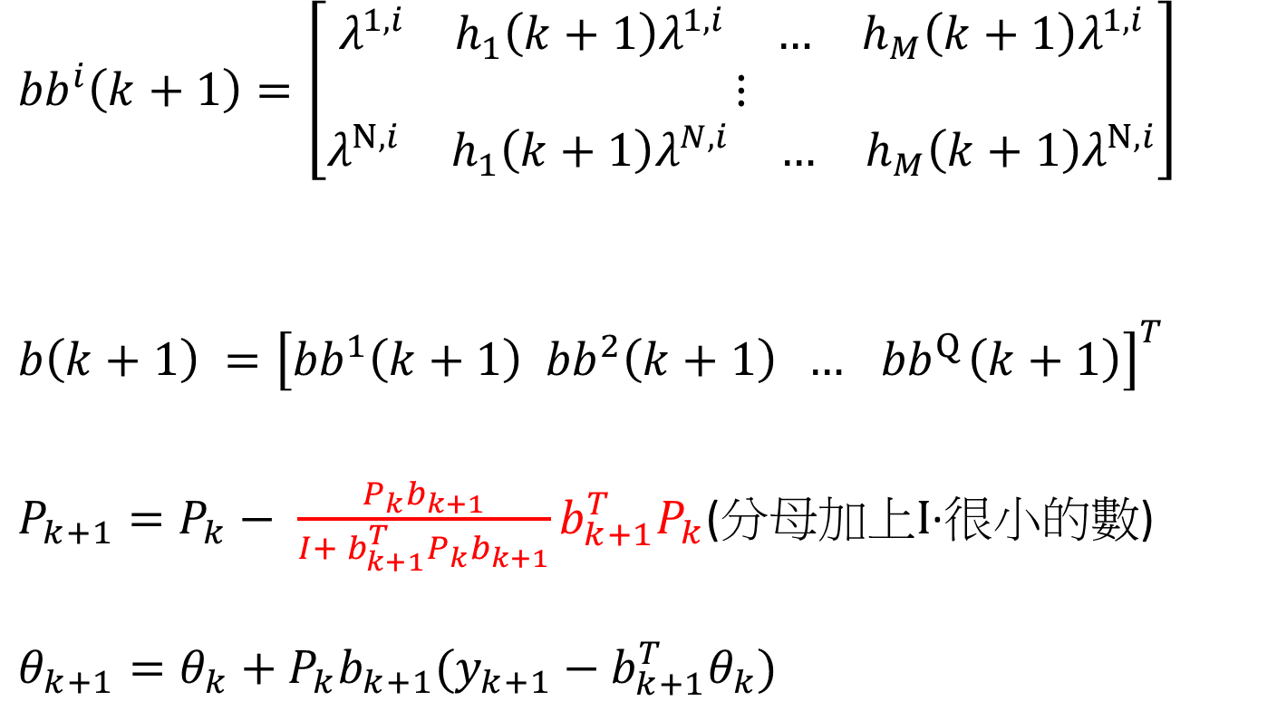








New(多輸入多輸出)
$i^{th}$, $i=1,2,…,Q$
$${bb}^{i}\left(k+1\right)=\left[\begin{matrix}\begin{matrix}\begin{matrix}λ^{1,i} & h_{1}\left(k+1\right)λ^{1,i}\end{matrix} & \begin{matrix}… & h_{M}\left(k+1\right)λ^{1,i}\end{matrix}\end{matrix} \\ ⋮ \\ \begin{matrix}\begin{matrix}λ^{N,i} & h_{1}\left(k+1\right)λ^{N,i}\end{matrix} & \begin{matrix}… & h_{M}\left(k+1\right)λ^{N,i}\end{matrix}\end{matrix}\end{matrix}\right]$$
$$b\left(k+1\right) ={\left[{bb}^{1}\left(k+1\right) {bb}^{2}\left(k+1\right) … { bb}^{Q}\left(k+1\right)\right]}^{T }$$
$P_{k+1}=P_{k}− {\frac{P_{k}b_{k+1}}{I+ b_{k+1}^{T}P_{k}b_{k+1}}b}_{k+1}^{T}P_{k}$(分母加上$I$·很小的數)
$$θ_{k+1}=θ_{k}+P_{k}b_{k+1}(y_{k+1}−b_{k+1}^{T}θ_{k})$$
$$N×(M+1)$$
$$1^{st}$$
$$2^{nd}$$
$$Q^{th}$$
$$(Q‧\left(M+1\right))×N$$
$(Q‧\left(M+1\right))×$ $(Q‧\left(M+1\right))$
$$N×N$$
$(Q‧\left(M+1\right))×$ $1$

