Slide 1
PSO+RLSE
教授:李俊賢
學生:林奇鋒

Slide 2
Model
PSO
RLSE
Gaussian
fuction
T-S
INPUT1
-
+
errors
target
Output
RMSE(root mean square error)
INPUT2

Slide 3
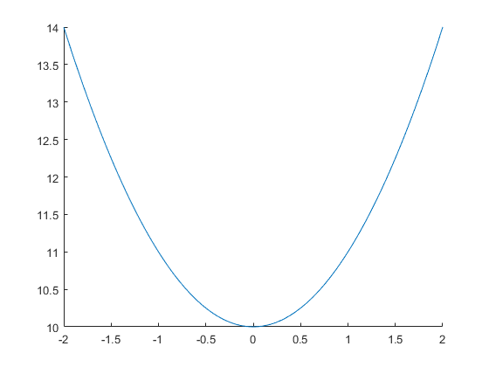
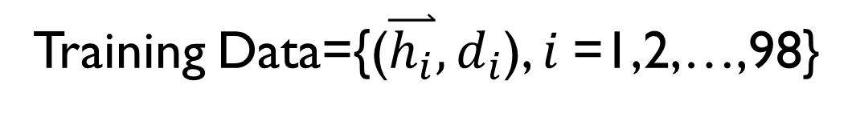
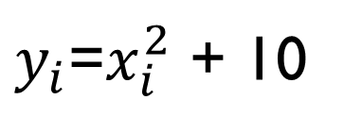

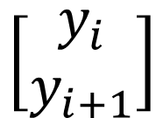
Homework
x=linspace(-2,2)
$y_{i}$=$x_{i}^{2}$ + 10
Training Data={($\overset{⃑}{h_{i}},d_{i}$), $i$=1,2,…,98}
$$\left[\begin{aligned}y_{i} \\ y_{i+1}\end{aligned}\right]$$
$$y_{i+2}$$

Slide 4
Model
PSO
RLSE
Gaussian
function
T-S
y(i)
-
+
errors
y(i+2)
Output(1)
y(i+1)

Slide 5



Flowchart of the PSO–RLSE method
Initialize swarm
Prepare A、y
Fuzzy set
Update Position
Firing-Strength
Initialize $P_{0}、 {\text{θ}}_{0}$
Calculate RMSE
Normalization
Update $P_{k+1}$
Update Gbest、Pbest
Recursive
Consequence part
Update ${\text{θ}}_{k+1}$
Update Position
Output
Get Cons. parameters
No
STOP?
Yes
End

Slide 6
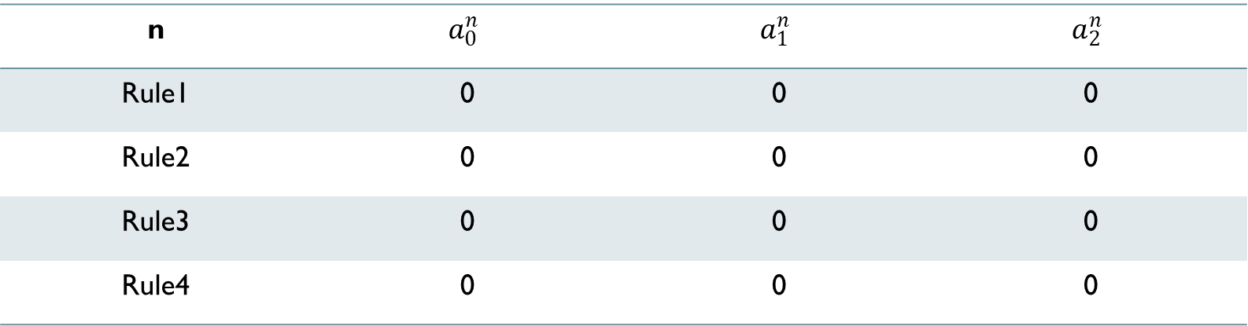
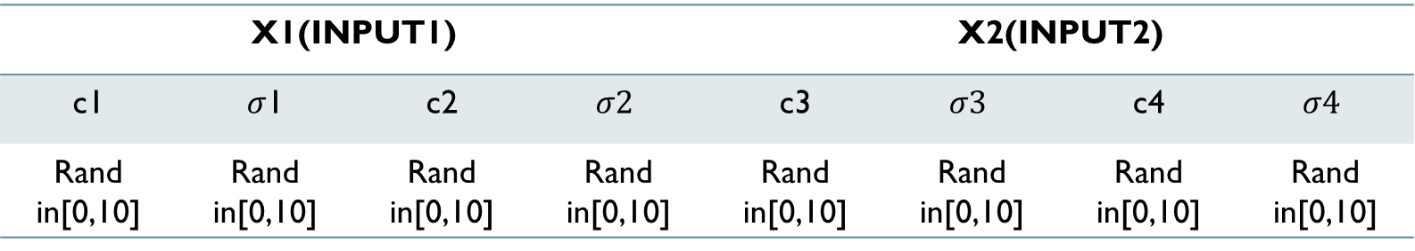
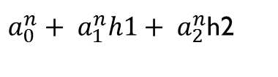
Premise(gauss)
X1(INPUT1) |  |  |  | X2(INPUT2)
c1 | $σ$1 | c2 | $$σ2$$ | c3 | $$σ3$$ | c4 | $$σ4$$
Rand in[0,10] | Rand in[0,10] | Rand in[0,10] | Rand in[0,10] | Rand in[0,10] | Rand in[0,10] | Rand in[0,10] | Rand in[0,10]
Consequence(T-S)
$a_{0}^{n}+ a_{1}^{n}h1+ a_{2}^{n}$h2
n | $$a_{0}^{n}$$ | $$a_{1}^{n}$$ | $$a_{2}^{n}$$
Rule1 | 0 | 0 | 0
Rule2 | 0 | 0 | 0
Rule3 | 0 | 0 | 0
Rule4 | 0 | 0 | 0

Slide 7
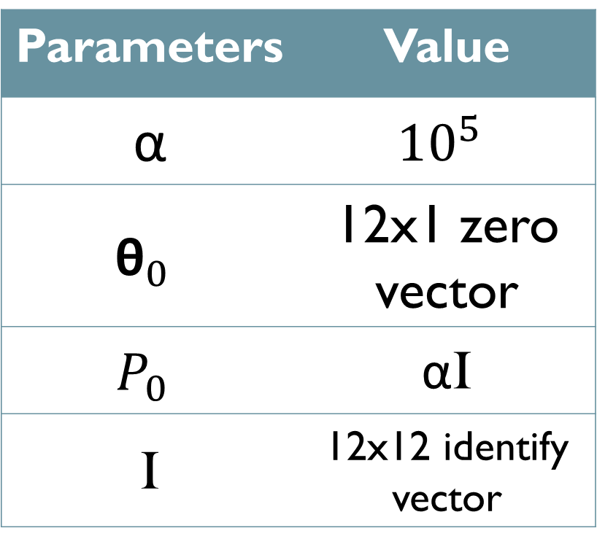
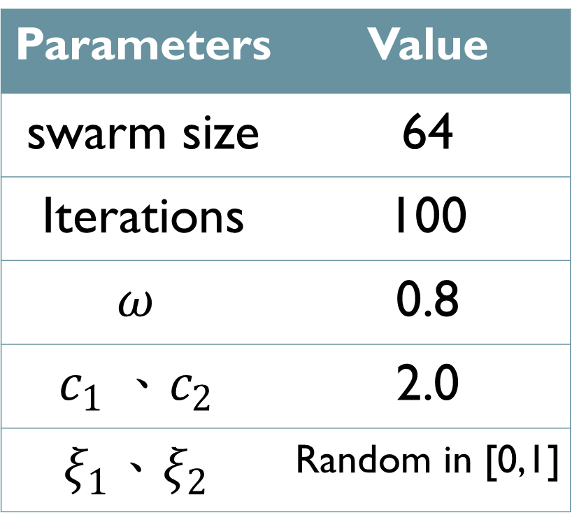
PSO parameters RLSE PARAMETERS
Parameters | Value
swarm size | 64
Iterations | 100
$$ω$$ | 0.8
$$c_{1} 、c_{2}$$ | 2.0
$$ξ_{1}、ξ_{2}$$ | Random in [0,1]
Parameters | Value
α | $${10}^{5}$$
$${\text{θ}}_{0}$$ | 12x1 zero vector
$$P_{0}$$ | αI
I | 12x12 identify vector

Slide 8
Result

Slide 9
Learning curve
RMSE=8.3894e-08

Slide 10
PSO+RLSE
PSO
RMSE=8.3894e-08
RMSE=0.0587

