Slide 1
Cooperative PSO
教授:李俊賢
學生:林奇鋒

Slide 2
Model
PSO
RLSE
Gaussian
function
T-S
y(i)
-
+
errors
y(i+2)
Output(1)
y(i+1)

Slide 3
Use subtractive clustering(9 rules)
Formation Matrix
1 | 1
1 | 2
1 | 3
2 | 1
2 | 2
2 | 3
3 | 1
3 | 2
3 | 3
INPUT1
INPUT2

Slide 4
Use treshold Filter(remain 7 rules)
Formation Matrix
1 | 1
1 | 2
1 | 3
2 | 1
2 | 2
2 | 3
3 | 1
3 | 2
3 | 3
INPUT1
INPUT2

Slide 5



Flowchart of the PSO–RLSE method
Initialize swarms
Prepare A、y
Fuzzy set
Update Position
Firing-Strength
Initialize $P_{0}、 {\text{θ}}_{0}$
Calculate RMSE
Normalization
Update $P_{k+1}$
Update Gbest、Pbest
Recursive
Consequence part
Update ${\text{θ}}_{k+1}$
STOP?
Output
Get Consequence parameters
No
Yes
End

Slide 6
Traditional PSO
1
1
2
PSO1
2
3
3
4
4
5
5
6
6
7
7
8
8
9
9
10
10
Premise parameters

Slide 7
Cooperative PSO
1
1
2
PSO1
2
3
PSO2
3
4
4
5
5
6
PSO3
6
7
7
8
PSO4
8
9
9
PSO5
10
10
Premise parameters

Slide 8



Flowchart of the CPSO–RLSE method
Initialize swarms
Start kth Iteration
Select one PSO species
Combine other PSO best parameters
Prepare A、y
Update Position
Initialize $P_{0}、 {\text{θ}}_{0}$
Fuzzy set
Calculate RMSE
Firing-Strength
Update $P_{k+1}$
Recursive
Update Gbest、Pbest
Normalization
Update ${\text{θ}}_{k+1}$
Final PSO
Species?
No
Consequence part
Get Consequence parameters
Yes
Stop Iteration?
No
Output
Yes
End

Slide 9
Premise(gaussian)
INPUT1 fuzzyset
c1 | σ1 | c2 | σ2 | c3 | σ3
randn*yMean*1000 | randn*yStd *1000 | randn*yMean*1000 | randn*yStd *1000 | randn*yMean*1000 | randn*yStd *1000
INPUT2 fuzzyset
c4 | σ4 | c5 | σ5 | c6 | σ6
randn*yMean*1000 | randn*yStd *1000 | randn*yMean*1000 | randn*yStd *1000 | randn*yMean*1000 | randn*yStd *1000

Slide 10
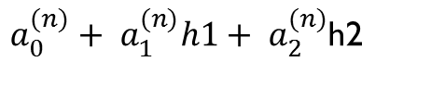
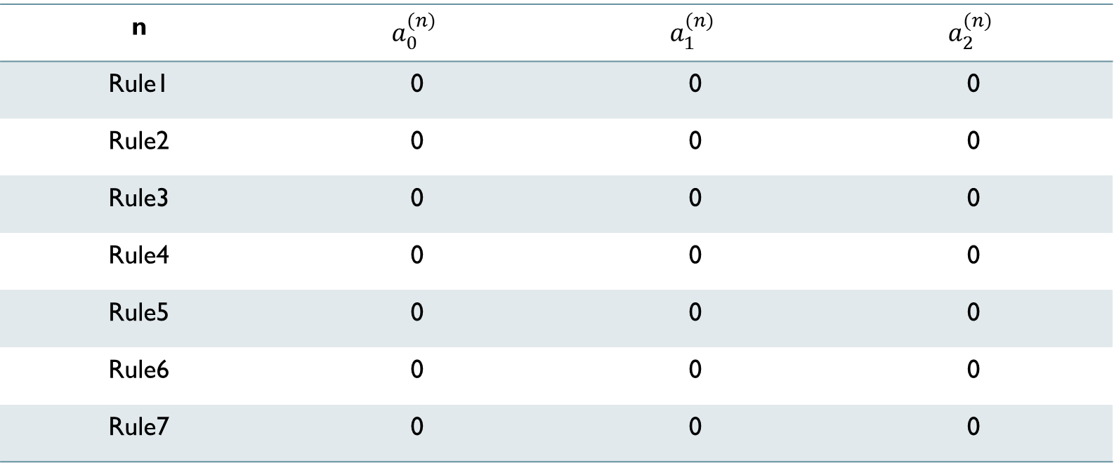
Consequence(T-S)
$a_{0}^{(n)}+ a_{1}^{(n)}h1+ a_{2}^{(n)}$h2
n | $$a_{0}^{(n)}$$ | $$a_{1}^{(n)}$$ | $$a_{2}^{(n)}$$
Rule1 | 0 | 0 | 0
Rule2 | 0 | 0 | 0
Rule3 | 0 | 0 | 0
Rule4 | 0 | 0 | 0
Rule5 | 0 | 0 | 0
Rule6 | 0 | 0 | 0
Rule7 | 0 | 0 | 0

Slide 11
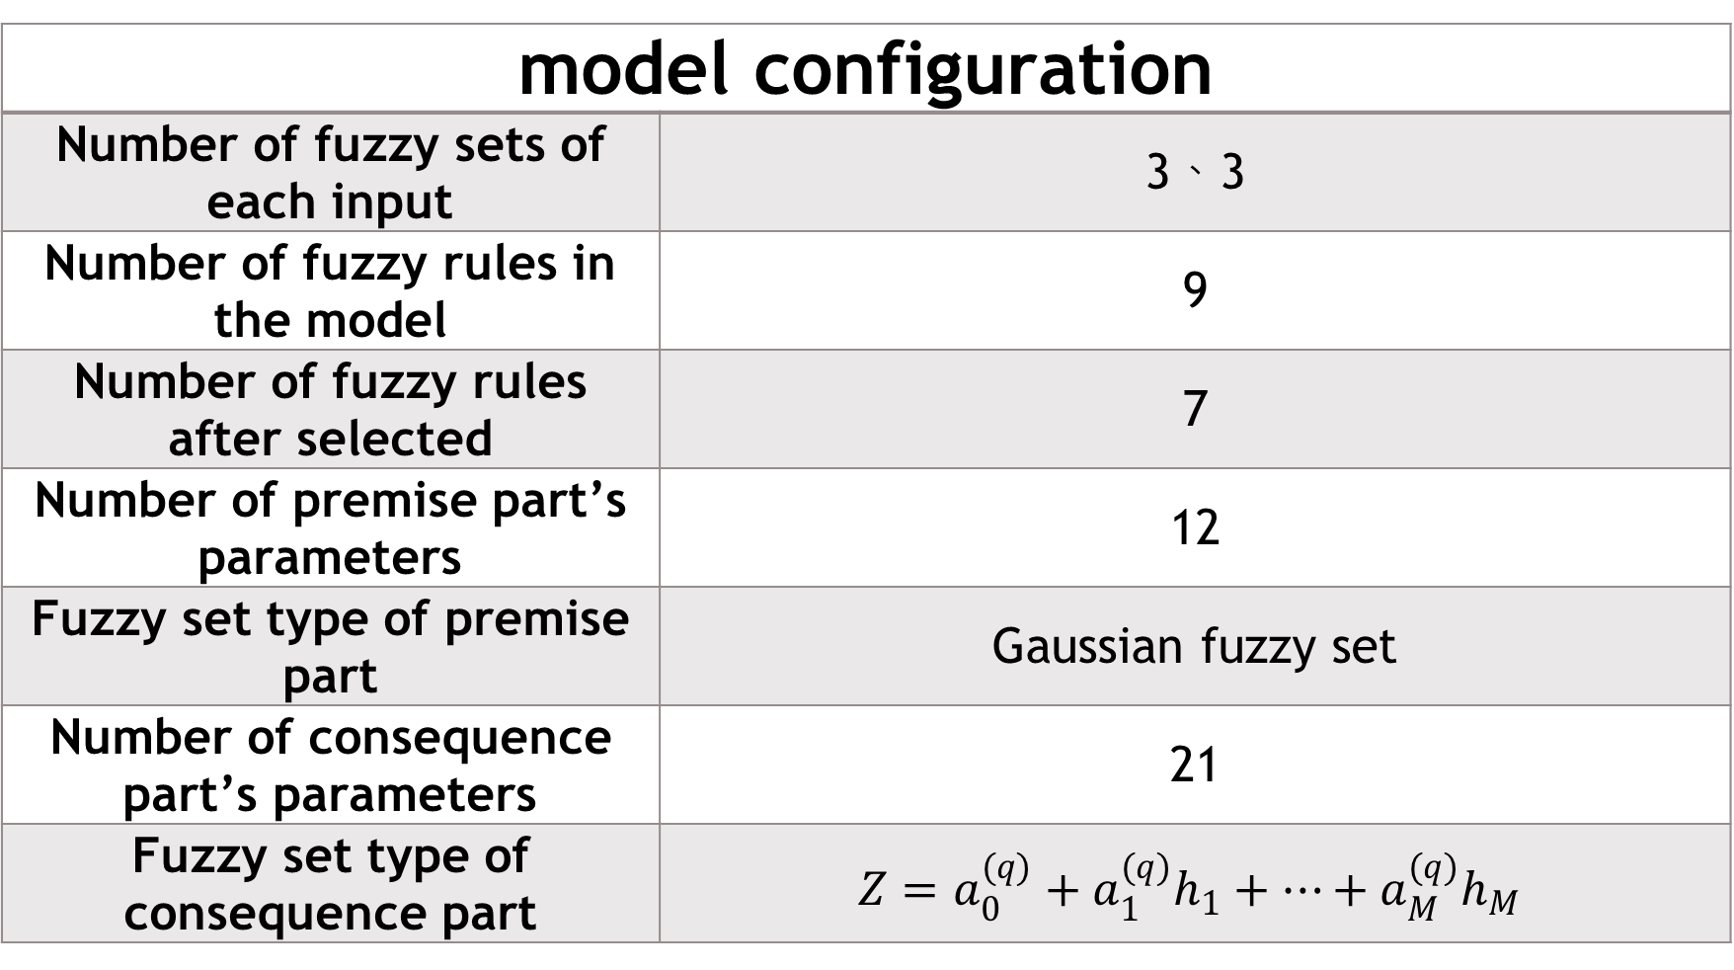
model configuration
Number of fuzzy sets of each input | 3、3
Number of fuzzy rules in the model | 9
Number of fuzzy rules after selected | 7
Number of premise part’s parameters | 12
Fuzzy set type of premise part | Gaussian fuzzy set
Number of consequence part’s parameters | 21
Fuzzy set type of consequence part | $$Z=a_{0}^{(q)}+a_{1}^{(q)}h_{1}+…+a_{M}^{(q)}h_{M}$$

Slide 12
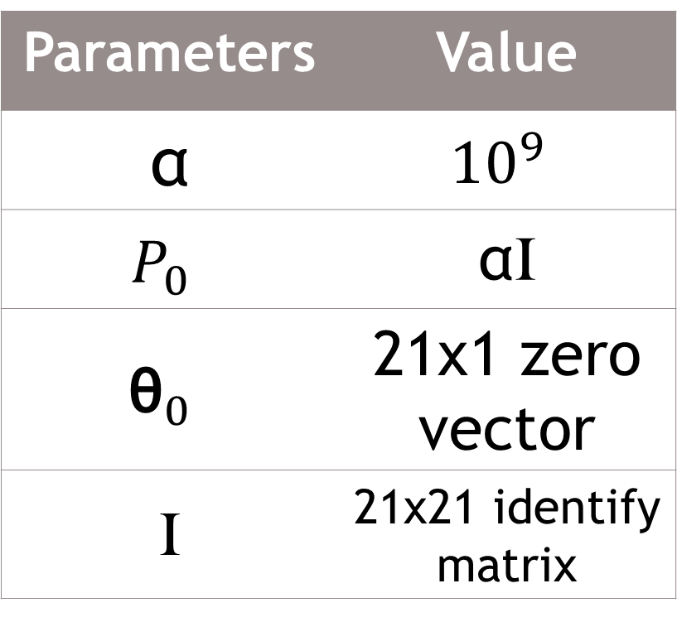
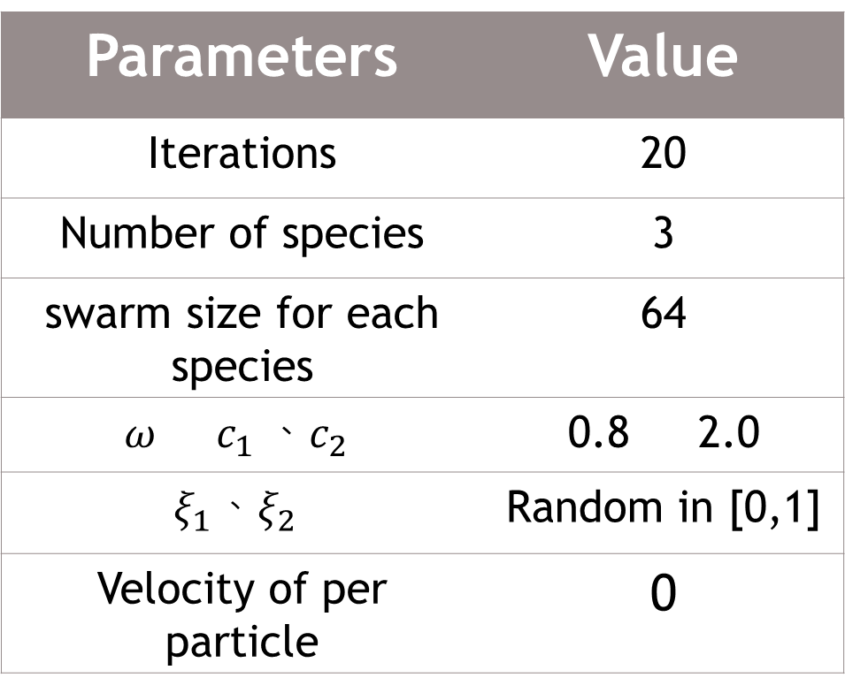
PSO parameters RLSE PARAMETERS
Parameters | Value
Iterations | 20
Number of species | 3
swarm size for each species | 64
$$ω c_{1} 、c_{2}$$ | 0.8 2.0
$$ξ_{1}、ξ_{2}$$ | Random in [0,1]
Velocity of per particle | 0
Parameters | Value
α | $${10}^{9}$$
$$P_{0}$$ | αI
$${\text{θ}}_{0}$$ | 21x1 zero vector
I | 21x21 identify matrix

Slide 13
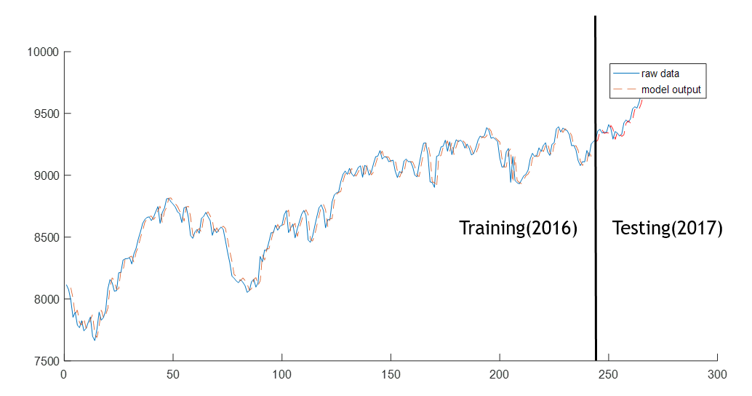
TAIEX(TW^II)

Slide 14
Training RMSE=71.4782
Testing RMSE=44.465

