Slide 1
多種類群PSO
教授:李俊賢
學生:林奇鋒

Slide 2
Model
PSO
RLSE
Complex
Gaussian
function
T-S
y(i)
-
+
errors
y(i+2)
Output(1)
y(i+1)

Slide 3
Use subtractive clustering(9 rules)
Formation Matrix
1 | 1
1 | 2
1 | 3
2 | 1
2 | 2
2 | 3
3 | 1
3 | 2
3 | 3
INPUT1
INPUT2

Slide 4
Use treshold Filter(remain 7 rules)
Formation Matrix
1 | 1
1 | 2
1 | 3
2 | 1
2 | 2
2 | 3
3 | 1
3 | 2
3 | 3
INPUT1
INPUT2

Slide 5



Flowchart of the PSO–RLSE method
Initialize swarm
Prepare A、y
Fuzzy set
Update Position
Firing-Strength
Initialize $P_{0}、 {\text{θ}}_{0}$
Calculate RMSE
Normalization
Update $P_{k+1}$
Update Gbest、Pbest
Recursive
Consequence part
Update ${\text{θ}}_{k+1}$
STOP?
Output
Get Cons. parameters
No
Yes
End

Slide 6
1
1
2
PSO1
2
3
3
4
4
5
5
6
6
7
7
8
8
9
9
10
10
Premise parameters

Slide 7
1
1
2
PSO1
2
3
PSO2
3
4
4
5
5
6
PSO3
6
7
7
8
PSO4
8
9
9
PSO5
10
10
Premise parameters

Slide 8



Flowchart of the CPSO–RLSE method
Initialize swarm
Start Iteration
Select PSO species
Combine other PSO best parameters
Prepare A、y
Update Position
Fuzzy set
Initialize $P_{0}、 {\text{θ}}_{0}$
Calculate RMSE
Firing-Strength
Update $P_{k+1}$
Recursive
Update Gbest、Pbest
Normalization
Update ${\text{θ}}_{k+1}$
No PSO Species?
No
Consequence part
Get Cons. parameters
Yes
No Iteration?
No
Output
Yes
End

Slide 9
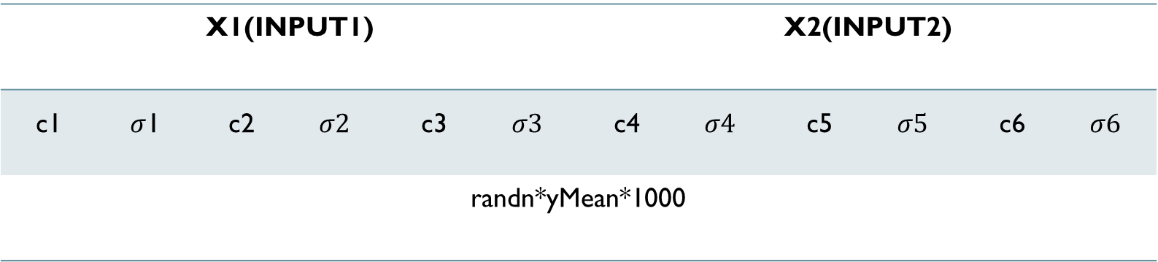
Premise(gauss)
X1(INPUT1) |  |  |  |  |  | X2(INPUT2)
c1 | $σ$1 | c2 | $$σ2$$ | c3 | $$σ3$$ | c4 | $$σ4$$ | c5 | $$σ5$$ | c6 | $$σ6$$
randn*yMean*1000

Slide 10
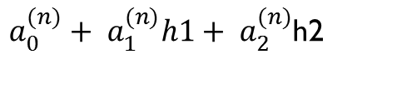
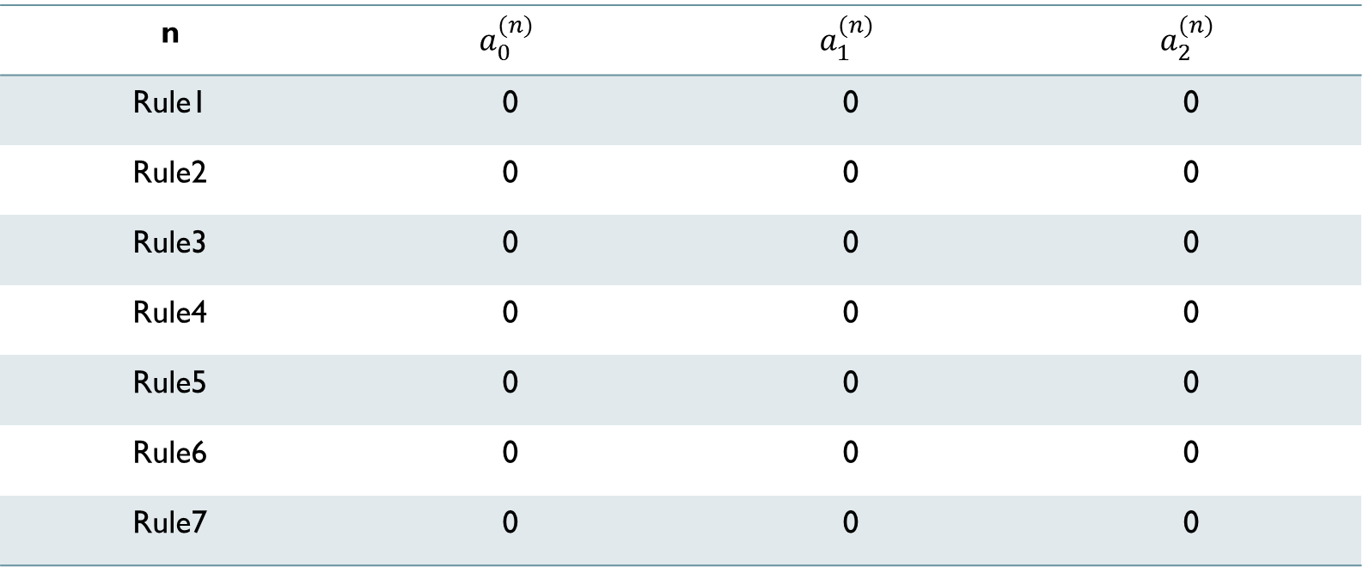
Consequence(T-S)
$a_{0}^{(n)}+ a_{1}^{(n)}h1+ a_{2}^{(n)}$h2
n | $$a_{0}^{(n)}$$ | $$a_{1}^{(n)}$$ | $$a_{2}^{(n)}$$
Rule1 | 0 | 0 | 0
Rule2 | 0 | 0 | 0
Rule3 | 0 | 0 | 0
Rule4 | 0 | 0 | 0
Rule5 | 0 | 0 | 0
Rule6 | 0 | 0 | 0
Rule7 | 0 | 0 | 0

Slide 11
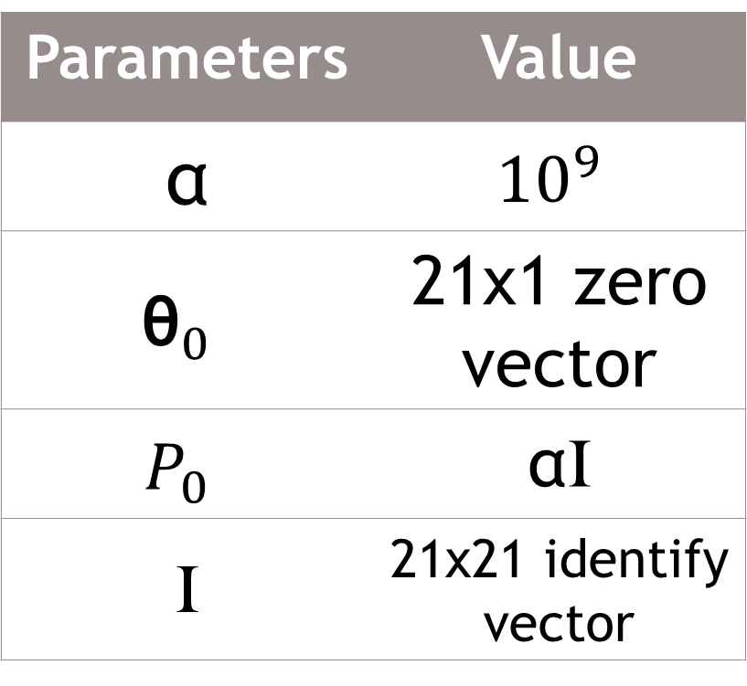
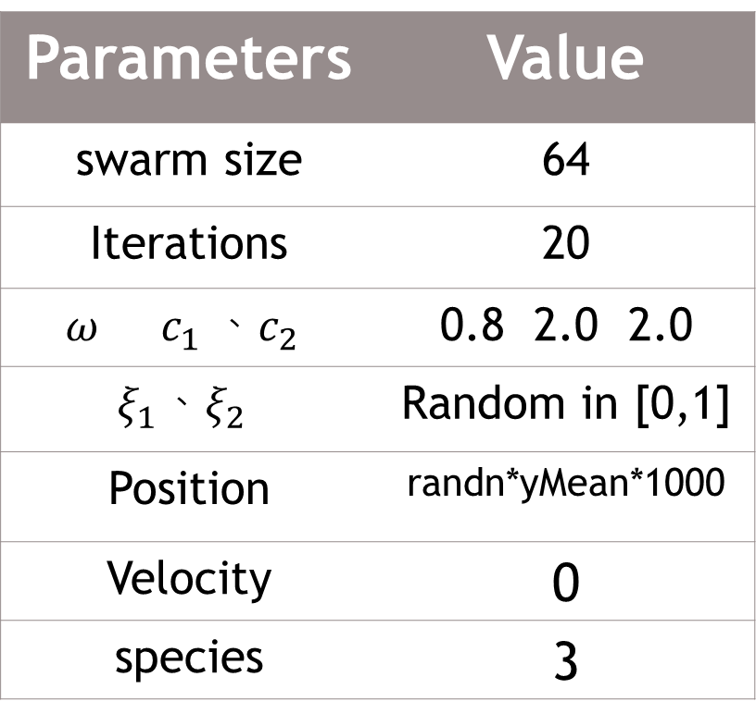
PSO parameters RLSE PARAMETERS
Parameters | Value
swarm size | 64
Iterations | 20
$$ω c_{1} 、c_{2}$$ | 0.8 2.0 2.0
$$ξ_{1}、ξ_{2}$$ | Random in [0,1]
Position | randn*yMean*1000
Velocity | 0
species | 3
Parameters | Value
α | $${10}^{9}$$
$${\text{θ}}_{0}$$ | 21x1 zero vector
$$P_{0}$$ | αI
I | 21x21 identify vector

Slide 12
Training(2016)
Testing(2017)

Slide 13
RMSE=71.4782 TEST_RMSE=44.465

Slide 14
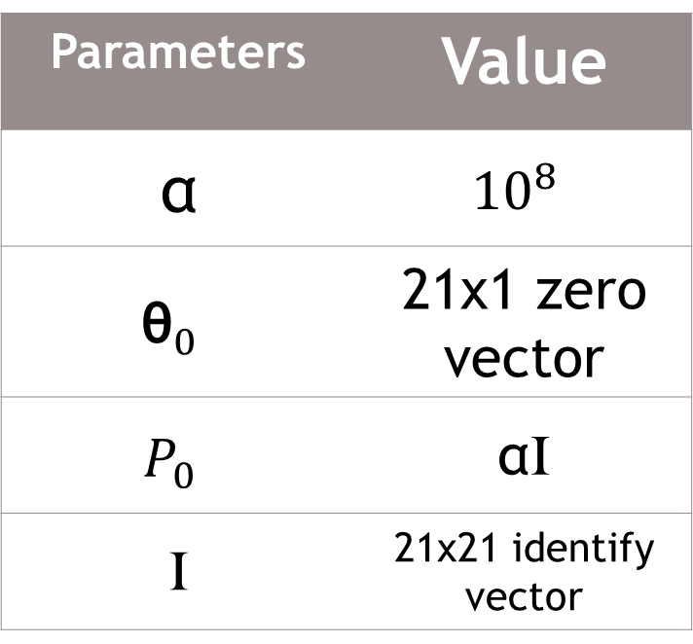
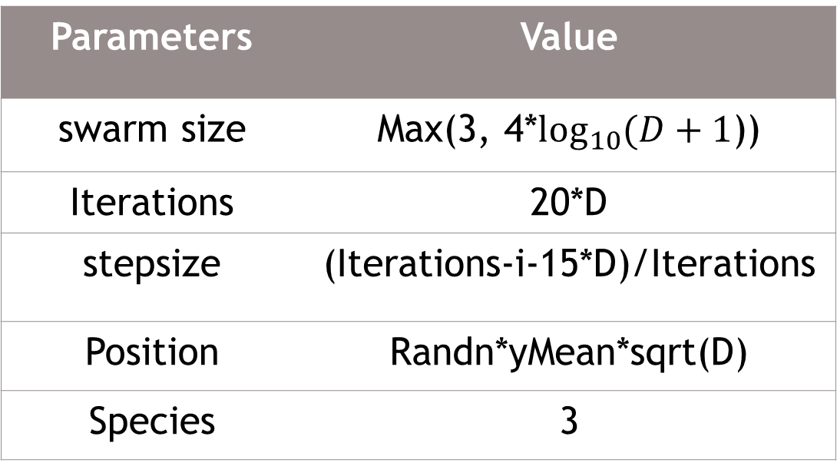
RO parameters RLSE PARAMETERS
Parameters | Value
α | $${10}^{8}$$
$${\text{θ}}_{0}$$ | 21x1 zero vector
$$P_{0}$$ | αI
I | 21x21 identify vector
Parameters | Value
swarm size | Max(3, 4*$\log_{10}{(D+1}$))
Iterations | 20*D
stepsize | (Iterations-i-15*D)/Iterations
Position | Randn*yMean*sqrt(D)
Species | 3
D:number of Premise parameters

Slide 15
Result(^TWII)
Training
(2016)
Testing
(2017)

Slide 16
Learning curve(^TWII)
RMSE=71.9232

