Slide 1
進度講解
學生:林奇鋒

Slide 2
Modeling
Unknown
Process
X
Y
e=Y-Ŷ
MSE(mean square error)
Model
Ŷ

Slide 3

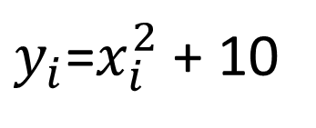
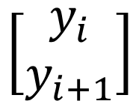
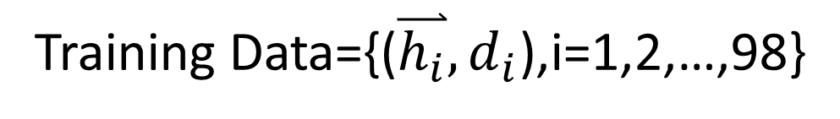
Homework
x=linspace(-2,2)
$y_{i}$=$x_{i}^{2}$ + 10
Training Data={($\overset{⃑}{h_{i}},d_{i}$),i=1,2,…,98}
$$\left[\begin{aligned}y_{i} \\ y_{i+1}\end{aligned}\right]$$
$$y_{i+2}$$

Slide 4
X1
Model
Ŷ
Y
Y(1)
e(1)
X2
Y(3)
Y(2)
X1
Model
Ŷ
e(2)
Y
Y(2)
X2
Y(4)
Y(3)
.
.
.
.
.
.
X1
Model
Ŷ
e(98)
Y
Y(98)
X2
Y(100)
Y(99)

Slide 5
(gauss)
Premise(4 rules) => 4*2=8 parameters
Consequence(T-S) => 4*3=12 parameters
20 parameters

Slide 6
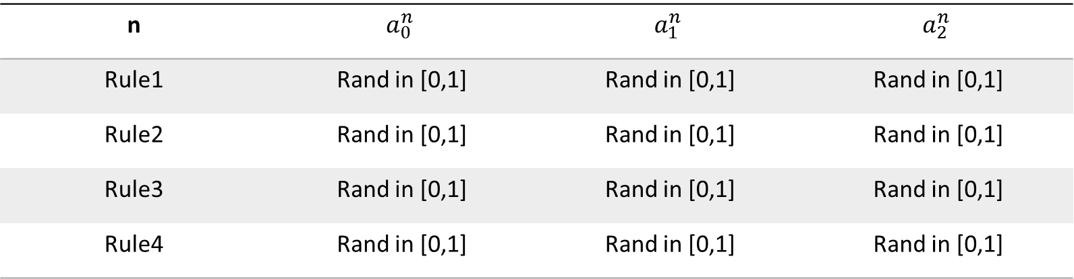
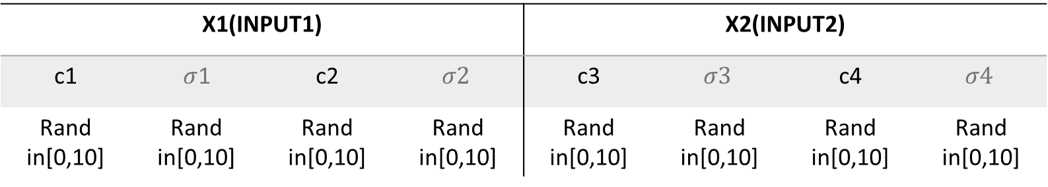
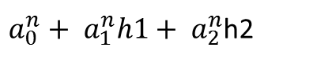
Premise(gauss)
X1(INPUT1) |  |  |  | X2(INPUT2)
c1 | $σ$1 | c2 | $$σ2$$ | c3 | $$σ3$$ | c4 | $$σ4$$
Rand in[0,10] | Rand in[0,10] | Rand in[0,10] | Rand in[0,10] | Rand in[0,10] | Rand in[0,10] | Rand in[0,10] | Rand in[0,10]
Consequence(T-S)
$a_{0}^{n}+ a_{1}^{n}h1+ a_{2}^{n}$h2
n | $$a_{0}^{n}$$ | $$a_{1}^{n}$$ | $$a_{2}^{n}$$
Rule1 | Rand in [0,1] | Rand in [0,1] | Rand in [0,1]
Rule2 | Rand in [0,1] | Rand in [0,1] | Rand in [0,1]
Rule3 | Rand in [0,1] | Rand in [0,1] | Rand in [0,1]
Rule4 | Rand in [0,1] | Rand in [0,1] | Rand in [0,1]

Slide 8
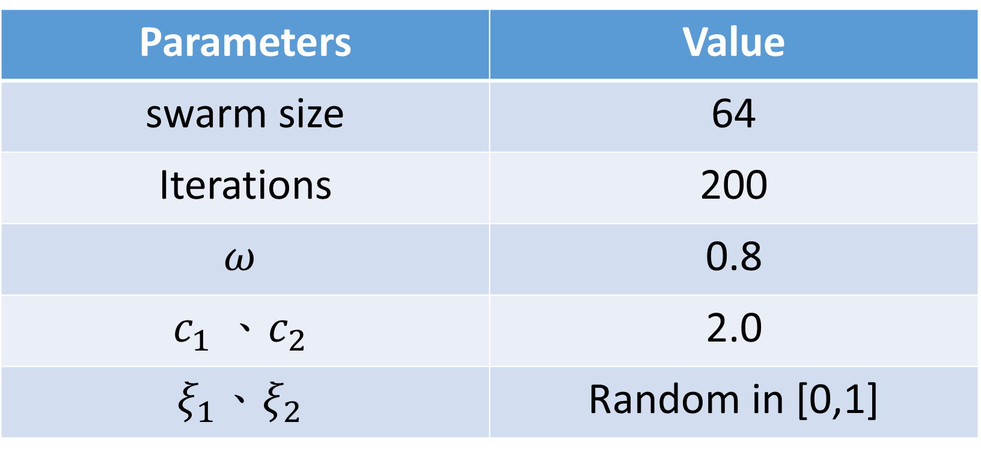
PSO parameters
Parameters | Value
swarm size | 64
Iterations | 200
$$ω$$ | 0.8
$$c_{1} 、c_{2}$$ | 2.0
$$ξ_{1}、ξ_{2}$$ | Random in [0,1]

Slide 9
Before learning
After learning

