Slide 1
HW3
學生:林奇鋒

Slide 2
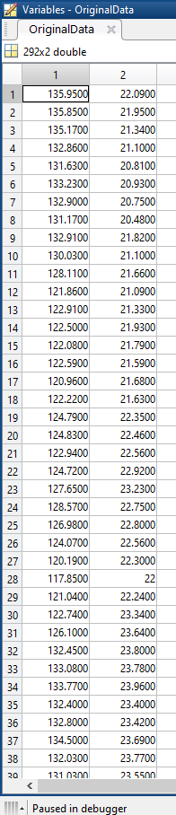
Data
TSMC:2016/01/04~2017/03/01
IBM:2016/01/04~2017/03/01
Ups and Downs : 30

Slide 3







Feature Selection
CP
SP
FP
$$g{(f}_{i}→t_{1})>0$$
$$f_{49}$$
$$f_{54}$$
$$f_{23}$$
$$f_{26}$$
.
.
.
.
$$f_{1}$$
$$f_{2}$$
.
.
.
$$f_{60}$$
$$SP^{(1)}$$
$$ρ\left(∅_{k}\right)>\overline{ω}∗\overline{g_{sum}}$$
$$g{(f}_{i}→t_{2})>0$$
$$SP^{(2)}$$

Slide 4



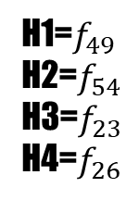





Data pair
INPUT
OUTPUT
TARGET
H1=$f_{49}$
H2=$f_{54}$
H3=$f_{23}$
H4=$f_{26}$
MODEL
$${\hat{Y}}_{1}$$
$$Y_{1}=IBM+TSMC∗j$$
$${\hat{Y}}_{2}$$
$$Y_{2}=???+???∗j$$
$${\hat{Y}}_{3}$$
$$Y_{3}=???+???∗j$$
$${\hat{Y}}_{4}$$
$$Y_{4}=???+???∗j$$

Slide 5





SCFSs
Membership degree
OUTPUT
TARGET
$$u_{1}=r∗exp(j(θ_{1}+θ_{2}))$$
$${\hat{Y}}_{1}$$
$$Y_{1}=IBM+TSMC∗j$$
$$u_{2}=r∗cos\left(θ_{2}\right)∗cos(θ_{1})$$
$${\hat{Y}}_{2}$$
$$Y_{2}=???+???∗j$$
$$u_{3}=r∗\cos\left(θ_{2}\right)∗\sin\left(θ_{1}\right)$$
$${\hat{Y}}_{3}$$
$$Y_{3}=???+???∗j$$
$$u_{4}=r∗\sin\left(θ_{2}\right)$$
$${\hat{Y}}_{4}$$
$$Y_{4}=???+???∗j$$
* $r=\exp\left(\frac{−{\left(x−c\right)}^{2}}{2a}\right)$ 、$θ_{1}=\frac{dr}{dx}$ 、$θ_{2}=\frac{d^{2}r}{dx^{2}}$

Slide 6




IF-part
Center
STD
FUZZYSETs
Subtractive clustering
H1=$f_{49}$
[ 0.04 0.42 -0.34]
[ 0.3776 ]
3
Subtractive clustering
H2=$f_{54}$
[ 0.04 0.43 -0.33]
[ 0.3872 ]
3
Subtractive clustering
H3=$f_{23}$
[ 0.23 2.63 -2.23]
[ 1.8200 ]
3
Subtractive clustering
H4=$f_{26}$
[ 0.23 2.63 -2.34]
[ 1.8087 ]
3
Number Of Rules=3*3*3*3=81

Slide 7

Premise selection
H1=$f_{49}$
H1’s Fuzzyset
H2=$f_{54}$
H2’s Fuzzyset
$$β$$
H3=$f_{23}$
H3’s Fuzzyset
H4=$f_{26}$
H4’s Fuzzyset

Slide 8

Premise selection
$$Threshold=0.3∗std(β)$$
Number Of Rules:81
Number Of Rules:27
Rule beta’s std > Threshold

Slide 9
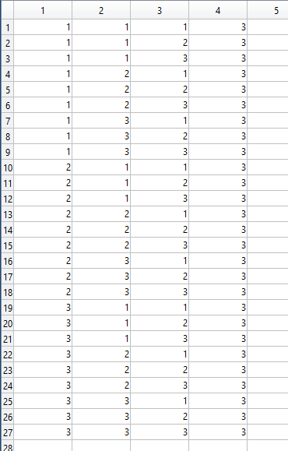
Formation Matrix

Slide 10

Consequence
Center
STD
FCM
2.0735+0.2344i
0.2043+0.0640i
-1.6335-0.2177i
1.7961 1.7961 1.7961
$$Y_{1}$$
[ H1 h2 h3 h4 ]
Subtractive clustering
Number Of Cons.

Slide 11


Aim Of Object
$f1\left(B_{i}^{(k)}\right)$的1次微分
$$λ_{i}^{(k→q)}=f1\left(B_{i}^{(k)}\right)∗exp\left(j∗w\right)$$
$B_{i}^{(k)}:第i個$目標中，第k個前鑑部的啟動強度
$$f1\left(B_{i}^{(k)}\right)=exp⁡(−\frac{{\left(B_{i}^{(k)}−aocC_{i}^{(q)}\right)}^{2}}{2{\left(aocS_{i}^{(q)}\right)}^{2}})$$
$$aocC_{i}^{(q)}=f2=r2∗exp\left(j∗w_{2}\right)$$
$$aocS_{i}^{(q)}=f3=r3∗exp\left(j∗w_{3}\right)$$
$$r2=exp⁡(−\frac{{\left(B_{i}^{(k)}−\overline{y_{i}}\right)}^{2}}{2{\left(σ_{i}\right)}^{2}})$$
$r2$的1次微分
$$r3=exp⁡(−\frac{{\left(X_{s}\right)}^{2}}{2{\left(σ_{i}\right)}^{2}})$$
$r3$的1次微分

Slide 12










Aim of Object
$$B=[{\overset{⃑}{B}}^{\left(1\right)} {\overset{⃑}{B}}^{\left(2\right)}…{\overset{⃑}{B}}^{(k)}]$$
$${{\overset{⃑}{\hat{y} }}^{(q)}}^{ }=φ^{(q)}∗{\overset{⃑}{a}}^{(q)}$$
$${\overset{⃑}{B}}^{\left(k\right)}={\left[B_{1}^{\left(k\right)}B_{2}^{\left(k\right)} …B_{N}^{\left(k\right)}\right]}^{T}$$
$${\overset{⃑}{a}}^{(q)}={\left[a_{0}^{(q)} a_{1}^{(q)} …a_{M}^{(q)}\right]}^{T}$$
$B_{N}^{(k)}:第N個$目標中，第k個前鑑部的啟動強度
$a_{0}^{(q)}\sim a_{M}^{(q)}:第$q個後鑑部參數
$$φ^{(q)}=B∗L∗H$$
$$L^{(q)}=\left[\begin{aligned}\begin{matrix}{{\overset{⃑}{λ}}^{\left(1→q\right)}}^{T} \\ {{\overset{⃑}{λ}}^{\left(2→q\right)}}^{T} \\ \begin{aligned}⋮ \\ {{\overset{⃑}{λ}}^{\left(k→q\right)}}^{T}\end{aligned}\end{matrix}\end{aligned}\right]$$
$$H=\left[\begin{aligned}\begin{matrix}{(\overset{⃑}{h_{a}})}^{T} \\ {(\overset{⃑}{h_{a}})}^{T} \\ \begin{aligned}⋮ \\ {(\overset{⃑}{h_{a}})}^{T}\end{aligned}\end{matrix}\end{aligned}\right]$$
$$\overset{⃑}{h_{a}}={\left[1 (\overset{⃑}{h})\right]}^{T}$$

Slide 13


Flowchart of the PSO–RLSE method
Initialize swarm
Prepare A、y
Construct Fuzzy set
Update Position
Caculate Firing-Strength
Initialize $P_{0}、 {\text{θ}}_{0}$
Calculate RMSE
Caculate Aim Of Object
Update $P_{k+1}$
Update Gbest、Pbest
Recursive
Update ${\text{θ}}_{k+1}$
Update Position
Caculate Output
Get Cons. parameters
No
STOP?
Yes
End

Slide 14
MODEL Parameter
Parameter | Value
Number of INPUTs | 4
Number of Targets | 2
Number of OUTPUTs | 1
Number of Rules | 27
Number of Premise Fuzzysets | 27
Number of Premise parameters | 24
Number of Consequences | 3
Number of Consequence parameters | 15

Slide 15
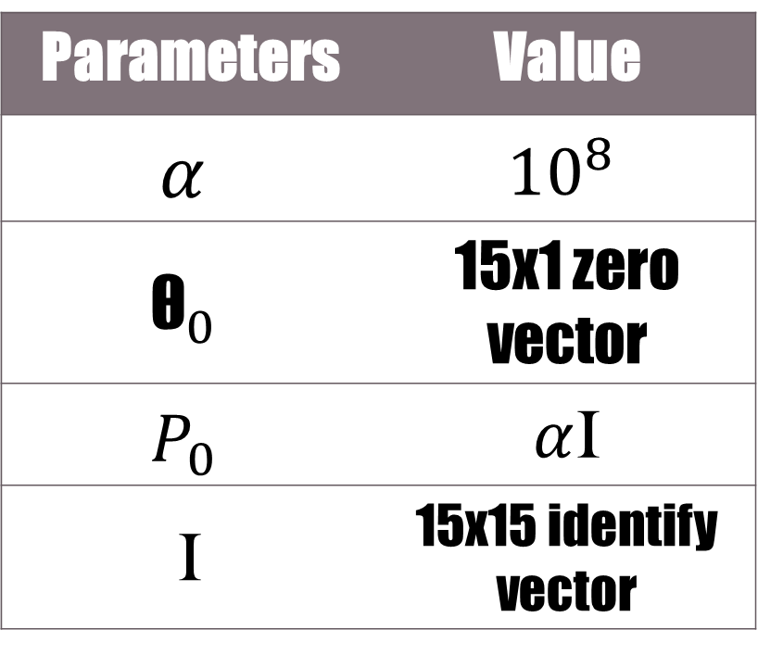
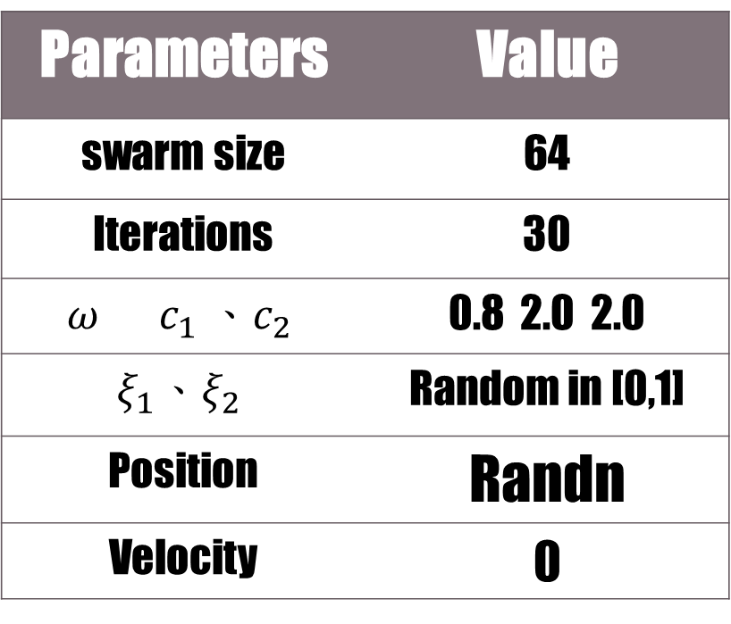
PSO parameters RLSE PARAMETERS
Parameters | Value
swarm size | 64
Iterations | 30
$$ω c_{1} 、c_{2}$$ | 0.8 2.0 2.0
$$ξ_{1}、ξ_{2}$$ | Random in [0,1]
Position | Randn
Velocity | 0
Parameters | Value
$$α$$ | $${10}^{8}$$
$${\text{θ}}_{0}$$ | 15x1 zero vector
$$P_{0}$$ | $α$I
I | 15x15 identify vector

Slide 16
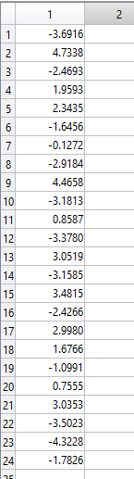
After Learning
 |  | H1 | H2 | H3 | H4
Fuzzyset1 | Center | -3.6916 | -0.1272 | 3.0519 | -1.0991
 | Std | 4.7338 | -2.9184 | -3.1585 | 0.7555
Fuzzyset2 | Center | -2.4693 | 4.4658 | 3.4815 | 3.0353
 | Std | 1.9593 | -3.1813 | -2.4266 | -3.5023
Fuzzyset3 | Center | 2.3435 | 0.8587 | 2.9980 | -4.3228
 | Std | -1.6456 | -3.3780 | 1.6766 | -1.7826

Slide 17
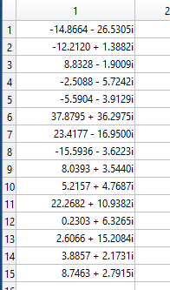
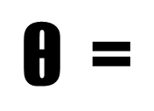
After Learning
$$\text{θ}\text{ =}$$

Slide 20
Performance(RMSE)
 | IBM | TSMC
Training | 1.5644 | 0.3691
Testing

