Slide 1
RO(+RLSE) VS PSO(+RLSE) (TAIEX、S&P500)
教授:李俊賢
學生:林奇鋒

Slide 2
Model
PSO or RO
RLSE
Gaussian
function
T-S
INPUT1
-
+
errors
target
Output
RMSE(root mean square error)
INPUT2

Slide 3
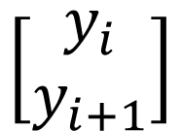
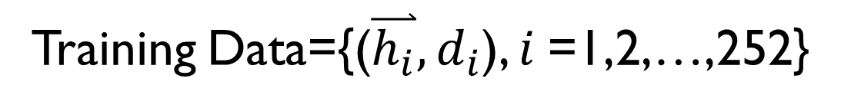

Homework
Training Data={($\overset{⃑}{h_{i}},d_{i}$), $i$=1,2,…,252}
$$\left[\begin{aligned}y_{i} \\ y_{i+1}\end{aligned}\right]$$
$$y_{i+2}$$
1/12016~12/31/2016

Slide 4
Model
PSO or RO
RLSE
Complex
Gaussian
function
T-S
y(i)
-
+
errors
y(i+2)
Output(1)
y(i+1)

Slide 5
Use subtractive clustering(9 rules)
Formation Matrix
1 | 1
1 | 2
1 | 3
2 | 1
2 | 2
2 | 3
3 | 1
3 | 2
3 | 3
INPUT1
INPUT2

Slide 6
Use treshold Filter(remain 7 rules)
Formation Matrix
1 | 1
1 | 2
1 | 3
2 | 1
2 | 2
2 | 3
3 | 1
3 | 2
3 | 3
INPUT1
INPUT2

Slide 7



Flowchart of the PSO–RLSE method
Initialize swarm
Prepare A、y
Fuzzy set
Update Position
Firing-Strength
Initialize $P_{0}、 {\text{θ}}_{0}$
Calculate RMSE
Normalization
Update $P_{k+1}$
Update Gbest、Pbest
Recursive
Consequence part
Update ${\text{θ}}_{k+1}$
Update Position
Output
Get Cons. parameters
No
STOP?
Yes
End

Slide 8
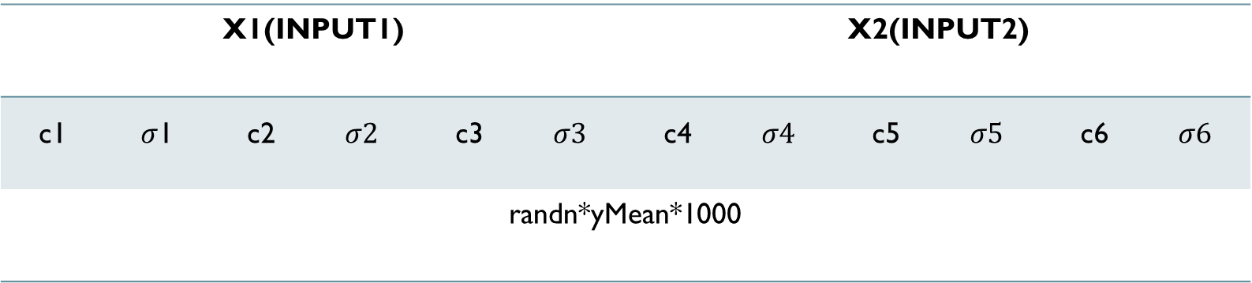
Premise(gauss)
X1(INPUT1) |  |  |  |  |  | X2(INPUT2)
c1 | $σ$1 | c2 | $$σ2$$ | c3 | $$σ3$$ | c4 | $$σ4$$ | c5 | $$σ5$$ | c6 | $$σ6$$
randn*yMean*1000

Slide 9
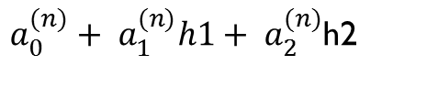
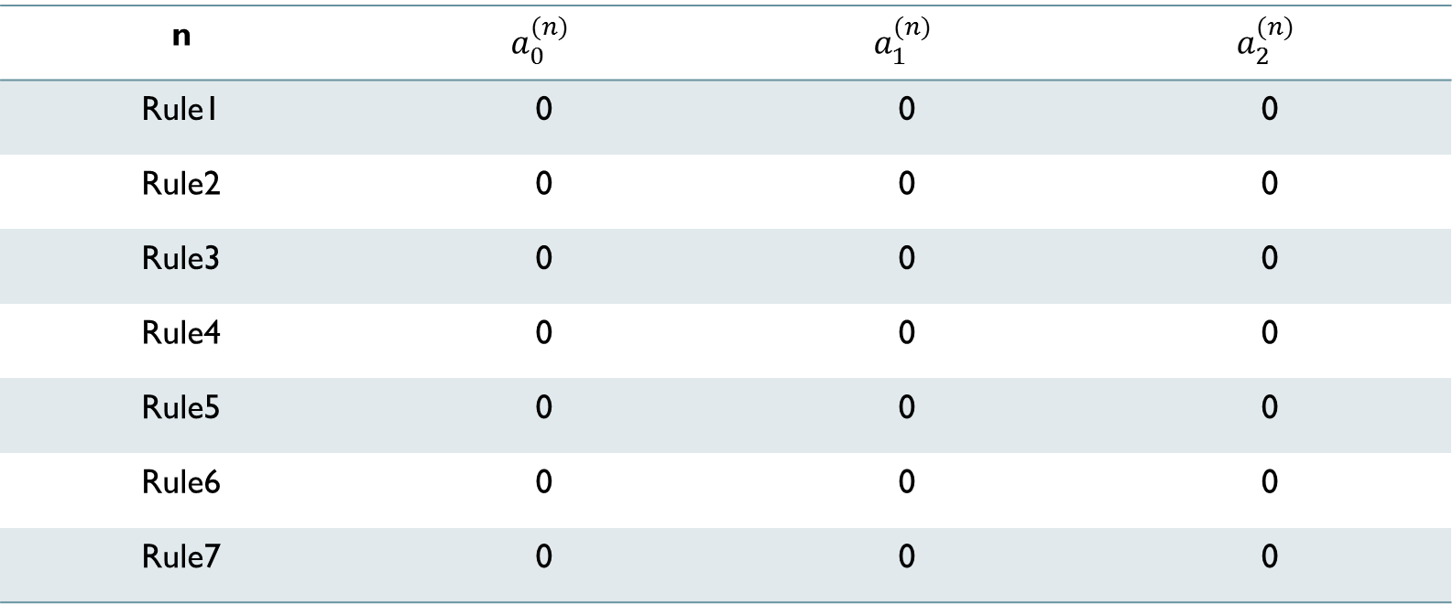
Consequence(T-S)
$a_{0}^{(n)}+ a_{1}^{(n)}h1+ a_{2}^{(n)}$h2
n | $$a_{0}^{(n)}$$ | $$a_{1}^{(n)}$$ | $$a_{2}^{(n)}$$
Rule1 | 0 | 0 | 0
Rule2 | 0 | 0 | 0
Rule3 | 0 | 0 | 0
Rule4 | 0 | 0 | 0
Rule5 | 0 | 0 | 0
Rule6 | 0 | 0 | 0
Rule7 | 0 | 0 | 0

Slide 10
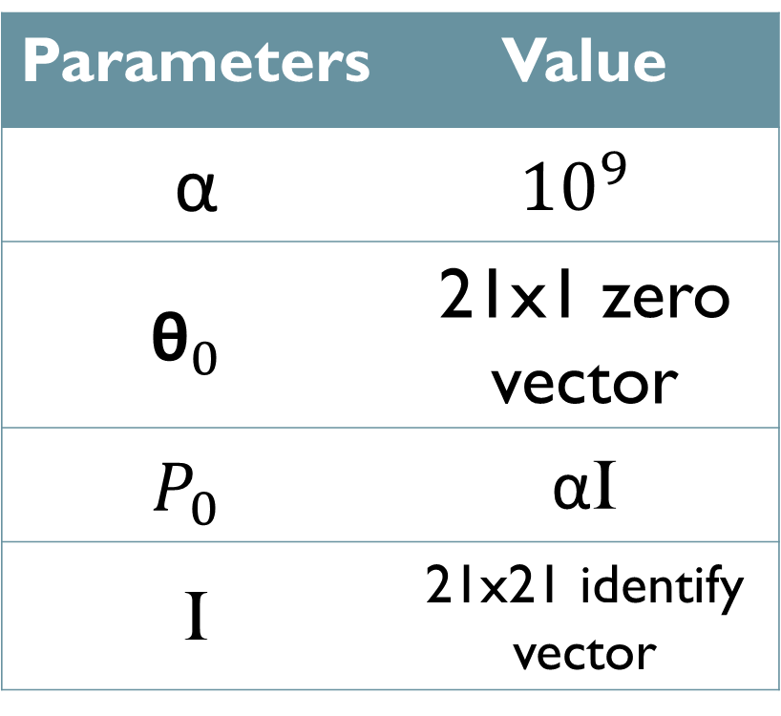
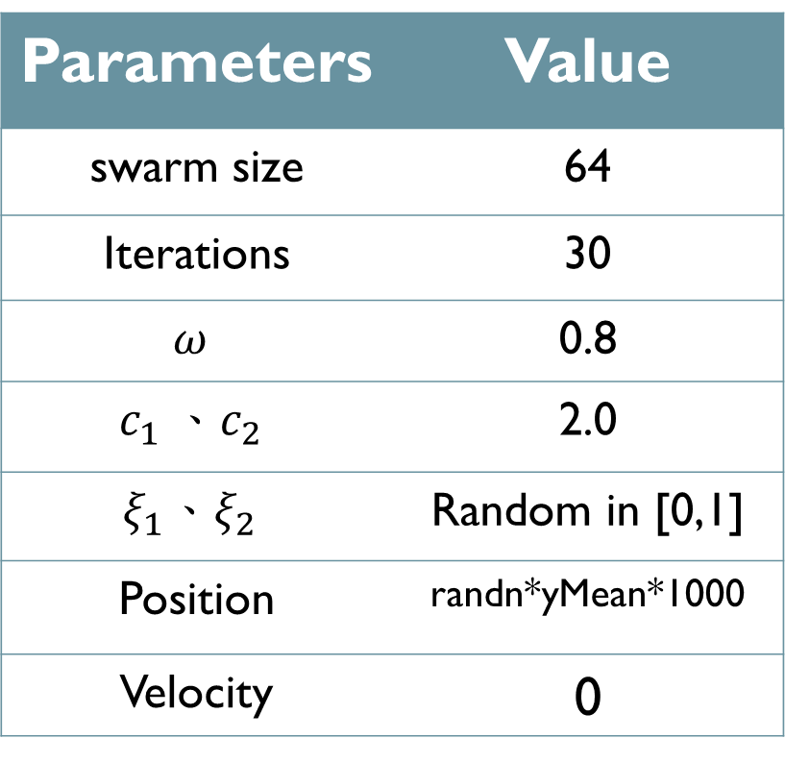
PSO parameters RLSE PARAMETERS
Parameters | Value
swarm size | 64
Iterations | 30
$$ω$$ | 0.8
$$c_{1} 、c_{2}$$ | 2.0
$$ξ_{1}、ξ_{2}$$ | Random in [0,1]
Position | randn*yMean*1000
Velocity | 0
Parameters | Value
α | $${10}^{9}$$
$${\text{θ}}_{0}$$ | 21x1 zero vector
$$P_{0}$$ | αI
I | 21x21 identify vector

Slide 11
Result(^TWII)
Execute time is 38.820567 seconds.
Training
(2016)
Testing
(2017)

Slide 12
Learning curve(^TWII)
RMSE=72.1552

Slide 13
Flowchart of the RO–RLSE method
Initialize swarm
Prepare A、y
Fuzzy set
Random Position
Firing-Strength
Initialize $P_{0}、 {\text{θ}}_{0}$
Calculate RMSE
Normalization
Update $P_{k+1}$
Update Gbest
Recursive
Consequence part
Update ${\text{θ}}_{k+1}$
Update Position
Output
Get Cons. parameters
No
STOP?
Yes
End

Slide 14

Premise(gauss)
X1(INPUT1) |  |  |  |  |  | X2(INPUT2)
c1 | $σ$1 | c2 | $$σ2$$ | c3 | $$σ3$$ | c4 | $$σ4$$ | c5 | $$σ5$$ | c6 | $$σ6$$
randn*yMean*sqrt(PrePara)

Slide 15
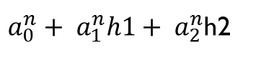

Consequence(T-S)
$a_{0}^{n}+ a_{1}^{n}h1+ a_{2}^{n}$h2
n | $$a_{0}^{n}$$ | $$a_{1}^{n}$$ | $$a_{2}^{n}$$
Rule1 | 0 | 0 | 0
Rule2 | 0 | 0 | 0
Rule3 | 0 | 0 | 0
Rule4 | 0 | 0 | 0
Rule5 | 0 | 0 | 0
Rule6 | 0 | 0 | 0
Rule7 | 0 | 0 | 0

Slide 16
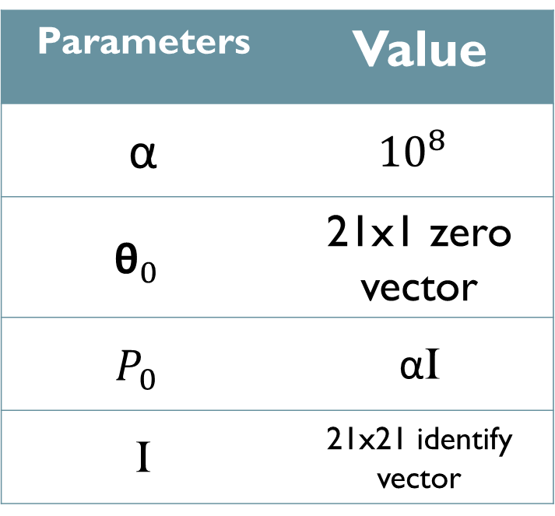
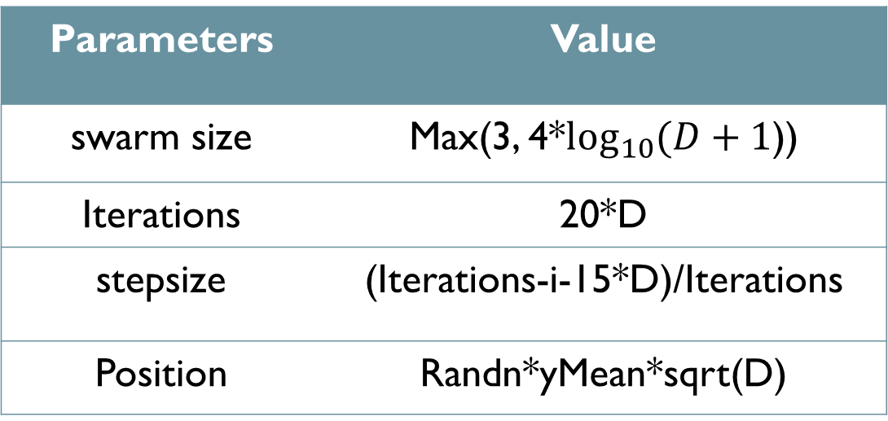
RO parameters RLSE PARAMETERS
Parameters | Value
swarm size | Max(3, 4*$\log_{10}{(D+1}$))
Iterations | 20*D
stepsize | (Iterations-i-15*D)/Iterations
Position | Randn*yMean*sqrt(D)
Parameters | Value
α | $${10}^{8}$$
$${\text{θ}}_{0}$$ | 21x1 zero vector
$$P_{0}$$ | αI
I | 21x21 identify vector
D:number of Premise parameters

Slide 17
Result(^TWII)
Execute time is 18.945298 seconds.
Training
(2016)
Testing
(2017)

Slide 18
Learning curve(^TWII)
RMSE=71.9232

Slide 19
PSO
RO
Parameters | Value
swarm size | 64
Iterations | 30
Execute time | 41.020605
Parameters | Value
swarm size | 4
Iterations | 240
Execute time | 18.945298

