Slide 1
1114_Treshold
林奇鋒

Slide 2
Training Data Set
[ ]
H
Target
，
i
H2
H1
H2
H1

Slide 3
INPUT1
H1
Subtractive Clustering
H1Std
H1Center
INPUT2
H2
Subtractive Clustering
H2Center
H2Std

Slide 4
H2center(1)
H2
H2center(2)
H1center(1)
H1
H1center(2)
H1center(3)

Slide 5
INPUT2(1)
H2center(1)
+
H2Std
H2center(2)
+
H2Std
INPUT2(2)
H1center(1)
+
H1Std
H1center(2)
+
H1Std
H1center(3)
+
H1Std
INPUT1(1)
INPUT1(2)
INPUT1(3)

Slide 6
INPUT2(1)
INPUT2(2)
INPUT1(1)
INPUT1(2)
INPUT1(3)

Slide 7
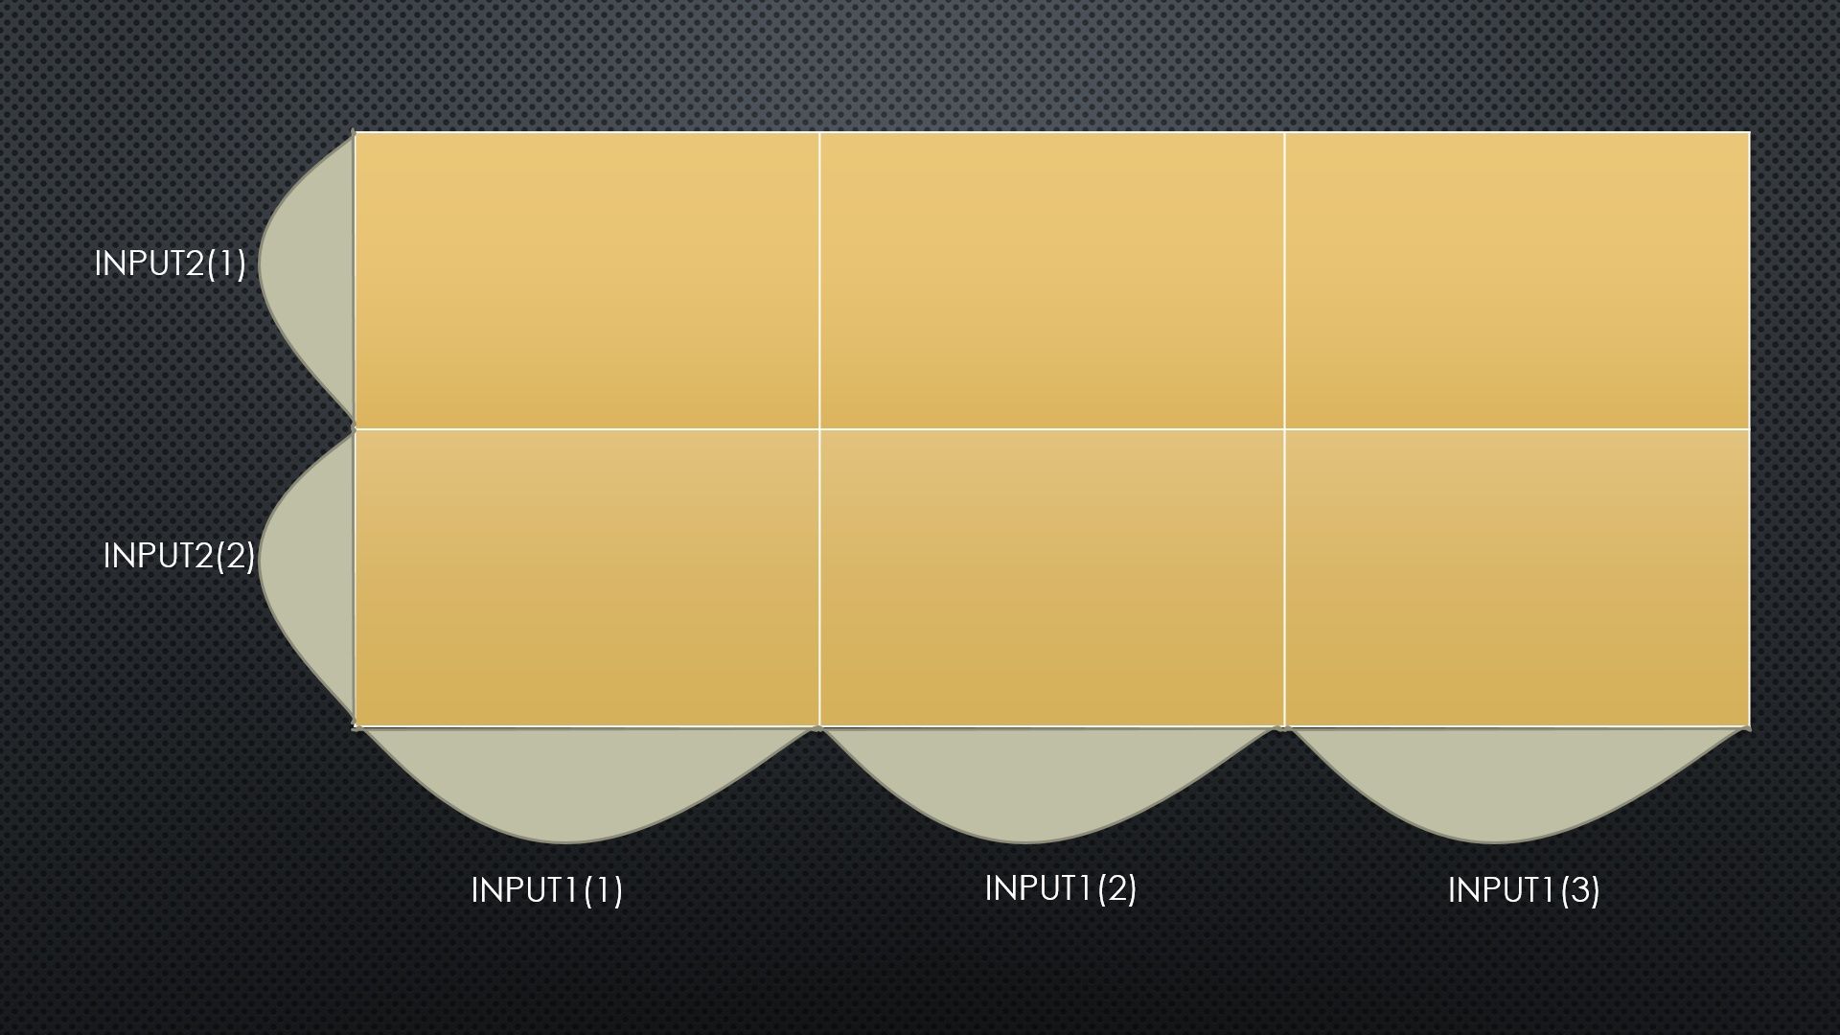
1
2
3
10 X
4
5
6
60 firing strength
Std()*tresholdPara
Treshold

Slide 8
1
2
3
10 X
4
5
6
10 firing strength
Std()
> Treshold??

