Slide 1


Slide 2
Overview
Introduction
Dragos
System/User Requirements
ER Diagram
Application Introduction
Demo

Slide 3
Introduction
We created an employee database for Dragos Inc.
Keep track of employees, employee types, pay group, supervisor, department, product, office, and assets
Visual representation (ERD's) and Software Implementation

Slide 4

Dragos
A Cybersecurity company founded in 2016
Specializes in protecting ICS and OT environments
Helps organizations detect, respond to, and prevent cyber threats

Slide 5
Employee Database System Requirements
Key Entities & Relationships
Employee
Employee Type
Pay Group
Department
Functionality
CRUD (Create, Read, Update, Delete) operations
Track relationships between entities
Notes:
Key Entities & Relationships:
Employee: Personal & job details (Name, ID, Address, etc.).
Relationships: Employee Type, Department, Office, Assets, Product, Supervisor
Employee Type: Categorization (Part-time, Full-time, Contractor).
Relationship: Pay Group
Pay Group: Pay structure (Rate, Frequency).
Supervisor: Tracks employee supervision.
Department: Organizational unit.
Designates bonus-eligible Department Head.
Product: Details of products.
Relationship: Department, Employee
Office: Physical work location.
Asset: Company-owned property assigned to employees.

Slide 6
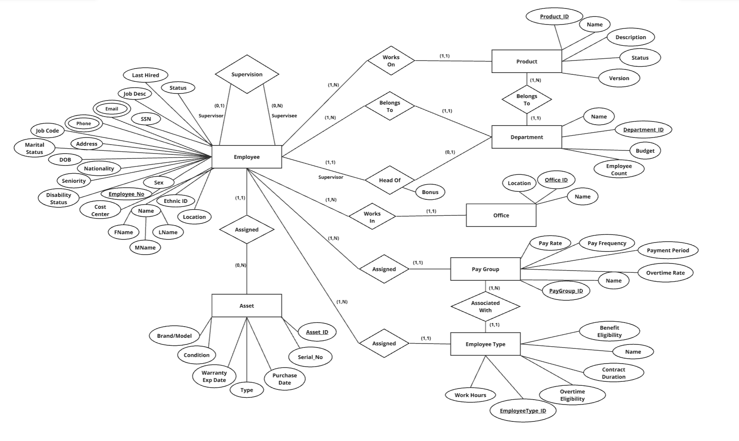
ER Diagram

Slide 7
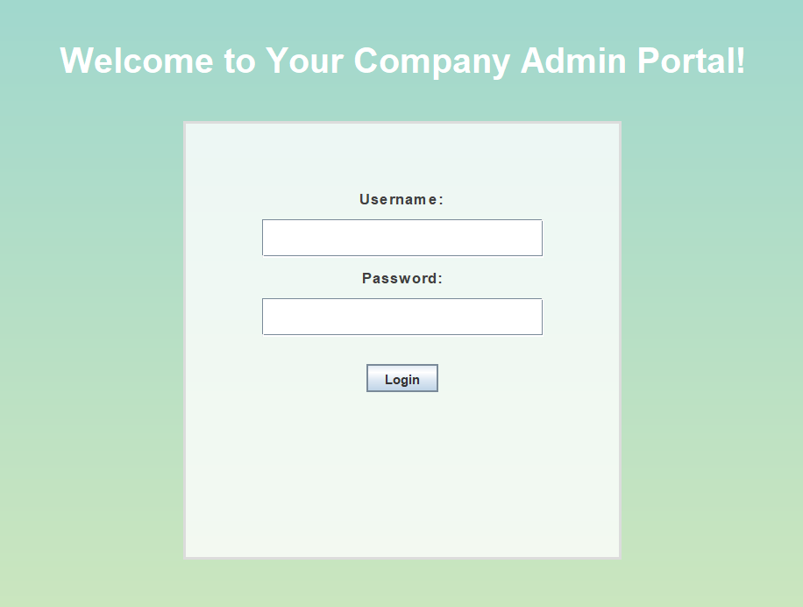
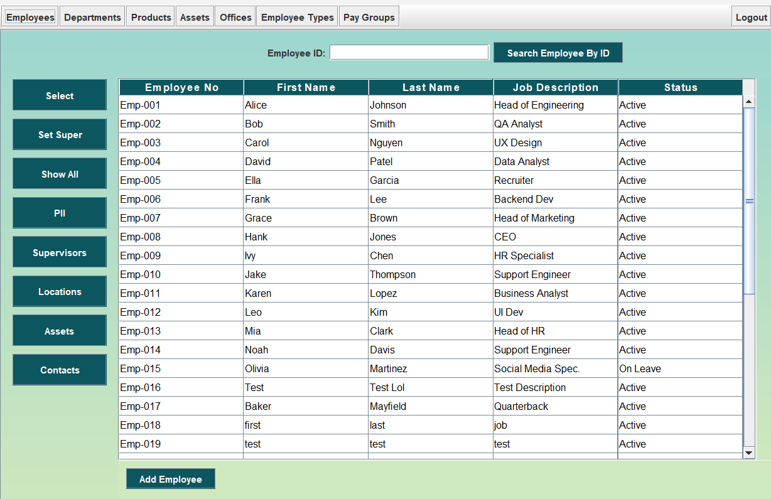
MySequel Solutions

Slide 8
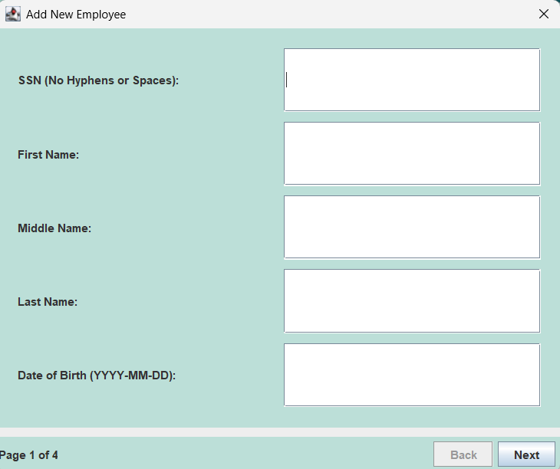
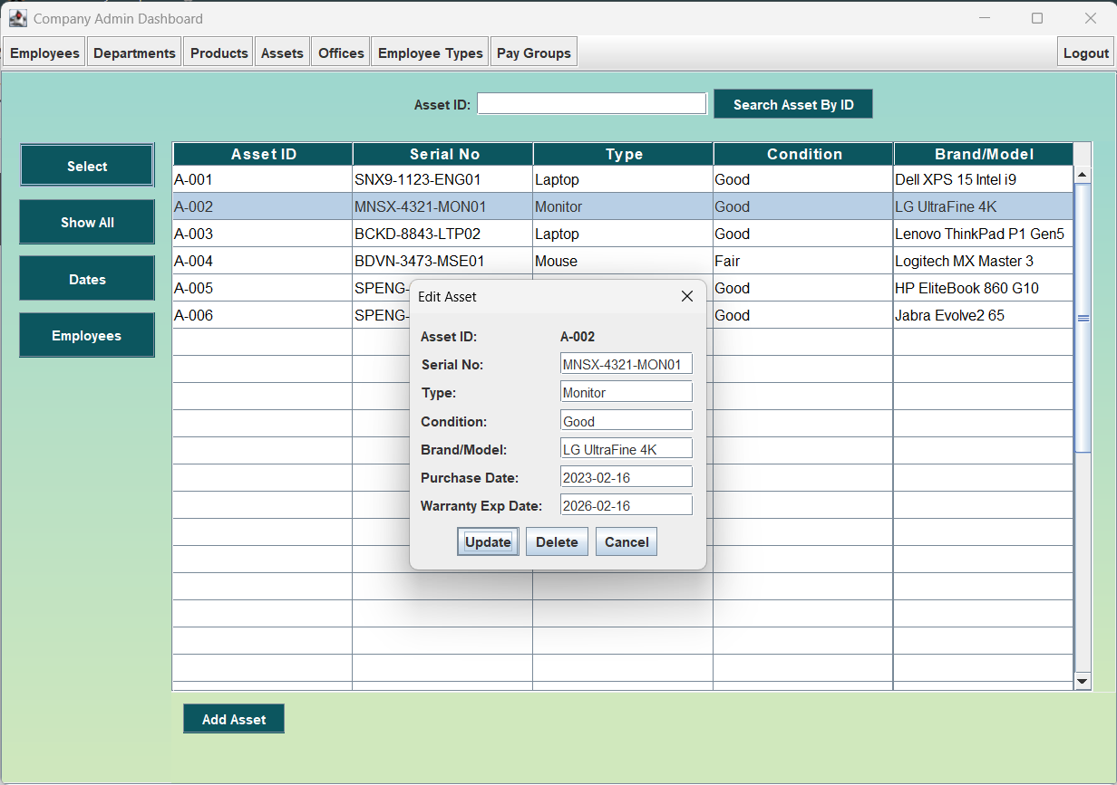
MySequel Solutions

Slide 9
Demo

