Slide 1
PROJECT
TOPIC:
SHOPPING WEBSITE
BY
ADITYA

Slide 2
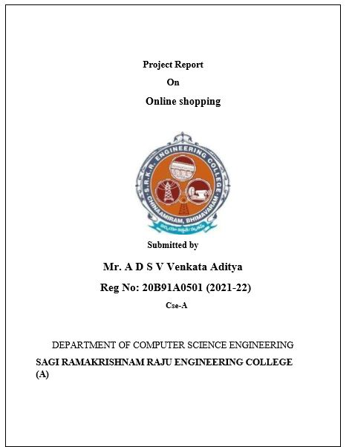
Shopping website

Slide 3
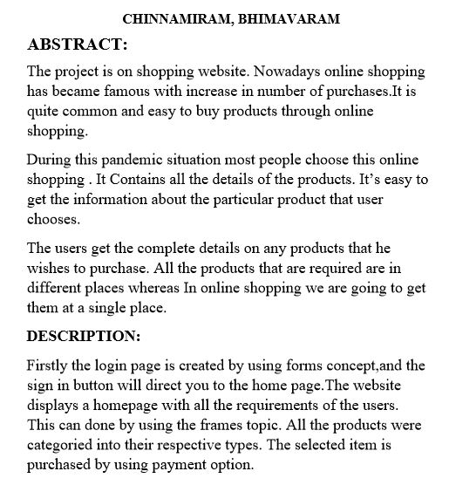

Slide 4
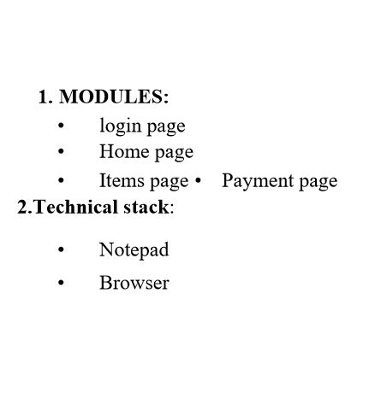

Slide 5
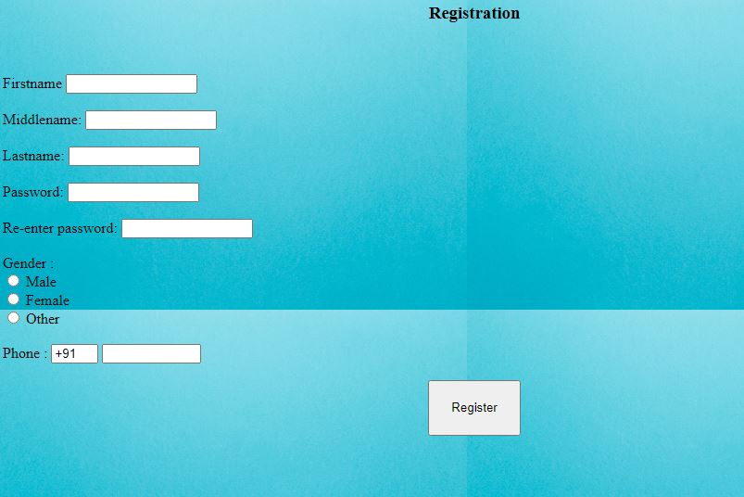
REGISTRATION PAGE

Slide 6
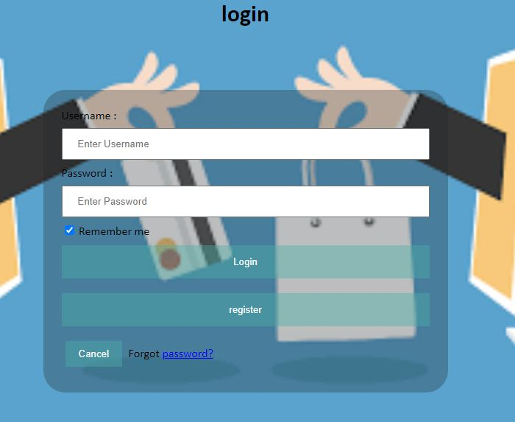
LOGIN PAGE

Slide 7

HOME PAGE-1

Slide 8
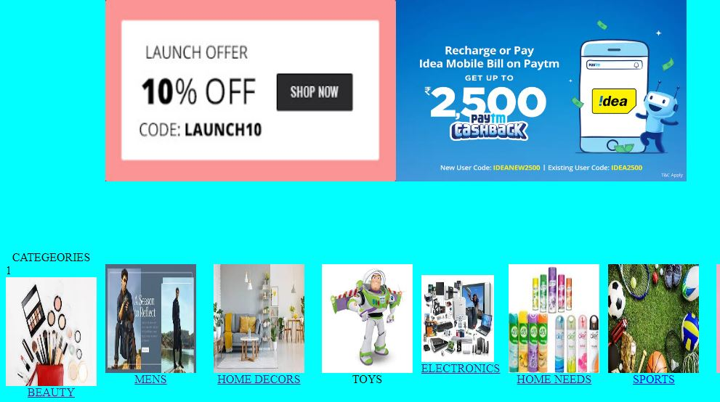
Home page-2

Slide 9
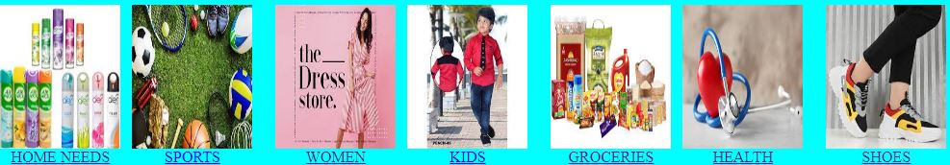
categeories

Slide 10
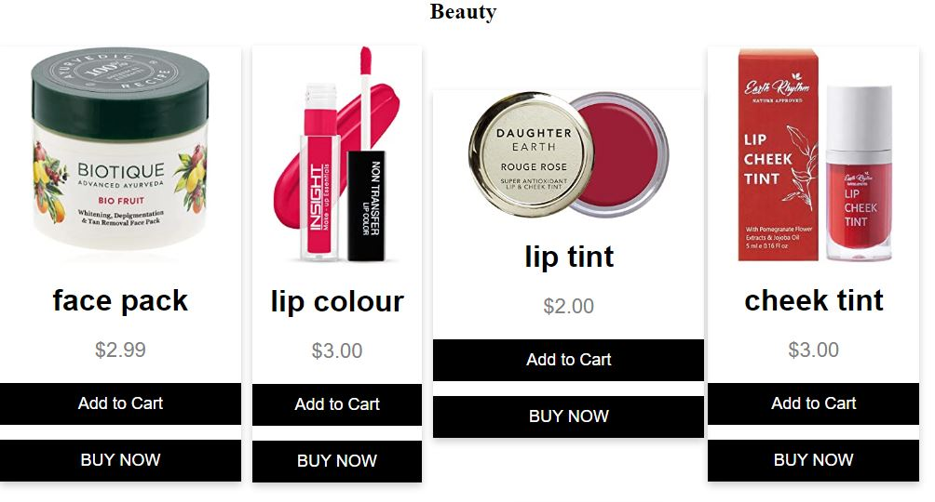
cosmetics

Slide 11
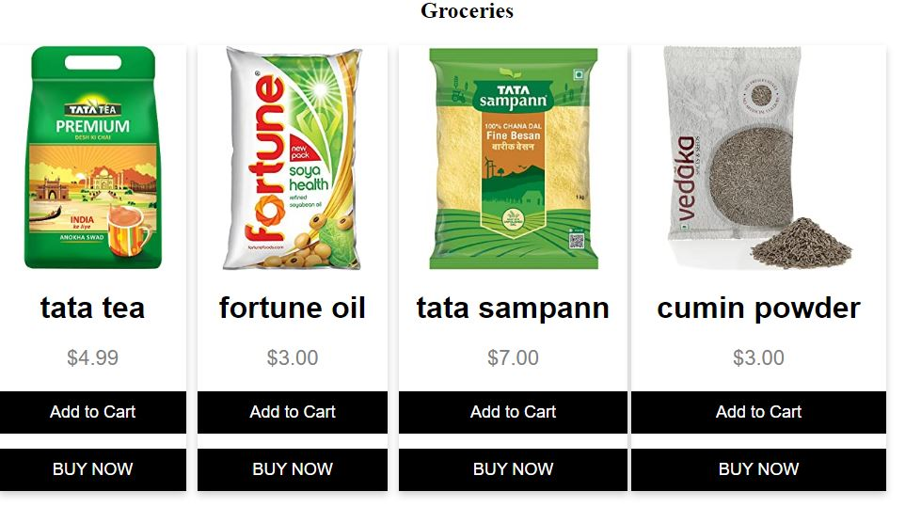
Groceries

Slide 12
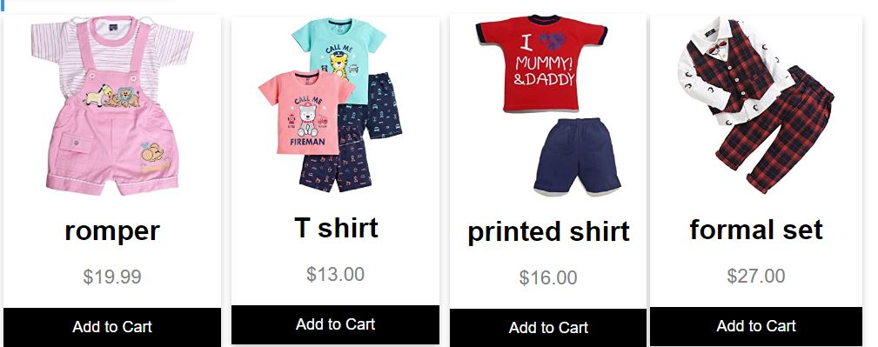
kidswear

Slide 13
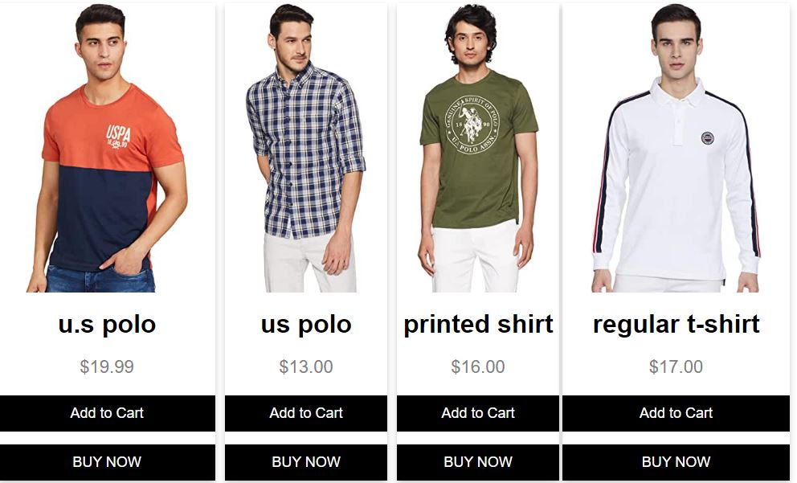
menswear

Slide 14
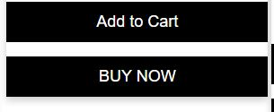
buy

Slide 15
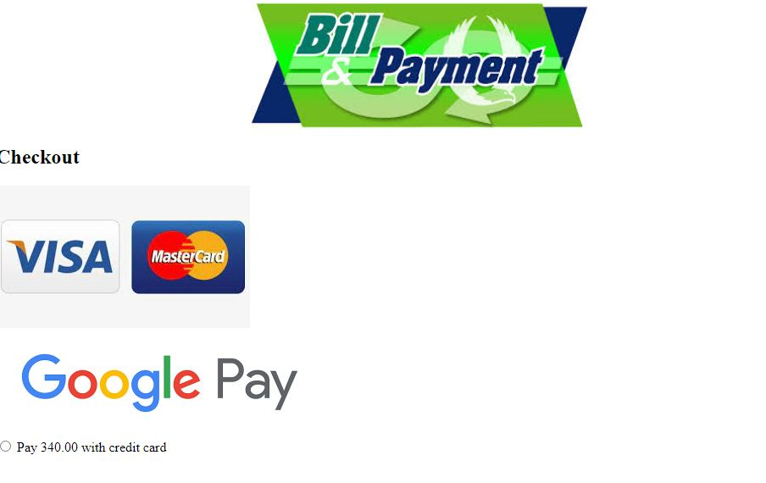
Payment page-1

Slide 16
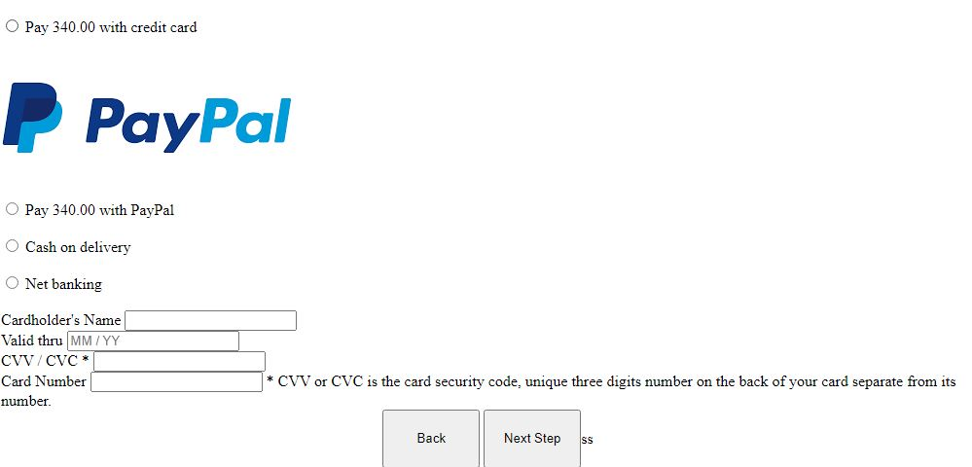
Payment page-2

Slide 17

successfull

Slide 18
Thank You

