Slide 1

Pre-Trained Model Trade-Off Analysis
Name: Sai Kishore Addala Course: Artificial Intelligence **Artifact 10: Pre-Trained Models Decision Matrix

Slide 2
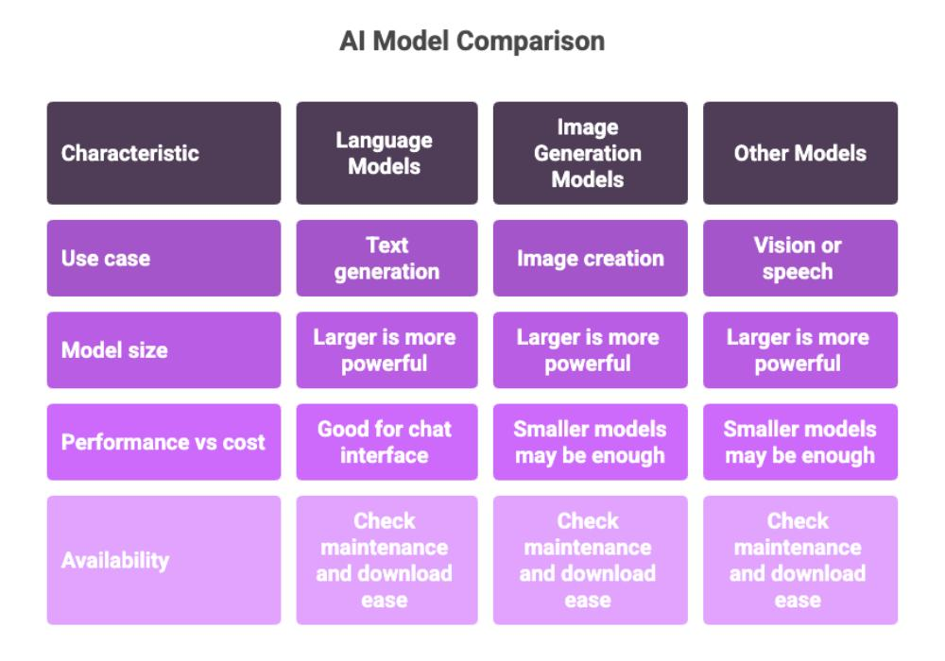
Why Model Selection Matters
Organizations use different AI models depending on their requirements.
When selecting a model, engineers must balance:
Accuracy
Speed
Model Size
Energy Consumption
Hardware Requirements
Explainability
Large Models
↓
Higher Accuracy
↓
Higher Cost
↓
Slower Speed
Small Models
↓
Lower Cost
↓
Faster Speed
↓
Easy Deployment

Slide 3

Selected Pre-Trained Models
NLP / Generative AI
BERT
Developed by Google
110 Million Parameters
Excellent for text classification
GPT-4
Advanced Generative AI
Trillions of parameters (estimated)
Excellent language generation
Computer Vision
MobileNetV3
Lightweight CNN
Designed for mobile devices
EfficientNet-B0
Balanced speed and accuracy
Tabular Data
LightGBM
Fast gradient boosting
XGBoost
Industry-leading tabular model

Slide 4
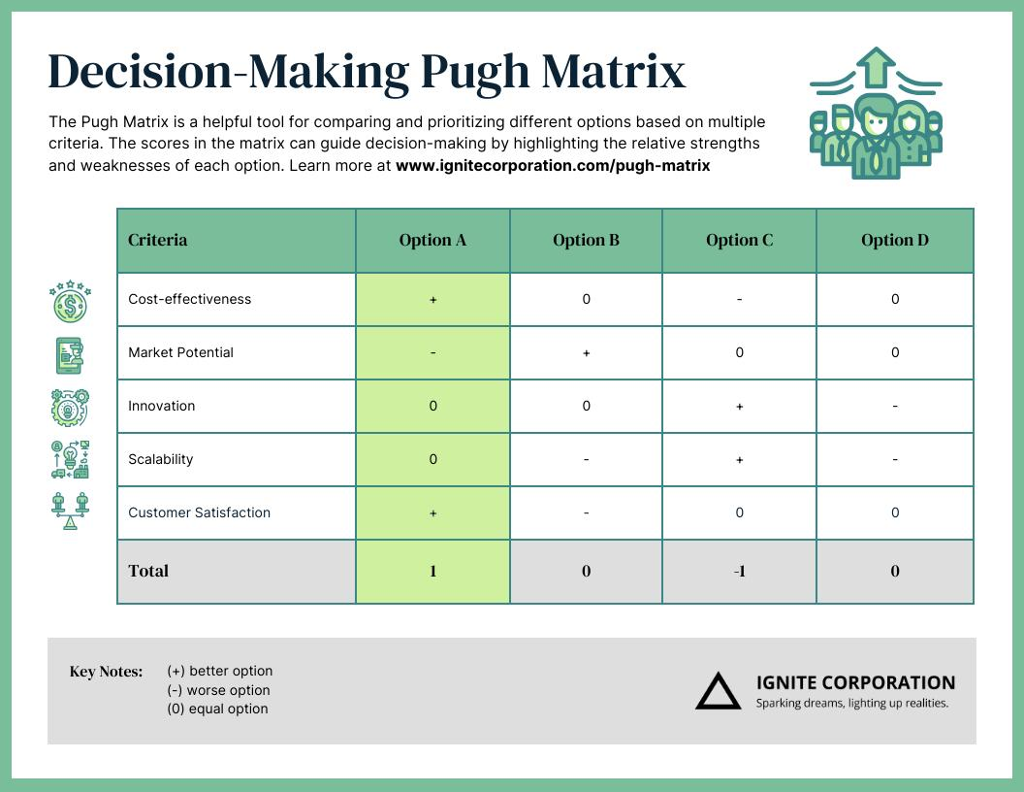
DECISION MATRIX
Model | Domain | Size | Accuracy | Speed | Explainability
BERT | NLP | Medium | High | Medium | Medium
GPT-4 | Generative AI | Very Large | Very High | Slow | Low
MobileNetV3 | Vision | Small | Good | Very Fast | Medium
EfficientNet-B0 | Vision | Small-Medium | High | Fast | Medium
LightGBM | Tabular | Small | High | Very Fast | High
XGBoost | Tabular | Medium | Very High | Fast | High

Slide 5
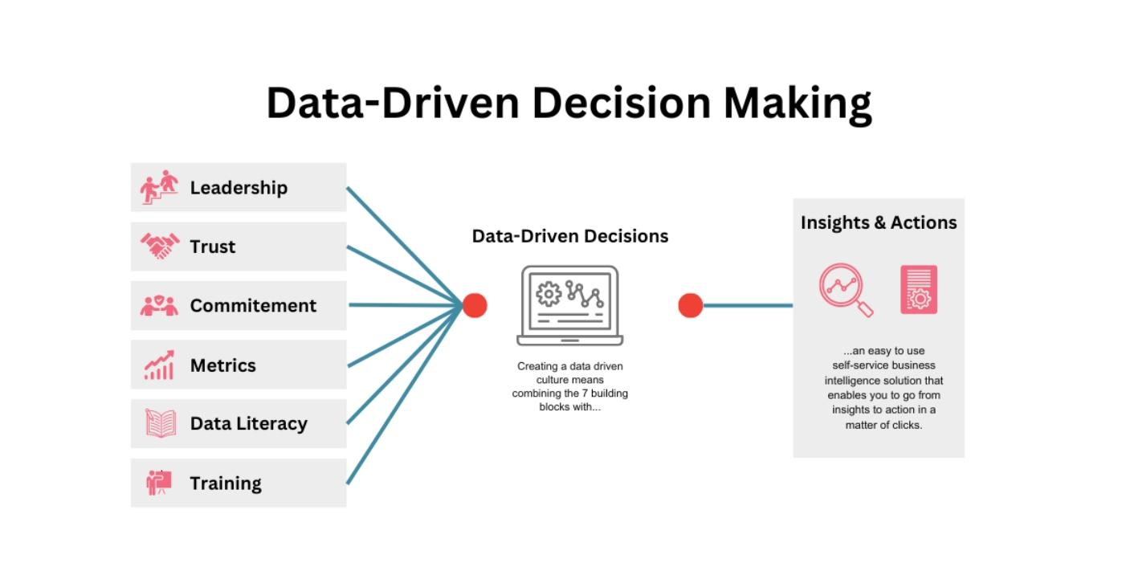
ANALYSIS AND RECOMMENDATIONS
Strengths and Recommendations
GPT-4
Strengths
Best language generation
Strong reasoning
Weaknesses
Expensive
Slow inference
Low explainability
Recommended for:
Chatbots
Content generation
Virtual assistants
BERT
Strengths
Strong language understanding
Lower cost than GPT
Recommended for:
Classification
Sentiment analysis
MobileNetV3
Strengths
Very fast
Small size
Recommended for:
Smartphones
Edge AI
EfficientNet-B0
Strengths
Balanced performance
Recommended for:
LightGBM and XGBoost
Strengths
Excellent for structured data
High interpretability
Recommended for:
Finance
Healthcare
Fraud detection

Slide 6

Key Findings ✔ No single model is best for every task. ✔ Larger models provide better accuracy but require more resources. ✔ Smaller models offer faster deployment and lower cost. ✔ Explainability remains critical in regulated industries. ✔ Model selection should balance performance, cost, speed, and transparency.
CONCLUSION
Task | Recommended Model
Chatbot | GPT-4
Text Classification | BERT
Mobile Vision | MobileNetV3
Image Classification | EfficientNet-B0
Structured Data Analytics | LightGBM
Business Prediction Models | XGBoost

