Slide 1

Explainable AI (XAI): Transparency, Validation, and Trust in Large Language Models
Sai Kishore Addala
MS Computer Information Systems – Artificial Intelligence

Slide 2
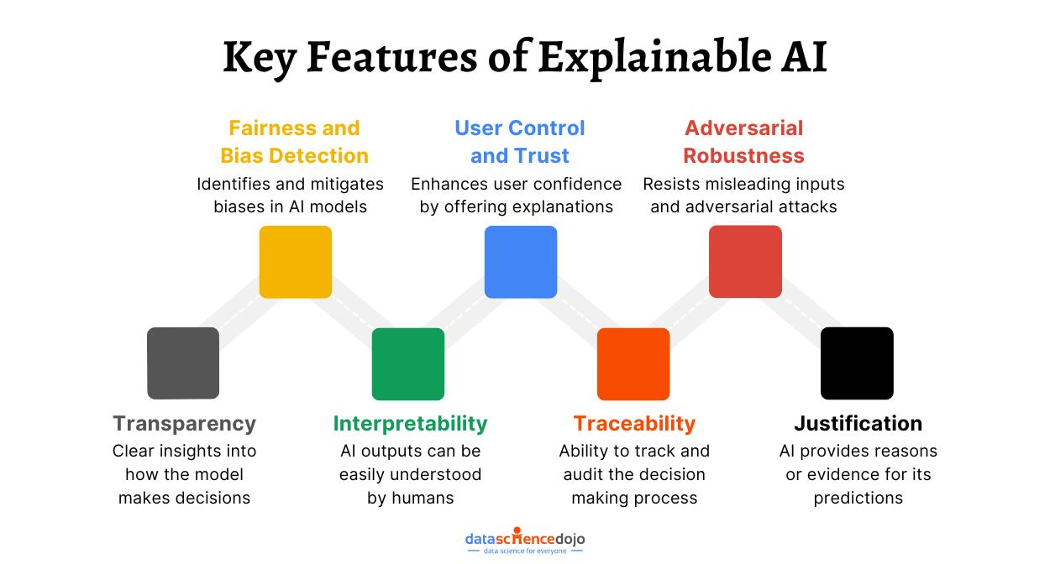
WHY EXPLAINABLE AI MATTERS
Explainable Artificial Intelligence (XAI) refers to methods and techniques that make AI systems understandable and transparent to humans. XAI helps users understand how AI models make decisions and predictions.
Why Explainability Matters
• Builds trust in AI systems
• Improves accountability and fairness
• Helps identify errors and bias
• Supports regulatory compliance
• Encourages responsible AI adoption
Real-World Applications
Healthcare: Explaining medical diagnoses and treatment recommendations.
Finance: Understanding loan approvals and fraud detection decisions.
Legal Systems: Supporting fair and transparent decision-making.

Slide 3

Challenges in Explainability
Large language models such as GPT, Claude, Gemini, and LLaMA are powerful but difficult to interpret. Their decision-making processes are often hidden within billions of parameters.
Key Challenges
Black Box Nature AI models often produce outputs without clearly showing how decisions were made.
Model Complexity Decisions emerge from complex interactions across many layers and parameters.
Bias in Training Data Models may inherit biases, inaccuracies, and imbalances from training datasets.
Post-Hoc Explanations Generated explanations may not accurately reflect the model’s true reasoning process.
Regulatory Concerns Organizations must increasingly justify AI decisions to meet ethical and legal requirements.

Slide 4
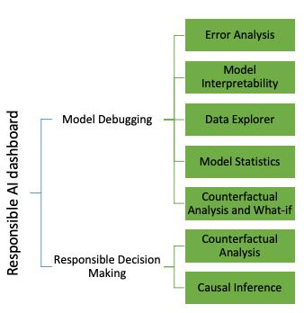
Current Solutions and Explainability Techniques
Researchers and technology companies are developing methods to improve AI transparency and trustworthiness.
Attention Visualization
Highlights which words or inputs have the greatest influence on model outputs.
Chain-of-Thought Prompting
Encourages step-by-step reasoning to make responses easier to understand.
Model Probing
Examines internal representations to better understand what the model has learned.
Explainability Dashboards
Provide visual tools that help users analyze and interpret AI behavior.
Industry Efforts
OpenAI: Reasoning models, safety evaluations, and transparency research.
Google: Model Cards and interpretability studies.
Meta: LLaMA transparency and open research initiatives.
Anthropic: Constitutional AI and alignment-focused research.

Slide 5
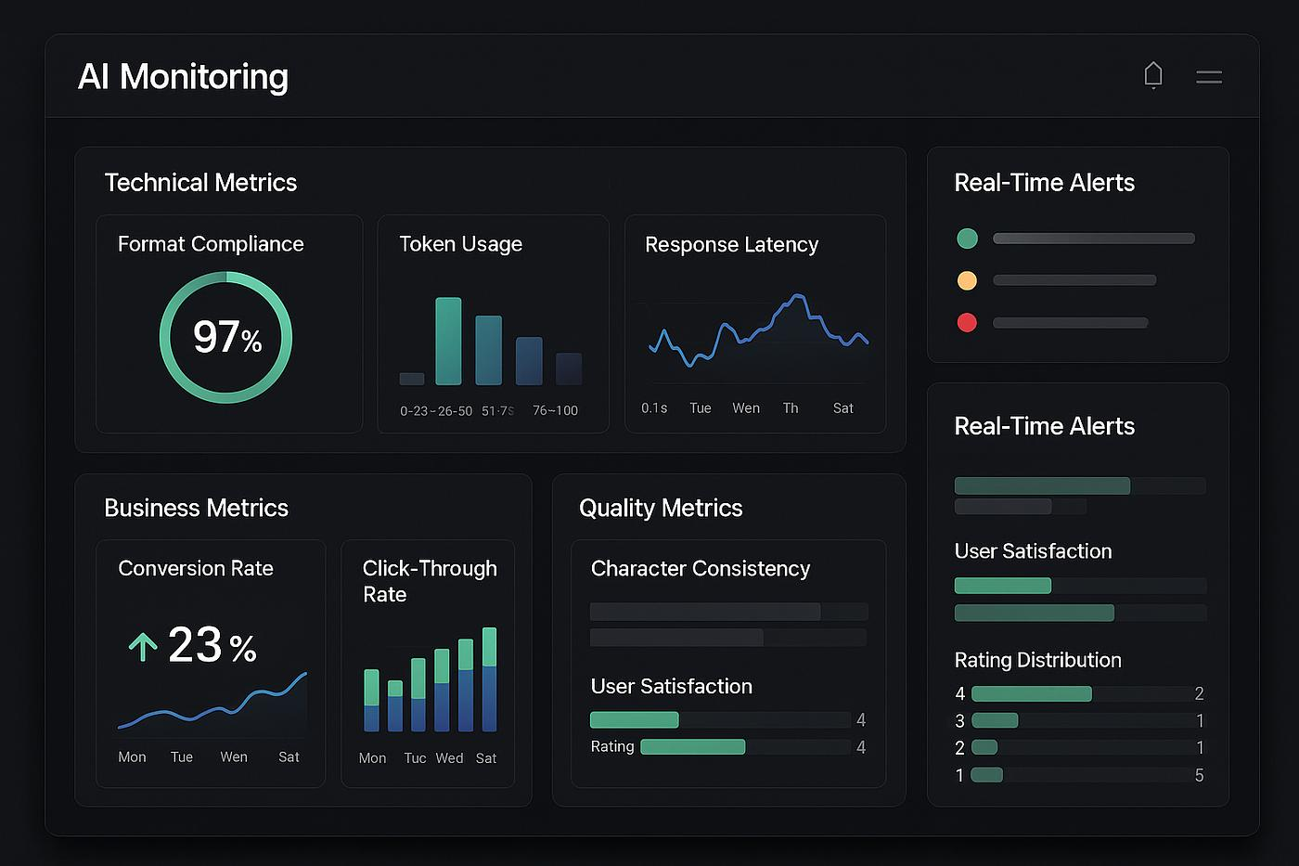
Validation and Performance Metrics
Validation and performance metrics are essential for evaluating the reliability, fairness, and effectiveness of AI systems.
Common Performance Metrics
Accuracy: Measures the percentage of correct predictions.
Precision: Measures how many predicted positive results are actually correct.
Recall: Measures how many relevant results were successfully identified.
F1 Score: Provides a balance between precision and recall.
Hallucination Rate: Measures how often AI generates false or misleading information.
Why Validation Matters
• Detects errors and weaknesses
• Improves reliability and consistency
• Supports accountability
• Builds user trust
• Enhances overall model performance
Conclusion
Explainability + Validation + Performance Metrics = Trustworthy AI
Transparent and well-validated AI systems improve trust, accountability, and responsible adoption across healthcare, finance, legal services, and many other industries.

