Slide 1
PlanetDEfense
Csce3513 Team 6 game Project – Spring2012

Slide 2
Description:
PlanetDefense will be a 2D game where the player flies a space ship just outside of the atmosphere and must shoot down asteroids that are falling towards Earth. The earth will have a health bar displayed and if too many asteroids hit the planet the health will be depleted and the game will be over.
Possible enhancements include:
Enemy ships in addition to the asteroids
Facebook login integration and high scores maintained online
Choosing your ship
Progression through levels
Earning points earns you ‘currency’ to purchase upgrades

Slide 3
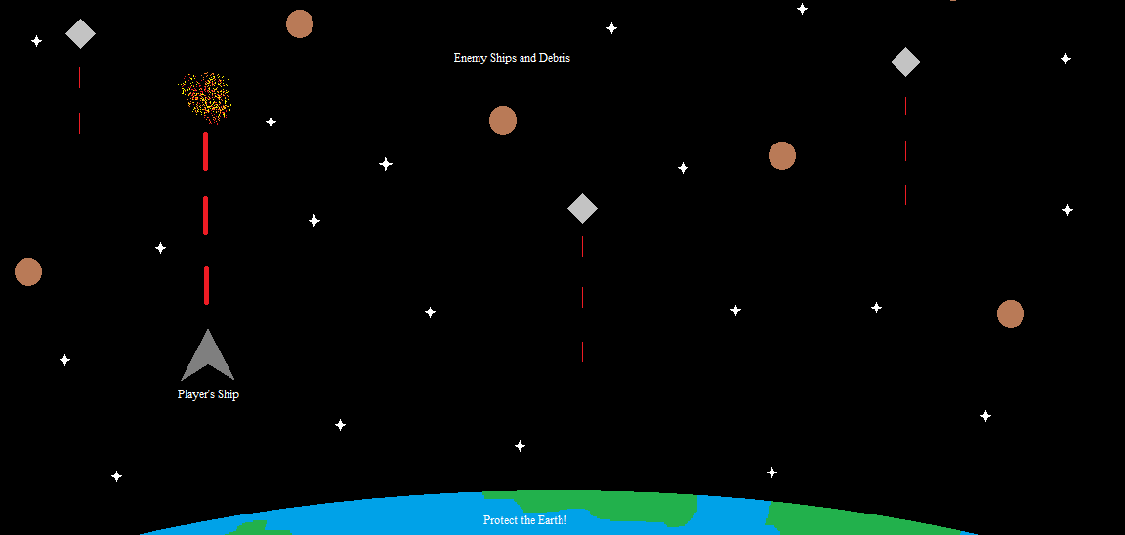
Initial View design:

Slide 4


Platform and Libraries:
Ruby Programming Language (Multiplatform)
Gosu 2D Game Development Library
RSpec
Ruby Testing Framework

Slide 5
Release License:
The MIT License (MIT) Copyright (c) 2012
Permission is hereby granted, free of charge, to any person obtaining a copy of this software and associated documentation files (the "Software"), to deal in the Software without restriction, including without limitation the rights to use, copy, modify, merge, publish, distribute, sublicense, and/or sell copies of the Software, and to permit persons to whom the Software is furnished to do so, subject to the following conditions:
The above copyright notice and this permission notice shall be included in all copies or substantial portions of the Software.
THE SOFTWARE IS PROVIDED "AS IS", WITHOUT WARRANTY OF ANY KIND, EXPRESS OR IMPLIED, INCLUDING BUT NOT LIMITED TO THE WARRANTIES OF MERCHANTABILITY, FITNESS FOR A PARTICULAR PURPOSE AND NONINFRINGEMENT. IN NO EVENT SHALL THE AUTHORS OR COPYRIGHT HOLDERS BE LIABLE FOR ANY CLAIM, DAMAGES OR OTHER LIABILITY, WHETHER IN AN ACTION OF CONTRACT, TORT OR OTHERWISE, ARISING FROM, OUT OF OR IN CONNECTION WITH THE SOFTWARE OR THE USE OR OTHER DEALINGS IN THE SOFTWARE.

Slide 6
Tasks for initial Alpha release:
Admin
Ideate and document user stories for remainder of game development
Input stories into Github Issues and assign to milestones
Plan initial sprint
Coding
Game initializes
Background image loads
Ship loads
Ship inputs x and y movement on view

Slide 7
Task Assignments
Initial assignments:
Denton: Wireframes and mockups
Addam/Michael: Coding tasks 1 & 2 from previous slide
Denton/Bryan: Coding tasks 3 & 4 from previous slide
Further tasks & user stories will be inputted and assigned in Github Issues.
Time Frame:
1 week per pair assignment

Slide 8
Meetings To Date:
Date | Mode | Attended
Tuesday, 24 Jan 12 | In person | Entire Team
Thursday, 26 Jan 12 | In person | Entire Team
Saturday, 28 Jan 12 | GoogleTalk | Entire Team

