Slide 1
PlanetDEfense V0.3.0
Csce3513 Team 6 game Project – Spring2012

Slide 2
User Stories:
Levels - As a user, I want to be able to progress through a series of levels.
Timed Scoring - As a user, I want to beat a level by surviving for a set amount of time.
Enhanced Options - As a user, I want to be able to change difficulty and volume settings.
Credit Screen - As a user, I want to be able to see information about the game's creation
on the credits screen.
Alternate Fire - As a user, I want to be able to periodically use an alternate firing mode to clear several
asteroids at once.
Performance - As a user, I want the game to run smoothly.

Slide 3
TDD-ing
Followed Test-Driven Development for all major changes
Options
Media Loader
Credits
Alternate Fire
For some small changes, TDD was not useful. For example, tests for checking that the correct amount of lasers were fired during alternate fire was easy, but testing for how the lasers should spread out was difficult using automated testing. It was much easier to test the spread of the lasers in-game.

Slide 4
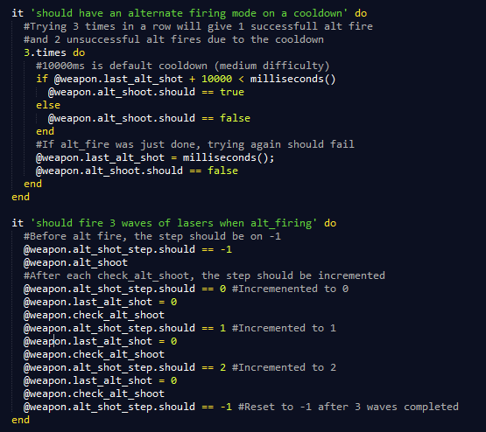
Unit testing – Updated weapon_spec for alternate firing

Slide 5
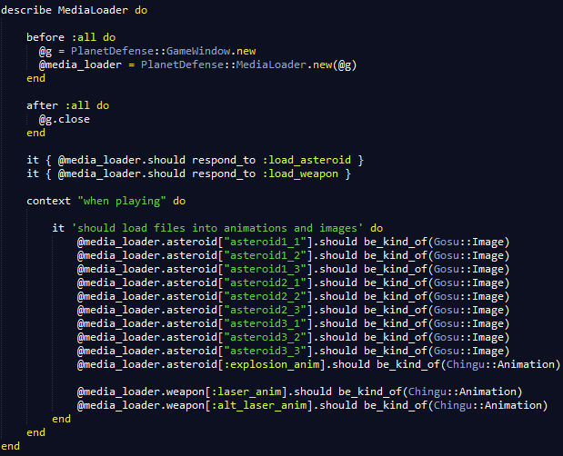
Unit testing - Simple testing for media_loader

Slide 6
DEMO

Slide 7
Current status of game
Nearly all of the features we originally wanted to implement for the game are done. We are now just polishing things and writing more tests.

Slide 8
Team meetings
Regular meetings every Tuesday
April 2nd - Campfire Group Chat
April 3rd - In Person
April 4th - In Person
Several short Google Talk chats while working individually to get help from other group members

Slide 9
Planning for next release
As a user, I want to be able to create a player profile.
Allow making a player profile
Save settings and scores based on currently active profile
As a user, I want to be able to view a high score list.
Read scores from all player profiles and sort in descending order (global high score list)
Read scores from individual player's profile (personal high score list)
As a user, I want to be able to grab power-ups floating around the game.
Change alternate fire from timed to power-up based
Possibly add other power-up abilities, like a shield or upgraded weapon
As a user, I want to be able to enter cheat codes.
Star Trek ship easter egg
Add codes for god mode, no weapon heat-up, etc.

Slide 10
Questions?

