Slide 1
PlanetDEfense V0.1.0
Csce3513 Team 6 game Project – Spring2012

Slide 2
User Stories:
As a user, I want to hear background music while playing and be able to adjust the volume
As a user, in order to destroy asteroids, my lasers need to make asteroids explode.
As a user, in order to beat the level, I need to destroy all asteroids in a given time period.
As a user, in order to lose the game, I need to die when I collide with an asteroid.
As a user, in order to shoot asteroids, my space ship needs to be able to shoot lasers
As a user, in order to lose the game, the game needs to be over when I run out of lives.
As a user I want [un]pause the game by pressing P
As a user, in order to play the game, the game needs to initialize after I start it
As a user, in order to play the game, my space ship needs to move vertically and horizontally on a 2 dimensional plane
Planned Stories: 12 Completed Stories: 9

Slide 3
Unit testing – Game Window
PlanetDefense::GameWindow
should respond to #close
should respond to #fps
should respond to #update
should respond to #draw
should respond to #root
should respond to #game_state_manager
should respond to #factor
should respond to #cursor
should respond to #root
should respond to #milliseconds_since_last_tick
Window should be initialized
Window should have correct dimensions
Window should automatically have current version number in caption

Slide 4
Unit testing – Player Object
PlanetDefense::Player
should respond to #draw
should collide with asteroids
should shoot lasers (FAILED - 1)
when initialized
should be at bottom middle of screen
when playing
should move left across the screen on command
should move right across the screen on command
should move up the screen on command
should move down the screen on command
should not exceed the left boundary
should not exceed the right boundary
should not exceed the top boundary
should not exceed the bottom boundary
should not exceed player max velocities

Slide 5
Unit testing – Current FAILURES
Failures:
1) PlanetDefense::Player should shoot lasers
Failure/Error: Laser.all.length.should > 0
expected: > 0
got: 0
# ./spec/lib/player_spec.rb:129:in `block (2 levels) in <module:PlanetDefense>'
Finished in 0.30494 seconds
26 examples, 1 failure
Failed examples:
rspec ./spec/lib/player_spec.rb:127 # PlanetDefense::Player should shoot lasers

Slide 6
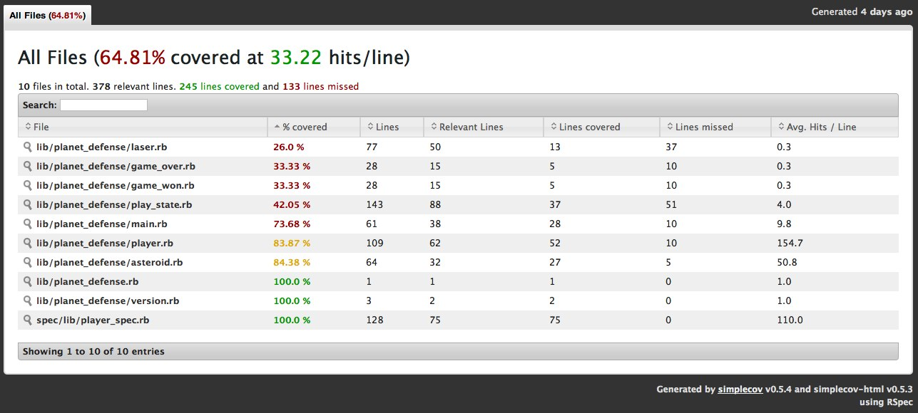
Unit testing – Coverage
64.81% covered at 33.22 hits/line

Slide 7
Test Driven Development
Were we 100% test driven?

Slide 8
Test Driven Development
Were we 100% test driven?
No :(
But we tried

Slide 9
Unit testing
Show specs on Github

Slide 10
DEMO

Slide 11
Preliminary v0.2.0 Planning
Menus
Difficulty Variations
Asteroid Explosion Animations
2nd Level

Slide 12
Questions? Adorations?

