Slide 1
PlanetDEfense V0.2.0
Csce3513 Team 6 game Project – Spring2012

Slide 2
User Stories:
Planned Stories: 12 Completed Stories: 9

Slide 3
Unit testing – Game Window
PlanetDefense::GameWindow
should respond to #close
should respond to #fps
should respond to #update
should respond to #draw
should respond to #root
should respond to #game_state_manager
should respond to #factor
should respond to #cursor
should respond to #root
should respond to #milliseconds_since_last_tick
Window should be initialized
Window should have correct dimensions
Window should automatically have current version number in caption

Slide 4
Unit testing – Player Object
PlanetDefense::Player
should respond to #draw
should collide with asteroids
should shoot lasers (FAILED - 1)
when initialized
should be at bottom middle of screen
when playing
should move left across the screen on command
should move right across the screen on command
should move up the screen on command
should move down the screen on command
should not exceed the left boundary
should not exceed the right boundary
should not exceed the top boundary
should not exceed the bottom boundary
should not exceed player max velocities

Slide 5
Unit testing – Current FAILURES
Failures:
1) PlanetDefense::Player should shoot lasers
Failure/Error: Laser.all.length.should > 0
expected: > 0
got: 0
# ./spec/lib/player_spec.rb:129:in `block (2 levels) in <module:PlanetDefense>'
Finished in 0.30494 seconds
26 examples, 1 failure
Failed examples:
rspec ./spec/lib/player_spec.rb:127 # PlanetDefense::Player should shoot lasers

Slide 6
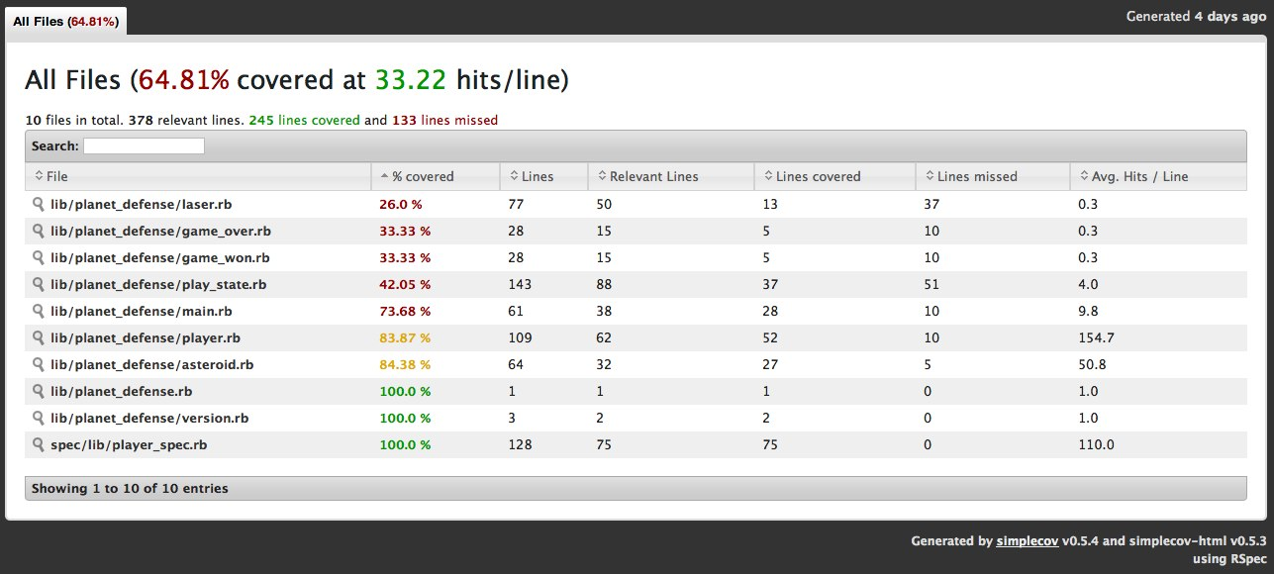
Unit testing – Coverage
64.81% covered at 33.22 hits/line

Slide 7
Unit testing
Show specs on Github

Slide 8
DEMO

Slide 9
Preliminary v0.3.0 Planning

Slide 10
Questions? Adorations?

