Slide 1
PlanetDEfense V1.0
Csce3513 Team 6 game Project – Spring2012

Slide 2
User Stories:
◦ As a user, I want to quickly learn how to play the game.
▪ “How to Play” screen
◦ As a user, I want to pick up power-ups to give bonuses to my weapons.
▪ Two types: heat reduction and extra alternate fire
◦ As a user, I want to change music and sound effect volume separately.
◦ As a user, I want the game to be polished.
▪ Ship animation based on velocity
▪ HUD improvements (alternate fire count, level timer countdown, z-order fixes)
▪ Image quality improved slightly
▪ Tweaked difficulty levels

Slide 3
TDD-ing
◦ Followed TDD for major features:
▪ Volume settings
▪ Power-Ups
▪ Player class changes
◦ Smaller changes did not require additional testing, for example:
▪ Alternate Fire HUD item - code is very similar to tested laser heat gauge code
▪ Help screen – uses only existing game objects (tested by ourselves) and GosuLib objects
(tested by authors of GosuLib)
▪ Tweaking difficulty levels – playing the game was the best way to test this

Slide 4
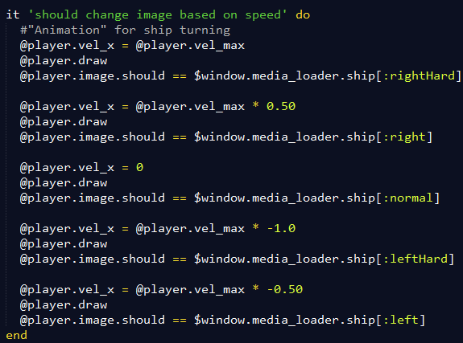
Unit testing – Player animation based on x-velocity:

Slide 5
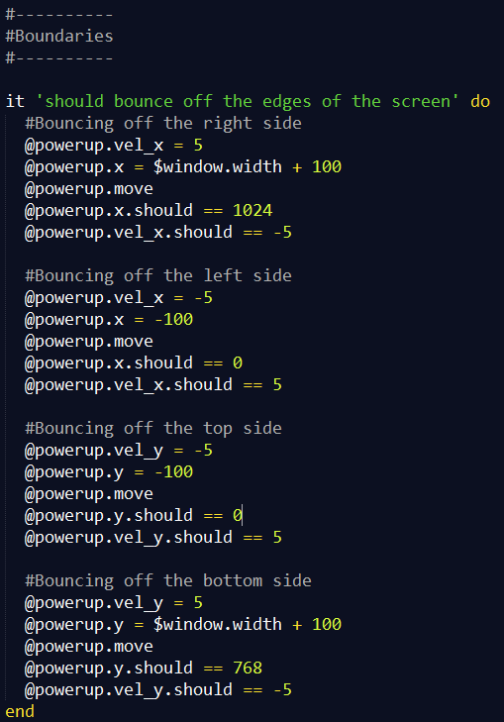
Unit testing - Power-Up bouncing off edges of the screen

Slide 6
Meetings
◦ Every Tuesday after class
◦ April 30 – worked on final presentation
◦ Several short Google Talk chats while working individually to get help from team members

Slide 7
DEMO

Slide 8
Questions?

