Slide 1
Classification: Basic Concept 8.5 ~ 8.6
조성운

Slide 2
목차
Metrics for Evaluating Classifier Performance
Holdout Method and Random Subsampling
Cross-Validation
Bootstrap
ROC Curve
Introducing Ensemble Methods
Voting
Bagging
Boosting and AdaBoost
Random Forest
Improving Classification Accuracy of Class-Imbalanced Data

Slide 3
Metrics for Evaluating Classifier Performance
Terminolopgy
class1
class2
Positive Tuple
Negative Tuple
P(Positive tuples) : the number of positive tuples
N(Negative tuples) : the number of negative tuples
T(True) : Correctly predicted by the classifier.
F(False) : Incorrectly predicted by the classifier.

Slide 4
Metrics for Evaluating Classifier Performance
Terminolopgy
TP(True positives) : These refer to the positive tuples that were correctly predicted by the classifier.
TN(True negatives) : These are the negative tuples that were correctly predicted by the classifier.
FP(False positive) : These are the negative tuples that were incorrectly predicted by the classifier.
FN(False negative) : These are the positive tuples that were incorrectly predicted by the classifier.

Slide 5
Metrics for Evaluating Classifier Performance
Confusion matrix
The confusion matrix is a useful tool for analyzing how well classifier can recognize tuples of different classes.
TP and TN tell us when the classifier is getting things right, while FP and FN tell us when the classifier is getting things wrong
Total
Predicted class
P(TP+FN) : 실제 positive tuple 개수
N(FP+TN) : 실제 Negative tuple 개수
P’(TP+FP) : Positive tuple로 예측된 개수
N’(FN+TN) : Negative tuple로 예측된 개수
 | Yes | No
Yes | TP | FN
No | FP | TN
Actual class
Total number of tuples
TP+TN+FP+FN
P+N
P’+N’

Slide 6
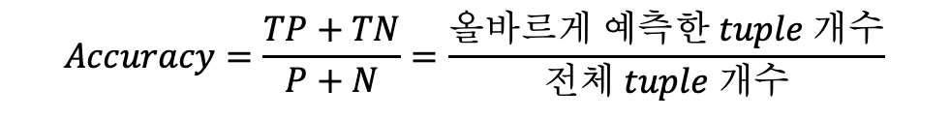
Metrics for Evaluating Classifier Performance
Accuracy
Predicted class
The percentage of test set tuples that are correctly classified by the classifier
 | Yes | No
Yes | TP | FN
No | FP | TN
$$Accuracy=\frac{TP+TN}{P+N}=\frac{올바르게 예측한 tuple 개수}{전체 tuple 개수}$$
Actual class
error rate
Predicted class
$$error rate=\frac{FP+FN}{P+N}=\frac{틀리게 예측한 tuple 개수}{전체 tuple 개수}=1−accuracy$$
 | Yes | No
Yes | TP | FN
No | FP | TN
Actual class

Slide 7
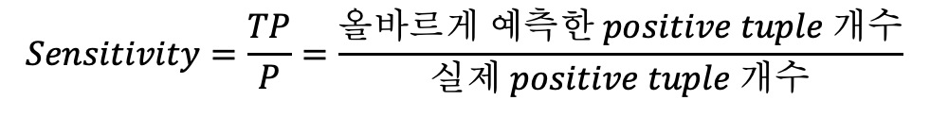
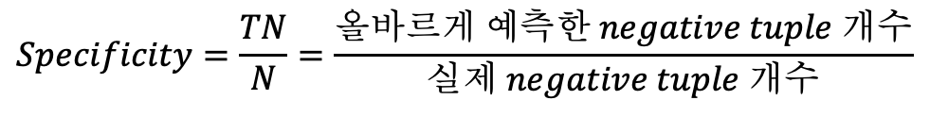
Metrics for Evaluating Classifier Performance
Sensitivity
Predicted class
The true positive rate, the propertion of positive tuples that correctly identified
 | Yes | No
Yes | TP | FN
No | FP | TN
$$Sensitivity=\frac{TP}{P}=\frac{올바르게 예측한 positive tuple 개수}{실제 positive tuple 개수}$$
Actual class
Specificity
Predicted class
The true negative rate , the proportion of negative tuples that are correctly identified
 | Yes | No
Yes | TP | FN
No | FP | TN
$$Specificity=\frac{TN}{N}=\frac{올바르게 예측한 negative tuple 개수}{실제 negative tuple 개수}$$
Actual class

Slide 8
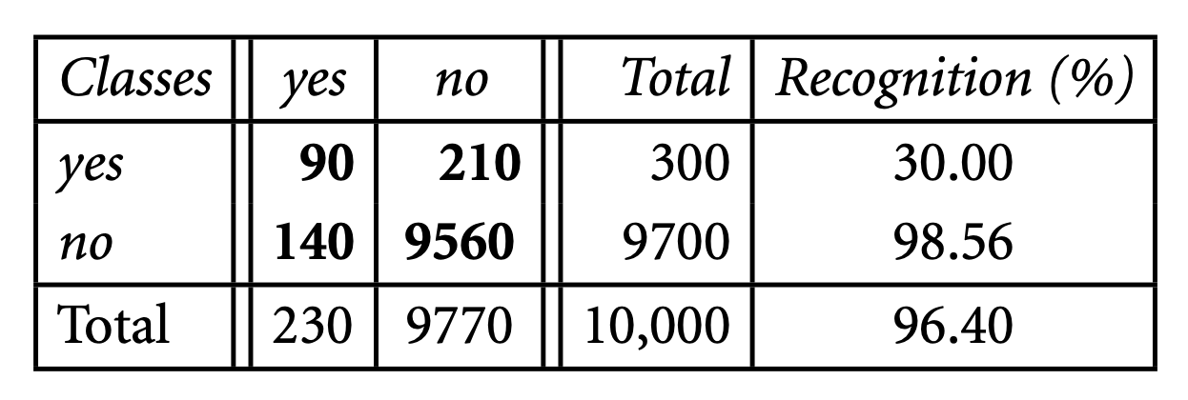
Metrics for Evaluating Classifier Performance
Class imbalance problem
The classes cancer = yes, cancer = no.
Sensitivity
Specificty
Accuracy
Accuracy는 class imbalance한 경우 각각 클래스 인식률을 모두 반영하지 못한다.

Slide 9
Metrics for Evaluating Classifier Performance
Precision
Predicted class
 | Yes | No
Yes | TP | FN
No | FP | TN
$$precision=\frac{TP}{TP+FP}=\frac{올바르게 예측한 positive tuple의 개수}{positive tuple로 예측한 개수}$$
Actual class
Recall
Predicted class
$$recall=\frac{TP}{TP+FN}=\frac{올바르게 예측한 positive tuple의 개수}{실제 positive tuple의 개수}$$
 | Yes | No
Yes | TP | FN
No | FP | TN
Actual class

Slide 10

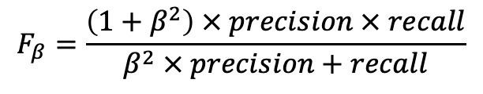

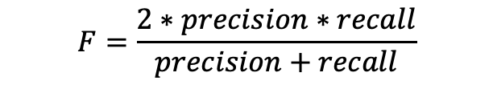
Metrics for Evaluating Classifier Performance
$F$-measure
$F_{β}$ measure
The harmonic mean of precision and recall
A weighted measure of precision and recall
$$F_{β}=\frac{\left(1+β^{2}\right) × precision × recall}{β^{2} × precision+recall}$$
$$F=\frac{2∗precision∗recall}{precision+recall}$$

Slide 11
Metrics for Evaluating Classifier Performance
Speed
The computational costs involved in generating and using the given classifier
Robustness
The ability of the classifier to make correct predictions given noisy data or data with missing values
Scalability
The ability to construct the classifier efficiently given large amounts of data
Interpretability
The level of understanding and insight that is provided by the classifier or predictor

Slide 12
Holdout Method and Random Subsampling
Holdout Method
Initial Data
Train Data
Test Data
The given data are randomly partitioned into two independent sets, a training set and a test set
The training set is used to derive the model
The Model’s accuracy is then estimated with the test set

Slide 13



Holdout Method and Random Subsampling
Random subsampling
Initial Data
Train Data
Test Data
$$Accuracy(M_{1})$$
k 개
Train Data
Test Data
$$Accuracy(M_{2})$$
Train Data
Test Data
$$Accuracy(M_{k})$$

Slide 14




Cross-Validation
K-fold cross-validation
K = 4 인 경우
Initial Data
Fold1
Fold2
Fold3
Fold4
$$Accuracy(M_{1})$$
Fold1
Fold2
Fold3
Fold4
$$Accuracy(M_{2})$$
Fold1
Fold2
Fold3
Fold4
$$Accuracy(M_{3})$$
Fold1
Fold2
Fold3
Fold4
$$Accuracy(M_{4})$$

Slide 15
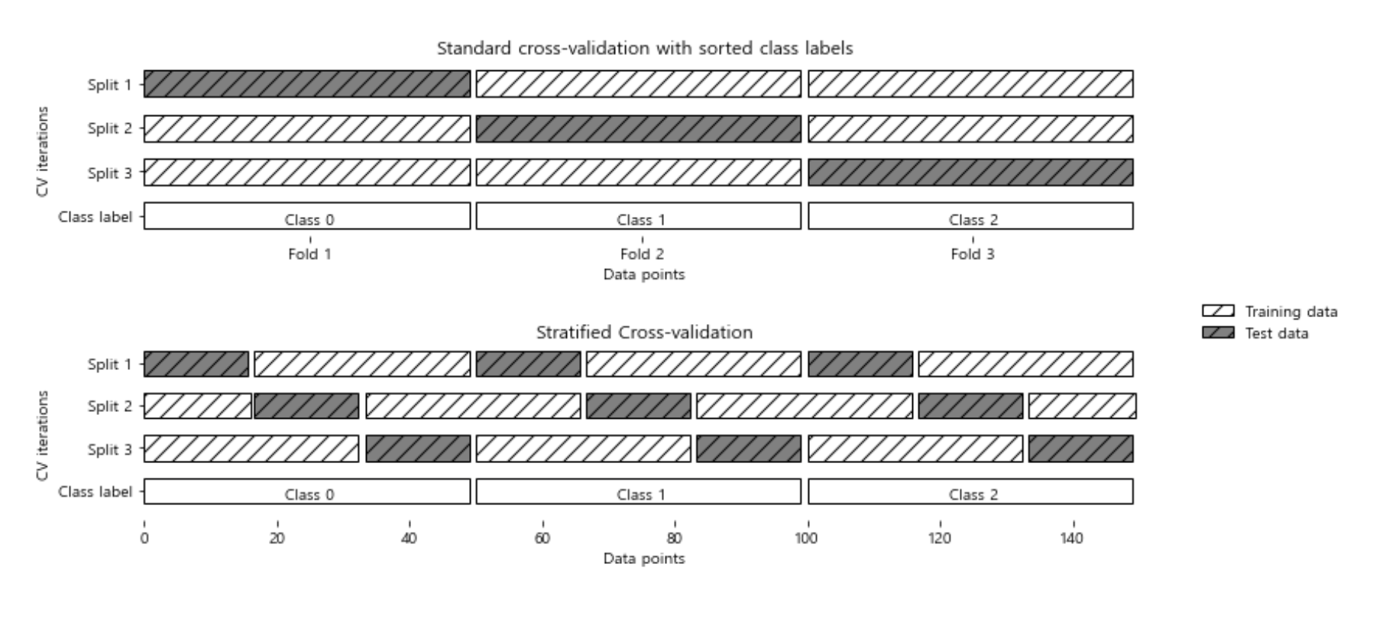
Cross-Validation
Stratified k-fold cross-validation
Initial Data
[0, 0, 0, 0, 0, 0, 1, 1, 1, 1, 1, 1, 2 ,2 ,2 ,2 ,2 ,2]
K=3
[0, 0, 0, 0, 0, 0, 1, 1, 1, 1, 1, 1, 2 ,2 ,2 ,2 ,2 ,2]

Slide 16
Cross-Validation
Leave-one-out
K = sample의 개수 인 경우의 k-fold cross validation

Slide 17
Bootstrap
Samples the given training tuples uniformly with replacement
The data tuples that did not make it into the training set end up forming the test set
데이터 양을 늘리고,
분포를 균등하게 만들 수 있다.

Slide 18
Initial Data
tuple1
tuple2
tuple3
tuple4
tuple5
tuple6
tuple7
tuple8
tuple9
tuple10
Bootstrap1
tuple8
tuple6
tuple2
tuple9
tuple5
tuple8
tuple1
tuple4
tuple8
tuple2
tuple3
tuple7
tuple10
Bootstrap2
tuple10
tuple1
tuple3
tuple5
tuple1
tuple7
tuple4
tuple2
tuple1
tuple8
tuple6
tuple9
Bootstrap3
tuple6
tuple5
tuple4
tuple1
tuple2
tuple4
tuple2
tuple6
tuple9
tuple2
tuple3
tuple7
tuple8
tuple10
Training Data
Test Data

Slide 19
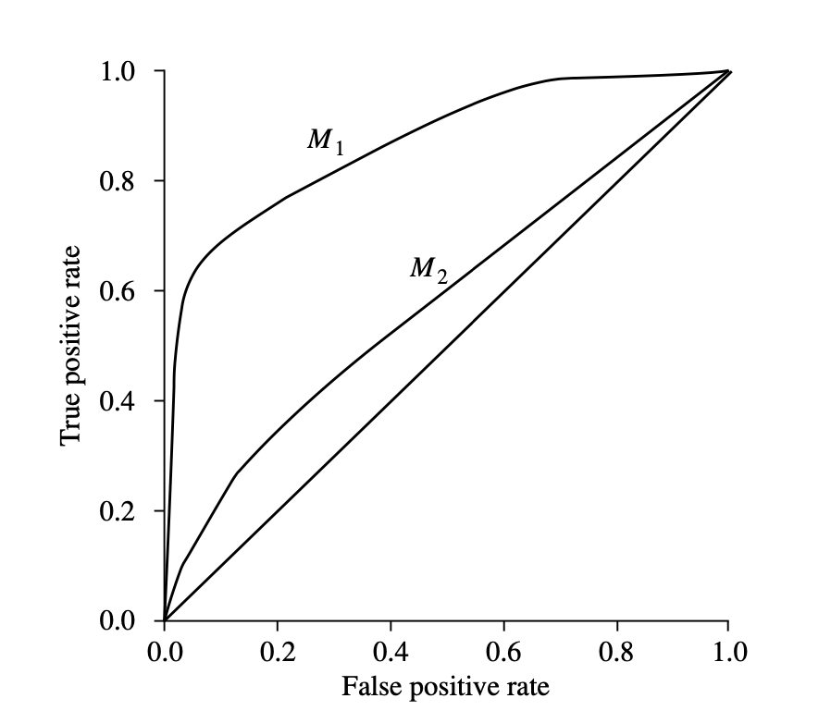
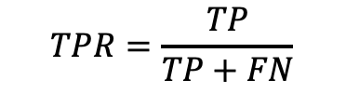
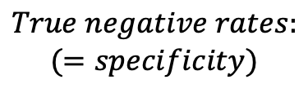
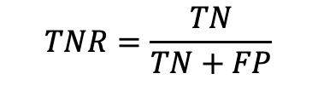
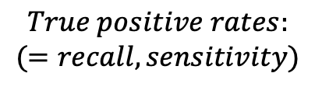
ROC Curve
An ROC curve for a given model shows the trade-off between the true positive rate(TPR) and the false positive rate(FPR)
$$True positive rates:$$
$$(=recall, sensitivity)$$
$$TPR=\frac{TP}{TP+FN}$$
$$True negative rates:$$
$$(=specificity)$$
$$TNR=\frac{TN}{TN+FP}$$
AUC(Area Under the Curve) 면적이 넓을 수록 좋은 성능!!

Slide 20
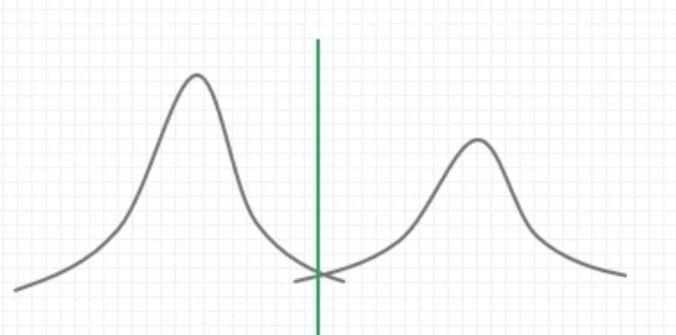
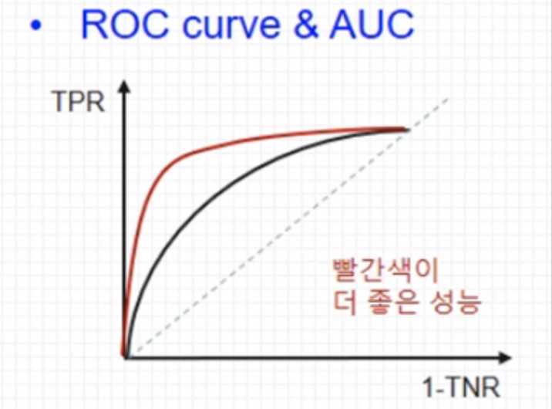
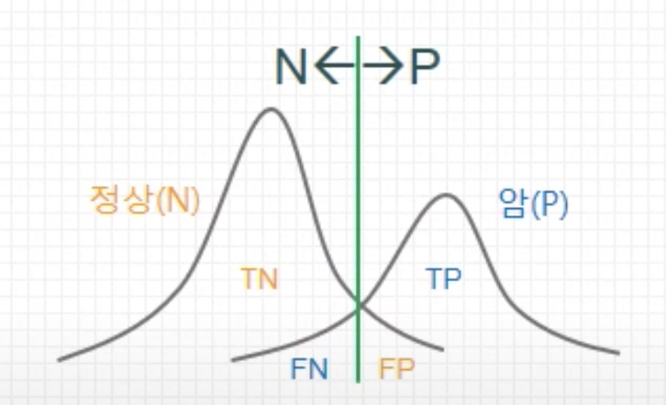




$$M_{1}$$
$$M_{1}$$
$$M_{2}$$
$$M_{2}$$
출처: ROC 커브 (+ AUC, Precision, Recall), Terry TaeWoong Um

Slide 21



Introducing Ensemble Methods
An ensemble for classification is a composite model, made up of a combination of classifier
The individual classifiers vote, and a class label prediction is returned by the ensemble based on the colletion of votes
$$D_{1}$$
Classifier1
voting
Bagging
Boosting
Random forests
$$D_{2}$$
Classifier2
Data
Combine votes
Prediction
$$D_{k}$$
Classifierk

Slide 22
Voting
Voting(Hard)
Class prediction
Classifier1
1
Classifier2
2
최종 예측값
Data
1
Classifier3
1
Classifier4
1

Slide 23
Bagging
Bootstrap
Class prediction
Sample1
Classifier1
1
Sample2
Classifier2
2
최종 예측값
Data
1
Sample3
Classifier3
1
Sample4
Classifier4
1

Slide 24
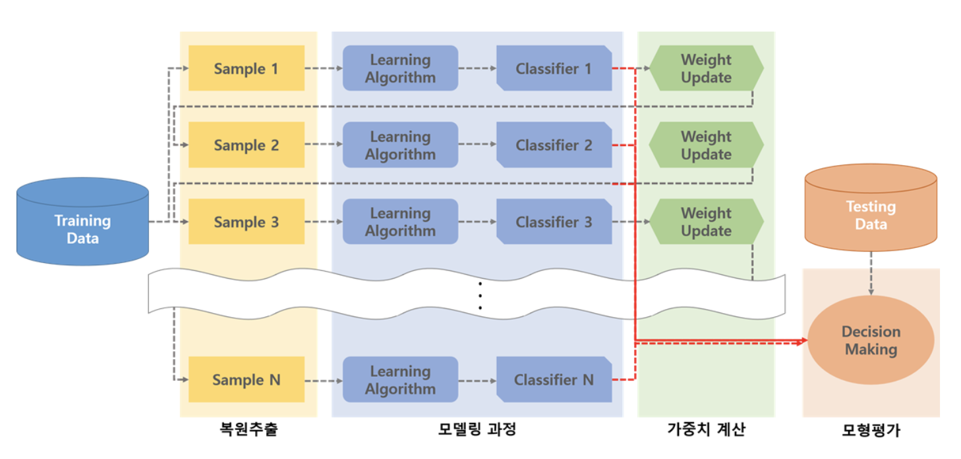
Boosting and AdaBoost

Slide 25
Random Forest
Bootstrap
Class prediction
Sample1
Decision Tree1
1
Sample2
Decision Tree 2
2
최종 예측값
Data
1
Sample3
Decision Tree 3
1
Sample4
Decision Tree 4
1

Slide 26
Improving Classification Accuracy of Class-Imbalanced Data
Imbalance problem
Oversampling
Resampling the positive tuples so that the resulting training set contains an equal number of positive and negative tuples
Undersampling
Decreasing the number of negative tuples. Randomly eliminates tuples from the majority
Threshold moving
Move the threshold so that the rare class tuples are easier to classify
Ensemble methods

