Slide 1
Bayesian Optimization Code Review
조성운

Slide 2
목차
BO Review
gp_minimize in skopt
Objective function
gp_minimize 적용

Slide 3
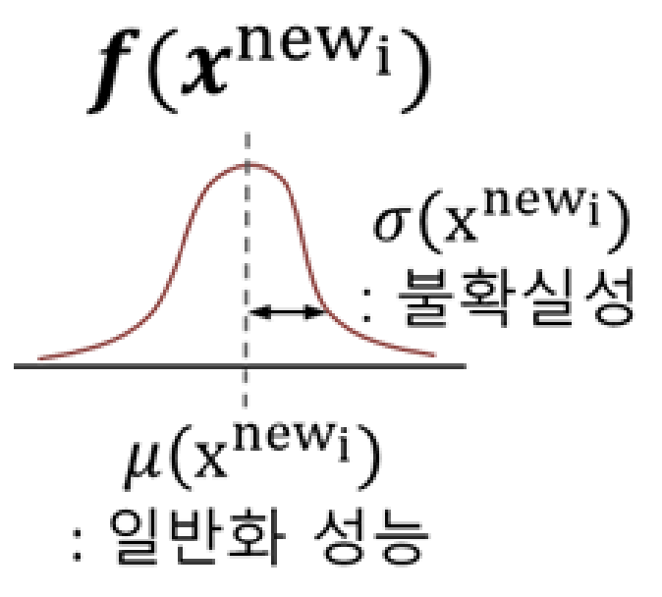


BO Review
Param_1 | Param_2 | Param_3 | … | Param_n
0.001 | 100 | 3 | ... | 128
0.001 | 100 | 3 | … | 128
Performance
100
200
X
Y
$$x^{new_{i}}$$
Surrogate Model
$$f$$
새로운 하이퍼파라미터 집합

Slide 4

argmax Acquisition
function
$$x^{∗}$$
Param_1 | Param_2 | Param_3 | … | Param_n
0.001 | 100 | 3 | ... | 128
0.001 | 100 | 3 | … | 128
Performance
100
200
X*

Slide 5
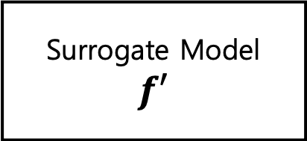

Param_1 | Param_2 | Param_3 | … | Param_n
0.001 | 100 | 3 | ... | 128
0.001 | 100 | 3 | … | 128
Performance
100
200
X’
Y’
$$x^{new_{i}}$$
Surrogate Model
$$f′$$
새로운 하이퍼파라미터 집합

Slide 6
gp_minimize in skopt
res = gp_minimize( objective_func, # Objective Function(목적 함수)
[ ( -2.0, 2.0 ), ( -1.0, 1.0 ), ( ‘yes’, ‘no’) ], # 각 파라미터의 범위 param_1, param_2, param_3
acq_func="EI", # the acquisition function
n_calls=15, # the number of evaluations of f
n_initial_points = 5, # Number of evaluations of func with initialization points
noise=0.1**2, # the noise level (optional)
random_state=1234) # the random seed

Slide 7
Objective Function
def objective_function( param_1, param_2, param_3 ):
model = Model(
param_1 = param_1,
param_2 = param_2,
…
param_n = param_n
)
model.fit( … )
return accuary
def objective_function( param_1, param_2, … , parma_n):
param 값으로 config file 생성
redis server 실행
memtier_bench 실행
throughput 값 추출
return throughput

Slide 8
Gp_minimize 적용
res = gp_minimize( objective_func, # Objective Function(목적 함수)
[ ( -2.0, 2.0 ), ( -1.0, 1.0 ), ( ‘yes’, ‘no’) ], # 각 파라미터의 범위 param_1, param_2, param_3
acq_func="EI", # the acquisition function
n_calls=15, # the number of evaluations of f
n_initial_points = 5, # Number of evaluations of func with initialization points
x0 = [ [ 0.6, -0.8, ‘yes’ ], [ 0.7, -0.9, ‘no’ ], [ 0.1, -0.4, ‘yes’ ] ], # sample1, sample2, sample3
y0 = [30602.63, 31379.3, 29495.68 ], # 최적화 대상
noise=0.1**2, # the noise level (optional)
random_state=1234) # the random seed
res.x # minimize한 y 값을 갖는 x의 값들 출력

