Slide 1
声学膜片阻抗测试系统
Theory Introduction
技术支持： 18362654625（微信同号） 王博士

Slide 2
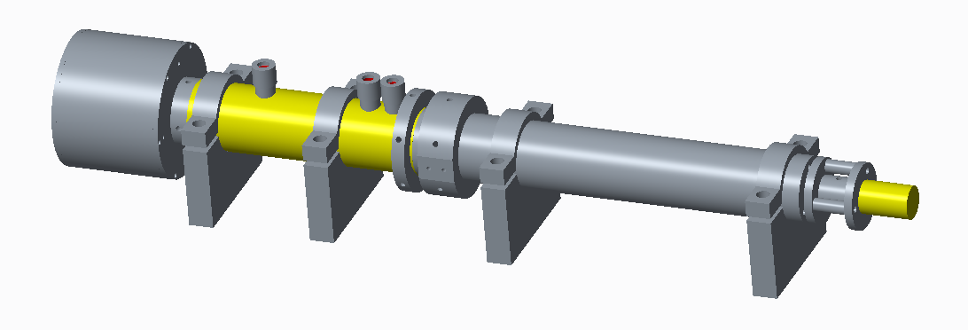
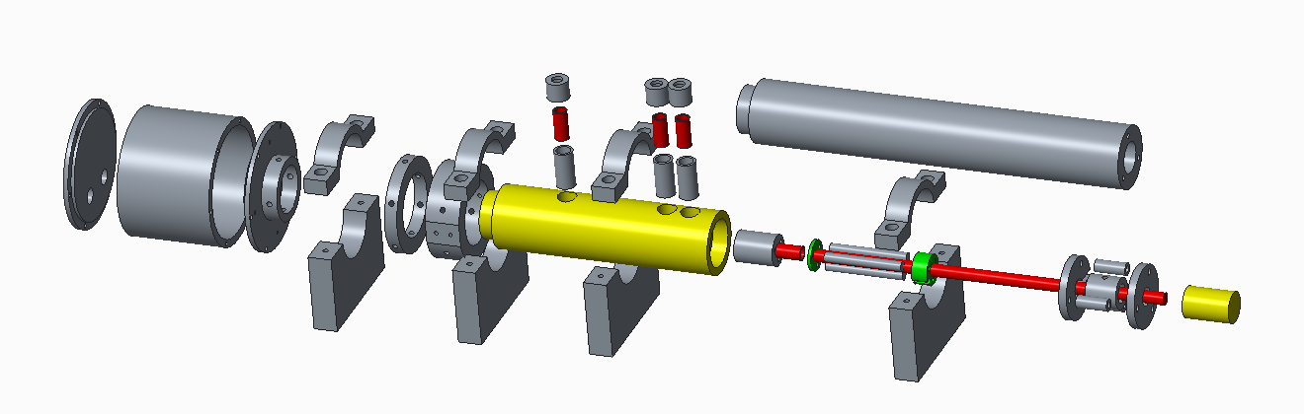
10kHz tube, inner diameter 20mm.

Slide 3
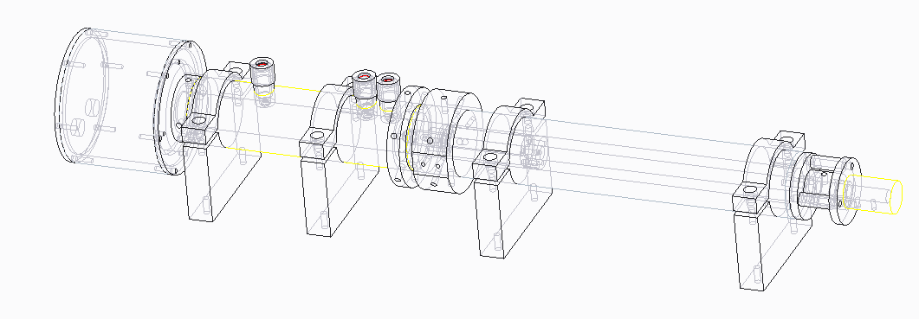
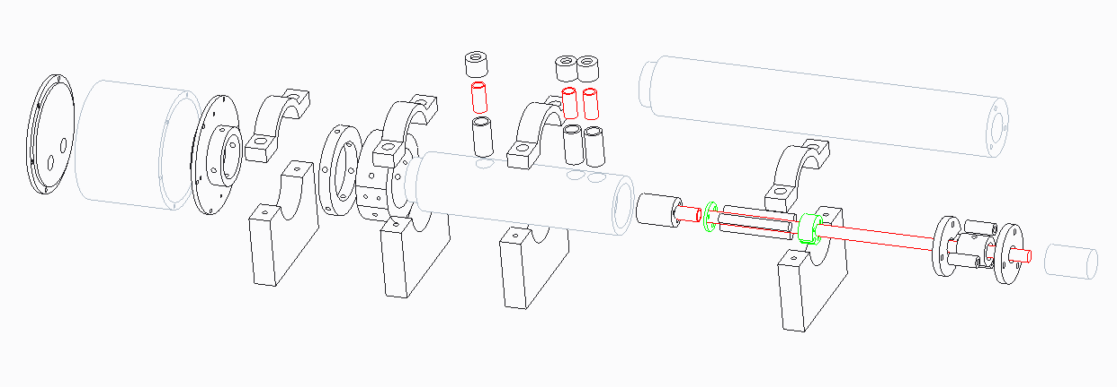
10kHz tube, inner diameter 20mm.

Slide 4
10k Hz tube, inner diameter 20mm.
Mic 1
Mic 2
Mic 3
Mic 5(Phantom Mic)
将rs反射波,与第一次入射波叠加，计算r
r_{s}
r
Mic 4
Sound Source
Sample under Test
Rigid Wall
-L_{s}
-x₁
-x₂
-x₃
0₊
0
L

Slide 5
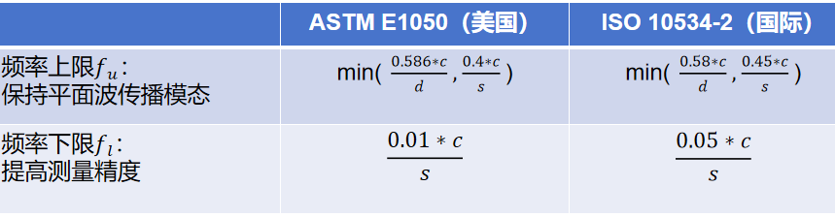
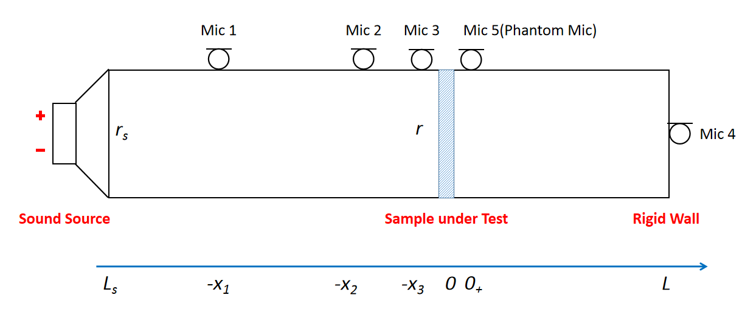
Microphone Layout:
coordinate | value
x₁ | 87mm
x₂ | 22mm
x₃ | 7mm
Mic Distance | Frequency Range
80mm(x1-x3) | 214Hz - 1929Hz
15mm(x2-x3) | 1143Hz - 10290Hz
Tube Effective range | Mics on work
10Hz - 220Hz | Mic 3; Mic 4
221Hz - 1500Hz | Mic 1; Mic 3; Mic 4
1501Hz - 10kHz | Mic 2; Mic 3; Mic 4
低频P0- = P3 中高频通过P3，P1计算r，再计算P0-

Slide 6
 | Tube Effective range | Mics on work
Low-frequency | 10Hz - 220Hz | Mic 3; Mic 4
Mid-range | 221Hz - 1500Hz | Mic 1; Mic 3; Mic 4
High-frequency | 1501Hz - 10kHz | Mic 2; Mic 3; Mic 4
A为左管Pia
Low - frequency
Mid-range & high - frequency
中频 高频 计算 r，用到的麦克风不一样
计算p0和p3时，都已经计算了rs的反射，相除rs被约掉了

Slide 7
 | Tube Effective range | Mics on work
Low-frequency | 10Hz - 220Hz | Mic 3; Mic 4
Mid-range | 221Hz - 1500Hz | Mic 1; Mic 3; Mic 4
High-frequency | 1501Hz - 10kHz | Mic 2; Mic 3; Mic 4
Mid-range:
r
high - frequency:

Slide 8
Low - frequency
Mid-range & high - frequency

Slide 9
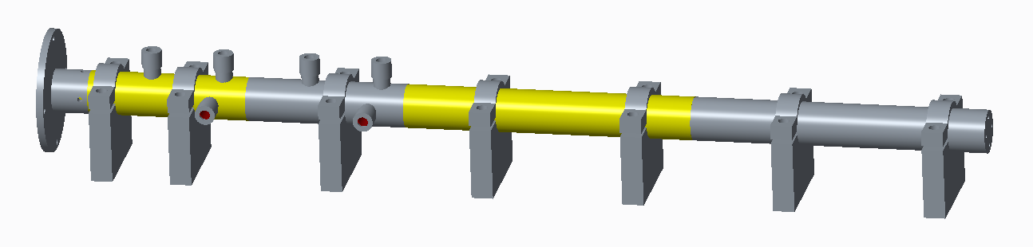
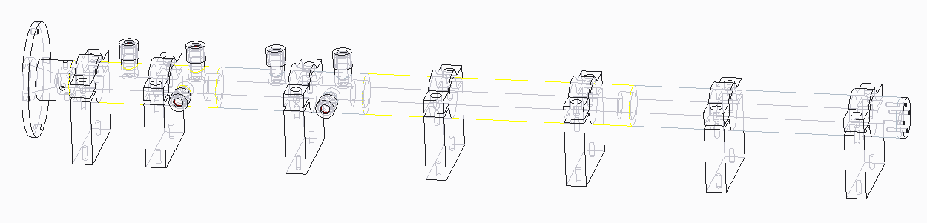
20kHz tube, inner diameter 10mm.

Slide 10
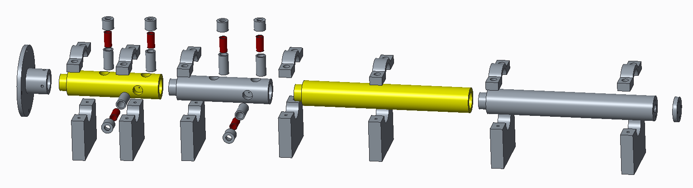
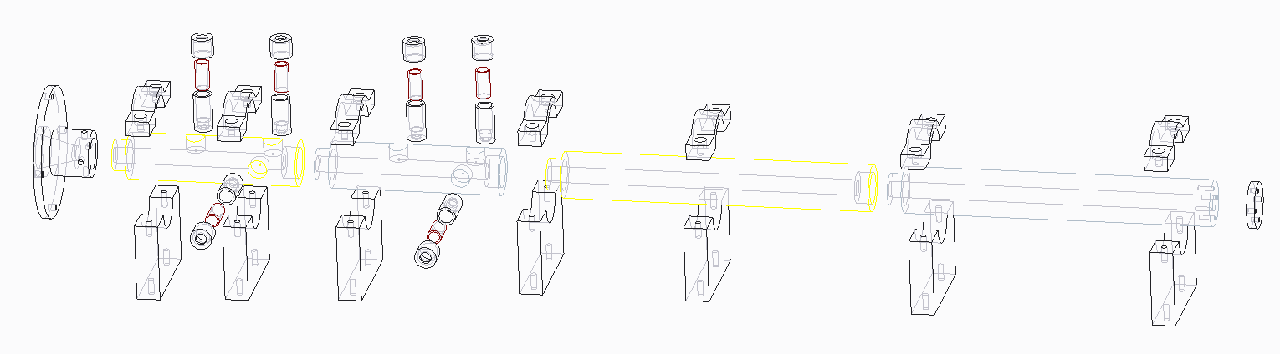
20kHz tube, inner diameter 10mm.

Slide 11
20kHz tube, inner diameter 10mm.
Mic 1
Mic 2
Mic 3
Mic 4
r_{s}
Input Tube
r₁
r₂
Transmission Tube
r₃
Sound Source
Sample under Test
Absorption terminal
-L_{s}
-x₁
-x₂
-x₃
0
x₃
L_{s}

Slide 12
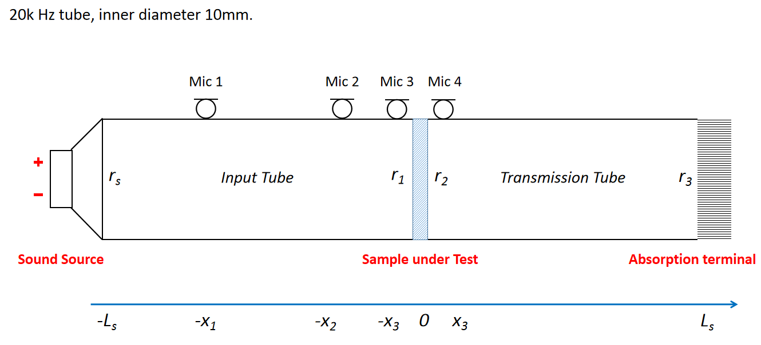
Microphone Layout:
coordinate | value
x₁ | 57mm
x₂ | 14.5mm
x₃ | 7mm
Mic Distance | Frequency Range
50mm | 343Hz - 3087Hz
7.5mm | 2286Hz - 20580Hz
Tube Effective range | Mics on work
500Hz - 2500Hz | Mic 1; Mic 3; Mic 4
2501Hz - 20kHz | Mic 2; Mic 3; Mic 4

Slide 13
 | Tube Effective range | Mics on work
Mid-range | 500Hz - 2500Hz | Mic 1; Mic 3; Mic 4
High-frequency | 2501Hz - 20kHz | Mic 2; Mic 3; Mic 4
Input Tube
Mid-range & high - frequency

Slide 14
 | Tube Effective range | Mics on work
Mid-range | 500Hz - 2500Hz | Mic 1; Mic 3; Mic 4
High-frequency | 2501Hz - 20kHz | Mic 2; Mic 3; Mic 4
Transmission Tube
r3与r1等价
r2与rs等价
Mid-range & high - frequency

Slide 15
 | Tube Effective range | Mics on work
Mid-range | 500Hz - 2500Hz | Mic 1; Mic 3; Mic 4
High-frequency | 2501Hz - 20kHz | Mic 2; Mic 3; Mic 4
Mid-range:
r₃
high - frequency:

Slide 16
Transmission Tube
Input Tube

Slide 17
Q&A

