Slide 1

[DATE]
IMPROVING MICRO-EXPRESSION RECOGNITION THROUGH TEMPORAL AND MOTION MODELING
A FACTORIAL ABLATION OF A STANDARD RECOGNITION PIPELINE ON CASME II
Master's thesis defence
[Your name] | Supervisor: [name]
MASTER'S THESIS DEFENCE
Notes:
Good morning, and thank you for being here. My name is [your name], and I will present my master's thesis, "Improving Micro-Expression Recognition through Temporal and Motion Modeling".
I will assume that you have not read the thesis. So I will first explain what micro-expressions are, how a computer can recognise them and which technologies are involved, before I show what I did and what I found.

Slide 2
WHAT THIS TALK COVERS
01
The problem
What micro-expressions are and why computers find them hard to recognise
02
The technologies
The building blocks of a recognition system, explained without equations
03
The experiment
Switching four building blocks on and off in every valid combination
04
Results
Which building blocks actually help, and how the models make mistakes
05
Conclusion
Answers to the research questions, limitations and next steps
In one sentence
I took a standard micro-expression recognition system apart and measured what each of its parts really contributes.
01 · THE PROBLEM
Notes:
The talk has five parts. First, the problem: what micro-expressions are and why they are hard for a computer. Second, the technologies: the building blocks a recognition system is made of. Third, the experiment: I switched four of these building blocks on and off in every valid combination. Fourth, the results: which blocks actually help. And fifth, the conclusion, with the limits of the study and the next steps.
In one sentence: I took a standard recognition system apart and measured what each of its parts really contributes.

Slide 3
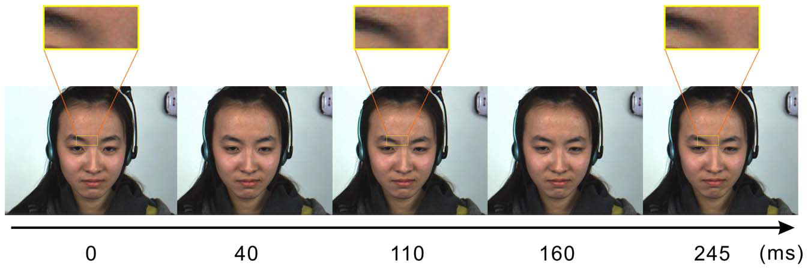
MICRO-EXPRESSIONS ARE BRIEF, FAINT AND INVOLUNTARY
Brief
They last no longer than about half a second.
Faint
Local, low-intensity movements close to the noise level of video.
Involuntary
They cannot be posed, so data must be elicited in the laboratory.
A CASME II micro-expression: AU 4 and AU 9, labelled as disgust. The apex occurs about 110 ms after onset (Yan et al., 2014).
Why it matters
A micro-expression reveals an emotion that a person is trying to conceal. Reported motivations include national safety, police interrogation, clinical diagnosis, lie detection and negotiation. These are motivating claims of the field, not deployed systems.
01 · THE PROBLEM
Notes:
A micro-expression is a very brief facial movement that appears when a person tries to hide an emotion. The pictures show a real example from the CASME II dataset: the inner brows move down very slightly, and the experts labelled this as disgust. The strongest point of the movement, called the apex, comes about 110 milliseconds after it starts.
Three properties make micro-expressions special. They are brief: no longer than about half a second. They are faint: the movement is close to the noise of an ordinary camera. And they are involuntary, so they cannot simply be acted; they must be provoked in a laboratory. Applications such as clinical diagnosis or interrogation are often mentioned, but these are motivations of the field, not working products.

Slide 4
THE TASK: FROM A SHORT VIDEO TO AN EMOTION
Recognition system
the pipeline studied in this thesis
Negative
Positive
Surprise
Input: a video clip from the start (onset) to the end (offset) of the movement
Negative = disgust, repression, sadness, fear; Positive = happiness
Output: one of three emotion classes
Short
≤ 0.5 s
Only a few frames of the video contain the movement.
Faint
a few grey levels
The change in brightness on the skin is close to the noise of an ordinary camera.
Scarce data
156 clips
Expressions must be provoked and filmed in a laboratory, so datasets are small.
01 · THE PROBLEM
Notes:
What does the computer actually have to do? It receives a short video clip that starts when the movement starts and ends when it ends. It must answer with one of three emotion classes: Negative, which covers disgust, repression, sadness and fear; Positive, which is happiness; or Surprise. This is called micro-expression recognition.
It is hard for three reasons. The movement is short, so only a few frames contain it. It is faint: it may change the brightness of the skin by only a few grey levels. And the data are scarce: because the expressions must be filmed in a laboratory, the dataset I used has only 156 usable clips.

Slide 5
A RECOGNITION SYSTEM IS A PIPELINE OF STAGES
1 · Magnify
make the tiny motion bigger
2 · Describe motion
how did each point move?
3 · Normalise length
same number of frames per clip
4 · Spatial features
patterns within each frame
5 · Temporal model
how the movement develops over time
Eulerian video magnification
optical flow and optical strain
uniform sampling of 33 frames
convolutional stem and SimAM attention
temporal transformer
Second row: the technology used for each stage in this thesis. Dashed boxes: the stages switched on and off in the experiment.
The problem with this
Each stage was proposed in a different paper, with its own reported improvement. They are usually used together, so it is unclear how much each one really contributes.
The next five slides explain each technology in simple terms.
01 · THE PROBLEM
Notes:
Researchers have responded to these difficulties by building recognition systems as a chain of stages, a pipeline. First, the tiny motion is magnified. Second, the video is turned into a description of motion: how did each point move? Third, every clip is brought to the same number of frames. Fourth, a spatial feature extractor looks for patterns inside each frame. And fifth, a temporal model follows how the movement develops over time. The second row shows the technology I used for each stage.
Each stage was introduced in a different paper, with its own reported improvement, and today they are usually used together. The dashed boxes mark the stages that I switch on and off. The next five slides explain each technology in simple terms.

Slide 6
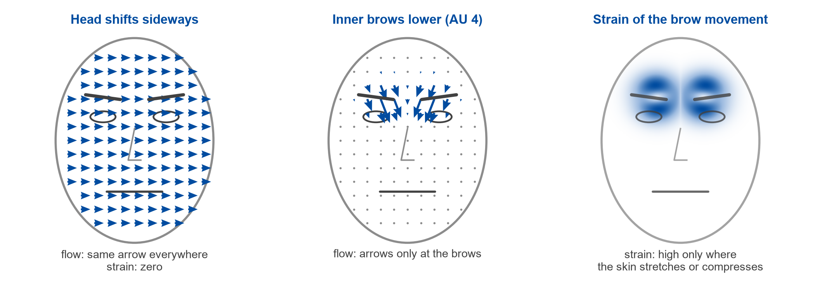
TECHNOLOGY 1: DESCRIBING MOTION WITH OPTICAL FLOW AND STRAIN
Schematic illustration, not data.
Optical flow
Two numbers per pixel: how far it moved horizontally (u) and vertically (v) between two frames. Estimator: Farnebäck.
Optical strain
One number per pixel: how strongly the skin stretches or compresses. The network sees only u, v and strain, never the face.
02 · THE TECHNOLOGIES
Notes:
The first technology describes motion. Optical flow compares two frames and computes, for every pixel, how far and in which direction the image moved: a horizontal number, u, and a vertical number, v. The drawing on the left shows what happens when the whole head moves sideways: every point gets the same arrow. The middle drawing shows a micro-expression: only the points around the inner brows move.
Optical strain goes one step further. It measures whether neighbouring points move differently, in other words whether the skin is stretched or compressed. When the whole head shifts, strain is zero; when the brows lower, strain is high only around the brows. In my system the network never sees the face itself, only these three motion maps: u, v and strain.

Slide 7
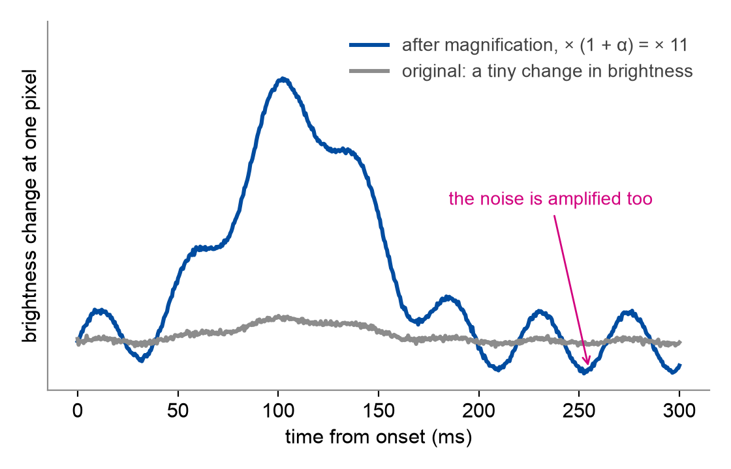
TECHNOLOGY 2: EULERIAN VIDEO MAGNIFICATION
A microscope for motion: small changes in brightness are made larger (Wu et al., 2012)
At every pixel, only changes within a chosen speed range are kept: 5–25 Hz, matching the duration of micro-expressions
These changes are multiplied: α = 10, so they become 11 times larger
Applied to the frames before the motion is measured
Schematic illustration of one pixel, not data.
Risk
The filter separates speeds, not causes: head movement and camera noise in the same range are amplified together with the expression.
02 · THE TECHNOLOGIES
Notes:
The second technology is Eulerian video magnification. You can think of it as a microscope for motion. At every pixel it looks at how the brightness changes over time, keeps only the changes within a chosen speed range, multiplies them and adds them back to the video. The grey line is a tiny change in brightness at one pixel; the blue line is the same change after magnification.
I used a factor alpha of 10, so the change becomes eleven times larger, and a range of 5 to 25 hertz, which matches the duration of micro-expressions. Magnification is applied before the motion is measured. Its risk is shown in pink: the method cannot tell an expression from noise or head movement in the same range, so those are amplified too.

Slide 8
TECHNOLOGY 3: HOW A NEURAL NETWORK LEARNS
layers of parameters
Training
The network sees clips with their correct labels and adjusts its parameters, step by step, to make fewer mistakes.
class scores
motion maps
u, v, strain
Negative
Positive
Testing
It is scored on clips of a person it has never seen.
Surprise
The highest score is the answer (here: Negative).
Why model size matters here
A parameter is one adjustable number. My models have between 5,187 and 363,763 of them, but the dataset has only 156 clips. A large model can memorise its training clips instead of learning what generalises.
02 · THE TECHNOLOGIES
Notes:
The remaining technologies are parts of a neural network, so a word on what that is. A neural network is a large collection of adjustable numbers, called parameters, arranged in layers. The input, here the motion maps, passes through the layers, and at the end the network gives a score for each of the three classes; the highest score is its answer.
During training, the network sees example clips with their correct labels and adjusts its parameters step by step to make fewer mistakes. During testing, it is scored on clips it has never seen. My models have between about five thousand and about three hundred and sixty thousand parameters, but there are only 156 clips. A large model can memorise its training clips instead of learning something general, so model size matters.

Slide 9
TECHNOLOGY 4: LEARNED SPATIAL FEATURES
Convolutional stem: learns local patterns
SimAM attention: highlights what stands out
stands out from the rest of its channel → weight close to 1
ordinary value → weight about 0.62
motion map + 3 × 3 filter
feature map
A small 3 × 3 filter slides over each frame and responds where its learned pattern appears
Three separate streams: horizontal flow, vertical flow and strain
Switched off: each frame is averaged to a coarse 4 × 4 grid instead
Attention means giving more weight to what matters
Each value is compared with the others in its channel; distinctive values keep their size, ordinary ones are turned down
No learned parameters; works only on the stem's output
02 · THE TECHNOLOGIES
Notes:
The fourth technology is the convolutional stem, which learns patterns within each frame. A convolution slides a small three-by-three filter over each motion map and responds wherever it finds the pattern it has learned, for example a local change in motion. My stem has three separate streams: one for horizontal flow, one for vertical flow and one for strain. When the stem is switched off, each frame is simply reduced to a coarse four-by-four grid of average motion.
SimAM is an attention module that works on the stem's output. Attention means giving more weight to what matters. SimAM gives a higher weight to values that stand out from the rest, and turns ordinary values down slightly. It has no adjustable parameters, and its weights always lie between about 0.62 and 1.

Slide 10
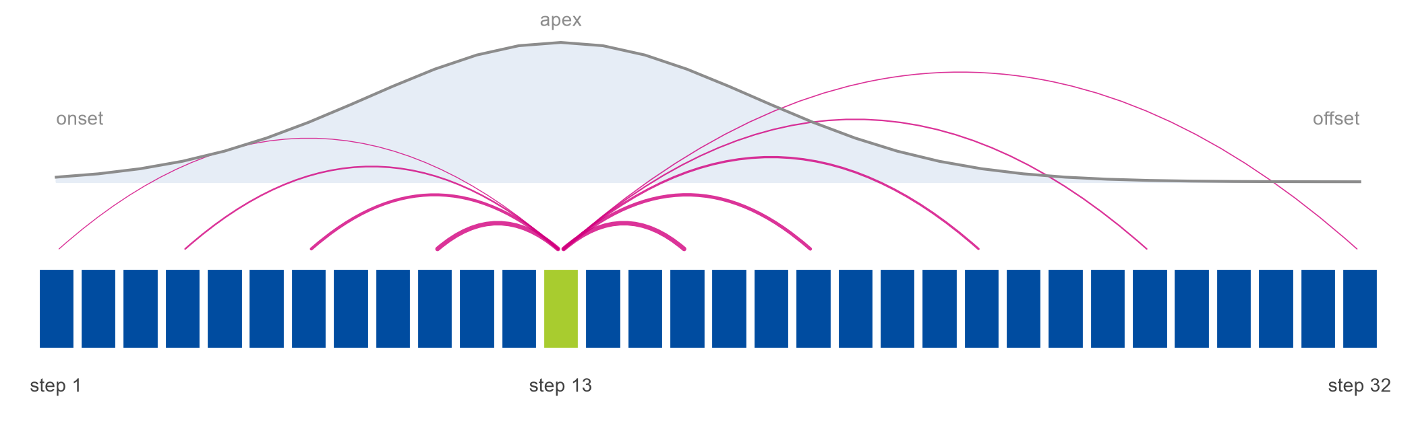
TECHNOLOGY 5: THE TEMPORAL TRANSFORMER
Schematic illustration: one step near the apex attends to all other steps (thicker arc = more weight).
With the transformer
The clip becomes 32 steps, one per pair of frames
Self-attention: every step weighs every other step
A positional encoding gives the order; 4 layers, 8 heads, trained from scratch
Switched off
The 32 steps are simply averaged
The order of the steps is lost
The rising and the falling movement partly cancel out
02 · THE TECHNOLOGIES
Notes:
The fifth technology is the temporal transformer. Transformers were introduced for machine translation; mine is a very small one. The clip becomes a sequence of 32 steps, one for each pair of neighbouring frames, shown here as boxes. In self-attention, every step looks at all the other steps and decides how much each of them matters. The pink arcs show this for one step near the apex: it can relate itself both to the rising and to the falling part of the movement. A positional encoding tells the model the order of the steps. My transformer has four layers and eight attention heads and is trained from scratch.
When the transformer is switched off, the 32 steps are simply averaged. Then the order is lost, and the rising and falling movement partly cancel each other out.

Slide 11
THE RESEARCH GAP: THE STAGES ARE NEVER TESTED TOGETHER
a
One component at a time
Ablations stay inside one proposed design and change one factor from its defaults. Interactions between components are never observed.
b
Inconsistent protocols
Sample counts (247, 255, 145), label sets and the choice of leave-one-subject, video or sample out differ between studies.
c
Richer training conditions
The strongest CASME II results rely on composite-dataset training or ImageNet pre-training, not on one small dataset.
d
Transferred parameters
Magnification factor, sequence length and input resolution have interior optima but are reused without re-validation.
The gap
No reviewed study varies several stages of the standard pipeline jointly under one protocol, so the literature cannot show which stages are necessary, which are inherited convention, and which depend on the presence of another.
02 · THE TECHNOLOGIES
Notes:
So what is missing? My literature review found four shared limitations. First, components are tested one at a time, inside one proposed system. Second, evaluation protocols differ: even the number of CASME II clips differs between papers. Third, the best results rely on extra training data or pre-training, which a single small dataset cannot reproduce. Fourth, settings such as the magnification factor are copied between systems without being re-tested.
Together this is the research gap: no reviewed study tests the stages of the standard pipeline in combination under one protocol. So we cannot say which stages are really needed, which are habit, and which only work together with others.

Slide 12
AIM AND RESEARCH QUESTIONS
Central research question
How can the modelling of temporal phases and motion cues improve recognition accuracy for subtle and short-lived facial expressions?
Temporal modelling
To what extent does a transformer encoder improve recognition, compared with an otherwise identical pipeline without it?
1
Motion magnification
Does amplifying subtle facial motion through Eulerian video magnification, before the motion representation is computed, improve recognition?
2
Learned spatial features
Do a learned convolutional stem and parameter-free attention add to the performance of the hand-computed motion representation alone?
3
02 · THE TECHNOLOGIES
Notes:
This leads to the central research question, taken from the task description: how can the modelling of temporal phases and motion cues improve the recognition of these subtle, short-lived expressions?
I split it into three concrete questions. One: how much does the temporal transformer help, compared with an otherwise identical system without it? Two: does Eulerian video magnification help? Three: do the learned convolutional stem and SimAM attention add anything beyond the motion maps themselves? The key words are "otherwise identical": every comparison removes one part and nothing else.

Slide 13
THE DATA: CASME II
Spontaneous micro-expressions recorded at 200 fps and 640 × 480 pixels, with onset, apex and offset annotation
The released coding contains 255 clips from 26 subjects
The residual Others category (99 clips) is excluded, which also removes subject 18
Working set: 156 clips from 25 subjects
Negative = disgust, repression, sadness, fear; Positive = happiness; Surprise = surprise
Majority-class reference
Always predicting Negative gives an accuracy of 0.6346 but a macro F1 of only 0.2588. Accuracy alone is therefore uninformative.
Class distribution of the working set: a ratio of about 4 : 1.3 : 1
03 · THE EXPERIMENT
Notes:
All experiments use CASME II, a dataset recorded at 200 frames per second, in which experts marked the start, the peak and the end of each micro-expression. The released version contains 255 clips from 26 people. I removed the category "Others", a leftover group for clips that fit no emotion; this also removes one person. That leaves 156 clips from 25 people: 99 Negative, 32 Positive and 25 Surprise.
This imbalance matters. A system that always answers "Negative" would already be right 63 percent of the time, without recognising anything.

Slide 14
PREPARING THE INPUT: FROM VIDEO CLIP TO MOTION MAPS
Frame preparation
greyscale, 224 × 224
Uniform sampling
33 frames, onset to offset
Magnification
Eulerian, α = 10, 5–25 Hz
Optical flow
Farnebäck, 32 frame pairs
Optical strain
from spatial gradients
Stack and normalise
[u, v, ε] to [0, 1]
Dashed box: component switched on and off in the ablation
Input tensor
3 × 32 × 224 × 224
channels × frame pairs × height × width
Channels: horizontal flow u, vertical flow v and strain magnitude ε
The network never receives pixel intensities, only displacement and deformation fields
The original frames are used: no face detection, alignment or cropping
Existing frames are sampled; no frames are synthesised by interpolation
Stage 1 runs once per clip, so all configurations are compared on identical inputs
03 · THE EXPERIMENT
Notes:
Here is how one clip becomes the input of the network. The frames are converted to greyscale and resized to 224 by 224 pixels. Thirty-three frames are taken at equal spacing between the start and the end of the expression. If magnification is switched on, it is applied at this point. Then optical flow is computed between each pair of neighbouring frames, which gives 32 pairs, and strain is computed from the flow.
The result is a block of numbers: three motion maps, for 32 time steps, each 224 by 224 pixels. This preparation is done once per clip, so every configuration receives exactly the same input.

Slide 15
FOUR PARTS ARE SWITCHED ON AND OFF
MOTION MODELLING
TEMPORAL MODELLING
1
2
3
4
Eulerian video magnification
Convolutional stem
SimAM attention
Temporal transformer
Amplifies subtle motion in a temporal frequency band before optical flow is computed.
Three streams with unshared weights, one per channel, using spatial-only kernels (1, 3, 3).
Parameter-free re-weighting of the stem's activations. Requires the stem.
Sinusoidal positions, four pre-norm layers and eight heads over 32 time steps.
When disabled
No magnification
When disabled
4 × 4 average pooling per frame and a linear projection 48 → 96
When disabled
Unmodified stream outputs
When disabled
Mean over time: no parameters, no temporal order
03 · THE EXPERIMENT
Notes:
These are the four parts that I switch on and off. Three of them deal with motion: magnification, the convolutional stem and SimAM attention. The fourth, the transformer, deals with time.
When a part is switched off, it is replaced by the simplest operation that keeps the system working: no magnification; a coarse four-by-four average instead of the stem; unchanged values instead of SimAM; and a plain average over time instead of the transformer. SimAM can only be switched on together with the stem, because it re-weights the stem's output.

Slide 16
TWELVE CONFIGURATIONS AND MATCHED PAIRS
Config. | EVM | SimAM | CNN | TF
C1 | – | – | – | –
C2 | – | – | – | ✓
C3 | – | – | ✓ | –
C4 | ✓ | – | – | –
C5 | – | ✓ | ✓ | –
C6 | – | ✓ | ✓ | ✓
C7 | ✓ | – | ✓ | ✓
C8 | ✓ | ✓ | ✓ | ✓
C9 | – | – | ✓ | ✓
C12 | ✓ | – | – | ✓
C13 | ✓ | – | ✓ | –
C16 | ✓ | ✓ | ✓ | –
Four on–off switches give 2⁴ = 16 combinations
Four would switch on SimAM without the stem: not possible, so not trained
Each of the 12 valid configurations is trained from scratch
Matched pair: the key idea
Two configurations identical except for one part. Example: C1 (nothing switched on) and C2 (only the transformer). Their score difference is the effect of the transformer in that setting.
6
6
4
4
Transformer pairs
EVM pairs
SimAM pairs
CNN stem pairs
EVM: magnification; CNN: convolutional stem; TF: transformer. Highlighted: the example pair.
The effect of a part = the average over all of its pairs (20 pairs in total).
03 · THE EXPERIMENT
Notes:
Four on-off switches give sixteen combinations. Four of them would switch on SimAM without the stem, which is not possible, so twelve valid configurations remain, named C1 to C16 in the table. Each one is trained from scratch.
To measure one part, I use matched pairs: two configurations that are identical except for that part. For example, C1 has nothing switched on, and C2 differs from it only by the transformer, so the difference between their scores is the effect of the transformer in that setting. There are twenty such pairs, and the effect of a part is the average over its pairs.

Slide 17
TESTING FAIRLY: UNSEEN PEOPLE AND A BALANCED SCORE
Leave-one-subject-out: test on an unseen person
Macro F1: every class counts equally
test 1
Always answering "Negative":
test 2
accuracy
0.6346
· · ·
test 25
macro F1
0.2588
blue: 24 training people lime: the test person
F1 of a class: how many of its clips are found, and how many answers for it are right
Macro F1: the average of the three class F1 scores
So the rare classes count as much as the common one
Repeated 25 times, once per person
Every clip is tested once, by a model that never saw that face
Results of the 25 tests are added up before scoring
Same rules for every configuration
Trained from scratch with one fixed recipe and random seed, no tuning. Declared limitation: the best training epoch was chosen on the test person.
03 · THE EXPERIMENT
Notes:
Two choices make the test fair. The first is how the data are split. In leave-one-subject-out testing, the model is trained on 24 people and tested on the one person it has never seen. This is repeated 25 times, once for every person, so each clip is tested exactly once, always by a model that never saw that face.
The second is the score. Because Negative is so common, I do not use plain accuracy. I use macro F1: for each class, F1 combines how many of its clips are found and how many of the answers for that class are right; the three class scores are then averaged, so the rare classes count as much as the common one. Always answering Negative gives 63 percent accuracy but a macro F1 of only 0.26. One declared limitation: the best training epoch was chosen on the test person.

Slide 18
RESULT 1: THE TRANSFORMER SPLITS THE RESULTS IN TWO
With transformer
0.5830 to 0.7122
Without transformer
0.4192 to 0.4480
The two groups do not overlap: the closest members are 0.1350 apart
No other component divides the configurations in this way
Each bar is one configuration. Blue: with transformer; grey: without.
04 · RESULTS
Notes:
Now the results. Each bar is one configuration, and higher is better. The picture is a clear split. The six blue bars are the configurations with the transformer; they score between 0.58 and 0.71. The six grey bars have no transformer and score between 0.42 and 0.45.
The two groups do not overlap at all: the closest members are 0.135 apart, and no other part divides the configurations like this. So the first result is simple: whether a system contains the temporal transformer decides which group it belongs to.

Slide 19
RESULT 2: THE FULL SYSTEM IS NOT THE BEST ONE
C2: transformer only
0.7122
pooled macro F1
accuracy 0.7436 (116 of 156 clips)
C8: all four components
0.6659
pooled macro F1
accuracy 0.7500 (117 of 156 clips)
All-Negative reference
0.2588
pooled macro F1
accuracy 0.6346
A transformer applied directly to the motion representation outperforms the complete pipeline by 0.0463
The two metrics select different configurations: C8 classifies one more clip correctly, but C2 is better on the minority classes
All twelve configurations exceed the majority-class reference in macro F1
The difference is a point estimate from a single seed, not a statistically established advantage
04 · RESULTS
Notes:
The best configuration is C2, which contains only the transformer, with a macro F1 of 0.7122. C8, with all four parts switched on, scores 0.6659, which is 0.0463 lower. Interestingly, C8 gets one more clip right, because it is stronger on the common Negative class, while C2 is better on the rare classes. Every configuration beats the always-Negative answer.
The gap between C2 and C8 comes from a single training run, so it is not a proven advantage. But it shows something important: had I evaluated only the complete system, I would never have noticed that a part of it works better.

Slide 20
RESULT 3: WHAT EACH PART CONTRIBUTES
Component | Positive pairs | Range
Transformer | 6 / 6 | +0.1578 to +0.2786
Magnification | 4 / 6 | −0.0541 to +0.0795
SimAM | 3 / 4 | −0.0288 to +0.0341
Conv. stem | 2 / 4 | −0.1292 to +0.0094
Even the smallest transformer gain exceeds the mean effect of every other component
The stem is the only component with a negative mean effect
The effects are not additive
04 · RESULTS
Notes:
This slide shows the average effect of each part. Adding the transformer improves macro F1 by 0.2173 on average, and it helps in all six of its pairs. Magnification adds only 0.0152, with four of six pairs positive. SimAM adds 0.0034, which cannot be told apart from zero. And the convolutional stem is the only part that hurts on average, by 0.0310.
Even the smallest improvement from the transformer is larger than the average effect of any other part. The effects are also not additive: switching everything on does not give the best result.

Slide 21
HOW THE MODELS MAKE MISTAKES
C1: no components
C8: all four components
C2: transformer only (best)
true\pred. | Neg. | Pos. | Sur.
Neg. | 42 42 % | 22 22 % | 35 35 %
Pos. | 4 12 % | 13 41 % | 15 47 %
Sur. | 5 20 % | 3 12 % | 17 68 %
true\pred. | Neg. | Pos. | Sur.
Neg. | 85 86 % | 3 3 % | 11 11 %
Pos. | 13 41 % | 15 47 % | 4 12 %
Sur. | 4 16 % | 4 16 % | 17 68 %
true\pred. | Neg. | Pos. | Sur.
Neg. | 71 72 % | 20 20 % | 8 8 %
Pos. | 3 9 % | 27 84 % | 2 6 %
Sur. | 3 12 % | 4 16 % | 18 72 %
Over-predicts the minority classes
Shifted towards the majority class
Similar recall on all three classes
How to read: rows are the true classes, columns the predicted classes; the diagonal holds the correct answers. Each cell gives the clip count and the share of its row. Counts are summed over all 25 tests.
Without the transformer, most Negative clips are misclassified: in C1, 35 of 99 are predicted as Surprise and 22 as Positive
With the stem and the transformer, predictions move towards Negative: in C8, 13 of 32 Positive clips are predicted as Negative
C2 reaches a recall of 0.72, 0.84 and 0.72; its main error is predicting Positive for 20 Negative clips
04 · RESULTS
Notes:
How do the models go wrong? A confusion matrix shows, for each true class in the rows, how its clips were classified in the columns. The diagonal holds the correct answers, and darker cells mean more clips.
On the left, C1, with nothing switched on, predicts the rare classes far too often: 35 of the 99 Negative clips are called Surprise. All systems without the transformer behave like this. A likely reason is that training shows the three classes equally often, so with weak features the model guesses them about equally. In the middle, C8 is pushed the other way: 13 of the 32 Positive clips become Negative. On the right, C2 recognises all three classes with similar success: 72, 84 and 72 percent.

Slide 22
WHY DID THE PARTS BEHAVE THIS WAY?
Temporal transformer
+0.2173
Its replacement averages over time, so the rising and falling phases partly cancel and their order is lost
Positional encoding and self-attention can relate onset, apex and offset
It also adds about 349,000 parameters, so order and capacity cannot be separated
Magnification
+0.0152
Optical flow already recovers faint motion, and per-channel normalisation removes amplitude differences
Without alignment, head movement and noise are amplified too
α = 10 was not tuned for a motion representation
SimAM attention
+0.0034
Its weight lies only between about 0.62 and 1
The output is then averaged over the whole frame
Statistics are computed per clip; λ was not tuned
Convolutional stem
−0.0310
Its output is averaged over the whole frame, discarding location; the replacement keeps a 4 × 4 grid
Flow and strain already make motion explicit
224 × 224 input and only 156 clips
These are the most plausible accounts of the observed results. None was isolated experimentally.
04 · RESULTS
Notes:
Why did the parts behave like this? These are plausible explanations, not tested ones. Without the transformer, the 32 steps are averaged, so the rising and falling movement cancel out and the order is lost; the transformer can relate start, peak and end. But it also adds about 349,000 parameters, so order and size cannot be separated.
Magnification helps little, probably because optical flow already captures faint motion, the maps are normalised anyway and, without face alignment, head movement is amplified too. SimAM can only scale values between about 0.62 and 1, so its effect is bound to be small. And the stem averages its output over the whole frame, which throws away where the movement happened, while its replacement keeps a coarse grid.

Slide 23
COMPARISON WITH PUBLISHED RESULTS
Not a like-for-like comparison
Training data
Published entries are trained on the composite dataset of 442 samples from 68 subjects; this study uses 156 clips from 25 subjects.
Evaluation data
The MEGC subset has 145 clips; this study uses 156, because sadness and fear are included in Negative.
Checkpoint selection
This study selects the epoch on the held-out subject, which can only raise its scores.
The comparison locates the results; it does not establish state-of-the-art performance.
UF1 on the CASME II subset, MEGC 2019 (See et al., 2019)
04 · RESULTS
Notes:
How does this compare with published work? The chart shows the results reported on CASME II in a well-known benchmark, the MEGC 2019 challenge. My best result, 0.7122, lies above two entries and below five.
But this is not a like-for-like comparison. The published systems were trained on a combined dataset of 442 clips, almost three times as many. They were evaluated on 145 CASME II clips, while I use 156. And my epoch selection can only raise my scores, so it cannot explain the gap. The comparison places my results in context; it does not claim the best performance.

Slide 24
ANSWERS TO THE RESEARCH QUESTIONS
Temporal modelling
Largest improvement by far: +0.2173 on average, and all six pairs improve. The best configuration contains the transformer alone (0.7122).
1
Motion magnification
No reliable improvement: +0.0152 on average, four of six pairs improve, and adding it to the best configuration loses 0.0541.
2
Learned spatial features
Neither adds to the motion representation: the stem has a mean effect of −0.0310, and SimAM (+0.0034) cannot be distinguished from zero.
3
Central research question
For a small dataset, the improvement comes from modelling the temporal evolution of an analytically computed motion representation, not from additional preprocessing or learned spatial processing. Robustness to noise was not measured separately.
05 · CONCLUSION
Notes:
To answer the research questions. One: the temporal transformer gave by far the largest improvement, 0.2173 on average, in all six pairs. Two: magnification did not improve recognition reliably, and it even lowered the best configuration. Three: neither the stem nor SimAM added to the motion maps; the stem hurt on average and SimAM could not be told apart from zero.
So, for the central question: on a small dataset, the improvement comes from modelling how the motion develops over time, not from more preprocessing or more learned spatial processing. Robustness to noise was not measured separately.

Slide 25
LIMITATIONS
1
Evaluation protocol
2
Fixed settings
One random seed, so no confidence intervals
Epoch selected on the held-out subject, which biases scores upwards
Per-clip predictions not retained, so no paired significance test
α = 10, T = 32, λ = 10⁻⁴ and γ = 2 taken from the literature
No hyperparameter search
Each component varied only as present or absent
3
Departures from reviewed methods
4
Single dataset
Twelve declared divergences
Stem has no temporal kernels and operates at 224 × 224
Magnification is applied after the clips are subsampled
156 clips from 25 subjects of CASME II
One ethnicity, narrow age range, laboratory recording
No claim extends to other populations or datasets
05 · CONCLUSION
Notes:
These results have clear limits. Each configuration was trained once, with one random seed, so there are no confidence intervals. The best epoch was chosen on the test person, which makes the scores somewhat optimistic. Individual predictions were not stored, so no significance test is possible.
The settings, such as the magnification factor, were fixed and not tuned. The implementation departs from the reviewed methods at twelve declared points, for example a stem without temporal filters. And everything rests on one dataset: 156 clips from 25 young people of one ethnicity, filmed in a laboratory.

Slide 26
FUTURE WORK
Evaluation
Select the epoch on withheld training subjects, retain per-clip predictions for McNemar's test, and repeat with several seeds.
1
Convolutional stem
Retrain at lower resolutions such as 28 × 28 and 56 × 56, and keep the spatial layout of its features.
2
Motion representation
Magnify before subsampling, vary the amplification factor, compare Farnebäck with TV-L1, and add a configuration without strain.
3
Temporal modelling
LSTM aggregator, onset-referenced flow, learned positions, and a control with comparable parameters but no temporal modelling.
4
Data
Evaluate on a composite dataset and on SAMM, CAS(ME)³ and DFME to test whether the effects hold beyond CASME II.
5
05 · CONCLUSION
Notes:
The limitations point directly to the next steps. First, a cleaner evaluation: choose the epoch on separate people, store every prediction for significance tests, and repeat with several seeds. Second, test the stem at lower resolutions such as 28 by 28 pixels. Third, apply magnification before the frames are sampled, try other magnification factors and another flow method. Fourth, compare the transformer with an equally large model that ignores time. And finally, repeat the study on larger and more diverse datasets such as SAMM, CAS(ME) cubed and DFME.

Slide 27
CONTRIBUTIONS AND CONCLUSION
1
2
3
A factorial evaluation of a standard pipeline
All twelve valid combinations of four components under one leave-one-subject-out protocol, so each contribution is measured against an otherwise identical pipeline.
A measured account of temporal and motion modelling
The transformer carries almost all of the effect (+0.2173); magnification and SimAM are small or indistinguishable from noise; the stem is negative on average.
The full pipeline is not the best configuration
The transformer alone reaches 0.7122 against 0.6659 for all four components. An evaluation of the complete system alone could not have revealed this.
Conclusion
Within one dataset, one training protocol and one setting of the preprocessing parameters, modelling the temporal evolution of facial motion matters more for micro-expression recognition than adding further preprocessing or spatial processing.
05 · CONCLUSION
Notes:
To sum up, the thesis makes three contributions. First, a factorial evaluation of a standard pipeline: all twelve valid combinations of four parts under one protocol. Second, a measured account of what each part contributes: the transformer carries almost all of the effect, magnification and SimAM are small, and the stem is negative on average. Third, evidence that the full pipeline is not the best configuration.
My conclusion: within one dataset and one training protocol, modelling how facial motion develops over time matters more for micro-expression recognition than adding more preprocessing or spatial processing.

Slide 28
THANK YOU
QUESTIONS AND DISCUSSION
Best configuration: transformer only, pooled macro F1 0.7122
Transformer mean effect: +0.2173 over six matched pairs
Backup slides with more detail follow.
05 · CONCLUSION
Notes:
Thank you for your attention. I am happy to take your questions. After this slide there are backup slides with more detail on the data, the model, the training and the full results, which I can show if they help to answer a question.

Slide 29
06
BACKUP SLIDES
ADDITIONAL DETAIL FROM THE THESIS, FOR THE DISCUSSION
Matched pairs · Per-class F1 · Model size · Datasets · Preprocessing · Model · Training and metrics · Literature evidence · Full results · Divergences and research gaps
06 · BACKUP SLIDES
Notes:
Backup slides. These are not part of the talk. Jump to one only when a question calls for it. They cover: datasets, CASME II labels, fold composition, magnification, optical flow and strain, temporal sampling, the convolutional stream and SimAM, the transformer and SLSTT, training settings, metrics, the published evidence, the full results table, the predicted class distribution, the twelve divergences, and the research gap per component.

Slide 30
ALL TWENTY MATCHED PAIRS
Transformer
mean +0.2173
Magnification
mean +0.0152
SimAM
mean +0.0034
Convolutional stem
mean −0.0310
Each bar is one pair of configurations (off → on) that differ in exactly one component. All four panels share the same vertical scale: change in pooled macro F1.
06 · BACKUP SLIDES
Notes:
Here are all twenty matched pairs behind those means. Each bar is one pair, labelled "off to on" by configuration number, and all four panels share the same vertical scale.
For the transformer, every bar is clearly positive. The largest gain is from C1 to C2, plus 0.279.
For magnification the picture is mixed. The largest gain, plus 0.080, is from C9 to C7, where the stem and the transformer are present. The largest loss, minus 0.054, occurs when magnification is added to the best configuration, C2 to C12.
For the convolutional stem, three of the four differences are smaller than 0.01. The mean is dominated by one pair: adding the stem to the best configuration, C2 to C9, loses 0.129.
So small means can hide considerable variation, and the two large losses both occur when a component is added to the transformer-only configuration.

Slide 31
PER-CLASS F1: MINORITY CLASSES DECIDE THE RANKING
Every configuration achieves a nonzero F1 on all three classes
C2 has the highest Positive and Surprise F1 (0.6506 and 0.6792)
C9 has the highest Negative F1 (0.8491) but a Surprise F1 of only 0.3000, with an accuracy of 0.7308
Negative F1 separates the groups: 0.75 to 0.85 with the transformer, 0.35 to 0.56 without
06 · BACKUP SLIDES
Notes:
Macro F1 is an average over the three classes, so it is worth looking at the classes separately.
First, every configuration has a nonzero F1 on all three classes. No configuration abandons a class.
Second, C2, the best configuration, has the highest Positive and Surprise scores, 0.65 and 0.68. Its advantage in macro F1 comes from the minority classes.
Third, C9, the stem plus the transformer, has the highest Negative F1 of all, 0.85, but a Surprise F1 of only 0.30. Its accuracy is nevertheless 0.73. This shows that high accuracy can coincide with weak minority-class performance, which is exactly why accuracy is not my primary metric.
Fourth, the Negative class separates the two groups most clearly: with the transformer, Negative F1 is between 0.75 and 0.85; without it, between 0.35 and 0.56.

Slide 32
STAGE 2: ONE MODEL WITH FOUR SWITCHES
Motion tensor
3 × 32 × 224 × 224
Convolutional stem
three streams
SimAM
parameter-free gate
Spatial pooling
sequence of 32 × 96
Transformer
4 layers, 8 heads
Classifier head
three class logits
Dashed boxes: ablated components. Each is replaced by a defined operation when disabled.
Component | Parameters
Convolutional stem (3 streams) | 14,544
Temporal transformer | 348,736
Replacement projection | 4,704
Classifier head | 483
SimAM, magnification | 0
Combination | Total
No stem, no transformer | 5,187
Stem only | 15,027
Transformer only | 353,923
Stem and transformer | 363,763
The transformer holds about 96 % of the parameters of the complete model. All configurations share the same implementation, initialisation and layer order.
06 · BACKUP SLIDES
Notes:
Stage two is training and evaluation. All twelve configurations are branches of a single model, in which each component is executed or skipped by a switch.
The motion tensor passes through the convolutional stem and SimAM if they are enabled. Spatial pooling then removes the spatial dimensions and leaves a sequence of 32 time steps with 96 features each. The transformer processes this sequence, the result is averaged over time, and the classifier head produces three class scores.
Because every configuration shares the same implementation, initialisation and layer order, two configurations that differ in one switch differ in nothing else.
The parameter counts are on the slide. The stem has about 14,500 parameters, the transformer about 349,000. SimAM and magnification add none. So in the complete model the transformer holds about 96 percent of the parameters. So the transformer adds capacity as well as temporal modelling.

Slide 33
SPONTANEOUS MICRO-EXPRESSION DATASETS
Dataset | Subjects | Micro samples | Frame rate (fps) | FACS | Ethnicities / mean age
CASME | 19 | 195 | 60 | Yes | 1 / 22.03
SMIC (HS) | 16 | 164 | 100 | No | 2 / 28.1
CASME II | 26 | 247 / 255 | 200 | Yes | 1 / 22.03
SAMM | 32 | 159 | 200 | Yes | 13 / 33.24
CAS(ME)² | 22 | 53 (+250 macro) | 30 | Yes | 1 / 22.59
MMEW | 36 | 300 (+900 macro) | 90 | Yes | 1 / 22.35
DFME | 671 | 7,526 | 200, 300, 500 | Yes | not reported
CASME II has the highest temporal resolution among the spontaneous datasets of comparable size
Its onset, apex and offset annotation makes temporal normalisation well defined
It remains the most widely reported single-dataset benchmark
CAS(ME)³ adds depth information; DFME is reported by its authors as the largest dataset at the time of publication
06 · BACKUP SLIDES
Notes:
Use this if asked why I chose CASME II or how it compares with other datasets.
The table lists the spontaneous micro-expression datasets most widely used for recognition. CASME II has 26 subjects in the released coding, 200 frames per second and FACS coding. SMIC is not FACS-coded. SAMM addresses the demographic narrowness with 13 ethnicities. CAS(ME) squared and MMEW also contain macro-expressions. DFME is far larger, with 7,526 clips from 671 participants.
I chose CASME II for three reasons: the highest temporal resolution among datasets of comparable size, well-defined onset and offset annotation, and its status as the most widely reported single-dataset benchmark. The price is that no result extends to other populations or datasets.

Slide 34
CASME II LABELS AND THE THREE SAMPLE COUNTS
247
Published paper
Micro-expressions reported by Yan et al. (2014)
255
Released coding
Clips in the distributed coding file; used in this thesis
145
MEGC 2019 subset
Five-category release: Negative = disgust and repression (88)
156
This thesis
Seven-label coding: sadness and fear added to Negative (99)
Released coding (255 clips). Blue: Negative (99); lime: Positive (32); cyan: Surprise (25); grey: excluded.
06 · BACKUP SLIDES
Notes:
Use this if asked about the class grouping or why my sample count differs from other papers.
The released coding has seven labels: disgust 63, repression 27, sadness 7, fear 2, happiness 32, surprise 25 and others 99. Seven-class recognition is not viable with two fear clips and seven sadness clips.
Three sample counts circulate for CASME II. The paper reports 247. The released coding file contains 255. MEGC 2019 uses 145, because its Negative class is disgust and repression only.
I use 156: I add sadness and fear to Negative, following the mapping MEGC gives for SAMM. Nine of the eleven extra clips are sadness and fear; two are unexplained, because disgust and repression number 90 in the released coding against 88 in the challenge.

Slide 35
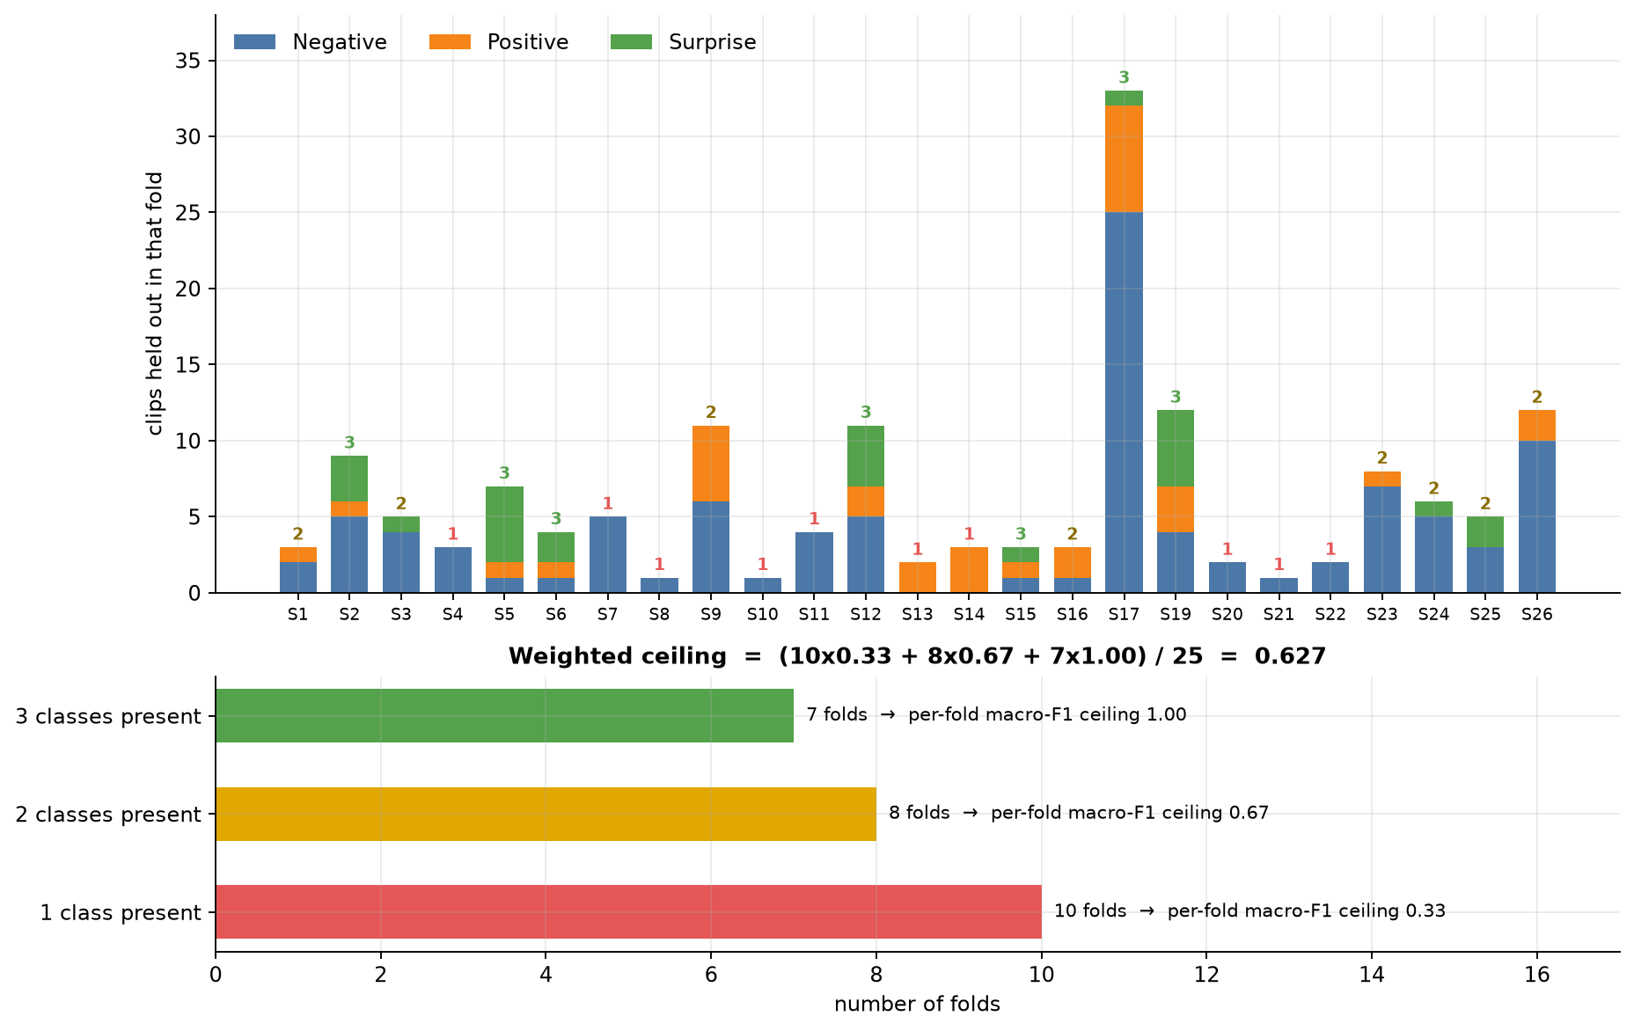
FOLD COMPOSITION AND THE MEAN-OF-FOLDS CEILING
Subject 17 alone contributes 33 clips, 21 % of the working set
Three subjects contribute one clip each, so fold sizes vary by a factor of 33
10 folds contain one class, 8 contain two, 7 contain all three
A class absent from a fold contributes an F1 of zero to that fold
Ceiling of the mean-of-folds macro F1
(10 · ⅓ + 8 · ⅔ + 7 · 1) / 25 ≈ 0.627
Pooling the confusion matrices avoids this ceiling. For C8, mean-of-folds accuracy exceeds pooled accuracy by 6.3 points.
Class composition of the 25 leave-one-subject-out folds (thesis figure).
06 · BACKUP SLIDES
Notes:
Use this if asked why I pool the confusion matrices instead of averaging per-fold scores.
Each bar is one held-out subject, and the number above it is how many of the three classes that subject has. The folds are very unequal: subject 17 alone contributes 33 clips, and three subjects contribute a single clip.
Ten folds contain only one class, eight contain two, and seven contain all three. A class that is absent from a fold contributes an F1 of zero, so a one-class fold can score at most one third and a two-class fold at most two thirds.
The mean-of-folds macro F1 is therefore capped at about 0.627, however good the model is. Pooling the counts over all 156 clips avoids this ceiling, and it is exactly how the UF1 of MEGC 2019 is defined.

Slide 36
EULERIAN VIDEO MAGNIFICATION IN DETAIL
Small-motion model
I(x, t) = f(x + δ(t)) ≈ f(x) + δ(t) · ∂f/∂x
After magnification
Ĩ(x, t) ≈ f(x) + (1 + α) · δ(t) · ∂f/∂x
Property | Implemented behaviour and consequence
Temporal band | 5–25 Hz, matching the duration of micro-expressions; Bai et al. narrowed it to 15–25 Hz to reduce noise
Temporal filter | Hard Fourier mask instead of a Butterworth filter; the pass-band has no smooth roll-off
Spatial amplification | The same α = 10 for every level of the four-level Laplacian pyramid; the Gaussian residual is not amplified
Colour | Greyscale intensity only, with no separate chromatic attenuation
Ordering | Applied after sampling to 33 frames at a nominal 200 fps, so the physical pass-band is clip-dependent (about 2.5–12.5 Hz at the median length)
The filter distinguishes frequencies, not causes: head movement, illumination variation and noise within the pass-band are amplified together with the facial movement.
06 · BACKUP SLIDES
Notes:
Use this if asked how magnification works or how my implementation differs from the reference.
The first equation is the small-motion approximation: a small displacement delta changes the intensity by delta times the spatial gradient. Amplifying that variation by alpha gives an intensity that resembles a displacement enlarged by one plus alpha.
The table lists the implementation choices. The band is the full 5 to 25 hertz, where Bai et al. narrowed it to 15 to 25 to reduce noise. The filter is a hard Fourier mask, not a Butterworth filter. The same alpha of 10 is applied to every level of a four-level Laplacian pyramid. And, most importantly, magnification is applied after the clip is sampled to 33 frames, so the realised pass-band depends on the clip length: about 2.5 to 12.5 hertz at the median length.
The filter separates frequencies, not causes, so head movement in the band is amplified too.

Slide 37
OPTICAL FLOW AND OPTICAL STRAIN
Optical flow
Optical strain
Brightness constancy
I(x, y, t) = I(x + uΔt, y + vΔt, t + Δt)
Strain tensor
ε = ½ (∇u + (∇u)^{T})
Flow constraint
I_{x} u + I_{y} v + I_{t} = 0
Shear component
ε_{xy} = ½ (∂u/∂y + ∂v/∂x)
One equation in two unknowns: the aperture problem
Farnebäck estimator on the 32 adjacent frame pairs
u and v are displacements in pixels between sampled frames
No flow-based fine alignment is performed
Magnitude used
ε_{mag} = √(ε_{xx}² + ε_{yy}² + ε_{xy}²)
Normal components: ∂u/∂x (horizontal) and ∂v/∂y (vertical)
A spatially uniform translation has zero strain
Shear is counted once; the Frobenius norm of Liong et al. counts it twice
No dedicated strain filter is applied
The two fields are stacked as [u, v, ε] and normalised per channel: min–max to [0, 1] per clip, then standardised when loaded.
06 · BACKUP SLIDES
Notes:
Use this if asked for the mathematics of the motion representation.
Optical flow rests on brightness constancy: a moving point keeps its intensity. A first-order expansion gives the flow constraint equation, which is one equation in two unknowns. That is the aperture problem, and it is why estimators add neighbourhood assumptions. I use the Farnebäck estimator.
Optical strain is the symmetric part of the gradient of the displacement field. Its normal components describe stretching and compression, and the off-diagonal component describes shear. A uniform translation has zero strain.
My scalar magnitude counts the shear component once. The Frobenius norm used by Liong et al. counts it twice. This is a declared divergence and was not tested experimentally.
The three fields, u, v and the strain magnitude, form the three input channels.

Slide 38
TEMPORAL SAMPLING AND EFFECTIVE FRAME RATE
31–126
frames per clip
median 66; 0.155 to 0.63 s at 200 fps
33
frames sampled
uniformly from onset to offset
100 fps
effective rate
at the median length; about 52 fps for the longest clip
81 / 156
clips
downsampled by a factor of two or more
In this thesis
In the reviewed literature
Effective frame rate after sampling: 6600 / N for a clip of N frames
Uniform index sampling of existing frames; no Temporal Interpolation Model
Three clips have only 31 frames, so indices repeat and give near-zero flow
The length of 33 frames is not varied
Ten frames is a convention, not a finding
Li et al. report the best performance at 10 frames; Ben et al. at 60 frames
Xu et al. prefer linear interpolation to TIM for motion features, without comparing them
Frame synthesis conflicts with motion analysis: synthesised frames give synthesised displacements
06 · BACKUP SLIDES
Notes:
Use this if asked about the sequence length, the frame rate or the Temporal Interpolation Model.
Clips are between 31 and 126 frames long, with a median of 66. I sample 33 frames uniformly, so the effective frame rate is 6600 divided by the clip length: 100 frames per second at the median, and about 52 for the longest clip. 81 of the 156 clips are downsampled by a factor of two or more. Three clips have only 31 frames, so indices repeat and give near-zero flow.
I sample existing frames and do not use the Temporal Interpolation Model, because synthesised frames would produce synthesised displacements.
In the literature, ten frames is a convention, and the studies that test the length disagree: Li et al. find ten frames best, Ben et al. find sixty. I did not vary the length.

Slide 39
CONVOLUTIONAL STREAM AND SIMAM IN DETAIL
Layer of one stream | Configuration | Output (channels × time × height × width)
3D convolution | 16 filters, kernel (1, 3, 3), no bias | 16 × 32 × 224 × 224
Normalisation, activation | batch norm, ReLU, 3D dropout (p = 0.3) | 16 × 32 × 224 × 224
3D convolution | 32 filters, kernel (1, 3, 3), no bias | 32 × 32 × 224 × 224
Normalisation, activation | batch norm, ReLU, 3D dropout (p = 0.3) | 32 × 32 × 224 × 224
3D max pooling | kernel and stride (1, 2, 2) | 32 × 32 × 112 × 112
Three streams, one per channel, are concatenated to 96 × 32 × 112 × 112. No kernel spans the temporal axis.
SimAM statistics
μ = (1/M) Σ x_{i} , v = (1/(M − 1)) Σ (x_{i} − μ)²
SimAM weight
E_{i}⁻¹ = (x_{i} − μ)² / (4 (v + λ)) + ½ , x̃_{i} = x_{i} · sigmoid(E_{i}⁻¹)
M = T · H · W positions per channel (whole clip), λ = 10⁻⁴. The weight lies between about 0.62 and 1, and SimAM adds no learned parameters.
06 · BACKUP SLIDES
Notes:
Use this if asked for the exact layers of the stem or the SimAM formula.
Each stream has two convolutions with spatial kernels of one by three by three, with 16 and then 32 filters, each followed by batch normalisation, ReLU and channel-wise dropout of 0.3, and a final max pooling that halves height and width. The three streams are concatenated to 96 channels. No kernel spans time.
SimAM computes the mean and variance of each channel, here over the whole clip. For each activation it computes a reciprocal energy that grows with the squared distance from the mean, and multiplies the activation by the sigmoid of that value.
Because the reciprocal energy is at least one half, the weight lies between about 0.62 and 1. So SimAM can only attenuate moderately, which is one reason its measured effect is small.

Slide 40
THE TEMPORAL ENCODER AND PUBLISHED SLSTT
Self-attention
Attention(Q, K, V) = softmax(Q K^{T} / √d_{k}) V
Positional encoding
PE(p, 2i) = sin(p / 10000^{2i/96}) , PE(p, 2i+1) = cos(p / 10000^{2i/96})
Property | Published SLSTT (Zhang et al., 2022) | This thesis
Attention axis | Spatial patches within a frame | Temporal tokens within a clip
Aggregation | LSTM over spatially encoded frames | Mean after temporal self-attention
Initialisation | ImageNet-pre-trained ViT-B/16 | Trained from scratch
Capacity | Twelve layers, width 768; 384 × 384 input | Four layers, width 96; 32 tokens
Positions | Learned spatial embeddings | Fixed sinusoidal temporal encoding
Input flow | Relative to the onset | Relative to the preceding sampled frame
The evaluated component is a small temporal transformer encoder, not a reproduction of SLSTT. Within SLSTT, UF1 on CASME II rises from 0.844 with mean aggregation to 0.901 with the LSTM.
06 · BACKUP SLIDES
Notes:
Use this if asked how my transformer relates to SLSTT.
The top equation is scaled dot-product self-attention. The second is the fixed sinusoidal positional encoding added to the 32 tokens; the feature dimension is 96.
The table lists the six differences from published SLSTT. In SLSTT, self-attention is spatial, over patches within a frame, and an LSTM models time. In my model, self-attention is temporal, over the tokens of a clip, followed by a mean. SLSTT uses an ImageNet-pre-trained ViT-B/16 with twelve layers; mine has four small layers trained from scratch. SLSTT uses learned positions and onset-referenced flow; I use sinusoidal positions and consecutive-frame flow.
So my component is a small temporal transformer encoder, not a reproduction of SLSTT, and I do not claim to validate SLSTT.

Slide 41
TRAINING SETTINGS AND LOSS FUNCTIONS
Setting | Value
Loss | Focal loss with γ = 2 and label smoothing 0.05; no class weights
Sampling | Class-balanced: weight inversely proportional to class size, with replacement
Augmentation | Random horizontal flip (p = 0.5), horizontal flow negated
Optimiser | AdamW, learning rate 10⁻⁴, weight decay 10⁻⁴
Learning rate | Linear warmup over 5 epochs from 10⁻⁵, then cosine annealing to 10⁻⁷
Epochs, batch | 50 epochs without early stopping; batch size 8
Stability | Gradient clipping at global norm 1.0; mixed precision
Random seed | 42, reset before every configuration and fold
Focal loss
FL = −α_{t} (1 − p_{t})^{γ} log p_{t}
Sampler weight
w_{i} = 1 / n_{c}
Smoothed target
q_{c} = (1 − ε) · 1[c = t] + ε / C
Class-weighting rule
Loss weights and the sampler correct the same imbalance, so only the sampler is used. In development, loss weights alone stopped predicting Positive; both together stopped predicting Negative. The causal effect of the rule is not isolated.
All settings are fixed defaults, identical across the twelve configurations and the 25 folds. No hyperparameter search was performed.
06 · BACKUP SLIDES
Notes:
Use this if asked for exact training settings or the loss.
The table gives the full recipe, identical for all configurations and folds. Focal loss with gamma of two, label smoothing of 0.05, a class-balanced sampler, AdamW with a learning rate and weight decay of ten to the minus four, five warmup epochs and cosine annealing, fifty epochs, batch size eight, gradient clipping and mixed precision.
On the right are the loss formulas. The focal term reduces the contribution of confidently classified examples. It depends on difficulty, not on class frequency, so the frequency correction must come from the sampler.
The class-weighting rule says that loss weights are used only when the sampler is inactive. It was introduced after two failures in opposite directions during development. I report that as context: its causal effect was not isolated.

Slide 42
EVALUATION METRICS
Precision and recall
P_{c} = TP_{c} / (TP_{c} + FP_{c}) , R_{c} = TP_{c} / (TP_{c} + FN_{c})
Class F1
F1_{c} = 2 TP_{c} / (2 TP_{c} + FP_{c} + FN_{c})
Macro F1
F1_{macro} = (1/C) Σ F1_{c}
Pooled macro F1 (primary)
Confusion matrices of the 25 folds are summed into one 3 × 3 matrix
Per-class F1 is computed once from the pooled counts
Identical in construction to the UF1 of MEGC 2019
Mean-of-folds macro F1 (rejected)
Macro F1 is computed in each fold and averaged
A class absent from a fold scores zero
Bounded at 0.627 by fold composition alone
Accuracy (reported alongside)
Equals micro F1 in single-label classification
Dominated by the majority class
All-Negative: accuracy 0.6346, macro F1 0.2588
06 · BACKUP SLIDES
Notes:
Use this if asked to define the metrics.
Precision is the share of predictions of a class that are correct. Recall is the share of clips of a class that are found. F1 is their harmonic mean. Macro F1 is the mean of the three class F1 scores, so each class has equal weight.
My primary metric is pooled macro F1: the confusion matrices of the 25 folds are summed first, and the class F1 scores are computed once. This is identical in construction to the UF1 of MEGC 2019.
I reject the mean of per-fold scores because of the fold composition: it is capped at 0.627.
I report pooled accuracy alongside, but accuracy equals micro F1 and is dominated by the majority class. Always predicting Negative gives 0.6346 accuracy and only 0.2588 macro F1.

Slide 43
PUBLISHED EVIDENCE FOR MAGNIFICATION AND STRAIN
Magnification on CASME II (Li et al., 2018)
Strain descriptors (Liong et al., 2016)
Descriptor | Without | With | Gain
LBP | 55.87 % | 60.73 % | +4.86
HOG | 57.49 % | 63.97 % | +6.48
HIGO | 57.09 % | 67.21 % | +10.12
Method | SMIC (%) | CASME II (%)
Baseline (texture) | 45.73 | 61.94
OSF | 41.46 | 51.01
OSF + OSW | 52.44 | 63.16
OFF + OFW (flow) | 40.24 | 55.87
Leave-one-subject-out accuracy, with descriptor and classifier held fixed
Xia et al. (2020b) run the same check on composite data with optical-flow input: magnification lowers the UAR of every model
Accuracy over α is 'rainbow-shaped', with the best performance generally in the range 8 to 16
The gains are for appearance-based descriptors computed on magnified pixel intensities
A matched comparison of strain and flow within one framework
CASME II is evaluated leave-one-video-out, which is not subject-independent
Hand-crafted descriptors; it does not establish the gain from a strain channel in a learned sequence model
06 · BACKUP SLIDES
Notes:
Use this if asked what the literature says about magnification and strain.
On the left is a controlled comparison with and without magnification, from Li et al. 2018, with descriptor and classifier held fixed. On CASME II, magnification raises accuracy by about 5 points for LBP, 6.5 for HOG and 10 for HIGO. The curve over alpha is non-monotonic, with the best range 8 to 16. But all of these descriptors are computed on magnified pixel intensities; none is an explicit motion field. That is the case my thesis tests on a single dataset. Xia et al. 2020 ran a similar check on the composite dataset with optical-flow input and found that magnification lowered the score of every model, which is consistent with my result.
On the right is Liong et al. 2016. Strain features alone are below the texture baseline; combined with strain weighting they reach 63.16 percent on CASME II, against 55.87 for the matched flow descriptors. But CASME II is evaluated leave-one-video-out there, which is not subject-independent, and these are hand-crafted descriptors.

Slide 44
FULL RESULTS FOR THE TWELVE CONFIGURATIONS
Rank | Config. | EVM | SimAM | CNN | TF | Macro F1 | Accuracy | F1 Neg. | F1 Pos. | F1 Sur.
1 | C2 | – | – | – | ✓ | 0.7122 | 0.7436 | 0.8068 | 0.6506 | 0.6792
2 | C8 | ✓ | ✓ | ✓ | ✓ | 0.6659 | 0.7500 | 0.8458 | 0.5556 | 0.5965
3 | C7 | ✓ | – | ✓ | ✓ | 0.6625 | 0.7051 | 0.7845 | 0.5479 | 0.6552
4 | C12 | ✓ | – | – | ✓ | 0.6581 | 0.6795 | 0.7485 | 0.5591 | 0.6667
5 | C6 | – | ✓ | ✓ | ✓ | 0.6171 | 0.7308 | 0.8325 | 0.4286 | 0.5902
6 | C9 | – | – | ✓ | ✓ | 0.5830 | 0.7308 | 0.8491 | 0.6000 | 0.3000
7 | C13 | ✓ | – | ✓ | – | 0.4480 | 0.4359 | 0.4127 | 0.5278 | 0.4035
8 | C4 | ✓ | – | – | – | 0.4386 | 0.4808 | 0.5641 | 0.5055 | 0.2462
9 | C1 | – | – | – | – | 0.4337 | 0.4615 | 0.5600 | 0.3714 | 0.3696
10 | C5 | – | ✓ | ✓ | – | 0.4302 | 0.4231 | 0.3840 | 0.5227 | 0.3838
11 | C3 | – | – | ✓ | – | 0.4252 | 0.4167 | 0.3607 | 0.5227 | 0.3922
12 | C16 | ✓ | ✓ | ✓ | – | 0.4192 | 0.4038 | 0.3500 | 0.5143 | 0.3934
Pooled over the 25 leave-one-subject-out folds (156 clips). EVM: magnification; CNN: convolutional stem; TF: transformer.
06 · BACKUP SLIDES
Notes:
Use this if asked for an exact number for any configuration.
The table gives, for all twelve configurations in rank order, the components that are enabled, the pooled macro F1, the pooled accuracy and the three per-class F1 scores.
Points worth knowing. C2 is first in macro F1 with 0.7122. C8 has the highest accuracy, 0.7500. C9 has the highest Negative F1, 0.8491, but a Surprise F1 of 0.3000. The lowest single class score is the Surprise F1 of C4, 0.2462. The six configurations without the transformer all lie between 0.4192 and 0.4480 in macro F1.

Slide 45
HOW OFTEN EACH CLASS IS PREDICTED
First group: true class sizes (99, 32, 25)
Without the transformer, Surprise is predicted 40 to 97 times and Positive 38 to 59 times
With the transformer, predicted counts lie much closer to the true counts
With stem and transformer, Negative is predicted 82 to 113 times
06 · BACKUP SLIDES
Notes:
Use this if asked why the models without a transformer have low accuracy.
The chart shows how many clips each configuration predicts as each class. The first group shows the true class sizes: 99, 32 and 25.
The six configurations on the right have no transformer. They predict Surprise between 40 and 97 times, although only 25 clips are Surprise, and they predict Positive more often than its 32 clips. Most Negative clips are therefore misclassified.
A likely cause is the balanced sampler: the model learns class frequencies near one third each, and when the features are weak, predictions follow that prior.
The configurations with the transformer are much closer to the true distribution. Those that also contain the stem predict Negative 82 to 113 times, a shift towards the majority class.

Slide 46
TWELVE DECLARED DIVERGENCES FROM THE REVIEWED LITERATURE
# | Divergence | Consequence
1 | Working set of 156 clips (sadness and fear in Negative); MEGC subset has 145 | Comparison with challenge results is not like-for-like
2 | Original frames used, not the registered release | No landmark detection or alignment precedes the network
3 | Magnification band 5–25 Hz with a Fourier mask, not 15–25 Hz with a Butterworth filter | Admits the low frequencies that Bai et al. rejected
4 | Strain magnitude counts shear once, not twice | Shear weighted lower by √2; untested
5 | No dedicated strain filter | Differentiation can amplify noise in the flow estimate
6 | Uniform index sampling, not TIM | Avoids fabricating motion; cannot lengthen short clips
7 | Magnification applied after subsampling | Realised pass-band is clip-dependent and lower than intended
8 | Stem kernels are spatial only | Tests a learned spatial stem, not spatio-temporal convolution
9 | Stem input is 224 × 224, above the 100 × 100 of Xia et al. | Stem effect may reflect resolution as much as architecture
10 | SimAM statistics over the whole clip; λ not re-tuned | Activations judged against the clip, not the frame
11 | Six differences from published SLSTT | The temporal encoder is not a reproduction of SLSTT
12 | Label smoothing of 0.05 | Neither supported nor contradicted by the reviewed literature
None invalidates the ablation, because every configuration shares them. They constrain the wording of the conclusions.
06 · BACKUP SLIDES
Notes:
Use this if asked how my implementation differs from the methods it draws on.
The literature review identified twelve points of departure, and I declare all of them so that no result rests on an unstated assumption.
Three were identified by the review itself and were not deliberate design decisions: the strain formula, the order of magnification and sampling, and the input resolution.
None of them invalidates the ablation, because every configuration shares them. What they do is constrain the wording of the conclusions. What I measure is the contribution of a spatial stem at 224 by 224 and of a temporal encoder within this pipeline. It is not a verdict on temporal convolution or on SLSTT.

Slide 47
RESEARCH GAP AND LIMITATION FOR EACH COMPONENT
Component | Research gap in the reviewed literature | Limitation in this thesis
Magnification | Evaluated only in front of appearance-based descriptors, never with an explicit motion field | α = 10 not varied; band, filter and ordering depart from the reference; no alignment
Optical flow | Estimator not settled; a single onset-to-apex field against a flow sequence has not been measured | Farnebäck only; consecutive-frame flow; no flow-based alignment
Optical strain | Evidence from hand-crafted descriptors under a protocol that is not subject-independent | Shear counted once; no strain filter; present in all twelve configurations
Convolutional stem | No study removes the learned stem; depth and resolution reduce performance on composite data | Spatial kernels only; 224 × 224 input
SimAM | Evaluated on natural images; per-frame against per-clip statistics untested | Clip-level statistics; λ not re-tuned; four pairs only
Temporal normalisation | Ten frames by convention; studies report different optima; no comparison for motion input | Uniform sampling, not TIM; 33 frames not varied
Transformer | Best results combine a pre-trained spatial transformer with an LSTM; from-scratch benefit not isolated | Six differences from SLSTT; self-attention not isolated
Blue: motion modelling. Green: temporal modelling. Training: the imbalance treatment, γ and label smoothing are identical in all configurations, so their effects are not measured.
06 · BACKUP SLIDES
Notes:
Use this if asked, for a specific component, what was unknown and what my study does not cover.
For each component the table gives the research gap left by the reviewed literature and the limitation of my implementation. The first five rows are motion modelling; the last two are temporal modelling.
For example, magnification has only been evaluated in front of appearance-based descriptors, and I fix alpha at 10. No study removes the learned spatial stem, and mine has spatial kernels only at 224 by 224. The best transformer results combine a pre-trained spatial transformer with an LSTM, and my ablation compares the complete encoder with mean pooling without isolating self-attention.
For training, the imbalance treatment, gamma and label smoothing are identical in all configurations, so their effects are not measured.

