Slide 1



SMART INDIA HACKATHON 2025
Problem Statement ID – SIH25031
Problem Statement Title- Crowdsourced Civic lssue Reporting and Resolution System
Theme- Clean & Green Technology
PS Category- Software
Team Name- Boltzmann Brains

Slide 2

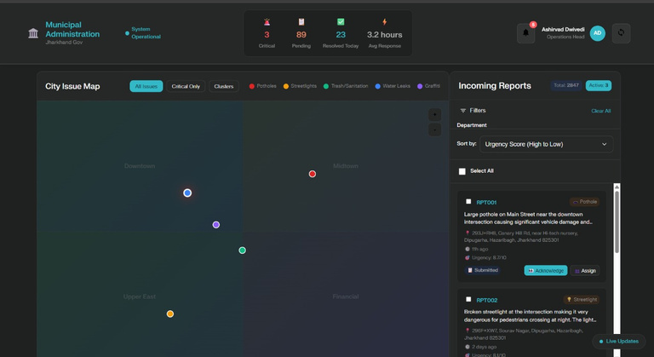
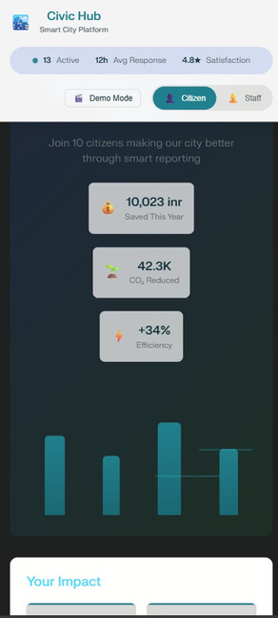
Proposed Solution
Smart Photo Analysis System: Citizens upload issues with automatic AI-powered categorization into 8 predefined types (Potholes, Streetlights, Trash, Water Leaks, etc.)
Real-Time Municipal Command Center: Live monitoring dashboard showing city health score (89), average response time (3.2h), and $187K annual cost savings
Comprehensive Impact Tracking: Individual citizen impact scores (94/100), resolution success rates (98%), and community engagement metrics for 8,934+ active users
Intelligent Department Routing: Automated assignment to 7 municipal departments with live performance tracking and trend analysis
Predictive Analytics Integration: AI insights detecting potential issues (23 predicted for next week) with 91% confidence based on weather patterns
2
Notes:
2

Slide 3





TECHNICAL APPROACH
3
Notes:
3

Slide 4
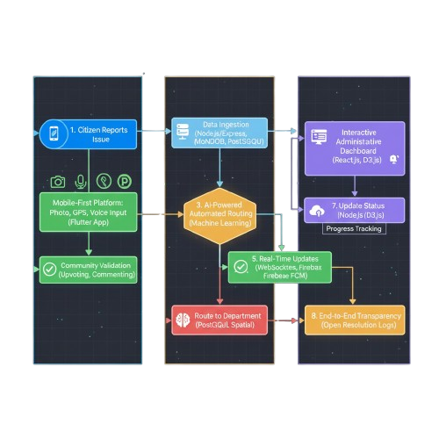
TECHNICAL APPROACH
3
Notes:
3

Slide 5
FEASIBILITY AND VIABILITY
High Technical Feasibility using proven open-source technologies with extensive documentation and community support
Scalable Cloud Infrastructure leveraging AWS/Heroku for handling traffic spikes and multimedia content efficiently
Cost-Effective Implementation with modular development approach allowing phased rollout and budget management
Risk Mitigation: Data privacy compliance, spam prevention through community validation, offline functionality for poor connectivity
Government Integration Strategy through API compatibility with existing municipal systems and gradual adoption approach
4
Notes:
4

Slide 6
IMPACT AND BENEFITS
Enhanced Civic Engagement empowering 70%+ more citizens to actively participate in local governance and community improvement
Faster Issue Resolution reducing average municipal response time from weeks to 24-48 hours through automated prioritization
Data-Driven Governance enabling predictive maintenance and resource optimization based on historical reporting patterns
Increased Government Transparency building public trust through trackable resolution processes and performance metrics
5
Notes:
5

Slide 7



RESEARCH AND REFERENCES
"Crowdsourcing Behavior in Reporting Civic Issues: The Case of Boston’s 311 Systems" (Lee et al., 2021): Analyzes how 311 platforms boost civic monitoring and explores data biases and regional inequalities.
Tracka and BudgIT, Nigeria: Civic tech initiatives driving public data sharing, budget transparency, and efficient government response.
"Research Study on How Municipal Financial Data can be used for public good" (ICAI, 2024): Explores use of municipal data and civic tech for transparency and financial oversight.
6
Notes:
6

