Slide 1
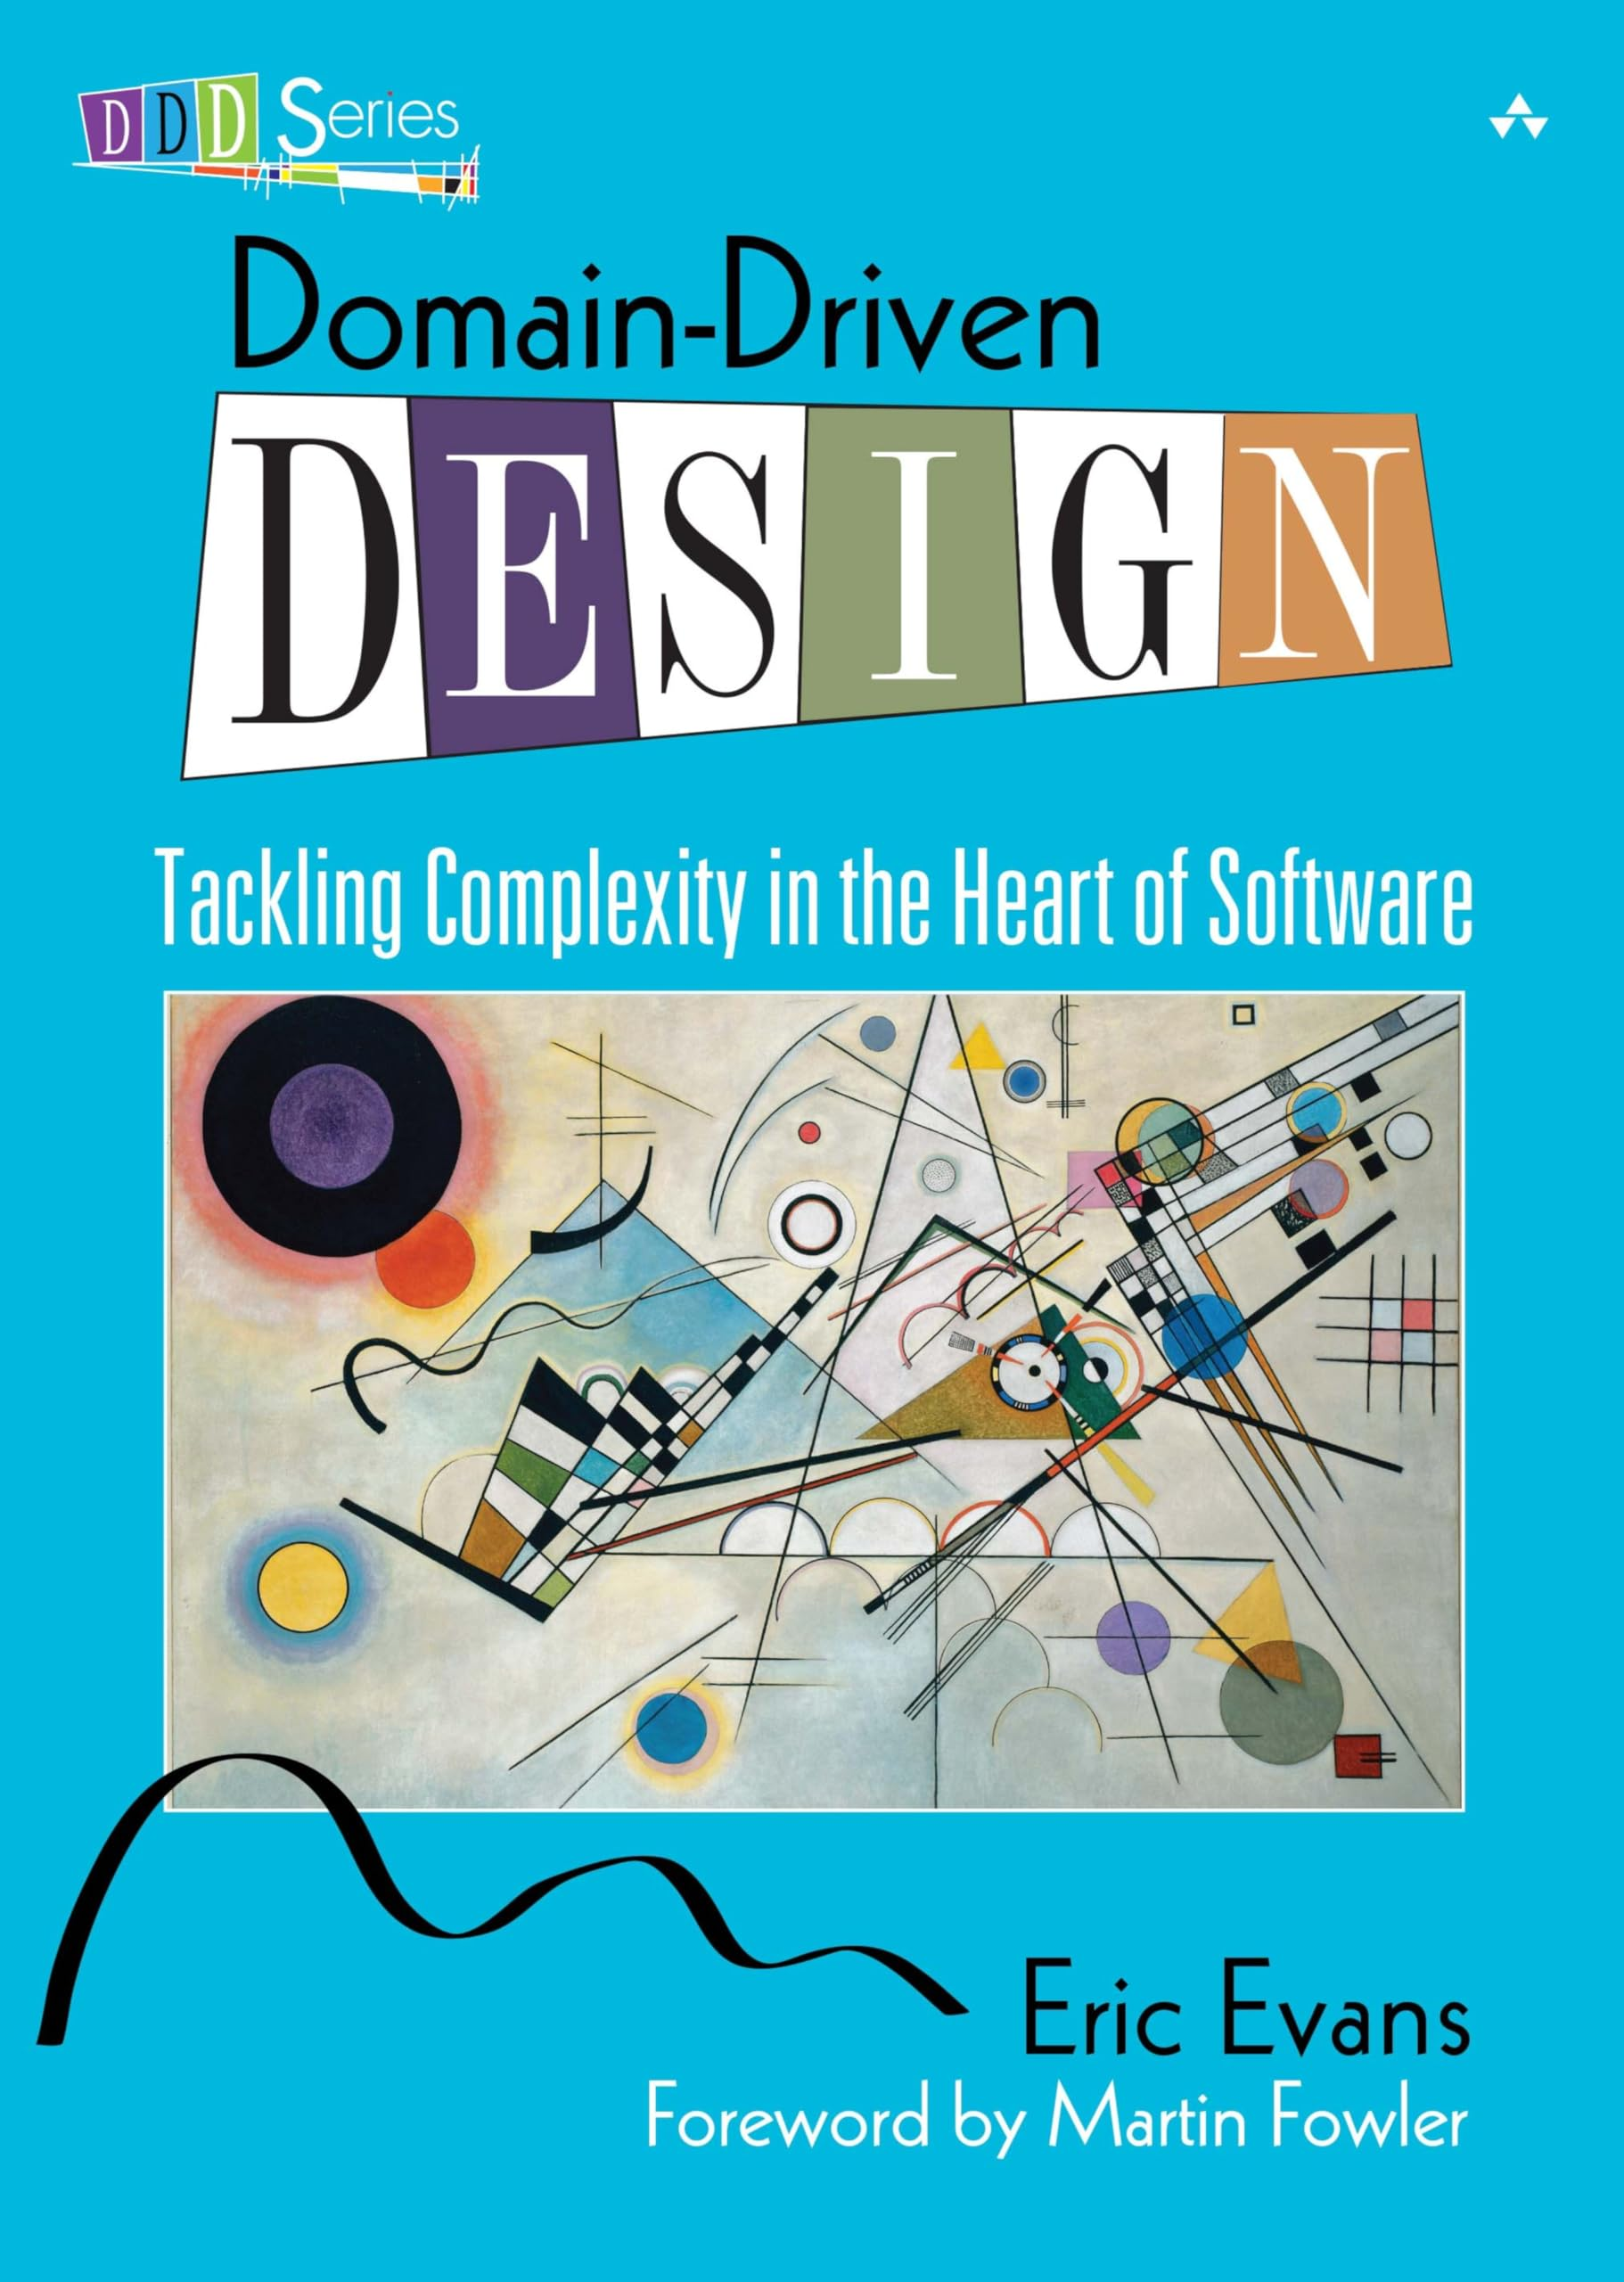
Just Enough Domain-Driven Design
the primary mechanism we use for finding
microservice boundaries is around the domain itself
Eric Evans’s Domain-Driven Design
important ideas that
helped us better represent the problem domain in our programs
core concepts of DDD
Ubiquitous language
Defining and adopting a common language to be used in code and in describing the domain, to aid communication.
Aggregate
A collection of objects that are managed as a single entity, typically referring to real-world concepts.
Bounded context
An explicit boundary within a business domain that provides functionality to the wider system but that also hides complexity.

Slide 2
Ubiquitous Language
we should strive to use the same
terms in our code as the users use
corporate liquidity, a fancy term that basically
refers to the ability to move cash among different accounts held by the same corporate entity
the IBM banking model
The data model had polluted the code to such an extent that the codebase was shorn of all real understanding of the system we were building.
By working the real-world language into the code, things became much easier. A
developer picking up a story written using the terms that had come straight from
the product owner was much more likely to understand their meaning and work
out what needed to be done.

Slide 3
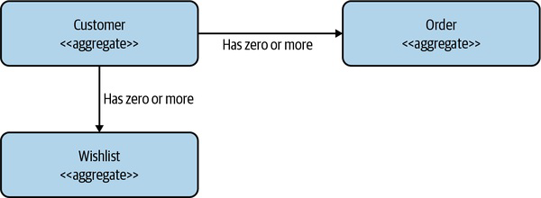
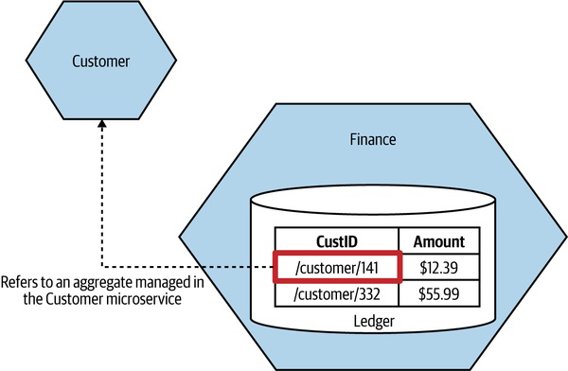
Aggregate
representation of a real domain concept
typically have a life cycle around them, which opens them up to being implemented as a state machine
self-contained units; we want to ensure that the
code that handles the state transitions of an aggregate are grouped together, along with the state itself
has state,
identity, a life cycle that will be managed as part of the system
the aggregate can say no
can have relationships with other aggregates
mental model of the system users be my guiding light on initial design until other factors come into play

Slide 4
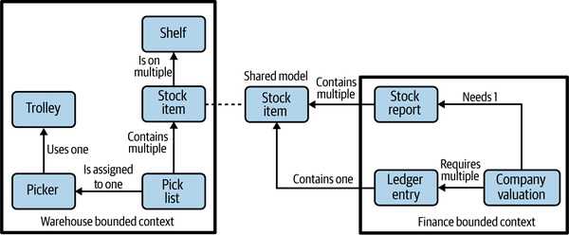
Bounded Context
represents a larger organizational boundary
Bounded contexts hide implementation detail
contain one or more aggregates
may be exposed outside the bounded context; others may be hidden internally
when you have different internal and
external representations, it may be beneficial to name them differently to avoid confusion
there is the internal-only representation and the
external representation we expose (see Stock item)
Hidden models
Shared models
We store information about the customer in both
locations, but the information is different

Slide 5
Mapping Aggregates and Bounded Contexts to
Microservices
Both the aggregate and the bounded context give us units of cohesion with well defined interfaces with the wider system.
target services that encompass entire bounded
contexts. As you find your feet and decide to break these services into smaller services
one microservice can manage one or more aggregates, but we don’t want one aggregate to be managed by more than one microservice*
Turtles all the way down
When considering the boundaries of your microservices, first think in terms of the larger, coarser-grained contexts, and then subdivide along these nested contexts when you’re looking for the benefits of splitting out these seams.
This is another form of information hiding

Slide 6
Event Storming
Alberto Brandolini
Collaborative brainstorming exercise designed to help surface a domain model
brings together technical and nontechnical stakeholders in a joint exercise
Logistics
The process
get everyone in a room together
participants identifying the domain events. These
represent things that happen in the system (captured on orange sticky notes)
want representatives of all parts of the domain that you plan
to model: users, subject matter experts, product owners, etc…
participants identify the commands that cause these events to happen. A command is a decision made by a human (a user of the software) to do something (captured on blue sticky notes)
pin large rolls of brown paper to the walls of the room
aggregates come next (events start to highlight what the potential aggregates might be and captured on yellow sticky notes)
main modeling tool is sticky notes to capture the various concepts, with differently colored notes representing different concepts
aggregates identified, they are grouped into bounded contexts

Slide 7
The Case for Domain-Driven Design for
Microservices
bounded contexts, which are so important to DDD, are explicitly about hiding information
whether we realize it or not, we are also adopting information hiding
Fundamentally, DDD puts the business domain at the heart of the software we are building.
helps improve domain expertise among the people who build the software
In a world in which we are increasingly trying to tear down the silos between IT and “the business,” this is no bad thing.

Slide 8
Alternatives to Business Domain Boundaries
it would be a mistake to think that this is the only technique
you should consider when finding microservice boundaries
Volatility
identify the parts of your system going through more frequent change and then extract that functionality into their own services
bimodal IT neatly breaks the world down into the snappily named “Mode 1” (aka Systems of Record) and “Mode 2” (aka Systems of Innovation) categories based on how fast (or slow) different systems need to go.
organizations adopting bimodal IT do end up having two speeds— slow and slower.

Slide 9
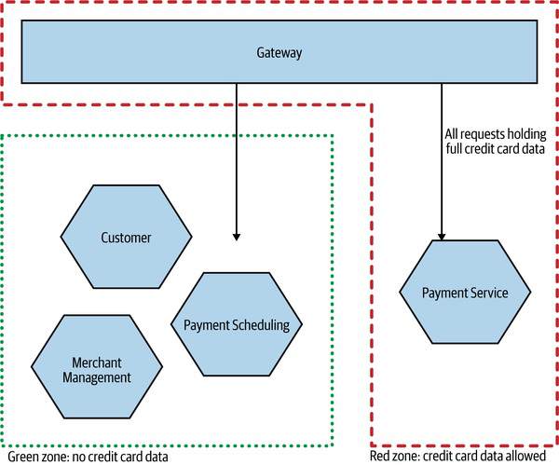
Alternatives to Business Domain Boundaries
it would be a mistake to think that this is the only technique
you should consider when finding microservice boundaries
Data
The nature of the data you hold and manage can drive you toward different forms of decomposition
you might want to limit which services handle personally identifiable information (PII)
PaymentCo had a need to handle the full credit card data, and at a volume that
meant its system had to comply with PCI Level 1
ensuring that the whole
system complied with these requirements, not least the need for the system to be
audited by an external party, was proving to be quite onerous

Slide 10
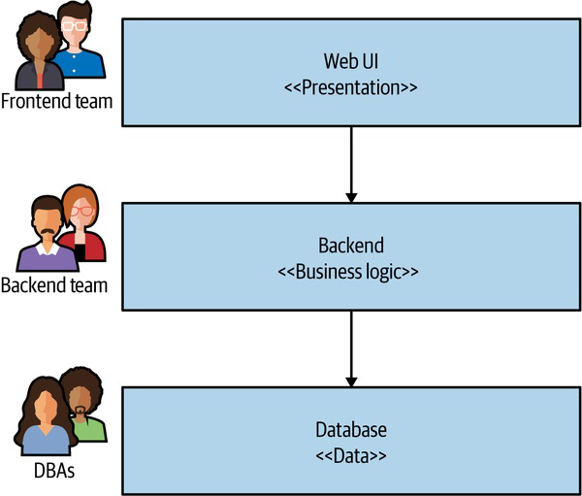
Alternatives to Business Domain Boundaries
it would be a mistake to think that this is the only technique
you should consider when finding microservice boundaries
Technology
The need to make use of different technology can also be a factor in terms of finding a boundary.
we have to be aware of where this can drive us if adopted as a general means of decomposition
As we’ve already explored, this is often a less than ideal architecture.

Slide 11
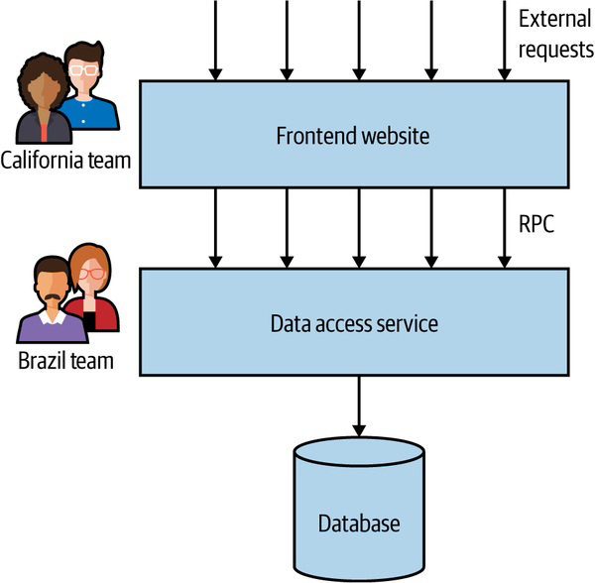
Alternatives to Business Domain Boundaries
it would be a mistake to think that this is the only technique
you should consider when finding microservice boundaries
Organizational
Conway’s law back in Chapter 1, there is
an inherent interplay between organizational structure and the system architecture you end up with
shared ownership of microservices is a fraught affair.
we must take into account the existing
organizational structure when considering where and when to define boundaries (and in some cases change the organizational structure to get the architecture we want)
I called this “onion architecture,” as it had lots of layers and made me cry when we had to cut through it.

Slide 12
Mixing Models and Exceptions
not dogmatic in terms of how you find these
boundaries
follow the guidelines of information hiding and appreciate the
interplay of coupling and cohesion
there can often be reasons to mix models
Being too narrow in your choices here will cause you to
follow the dogma rather than doing the right thing
improving the speed of delivery traded for delivery contention (volatility-based decomposition)
if one part of that system needs to be implemented in C++
and another part in Kotlin (technology-based decomposition)

