Slide 1
What Are Microservices?
Microservices are independently releasable services that are modeled around a business domain.
encapsulates functionality and makes it accessible to
other services via networks
Information hiding
means hiding as much information as possible inside a component and exposing
as little as possible via external interfaces.
This allows for clear separation
between what can change easily and what is more difficult to change.
Service-oriented architecture (SOA) is a design approach in which multiple
services collaborate to provide a certain end set of capabilities. (A service here typically means a completely separate operating system process.)
https://en.wikipedia.org/wiki/Hexagonal_architecture_(software)

Slide 2
Independent Deployability
Independent deployability is the idea that we can make a change to a
microservice, deploy it, and release that change to our users, without having to
deploy any other microservices.
To ensure independent deployability, we need to make sure our microservices
are loosely coupled: we must be able to change one service without having to
change anything else.

Slide 3
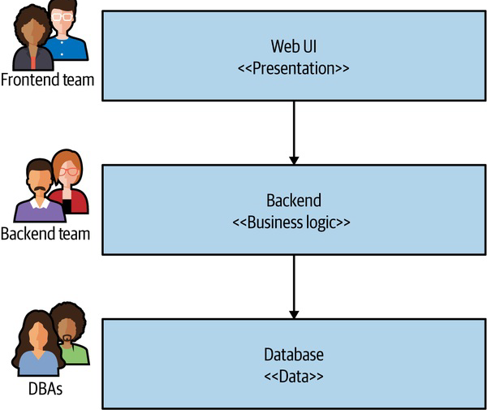
Modeled Around a Business Domain
Layered Architectures
It therefore follows that we want to find ways to make cross-service changes as infrequent as possible.
Arguably, with microservices we have made a decision to
prioritize high cohesion of business functionality over high cohesion of technical
functionality.

Slide 4
Owning Their Own State
microservices should avoid the use of shared databases.
allows us to clearly separate functionality
that can change freely (our internal implementation) from the functionality that
we want to change infrequently (the external contract that the consumers use).
Hiding internal state in a microservice is analogous to the practice of
encapsulation in object-oriented (OO) programming. Encapsulation of data in
OO systems is an example of information hiding in action.
The encapsulation of data
and behavior in this way gives us high cohesion of business functionality. By
hiding the database that backs our service, we also ensure that we reduce
coupling.

Slide 5
Size
“How big should a microservice be?”
James Lewis, technical director at Thoughtworks, has been known to say that “a
microservice should be as big as my head.”
a microservice should be kept to the size at which it can be
easily understood.
First, how many microservices
can you handle? As you have more services, the complexity of your system will
increase, and you’ll need to learn new skills (and perhaps adopt new technology)
to cope with this.
the goal of microservices is to have “as
small an interface as possible.”
Ultimately, the concept of size is highly contextual.
Second, how do you define microservice boundaries to get the most out of them,
without everything becoming a horribly coupled mess? These topics are much
more important to focus on when you start your journey.

Slide 6
Flexibility
“microservices buy you options.”
The resulting flexibility on a number of axes—organizational, technical, scale,
robustness—can be incredibly appealing.
Think of adopting microservices as less like flipping a switch, and more like
turning a dial. As you turn up the dial, and you have more microservices, you
have increased flexibility. But you likely ramp up the pain points too.

Slide 7
Alignment of Architecture and Organization
All architecture ends up getting optimized
around a set of goals.
the biggest reason we see this architecture again
and again is because it is based on how we organize our teams.
This is an architecture that has high cohesion of related
technology but low cohesion of business functionality.
The now famous Conway’s law states the following:
Organizations which design systems...are constrained to produce designs
which are copies of the communication structures of these organizations.
—Melvin Conway, “How Do Committees Invent?”
We now group people in poly-skilled teams to reduce
handoffs and silos. We want to ship software much more quickly than ever
before.
instead we need to change how we group code, choosing
cohesion of business functionality rather than technology.

Slide 8
The Monolith
microservices are most often discussed
as an architectural approach that is an alternative to monolithic architecture.
When all functionality in a system must be deployed
together, I consider it a monolith.

Slide 9
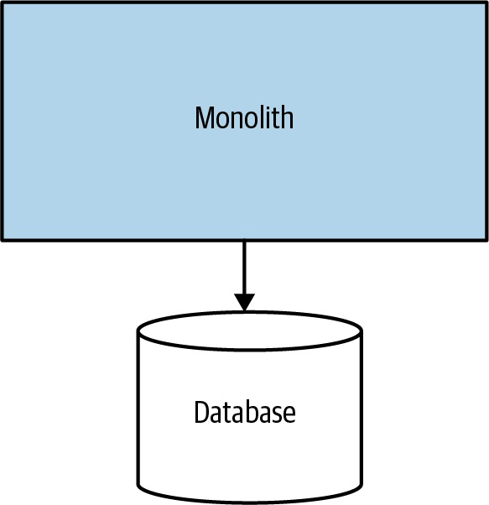
The Single-Process Monolith
system in which all of the code is deployed as a single process
A classic single-process monolithic deployment can make sense for many
organizations. David Heinemeier Hansson, the creator of Ruby on Rails, has
made the case effectively that such an architecture makes sense for smaller
organizations.

Slide 10

The Modular Monolith
modular monolith is a variation
in which the single process consists of separate modules.
If the
module boundaries are well defined, it can allow for a high degree of parallel
work, while avoiding the challenges of the more distributed microservice
architecture by having a much simpler deployment topology.
Shopify is a great
example of an organization that has used this technique as an alternative to
microservice decomposition
One of the challenges of a modular monolith is that the database tends to lack
the decomposition we find in the code level, leading to significant challenges if
you want to pull apart the monolith in the future.

Slide 11
The Distributed Monolith
A distributed monolith is a system that consists of multiple services, but for
whatever reason, the entire system must be deployed together.
a distributed monolith has all
the disadvantages of a distributed system, and the disadvantages of a single-process
monolith, without having enough of the upsides of either.
not enough
focus was placed on concepts like information hiding and cohesion of business
functionality.

Slide 12

Monoliths and Delivery Contention
As more and more people work in the same place, they get in one another’s way
confusion around who owns what and who makes decisions.
Advantages of Monoliths
much simpler deployment topology can avoid
many of the pitfalls associated with distributed systems.
simpler developer workflows, and monitoring, troubleshooting, and activities
like end-to-end testing
all the code is there; just use it!
Some think the term monolith is synonymous with legacy. This is a problem. A monolithic architecture is a choice, and a valid one at that.

Slide 13
Enabling Technology
you should constantly be
looking for issues caused by your increasingly distributed system, and then for
technology that might help.
technology has played a large part in the adoption of microservices as
a concept.
microservices
require an understanding of the supporting technology to such a degree that
previous distinctions between logical and physical architecture can be
problematic

Slide 14
Log Aggregation and Distributed Tracing
TIP
Be cautious about taking on too much new technology when you start off with microservices.
That said, a log aggregation tool is so essential that you should consider it a prerequisite for
adopting microservices.
These systems allow you to collect and aggregate logs from across all your
services, providing you a central place from which logs can be analyzed, and
even made part of an active alerting mechanism.

Slide 15
Containers and Kubernetes
Ideally, you want to run each microservice instance in isolation. This ensures
that issues in one microservice can’t affect another microservice—for example,
by gobbling up all the CPU.
Don’t feel the need to rush to adopt Kubernetes, or even containers for that
matter. They absolutely offer significant advantages over more traditional
deployment techniques, but their adoption is difficult to justify if you have only
a few microservices.
Containers, on the other hand, provide a much more lightweight way to
provision isolated execution for service instances
you’ll also realize that you need
something to allow you to manage these containers across lots of underlying
machines.
Container orchestration platforms like Kubernetes do exactly that

Slide 16
Streaming
Although with microservices we are moving away from monolithic databases,
we still need to find ways to share data between microservices.
For many people, Apache Kafka has become the de facto choice for streaming
data in a microservice environment (we will implement later as part of this course).

Slide 17
Public Cloud and Serverless
Public cloud providers, or more specifically the main three providers—Google
Cloud, Microsoft Azure, and Amazon Web Services (AWS)—offer a huge array
of managed services and deployment options for managing your application. As
your microservice architecture grows, more and more work will be pushed into
the operational space.

Slide 18
Advantages of Microservices
The advantages of microservices are many and varied. Many of these benefits
can be laid at the door of any distributed system. Microservices, however, tend to
achieve these benefits to a greater degree primarily because they take a more
opinionated stance in the way service boundaries are defined. By combining the
concepts of information hiding and domain-driven design with the power of
distributed systems, microservices can help deliver significant gains over other
forms of distributed architectures.

Slide 19
Technology Heterogeneity
With a system composed of multiple, collaborating microservices, we can decide
to use different technologies inside each one.
With microservices, we are also able to more quickly adopt technologies and to
understand how new advancements might help us.
One of the biggest barriers to
trying out and adopting a new technology is the risks associated with it.
Embracing multiple technologies doesn’t come without overhead, of course.

Slide 20
Robustness
A key concept in improving the robustness of your application is the bulkhead
elements of an application are isolated into pools so that if one fails, the others will continue to function. It's named after the sectioned partitions (bulkheads) of a ship's hull.
Service
boundaries become your obvious bulkheads.
In a monolithic service, if the
service fails, everything stops working.
Networks can and
will fail, as will machines. We need to know how to handle such failures and the
impact (if any) those failures will have on the end users of our software.

Slide 21
Scaling
With a large, monolithic service, we need to scale everything together.
With smaller services, we can scale just those
services that need scaling, allowing us to run other parts of the system on
smaller, less powerful hardware
When embracing on-demand provisioning systems like those provided by AWS,
we can even apply this scaling on demand for those pieces that need it. This
allows us to control our costs more effectively. It’s not often that an architectural
approach can be so closely correlated to an almost immediate cost savings.

Slide 22
Ease of Deployment
A one-line change to a million-line monolithic application requires the entire
application to be deployed in order to release the change. That could be a large impact,
high-risk deployment.
The bigger the delta between releases, the higher the risk that we’ll get something wrong!
With microservices, we can make a change to a single service and deploy it
independently of the rest of the system. This allows us to get our code deployed
more quickly. If a problem does occur, it can be quickly isolated to an individual
service, making fast rollback easy to achieve. It also means that we can get our
new functionality out to customers more quickly.

Slide 23
Organizational Alignment
Microservices allow us to better align our architecture to our organization,
helping us minimize the number of people working on any one codebase to hit
the sweet spot of team size and productivity.

Slide 24
Composability
With
microservices, we allow for our functionality to be consumed in different ways
for different purposes.
With microservices, think of us opening up seams in our system that are
addressable by outside parties. As circumstances change, we can build
applications in different ways.

Slide 25
Microservice Pain Points
Microservice architectures bring a host of benefits, as we’ve already seen. But
they also bring a host of complexity.
the bulk of this book is about dealing with the pain,
suffering, and horror of owning a microservice architecture.

Slide 26
Developer Experience
There is a limit to the number of things you can run locally, which inevitably will start
conversations about what to do when you can’t run the entire system on one
machine. This can become even more complicated if you are using cloud
services that you cannot run locally.
limiting the scope of
which parts of a system a developer needs to work on is likely to be a much
more straightforward approach. However, this might be problematic if you want
to embrace more of a “collective ownership” model in which any developer is
expected to work on any part of the system.

Slide 27
Technology Overload
Microservices may well give you the option for each microservice to be written
in a different programming language, to run on a different runtime, or to use a
different database—but these are options, not requirements.
The bandwidth taken up by trying to understand all of this new technology will
reduce the time you have for actually shipping features to your users.
You don’t need a Kubernetes
cluster when you have three services!

Slide 28
Cost
in the short term at least you’ll see an increase in costs
from a number of factors. Firstly, you’ll likely need to run more things
Secondly, any change you introduce into a team or an organization will slow you
down in the short term.
So are microservices a way to drive more
profits? Perhaps. Are microservices a way to reduce costs? Not so much.

Slide 29
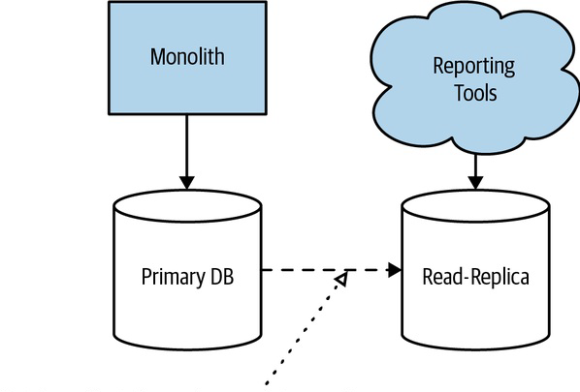
Reporting
With a monolithic system, you typically have a monolithic database. This means
that stakeholders who want to analyze all the data together, often involving large
join operations across data, have a ready-made schema against which to run their
reports.
With a microservice architecture, we have broken up this monolithic schema.

Slide 30
Monitoring and Troubleshooting
With a monolithic system, if our CPU is stuck at 100% for a long time, we know
it’s a big problem. With a microservice architecture with tens or hundreds of
processes, can we say the same thing? Do we need to wake someone up at 3 a.m.
when just one process is stuck at 100% CPU?

Slide 31
Security
more information flows over networks between our services.
This can make our data more vulnerable to being observed in transit and also to
potentially being manipulated as part of man-in-the-middle attacks.

Slide 32
Testing
with a microservice architecture, the scope of our end-to-end tests becomes
very large.
as your microservice architecture grows, you will get a
diminishing return on investment when it comes to end-to-end testing. The
testing will cost more but won’t manage to give you the same level of
confidence that it did in the past.

Slide 33
Latency
With a microservice architecture, processing that might previously have been
done locally on one processor can now end up being split across multiple
separate microservices.
serialized, transmitted, and deserialized over networks
that you might be exercising more than ever before.
can be difficult to measure the exact impact on latency of operations
at the design or coding phase
you have some way of measuring the
end-to-end latency for the operations you care about

Slide 34
Data Consistency
in the past you might have relied on database
transactions to manage state changes, you’ll need to understand that similar
safety cannot easily be provided in a distributed system.
Adopting an incremental
approach to decomposition, so that you are able to assess the impact of changes
to your architecture in production, is really important.

Slide 35
Should I Use Microservices?
They are an architectural approach, not the architectural approach.
Whom They Might Not Work For
Given the importance of defining stable service boundaries, I feel that
microservice architectures are often a bad choice for brand-new products or
startups.
“If we’re really successful, we’ll need to scale!”
organizations creating software that will be deployed and managed by
their customers may struggle with microservices.
coordinating changes across
service boundaries is an expensive undertaking.
Uber initially focused
on limos, and Flickr spun out of attempts to create a multiplayer online game.
microservice architectures can push a lot of complexity into the deployment and
operational domain. If you are running the software yourself, you are able to
offset this new complexity by adopting new technology, developing new skills,
and changing working practices.

Slide 36
Where They Work Well
A five-person startup is likely to find a
microservice architecture a drag. A hundred-person scale-up that is growing
rapidly is likely to find that its growth is much easier to accommodate with a
microservice architecture properly aligned around its product development
efforts.
Software as a Service (SaaS) applications are, in general, also a good fit for a
microservice architecture.
Microservices also present clear benefits for organizations looking to provide
services to their customers over a variety of new channels.
Above all, a microservice architecture is one that can give you a lot of flexibility
as you continue to evolve your system.

