Slide 1
Chapter 2. How to Model
Microservices
where to start?
foundational concepts such as
information hiding, coupling, and cohesion and understand how they’ll shift our thinking about drawing boundaries around our microservices.
maximize the upsides and avoid some of the potential downsides.

Slide 2
Introducing MusicCorp
until recently just a brick-and-mortar retailer
focused more and more of its
efforts online
decided that its best chance of taking over the world is to make sure it can
make changes as easily as possible. Microservices for the win!

Slide 3
What Makes a Good Microservice Boundary?
let’s put
the brakes on and talk a bit about the most important underlying idea we need to
keep in mind.
able to be changed and deployed,
and their functionality released to our users, in an independent fashion.
In essence, microservices are just another form of modular decomposition
we can rely on a lot of prior art in the
space of modular software and structured programming to help guide us in terms
of working out how to define our boundaries.
information hiding, cohesion, and coupling

Slide 4
The connections between modules are the assumptions which the modules make about each other
Information Hiding
developed by David Parnas to look at the most
effective way to define module boundaries.
desire to hide as many details as possible behind a module (or, in our case, microservice) boundary.
benefits that modules should theoretically give us;
Improved development time
More work to be done in parallel
Comprehensibility
looked at in isolation and understood in isolation
Flexibility
changes to be made to the functionality of the system without requiring other modules to change
deliver new functionality by combining modules

Slide 5
Cohesion
“the code that changes together, stays together.”
ease of making changes in business
functionality
We want related behavior to sit together, and unrelated behavior to sit elsewhere
we want to be able to change it in
one place and release that change… ASAP
If the related functionality is spread across the system, we
say that cohesion is weak
whereas for our microservice architectures we’re
aiming for strong cohesion

Slide 6
Coupling
loosely coupled, a change to one service should not require a
change to another
The whole point of a microservice
What sorts of things cause tight coupling?
A loosely coupled service knows as little as it needs to about the services with which it collaborates.
chatty communication can lead to tight coupling
Coupling, though, comes in many forms

Slide 7
The Interplay of Coupling and Cohesion
coupling and cohesion are obviously related
Constantine’s law
Larry Constantine, sums this up neatly:
A structure is stable if cohesion is strong, and coupling is low.
we need some degree of stability in the boundaries themselves
both concepts describe the relationship between things.
Cohesion applies to the relationship between things inside a boundary (a microservice in our context)
Coupling describes the relationship between things across a boundary
coupling and cohesion are just one way to articulate the various trade-offs we make around where we group code, and why

Slide 8
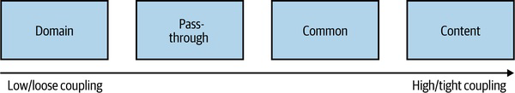
Types of Coupling
Ultimately, some coupling in our system will be unavoidable
Much of our work in computing involves building on the work that came before.
Larry Constantine; his book with Edward Yourdon, Structured Design
Meilir Page-Jones’s The Practical Guide to Structured Systems Design
support your local library!
In Figure 2-1 we see a brief overview of the different types of coupling, organized from low (desirable) to high (undesirable).

Slide 9
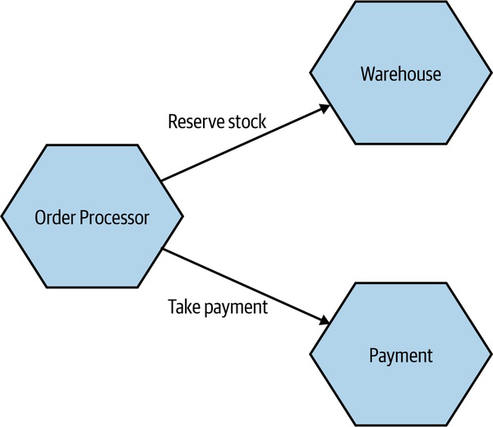
Domain Coupling
one microservice needs to
interact with another microservice, because the first microservice needs to make
use of the functionality that the other microservice provides.
In a microservice architecture, this type of interaction is largely unavoidable.
A microservice-based system relies on multiple microservices collaborating for it to do its work.
it might imply a microservice
that is doing too much.
Just remember the importance of information hiding. Share only what you absolutely must and send only the absolute minimum amount of data that you need.

Slide 10
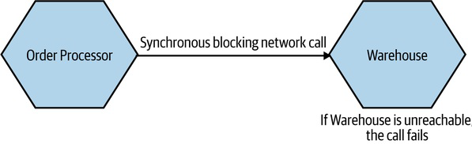
A BRIEF NOTE ON TEMPORAL COUPLING
situation
in which concepts are bundled together purely because they happen at the same time.
situation in which one
microservice needs another microservice to do something at the same time
for the operation to complete.
avoid temporal coupling is to use some form of asynchronous
communication, such as a message broker

Slide 11
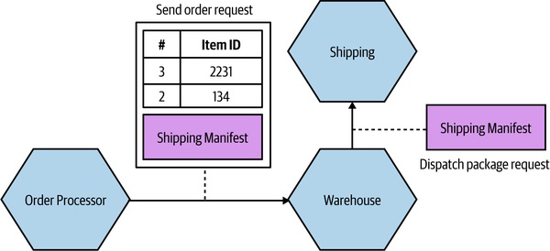
Pass-Through Coupling
one microservice passes data to another microservice purely because the data is needed by some other microservice further downstream.
a change to the required data
downstream can cause a more significant upstream change.

Slide 12
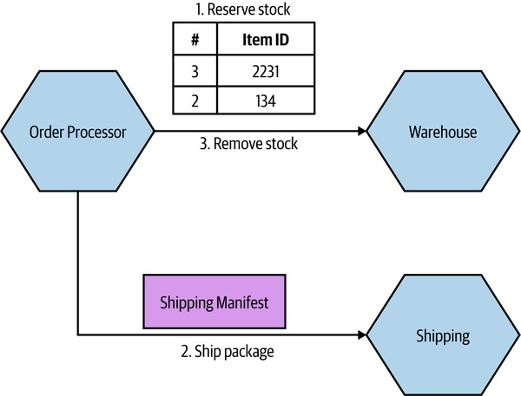
Solution 1
calling microservice to just bypass the intermediary

Slide 13
Solution 2B
Solution 2A
final approach that could help reduce the pass-through coupling would be
for the Order Processor to still send the Shipping Manifest to the Shipping
microservice via the Warehouse, but to have the Warehouse be totally unaware
of the structure of the Shipping Manifest itself.
totally hide the requirement for a Shipping Manifest from
Order Processor.
While this will help protect the Warehouse microservice from some changes to
Shipping, there are some things that would still require all parties to change.

Slide 14
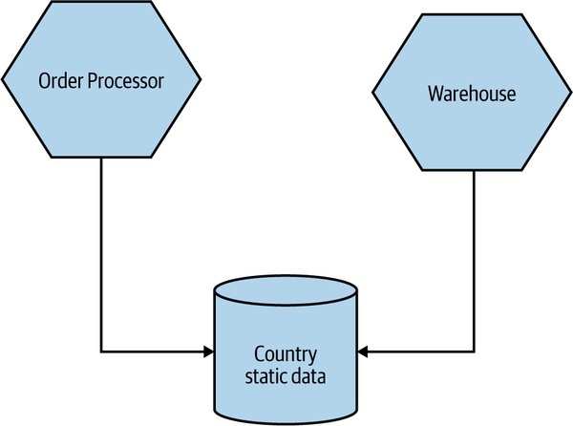
Common Coupling
when two or more microservices make use of a common set of data i.e., database, shared memory, or shared file system
changes to the structure of the data
can impact multiple microservices at once.
Ok - static reference data doesn’t tend to change often, and
because this data is read-only—
Problematic - structure of the common data changes more frequently, or if multiple microservices are reading and writing to the same data.
Conceptually, we have both the Order Processor and Warehouse microservices managing different aspects of the life cycle of an order.
can I be sure that I am not changing the
order data in such a way that it breaks Warehouse’s view of the world, or vice versa?

Slide 15
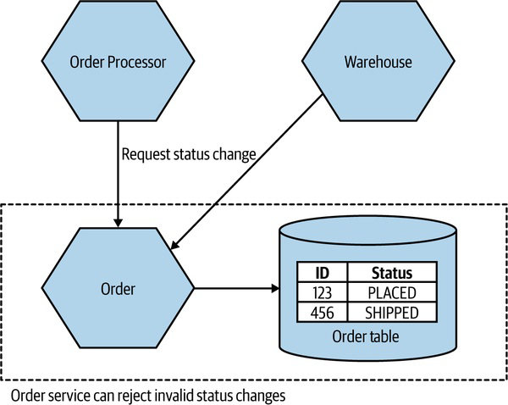
Solution 1 – Finite State Machine
WARNING
If you see a microservice that just looks like a thin wrapper around database CRUD operations,
that is a sign that you may have weak cohesion and tighter coupling, as logic that should be in
that service to manage the data is instead spread elsewhere in your system.
a single microservice manages the order state
TIP
Make sure you see a request that is sent to a microservice as something that the downstream microservice can reject if it is invalid.
Common coupling also potential sources of resource contention
I’ve seen more than one database brought to its knees by an
expensive SQL query—
common coupling is sometimes OK, but often it’s not

Slide 16
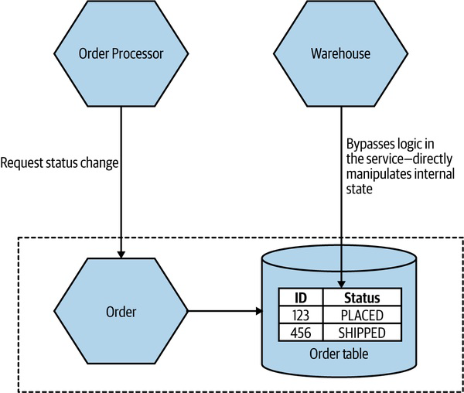
Content Coupling
an upstream service reaches into
the internals of a downstream service and changes its internal state.
The easy fix here is to have the Warehouse send requests to
the Order service itself
people refer to it as pathological
coupling
In short, avoid content coupling.

