Slide 1
Chapter 2. How to Model
Microservices
where to start?
foundational concepts such as
information hiding, coupling, and cohesion and understand how they’ll shift our thinking about drawing boundaries around our microservices.
maximize the upsides and avoid some of the potential downsides.

Slide 2
Introducing MusicCorp
until recently just a brick-and-mortar retailer
focused more and more of its
efforts online
decided that its best chance of taking over the world is to make sure it can
make changes as easily as possible. Microservices for the win!

Slide 3
What Makes a Good Microservice Boundary?
let’s put
the brakes on and talk a bit about the most important underlying idea we need to
keep in mind.
able to be changed and deployed,
and their functionality released to our users, in an independent fashion.
In essence, microservices are just another form of modular decomposition
we can rely on a lot of prior art in the
space of modular software and structured programming to help guide us in terms
of working out how to define our boundaries.
information hiding, cohesion, and coupling

Slide 4
The connections between modules are the assumptions which the modules make about each other
Information Hiding
developed by David Parnas to look at the most
effective way to define module boundaries.
desire to hide as many details as possible behind a module (or, in our case, microservice) boundary.
benefits that modules should theoretically give us;
Improved development time
More work to be done in parallel
Comprehensibility
looked at in isolation and understood in isolation
Flexibility
changes to be made to the functionality of the system without requiring other modules to change
deliver new functionality by combining modules

Slide 5
Cohesion
“the code that changes together, stays together.”
ease of making changes in business
functionality
We want related behavior to sit together, and unrelated behavior to sit elsewhere
we want to be able to change it in
one place and release that change… ASAP
If the related functionality is spread across the system, we
say that cohesion is weak
whereas for our microservice architectures we’re
aiming for strong cohesion

Slide 6
Coupling
loosely coupled, a change to one service should not require a
change to another
The whole point of a microservice
What sorts of things cause tight coupling?
A loosely coupled service knows as little as it needs to about the services with which it collaborates.
chatty communication can lead to tight coupling
Coupling, though, comes in many forms

Slide 7
The Interplay of Coupling and Cohesion
coupling and cohesion are obviously related
Constantine’s law
Larry Constantine, sums this up neatly:
A structure is stable if cohesion is strong, and coupling is low.
we need some degree of stability in the boundaries themselves
both concepts describe the relationship between things.
Cohesion applies to the relationship between things inside a boundary (a microservice in our context)
Coupling describes the relationship between things across a boundary
coupling and cohesion are just one way to articulate the various trade-offs we make around where we group code, and why

Slide 8
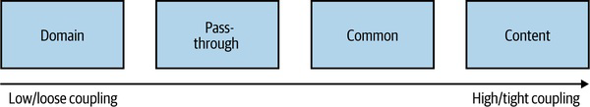
Types of Coupling
Ultimately, some coupling in our system will be unavoidable
Much of our work in computing involves building on the work that came before.
Larry Constantine; his book with Edward Yourdon, Structured Design
Meilir Page-Jones’s The Practical Guide to Structured Systems Design
support your local library!
In Figure 2-1 we see a brief overview of the different types of coupling, organized from low (desirable) to high (undesirable).

Slide 9
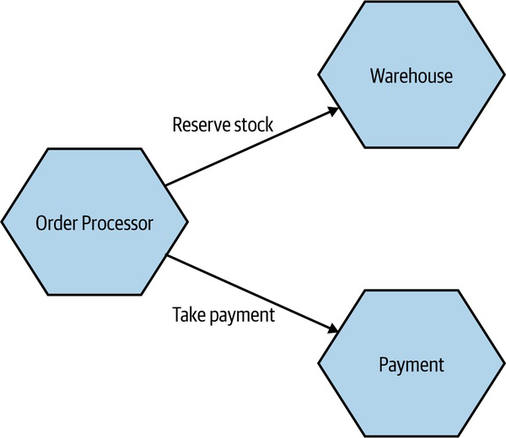
Domain Coupling
one microservice needs to
interact with another microservice, because the first microservice needs to make
use of the functionality that the other microservice provides.
In a microservice architecture, this type of interaction is largely unavoidable.
A microservice-based system relies on multiple microservices collaborating for it to do its work.
it might imply a microservice
that is doing too much.
Just remember the importance of information hiding. Share only what you absolutely must and send only the absolute minimum amount of data that you need.

Slide 10
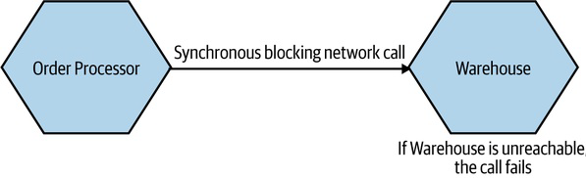
A BRIEF NOTE ON TEMPORAL COUPLING
situation
in which concepts are bundled together purely because they happen at the same time.
situation in which one
microservice needs another microservice to do something at the same time
for the operation to complete.
avoid temporal coupling is to use some form of asynchronous
communication, such as a message broker

