Slide 1
Chapter 11. Security
highlight those aspects of security that I consider worthwhile
for a general developer, architect, or operations person working on a microservice architecture to understand
it’s still important for you to have some grounding in these topics (even if you do have dedicated security experts).
our surface area of attack is much greater (compare monolith to distributed systems). More data flowing over networks, more machines, etc…
microservices give us more opportunity to defend in depth and limit the scope of access, potentially
increasing the projection of our system while also reducing the impact of an attack should it occur – interesting paradox that microservices make our system both more secure and less secure (let’s dig into that). All about balance*

Slide 2
Core principles
The five functions of cybersecurity
Identify, protect, detect, respond, and recover—an overview of the five key function areas for application security
Foundations of application security
Some specific fundamental concepts of application security and how they apply to microservices, including credentials and secrets, patching, backups, and rebuild
Implicit trust versus zero trust
Different approaches for trust in our microservice environment and how this impacts security-related activities
Securing data
How we protect data as it travels over networks and as it rests on disk
Authentication and authorization
How single sign-on (SSO) works in a microservice architecture, centralized versus decentralized authorization models, and the role of JWT tokens as part of this

Slide 3
Core Principles
with security is that you’re only as secure as your least secure aspect (doesn’t do you much good to have a super secure front door with a bunch of cameras, etc… if your back door is wide open).
Principle of Least Privilege
we should pay careful attention to what access we grant (to internal & external parties or even our own applications).
Definition – the idea that when granting access, we should grant the minimum access a party needs to carry out the required functionality, and only for the time they need it. If credentials are compromised, will give attacker access to as little as possible.
can extend to ensuring that access controls are only granted for limited timeframes as well

Slide 4
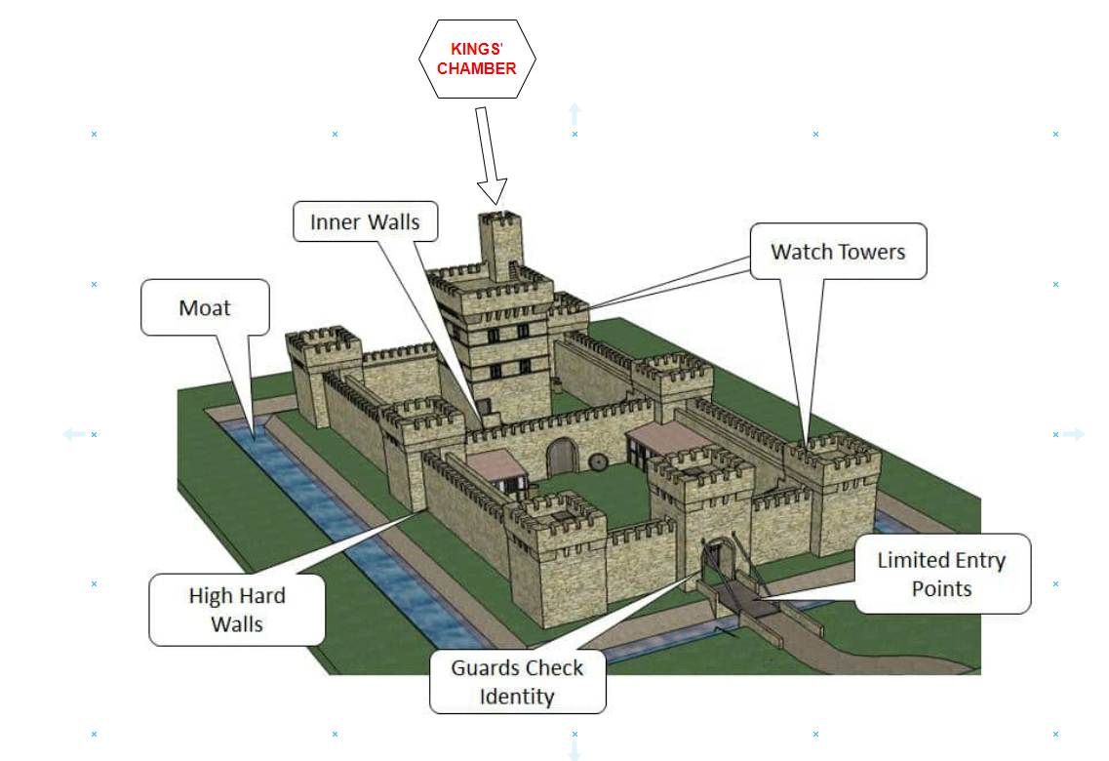
Defense in Depth
remind us of a time when people felt the need to defend their property from foes (great example of the principal of defense in depth).
It has not one wall but two—a breach in the first wall still requires that an attacker deals with the second one.
Same principal applies to microservices i.e., having multiple protections in place to defend against attackers is vital
By breaking our functionality apart into different
microservices and limiting the scope of what those microservices can do, we’re already applying defense in depth
We can also run microservices on different
network segments, apply network-based protections at more places, and even make use of a mix of technology for building and running these microservices such that a single zero-day exploit may not impact everything we have
A zero-day exploit occurs when a malicious actor identifies and exploits a vulnerability in software, hardware, or firmware before the vendor or developers are aware of the issue and can release a patch or fix

Slide 5
TYPES OF SECURITY CONTROLS
Preventative
Stopping an attack from happening. This includes storing secrets securely, encrypting data at rest and in transit, and implementing proper authentication and authorization mechanisms.
Detective
Alerting you to the fact that an attack is happening/has happened. Application firewalls and intrusion detection services are good examples.
Responsive
Helping you respond during/after an attack. Having an automated mechanism to rebuild your system, working backups to recover data, and a proper comms plan in place in the wake of an incident can be vital.

Slide 6
Automation
automation becomes key to helping us manage the growing complexity of our system (because we have so many moving parts).
we have a drive toward increasing the speed of delivery (again automation is key here).
reduce human error and make it easier to implement the principle of least privilege (tell story of Gocladdy.com).
automation can help us recover in the wake
of an incident. We can use it to revoke and rotate security keys and make use of tooling to help detect potential security issues more easily (embracing a culture of automation will help you immensely with security).

Slide 7
Build Security into the Delivery Process
Security has often been looked at as something of a blocker to getting software out the door (because it’s often an afterthought and not thought of until the product is created).
similar issues with testing, usability, and
Operations (sometimes thought of as the “do you want fries with that mentality”. i.e., something sprinkled on with the main meal.
We’ve gotten better at pulling testing forward into the main delivery process, as we’ve done with operational aspects (DevOps, anyone?) and usability—security should be no different
There are automated tools that can probe our systems for vulnerabilities, such as
by looking for cross-site scripting attacks. The Zed Attack Proxy (aka ZAP) is a good example. Informed by the work of OWASP, ZAP attempts to re-create malicious attacks on your website (other tools use static code analysis).
They don’t replace the need to understand the security of your system at a wider, systemic level.

Slide 8
The Five Functions of Cybersecurity
US National Institute of Standards and Technology
(NIST), which outlines a useful five-part model for the various activities involved in cybersecurity: (identify, protect, detect, respond, recover).
Identify who your potential attackers are, what targets they are trying to acquire, and where you are most vulnerable.
Protect your key assets from would-be hackers.
Detect if an attack has happened, despite your best efforts.
Respond when you’ve found out something bad has occurred.
Recover in the wake of an incident.
I find this model to be especially useful due to its holistic nature.

Slide 9
Identify
who might be after our stuff and what exactly they might be looking for
Threat modeling is the first thing you should look at when addressing this aspect of application security (you must put yourself in the attackers' shoes).
As human beings, we are quite bad at understanding risk. We often fixate on the wrong things while ignoring the bigger problems that can be just out of sight.
namely the fact that people seemed unconcerned that the
front door of one of the main offices had a faulty lock, and that for years people would arrive in the morning to find the door unlocked.
The goal of threat modeling is about helping you understand what an attacker might want from your system (i.e., what are they after?).
One of the outputs of a threat modeling
exercise would be a list of recommendations for what security controls need to
be put in place
having an external party help drive a
threat modeling exercise can be very useful.

Slide 10
Protect
Once we’ve identified our most valuable—and most vulnerable—assets, we
need to ensure that they are properly protected.
We’ll spend most of this chapter focusing on
various aspects of protection, primarily because this is the area where microservice architectures create the most challenges.

Slide 11
Detect
With a microservice architecture, detecting an incident can be more complex.
log aggregation, can help us gather information that will help us detect that something bad might be happening. In addition to those, there are special tools like intrusion detection systems that you might run to spot bad behavior

Slide 12
Respond
Working out an effective incident response approach is vital to limiting the damage caused by a breach (normally starts by identifying the scope, and the nature of the data that’s been exposed). If involving (PII) then you also need to follow privacy incident response as well as security.
but also what you should do in terms of looking after the users of your software (not just what you have to do from a compliance or legal perspective). GDPR says that you have to report data breaches within 72 hours.
Organizations that have a culture of blame and fear are likely going to fare badly in the wake of a major incident (important how you deal with it internally).
An organization that focuses on openness and safety will be best placed to learn the lessons that ensure that similar incidents are less likely to happen

Slide 13
Recover
our ability to get the system up and running again in the wake
of an attack, and also our ability to implement what we have learned to ensure problems are less likely to happen again
later in this chapter we will look at how simple
things like automation and backups can help you rebuild a microservice system on demand and get your system back up and running as quickly as possible

Slide 14
Foundations of Application Security
credentials, patching, backups, and rebuild (more specific to the microservices architecture).
Credentials
give a person (or computer) access to some form of restricted resource (database, computer, user account, or something else).
likely have the same number of humans involved, but we have lots more credentials in the mix (monolith vs. microservices).
can lead to a “lazy” approach in which a small number of
credentials with broad privileges are used to simplify things*
credentials of the users (and operators) of our system (often the weakest point) and are commonly used as an attack vector.
pieces of information that are critical to running our microservices (must consider rotation, revocation, and limiting scope for each type).

Slide 15
User credentials
potential weak spot when it comes to our systems being accessed by malicious parties
were stolen through mechanisms like phishing attacks or where
passwords were brute-forced (Verizon found this in 80% of cases caused by hacking).
Latest advice from both NIST and the UK’s National Cyber Security Centre (use password managers and long passwords (to avoid the use of complex password rules, avoid mandated regular password changes).
credentials also extend to managing things like API keys for third-party systems, such as accounts for your public cloud provider (can lead to a company going out of business i.e., Code Spaces, or spinning up a virtual machine to mine Bitcoin ☺ ).
there are bots out there that will just scan for credentials and try to use them to launch machines for cryptocurrency mining

Slide 16
Secrets
critical pieces of information that a microservice needs to operate and that are also sensitive enough that they require protecting from malicious parties (broadly speaking).
i.e., Certificates for TLS, SSH keys, Public/private API keypairs, and Credentials for accessing databases.
Various aspects of secrets management that might require different security needs (the life cycle of a secret).
Creation – how do we create the secret in the first place?
Distribution – once created, how do we make sure it gets to the right place (and only the right place)?
Storage – is it stored in a way that only authorized parties can access it?
Monitoring – do we know how this secret is being used?
Rotation – are we able to change the secret without causing problems?
we’re going to need to use tooling to help manage all of this (Kubernetes, Hashicorp’s Vault, Azure Key Vault, etc…)

Slide 17
Rotation
we want to rotate credentials frequently to limit the damage someone can do if they gain access to the credentials
Moving to a process of frequent rotation of credentials like keys can be painful (i.e., systems stop working when keys are changed). Do to it being unclear as to what is using a particular credential.
If the scope of the credential is limited, the potential impact of rotation is significantly reduced (with broad use, the impact of a change can be difficult to sus out).
Most sensible way forward would likely be to adopt tooling to help automate this process while also limiting the scope of each set of credentials at the same time.

Slide 18
Revocation
What happens if you know that a given credential has fallen into the wrong hands? Do you have to wait until a scheduled rotation kicks in for that credential to no longer be valid?
The use of tools that allow for centralized secrets management can help here (need to make sure your microservices can get the new values or do a rolling restart if they’re only read at startup).
SCANNING FOR KEYS
Accidentally checking in private keys to source code repositories is a common way for credentials to be leaked to unauthorized parties (happens a surprising amount).
By setting it up as a commit hook, it can stop commits even being made (git-secrets).

Slide 19
Limiting scope
Limiting the scope of credentials is core to the idea of embracing the principle of least privilege.
Limiting scope can apply in terms of both what the set of credentials can access and who has access to that set of credentials.
some form of automation would be essential—

Slide 20
Patching
The 2017 Equifax data breach is a great example of the importance of patching
Months before the breach, the vulnerability in Apache Struts had been identified, and a new release had been made by the maintainers fixing the issue. Unfortunately, Equifax hadn’t updated to the new version of the software, despite it being available for months before the attack (wouldn’t have been possible if the update was made in a timely manner).
Containers throw us an interesting curveball here. We treat a given container instance as immutable. But a container contains not just our software but also an operating system.
companies like Aqua provide tooling to help you analyze your running production containers so you can understand what issues
need to be addressed (not just the code we write, what about third parties?).

Slide 21
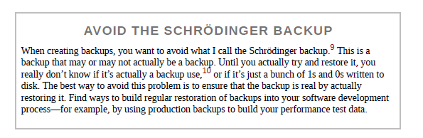
Backups
sometimes think that taking backups is like flossing (lots more people say they do it than do).
What matters is that your backups are stored in a
way that they are as isolated as possible from your core systems, so that a compromise in the core system won’t also put your backups at risk.
you should take backups, because data is valuable, and you don’t want to lose it.
Backups are as important as ever. So please, back up your
critical data.
So, make sure you back up critical data, keep those backups in a system separate to your main production environment, and make sure the backups work by regularly restoring them.
With the right filesystem technology, it’s possible to take near instantaneous block-level clones of a database’s data without noticeably interrupting service

Slide 22
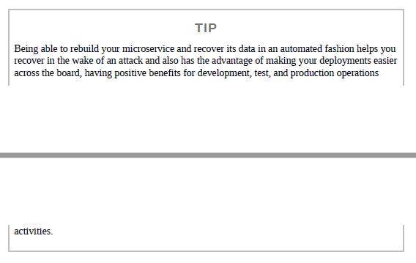
Rebuild
often the most important thing you
can do in the initial aftermath is get the system up and running again (but in such a way that you have removed access from the unauthorized party).
In the end, we basically had to reinstall the entire server from scratch (they had modified system commands).
but if you are routinely rebuilding
your servers and rotating credentials, you may be drastically limiting the impact of what they can do without your realizing it.
Comes down to the quality of your automation and backups (ability to rebuild a microservice, or even an entire system).
If you can deploy and configure each microservice from scratch based on information stored in source control, you’re off to a good start.
use the same process for rebuilding a microservice as you do for every deployment.

Slide 23
Implicit Trust Versus Zero Trust
When it comes to application security, we need to consider the
issue of trust among all those points of contact (human to system via interfaces, interfaces to microservices, and microservices to microservices).
Do we trust everything running in our network? Or do we view everything with
suspicion? Here, we can consider two mindsets—implicit trust and zero trust.

Slide 24
Implicit Trust
Our first option could be to just assume that any calls to a service made from inside our perimeter are implicitly trusted.
However, should an attacker penetrate your network, all hell could break loose.
If the attacker decides to intercept and read the data being sent, change the data without you knowing, or even in some circumstances pretend to be the thing you are talking to, you may not know much about it (man in the middle attack).
worry that the implicit trust model is not a conscious
decision; rather, people are unaware of the risks in the first place

Slide 25
Zero Trust
“Jill, we’ve traced the call—it’s coming from inside the house!”
you must assume that you are operating in an environment that has already been compromised—
the computers you are talking to could have been compromised, the inbound connections could
be from hostile parties, the data you are writing could be read by bad people. Paranoid? Yes! Welcome to zero trust.
In effect, the concept of a “perimeter” is meaningless with zero trust (for this reason, zero trust is often also known as “perimeterless computing”).
[With zero trust] you can actually make certain counter-intuitive access decisions and for example allow connections to internal services from the internet because you treat your “internal” network as equally trustworthy as the internet (i.e., not at all).
—Jan Schaumann

Slide 26
It’s a Spectrum
I don’t mean to imply that you have a stark choice between implicit and zero trust (trust can be based upon the sensitivity of information being accessed).
adopt a concept of zero trust for any microservices
handling PII but be more relaxed in other areas (cost of security implementation must be justified (and driven) by your threat model.
let's look at MedicalCo, a company I worked with that managed
sensitive healthcare data pertaining to individuals (straightforward approach).
Public – Data that could be freely shared with any external party. This information is effectively in the public domain.
Private – Information that should be available only to logged-in users. Access to this information could be further limited due to authorization restrictions. This might include things such as which insurance plan a customer was on.
Secret – Incredibly sensitive information about individuals that could be accessed by people other than the individual in question only in extremely specific situations. This includes information about an individual’s health data.

Slide 27
Securing Data
Let’s look in more detail at how we can protect our data as it moves over networks, and as it sits at rest.
Data in Transit
will depend largely on the nature of the communication protocols you have picked (nature of protection depends on this).
consider more generically the four main areas of interest when it comes to securing data in transit.

Slide 28
Server identity
Is the server you are talking to is exactly who it claims to be?
When people talk about “HTTPS,” they are typically referring to using HTTP with TLS.
With most communication over the public internet, due to the
various potential attack vectors out there (unsecured WiFi, DNS poisoning, and the like), it is vital to ensure that when we go to a website it really is the website it claims to be.
With HTTPS, our browser can look at the certificate for that
website and make sure it is valid (“HTTPS Everywhere” has become the rallying cry for the public internet).

Slide 29
Client identity
we are referring to the microservice making a call— (number of different ways).
We could ask that the client send us some information in the request telling us who they are (example would be a shared secret or a client-side certificate to sign the request).
I struggle to think of a situation in which I would verify client identity without also verifying server identity—to verify both, you would typically end up
implementing some form of mutual authentication. With mutual authentication, both parties authenticate each other. So in Figure 11-6, the Order Processor
authenticates the Payment microservice, and the Payment microservice authenticates the Order Processor (do this through mutual TLS or MTLS).
In our microservice architecture, though, especially where we might be operating in a zero-trust environment, this is much more common.

Slide 30
Visibility of data
When we send data from one microservice to another, can someone view the data (some data we don’t care because it’s in the public domain) already? Other data might include PII, which we need to ensure is protected.
plain old HTTPS or mutual TLS, data won’t be visible to
intermediate parties—this is because TLS encrypts the data being sent (can be problematic if you’re trying to use proxies to cache data).

Slide 31
Manipulation of data
The same things that protect us against data being visible ensure that data can’t be manipulated. In cases that you want data to be out in the open: For HTTP, one such approach is to use a hash-based message
authentication code (HMAC) to sign the data being sent. With HMAC, a hash is generated and sent with the data, and the receiver can check the hash against the data to confirm that the data hasn’t been changed.

Slide 32
Data at Rest
Data lying about is a liability (especially if it’s sensitive).
Badly implemented encryption could be worse than having none, as the false sense of security (pardon the pun) can lead you to take your eye off the ball.
defense in depth is key (we’ve done a lot to protect our networks, applications, operating systems, etc… but we should still be prepared).
(high profile security breaches involve data at rest) why? data was stored in an unencrypted form or because the mechanism used to protect the data had a fundamental flaw
The mechanisms by which data at rest can be protected are many and varied, but there are some general things to bear in mind
making use of your database’s built-in support for encryption (if you find a need to encrypt and decrypt data in your own system, make sure you’re going with a well-known and tested implementation).
try to implement your own encryption algorithms (and if you’re securing passwords make sure you’re using salted password hashing).

Slide 33
Pick your targets
Assuming everything should be encrypted can simplify things somewhat (no guesswork).
computational overhead of encrypting everything can
become onerous and require more powerful hardware as a result (for example database migrations i.e., decrypt data, migrate, and then re encrypt.
Limiting this encryption to a known set of tables is a sensible approach.

Slide 34
Be frugal
ease with which bulk amounts of information can be captured and stored is improving rapidly (data is valuable, not only to the businesses themselves, but also to the users who value their own privacy).
Why not scrub as much information as possible that can be personally identifiable (do it ASAP).
The advantages to being frugal with data collection are manifold. First, if you don’t store it, no one can steal it. If you don’t store it no one can ask for it.
Datensparsamkeit represents this concept (German phrase).
storing only as much information as is absolutely required to fulfill business operations or satisfy local laws

Slide 35
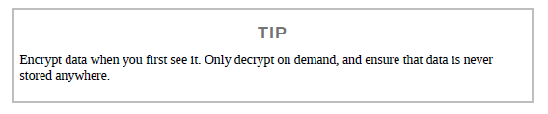
It’s all about the keys
Most forms of encryption involves making use of some key in conjunction with a suitable algorithm to create encrypted data (customers may need access to these keys).
So where are your keys stored (if I put a bunch of work in to encrypt my data in a database, but include the key in the database I haven’t achieved much)?
Recall how we manage secrets, use a separate appliance to store keys. How you manage these keys becomes very important!
Encrypt backups
if the data is sensitive enough that we want it to be encrypted in our running production system, then we will probably also want to make sure that any backups of the same data are also encrypted!

Slide 36
Authentication and Authorization
core concepts when it comes to people and
things that interact with our system
authentication is the process by which we confirm that a party is who they say they are (typically by typing in their username and password). More complex systems exist i.e. fingerprint, etc…
talking abstractly about who or what is being authenticated, we refer to that party as the principal.
Authorization is the mechanism by which we map from a principal to the action we are allowing them to do (we get additional information about the principal telling us what they can do for example what department or office they work in).
we also need to look at how we can implement single sign-on (SSO) in a microservices environment (to make our systems easiest to use).

Slide 37
Service-to-Service Authentication
Earlier we discussed mutual TLS, which, aside from protecting data in transit, also allows us to implement a form of authentication. When a client talks to a server using mutual TLS, the server can authenticate the client, and the client is able to authenticate the server—this is a form of service-to-service authentication. Other authentication schemes can be used besides mutual TLS. A common example is the use of API keys, where the client needs to use the key to hash a request in such a way that the server can verify that the client used a valid key.

Slide 38
Human Authentication
being used as part of a multifactor authentication approach, where a user may need more than one piece of knowledge (a factor) to authenticate themselves (typical MFA). More than one factor is needed.
MFA would most commonly involve the use of a normal
username and password combo, in addition to providing at least one additional factor.
For managing authentication of key services
that are vital to the running of your software or allow access to especially sensitive information (e.g., source code access), I’d consider the use of MFA to be a must.

Slide 39
Common Single Sign-On Implementations
single sign-on (SSO) solution to ensure that a user has only to authenticate themselves only once per session (even if they interact with multiple downstream services or applications).
SAML is a SOAP-based standard and is known for being complex to work
with despite the libraries and tooling available to support it, and since the first
edition of this book it has rapidly fallen out of favor. OpenID Connect is a
standard that has emerged as a specific implementation of OAuth 2.0, based on
the way Google and others handle SSO. It uses simpler REST calls, and due in
15
part to its relative simplicity and widespread support, it is the dominant
mechanism for end-user SSO and has gained significant inroads into enterprises.
When a principal tries to access a resource (like a web-based interface), they are directed to authenticate with an identity provider (requires username and password and in some cases some other factor (in case of MFA)).
it gives information to the service provider,
allowing it to decide whether to grant them access to the resource
Often the directory service and the identity provider are one and the same.
So, the identity provider gives the system information about who the principal is, but the system decides what that principal is allowed to do.

Slide 40
Single Sign-On Gateway
We could decide to handle the redirection to, and handshaking with, the identity provider within each microservice, so that any unauthenticated request from an outside party is properly dealt with (recall DRY and the perils of code reuse and the potential for coupling as a result, also wouldn’t help if microservices are written in a different tech stack).
more common approach is to use a gateway to act as a proxy, sitting between your services and the outside world
we still need to solve the problem of how the downstream service receives information about principals (username & roles).
If using HTTP, you could have your gateway populate headers with this information.
create a JSON Web Token (JWT) containing all the
information about the principal; something we can pass microservice to microservice.
it can be harder to reason about how a microservice behaves when looking at it in isolation (even harder to produce a production like environment). Also, can lull you into a false sense of security (defense in depth don’t rely on the gateway for everything). Can become a huge coupling point, the more functionality the greater the attack surface.

Slide 41
Fine-Grained Authorization
it is common to place people in groups or assign them to
roles. We can use this information to understand what they can do (i.e., only can access helpdesk application if in role of STAFF).
we need to leave the rest to the microservice itself; it will
need to make further decisions about what operations to allow.
using fine-grained roles like CALL_CENTER_50_DOLLAR_REFUND, where they end up putting information specific to one piece of microservice functionality into their directory services (this is a nightmare).
Instead, favor coarse-grained roles modeled around how your organization works.

Slide 42
The Confused Deputy Problem
occurs when an upstream party tricks an intermediate party into doing things it shouldn’t be doing.
But should these downstream services accept the calls from the Web Shop? We could adopt a stance of implicit trust: because the call came from within our perimeter, it is OK (we could even use certificates or API keys to validate Web Shop Identity but is this enough?).
What if the customer could trick the web shop’s UI into
making a request for someone else’s details, maybe by making a call with their own logged-in credentials (what is stopping a customer from asking for details of an order that is not theirs)?
while we have authenticated the
user in question, we aren’t providing sufficient authorization. What we want is some part of our system to be able to judge that a request to see User A’s details can be granted only if it’s User A asking to see them (but where?).

Slide 43
Centralized, Upstream Authorization
perform all required authorization as soon as the request is received in our system (authorize request in SSO Gateway, or Web Shop). Think about how this effects independent deployability, and what trust model does this follow?
we’d want to push the decision about whether the call should be authorized into the same microservice where the functionality being requested lives. This makes the microservice more self-contained and gives us the option to implement zero trust if we want.
Decentralizing Authorization
microservice needs information about what human is making the request (how to get it there).
Pass It in the header, most recently to use JSON Web Tokens.

Slide 44
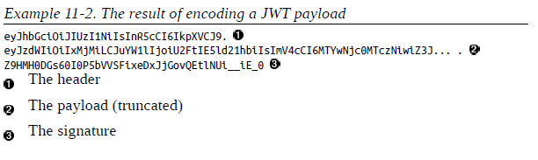
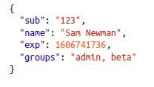
JSON Web Tokens
JWTs allow you to store multiple claims about an individual into a string that can be passed around (can be signed to make sure the structure hasn’t been manipulated). Can be used for generic exchanges of information, but most used for authorization. Most identity providers support them & large number of libraries for supporting them in your code.
The header contains information about the signing algorithm being used.
Format
The payload is where
we store information about the claims that the token is making
JSON structure, which broadly speaking can
contain anything you want
If you use these public claim fields correctly, there is a good
chance that the libraries you use will be able to make use of them appropriately (for example rejecting a token if it has expired).
The signature is used to ensure that the payload hasn’t been manipulated

Slide 45
Using tokens
One alternative is to generate the JWT token when the user is initially authenticated but remember we’d like to limit the period of validity for system-generated credentials to
reduce the chances of them being misused i.e., would have to be valid for the entire user session and stored on the client device.
So, with suitable JWT token generation, our downstream microservices can get all the information they need to confirm the identity of the user making the
request, as well as additional information such as the groups or roles that user is in. The validity of this token can also be checked by the microservice simply by checking the signature of the JWT token as well. Compared to the previous
solutions in this space (such as nested SAML assertions), JWT tokens have made the process of decentralizing authorization in a microservice architecture much simpler.

Slide 46
Challenges
In the case of signed JWT tokens, to verify a signature,
the receiver of a JWT token is going to need some information that will need to be communicated out of band—normally a public key (all issues of key management apply in this case).
Secondly, getting the expiration right for a token can be tricky if long processing times are involved (at what point does having a long-lived token become more troublesome than having no token at all)?
Finally, in some situations you can end up needing so much information in the JWT token that the token size itself becomes a problem (rare but does happen).

