Slide 1
Chapter 4. Microservice Communication Styles
people gravitate toward a chosen technological approach without first considering the different types of communication they might want
synchronous blocking and asynchronous nonblocking
communication mechanisms, as well as comparing request-response collaboration with event-driven collaboration
start looking at more detailed implementation concerns in the
following chapters.

Slide 2
From In-Process to Inter-Process
calls between different processes across a network (interprocess) are very different from calls within a single process (in-process).
think of one object making a method call on another object and then just map this interaction to two microservices communicating via a network.
Performance
Expect the overhead of an inter-process call to be
significant compared to the overhead of an in-process call.
When I pass a parameter into a method, the data structure I pass in typically doesn’t move—
When making calls between microservices over a network, on the other hand, the data must be serialized into some form that can be transmitted over a network.
might lead you to reduce the amount of data being sent or received (recall information hiding)

Slide 3
Changing Interfaces
inside a process, the act of rolling out the change is straightforward
the microservice exposing an interface and the consuming microservices using that interface are separately deployable microservices
backward-incompatible change to a microservice interface, we either need to do a lockstep deployment with consumers, making sure they are updated to use the new interface, or else find some way to phase the rollout of the new microservice contract

Slide 4
Error Handling
the errors either are expected and easy to handle, or they are catastrophic to the point that we just propagate the error up the call stack. Errors, overall, are deterministic
the nature of errors can be different (out of your control in some cases)
Networks time out. Downstream microservices might be temporarily unavailable. Networks get disconnected, containers get killed due to consuming too much memory, and in extreme situations, bits of your data center can catch fire
Crash, Omission, Timing, Response, and Arbitrary Failures (Distributed Systems - five types of Failure Modes).
Many of these errors are often transient in nature—they are short-lived problems that might go away
it can become important to have a richer set of semantics for returning errors in a way that can allow clients to take appropriate action (HTTP is an example protocol that understands the importance of this).

Slide 5
Technology for Inter-Process Communication:
So Many Choices
And in a world where we have too many choices and too little time, the obvious thing to do is just ignore stuff.
—Seth Godin
People gravitate to technology that is familiar to them, or perhaps just to the latest hot technology they learned about from a conference
when you buy into a specific technology choice, you are often buying into a set of ideas and constraints that come along for the ride
important to talk first about the style of communication you want, and only then look for the right technology to implement that style

Slide 6
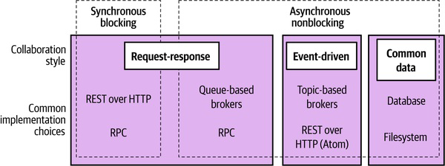
Styles of Microservice Communication
good high-level overview for considering the different styles of communication that are most widely used for microservice architectures

Slide 7
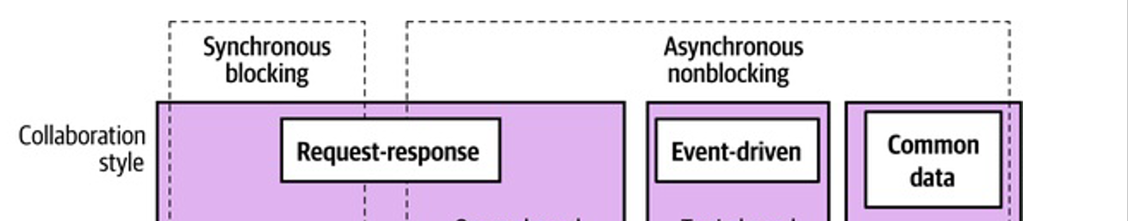
Styles of Microservice Communication
Synchronous blocking
A microservice makes a call to another microservice and blocks operation waiting for the response.
Asynchronous nonblocking
The microservice emitting a call can carry on processing whether the call is received or not.
Request-response
A microservice sends a request to another microservice asking for something to be done. It expects to receive a response informing it of the result.
Event-driven
Microservices emit events, which other microservices consume and react to accordingly. The microservice emitting the event is unaware of which microservices, if any, consume the events it emits.
Common data
Not often seen as a communication style, microservices collaborate via some shared data source.

Slide 8
Pattern: Synchronous Blocking
a microservice sends a call of some kind to a downstream process (likely another microservice) and blocks until the call has completed, and potentially until a response has been received.
Typically, a synchronous blocking call is one that is waiting for a response from the downstream process.
result of the call is needed for some further operation, or just because it wants to make sure the call worked and to carry out retry if not
every synchronous blocking call I see would also constitute being a request response call

Slide 9
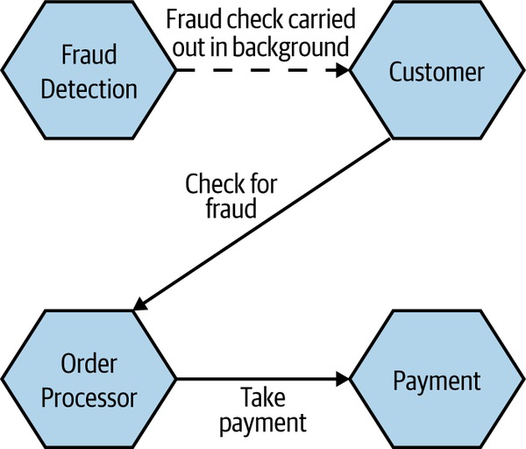
Pattern: Synchronous Blocking
Advantages
Many of us learned to program in a fundamentally synchronous style
sticking with those ideas that are familiar when there is so much else going on that is brand-new can make sense
Disadvantages
main challenge with synchronous calls is the inherent temporal coupling that occurs
the use of synchronous calls can make a system vulnerable to cascading issues caused by downstream outages more readily than can the use of asynchronous calls
Where to Use It
For simple microservice architectures, I don’t have a massive problem with the use of synchronous, blocking calls
problematic when you start having more chains of calls

Slide 10
Pattern: Asynchronous Nonblocking
the act of sending a call out over the network doesn’t block the microservice issuing the call (three common styles)
Communication through common data
The upstream microservice changes some common data, which one or more microservices later make use of.
Request-response
A microservice sends a request to another microservice asking it to do something. When the requested operation completes, whether successfully or not, the upstream microservice receives the response. Specifically, any instance of the upstream microservice should be able to handle the response.
Event-driven interaction
A microservice broadcasts an event, which can be thought of as a factual statement about something that has happened. Other microservices can listen for the events they are interested in and react accordingly.

Slide 11
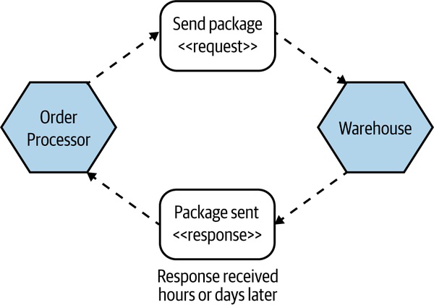
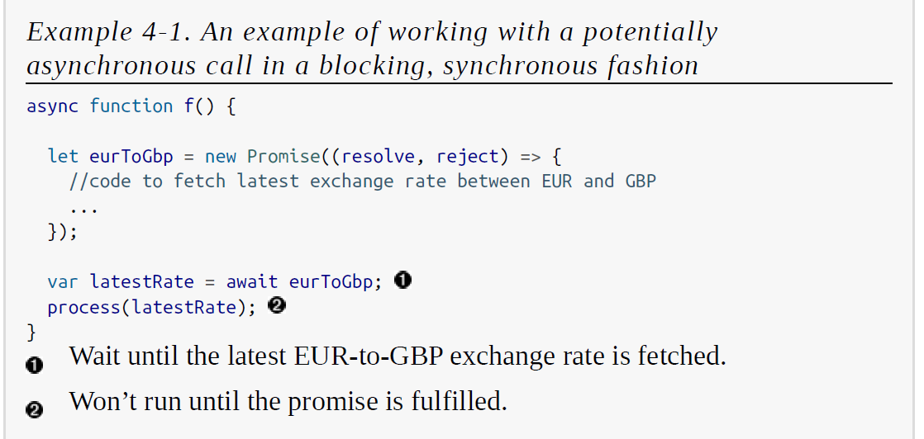
Pattern: Asynchronous Nonblocking
Advantages
the microservice making the initial call and the microservice (or microservices) receiving the call are decoupled temporarily
beneficial if the functionality being triggered by a call will take a long time to process
it wouldn’t be feasible to do this with synchronous blocking calls
Disadvantages
level of complexity and the range of choice
there are a lot of different, interesting ways in which you can get yourself into a lot of trouble
Where to Use It
Long-running processes are an obvious candidate
situations in which you have long call chains that you can’t easily restructure could be a good candidate

Slide 12
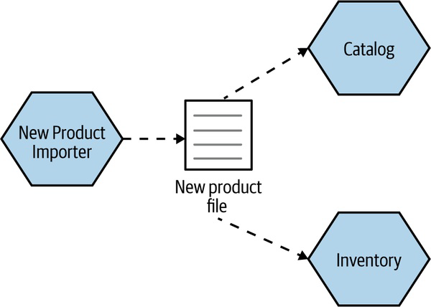
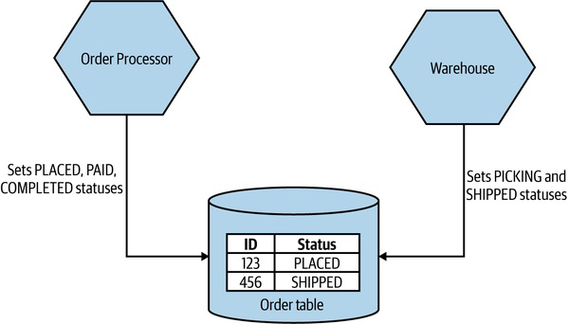
Pattern: Communication Through Common Data
used when one microservice puts data into a defined location, and another microservice (or potentially multiple microservices) then makes use of the data
most common general inter-process communication pattern that you’ll see
Implementation
need some sort of persistent store for the data
any downstream microservice that is going to act on this data will need its own mechanism to identify that new data is available (polling is common)
data lake and the data warehouse (two common examples)
assumption is that the flow of information is in a single direction (avoid the situation of common coupling)
unidirectional flow can make it easier to reason about
the flow of information

Slide 13
Pattern: Communication Through Common Data
Advantages
implemented very simply, using commonly understood technology (if you can read/write to a file / database you can use this pattern)
enables interoperability between different types of systems
sending lots of data in one big go, this pattern can work well
Disadvantages
unlikely to be useful in low-latency situations (due to polling)
common data store becomes a potential source of coupling
The robustness of the communication will also come down to the robustness of the underlying data store (not necessarily a disadvantage but something to be aware of)
Where to Use It
enabling interoperability between processes that might have restrictions on what technology they can use
sharing large volumes of data

Slide 14
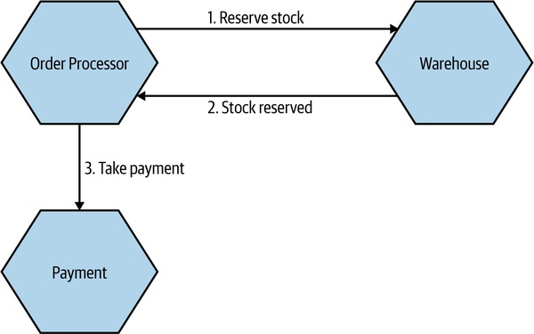
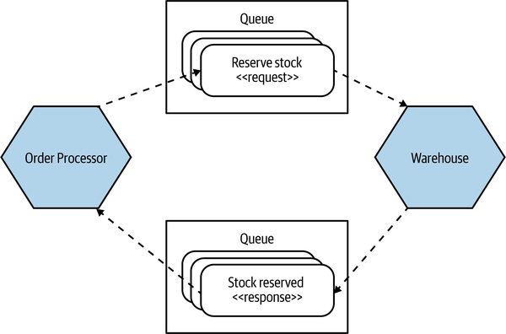
Pattern: Request-Response Communication
a microservice sends a request to a downstream service
asking it to do something and expects to receive a response with the result of the request (synchronous blocking / asynchronous nonblocking).
where calls need to be completed in a certain order is
commonplace
COMMANDS VERSUS REQUESTS
just remember that a microservice gets to reject the request/command if appropriate.
Implementation: Synchronous Versus Asynchronous
When using a queue, we have the added benefit that multiple requests could be buffered up in the queue waiting to be handled. This can help in situations in which the requests can’t be handled quickly enough.

Slide 15
Pattern: Request-Response Communication
PARALLEL VERSUS SEQUENTIAL CALLS
you will need to make multiple calls before you can continue with some processing
We could decide to make the three calls in sequence— (waiting for each one to finish before proceeding)
waiting for the sum of latencies of each of the calls
run these three requests in parallel
overall latency of the operation would be based on the slowest API call
can result in significant improvements in the latency of some operations
Where to Use It
the result of a request is needed before further processing can take place
microservice wants to know if a call didn’t work
so that it can carry out some sort of compensating action, like a retry

Slide 16
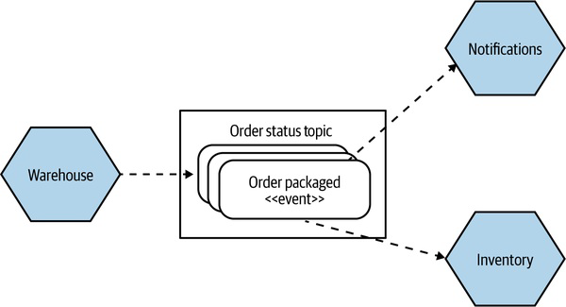
Pattern: Event-Driven Communication
a microservice emits events that may or may not be received by other microservices
An event is a statement about something that has occurred (nearly always inside the world of microservice emitting the event)
has no knowledge of the intent of other microservices to use the event
event-driven interactions much more loosely coupled in general
The intent behind an event could be considered the opposite of a request
EVENTS AND MESSAGES
request-response, the requester has to have knowledge of
what the downstream recipient can do, implying a greater degree of domain coupling
An event is a fact—a statement that something happened, along with some information about exactly what happened
Can reduce centralized knowledge both organizationally and technologically i.e., we just publish events and have dedicated microservices that need to know about those events and their side effects
implement that broadcast mechanism would be to put the
event into a message. The message is the medium; the event is the payload

Slide 17
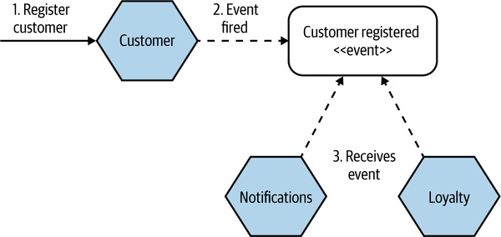
Pattern: Event-Driven Communication
Implementation
way for our microservices to emit events
way for our consumers to find out those events have happened
message brokers like RabbitMQ try to handle both problems
What’s in an Event?
With a request, we are asking a microservice to do something and providing the required information for the requested operation to be carried out. With an event, we are broadcasting a fact that other parties might be interested in, but as the microservice emitting an event can’t and shouldn’t know who receives the event
What, exactly, should be inside the event?

Slide 18
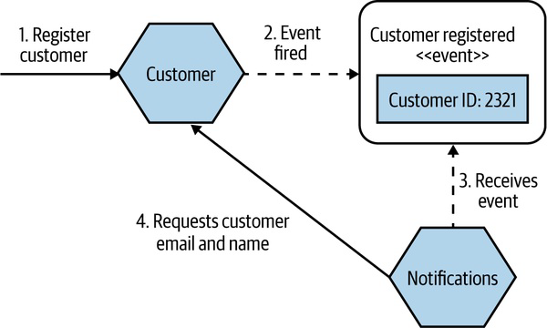
Pattern: Event-Driven Communication
Just an ID
One option is for the event to just contain an identifier
There are some downsides with this approach
Fully detailed events
The alternative, which I prefer, is to put everything into an event that you would be happy otherwise sharing via an API
In addition to the fact that events with more information can allow for looser coupling, events with more information can also double as a historical record of what happened to a given entity.
Downsides
Firstly, if the data associated with an event is large, we might have concerns about the size of the event (can implement a hybrid approach in that case). Most message limits range from 1MB (Kafka) – 512MB (RabbitMQ)
Information hiding is still an
important concept in event-driven collaboration
OK putting information into an event if I’d be happy
sharing the same data over a request-response API

Slide 19
Pattern: Event-Driven Communication
Where to Use It
thrives in situations in which information wants to be
broadcast, and in situations in which you are happy to invert intent
you are focusing on loose coupling more than other factors
often new sources of complexity that come to the fore with this style of collaboration, especially if you’ve had limited exposure to it
I see far more teams replacing request-response interactions with event-driven interactions than the reverse
Proceed with Caution
these communication styles do lead to an increase in complexity.
Arguably, regarding failure handling, synchronous blocking calls can cause us just as many headaches when it comes to working out if things have happened (or not). It’s just that those headaches may be more familiar to us!
Part II. Implementation…

