Slide 1

Ordered sets for Data Analysis
Aleksey Ryabykin
12/12/22

Slide 2




Datasets
I have chosen three datasets to check the base algorithm and my proposed one performances. All of them belong to the UCI Machine Learning Repository:
Car dataset:
Instances: 1728 Features: 7
Mushrooms dataset:
Instances: 8124 Features: 23
Congressional voting records:
Instances: 435 Features: 17

Slide 3
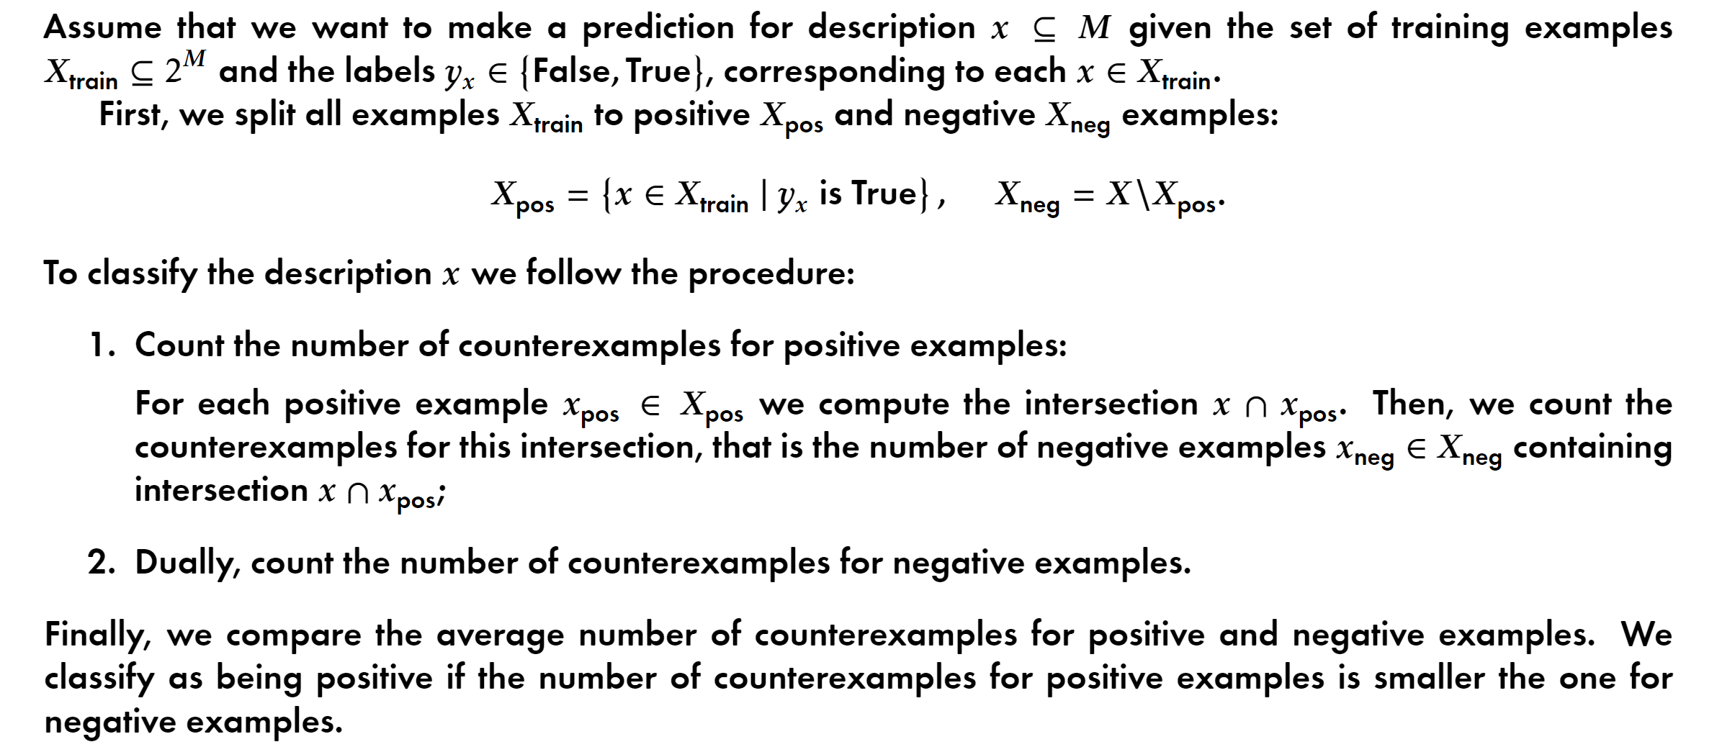
Initial algorithm

Slide 4
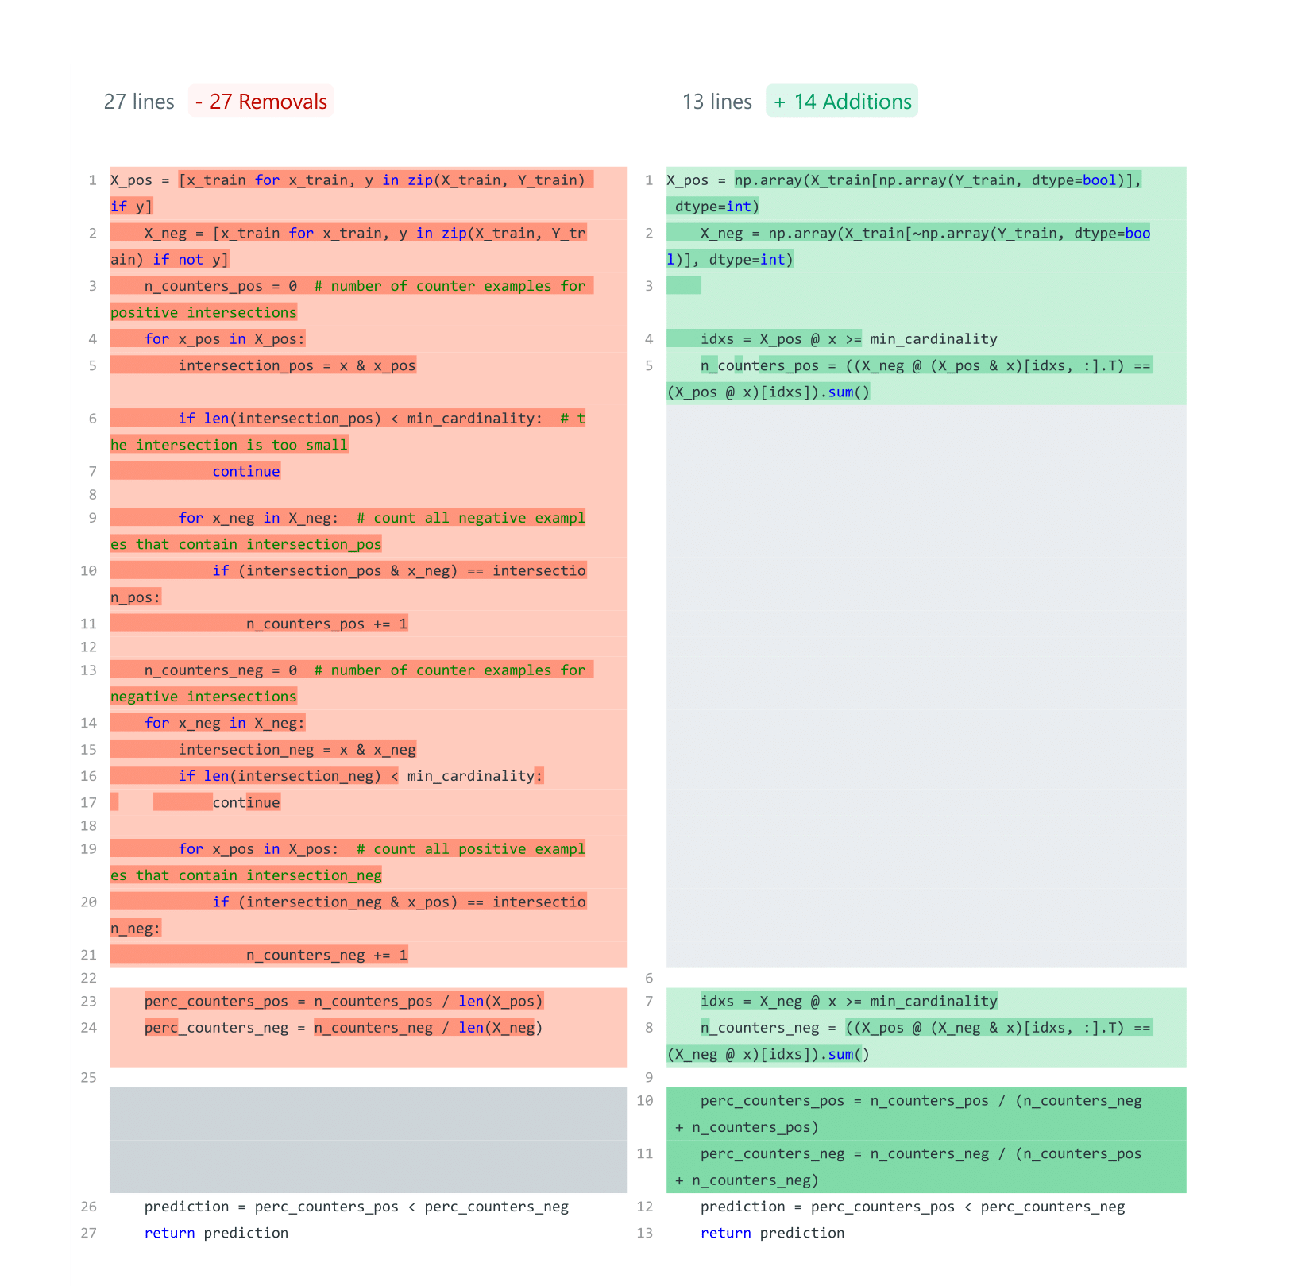
Proposed improvements to the initial algorithm
The core idea is the same as for the initial algorithm. But the chosen path to calculate the intersections is different with the previous one. The procedure can be expressed in terms of matrix multiplication of bitmasks that had been obtained after binarization.
Also, there is some bad influence of proposed in the initial algorithm normalization of counts of counterexamples.

Slide 5
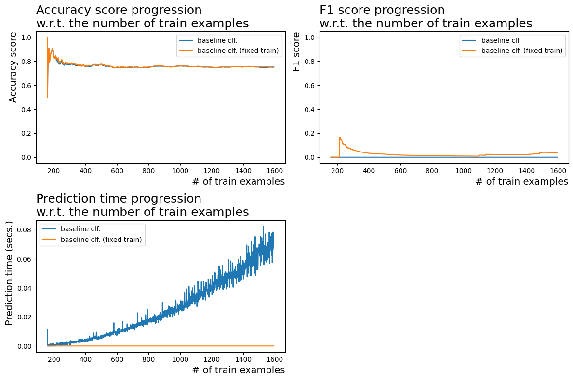
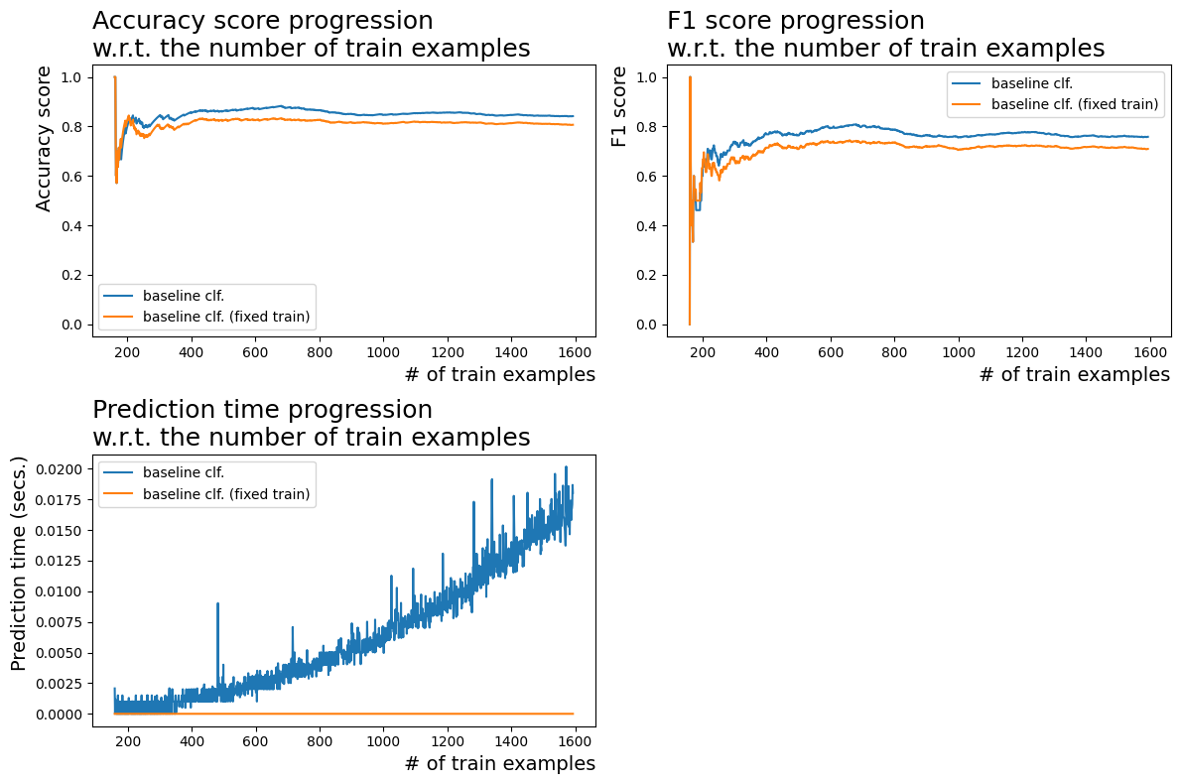
Comparison
Initial algorithm
Improved algorithm

Slide 6
Results (Accuracy scores)
Data | Catboost CLF | DecisionTree CLF | RandomForest CLF | XBGRF CLF | LGBM CLF | Initial Algorithm | Improved Algorithm
Car | 0.958 | 0.816 | 0.743 | 0.796 | 0.813 | 0.78 | 0.78
Mushrooms | 1 | 0.926 | 0.917 | 0.932 | 0.927 | 0.93 | 0.93
Congress | 0.952 | 0.966 | 0.961 | 0.971 | 0.957 | 0.7 | 0.92

Slide 7
Results (F1 scores)
Data | Catboost CLF | DecisionTree CLF | RandomForest CLF | XBGRF CLF | LGBM CLF | Initial Algorithm | Improved Algorithm
Car | 0.921 | 0.838 | 0.829 | 0.844 | 0.865 | 0.18 | 0.78
Mushrooms | 1 | 0.937 | 0.930 | 0.944 | 0.941 | 0.9 | 0.91
Congress | 0.949 | 0.965 | 0.961 | 0.970 | 0.957 | 0.66 | 0.9

Slide 8
Results (Elapsed time)
Data | Catboost CLF | DecisionTree CLF | RandomForest CLF | XBGRF CLF | LGBM CLF | Initial Algorithm | Improved Algorithm
Car | 16s | 90ms | 480ms | 220ms | 75ms | 839ms | 560ms
Mushrooms | 17s | 440ms | 850ms | 670ms | 156ms | 3min 13s | 43.5s
Congress | 1.1s | 70ms | 360ms | 90ms | 65ms | 303ms | 58ms

Slide 9
Results
Code reduction
≈50%
Chosen datasets
3
Time improvement
≈6.5x
Average quality improvement
≈23%
Number of comparing models
5
Pattern structures
0

Slide 10



Inferences
Little data
Binary
Interpretable

