Slide 1
Laddha Enterprises
ESTABLISHED
2008
Civil construction services — buildings, roads, highways, electrical works, water supply and turnkey solutions for all infrastructure needs. Established in Kota, Rajasthan, in 2008.
Kota, Rajasthan
+91 98293 54600
·
laddha.ankit1986@gmail.com

Slide 2
Contents
01
The company
02
Private projects
03
Government works
04
Capability and clients
Laddha Enterprises — Company Profile

Slide 3
01
The Company

Slide 4
Company overview
The firm
Leadership
Established in Kota, Rajasthan, in 2008, Laddha Enterprises provides civil construction services across buildings, roads, highways and industrial roads — for private developers and government bodies across the Hadoti region.
The team is managed and guided by Mr. Ashok Laddha, whose thirty-six years in civil engineering services anchor the firm’s planning, execution and client relationships.
Laddha Enterprises — Company Profile

Slide 5
Quality assurance
Raw material procured from quality-driven suppliers and checked at our own inspection unit
Delivery to the client’s specification, meeting international quality standards
Consistent quality improvement with innovative, cost-effective methods
Timely execution of every service undertaken
Laddha Enterprises — Company Profile

Slide 6
02
Private Projects

Slide 7
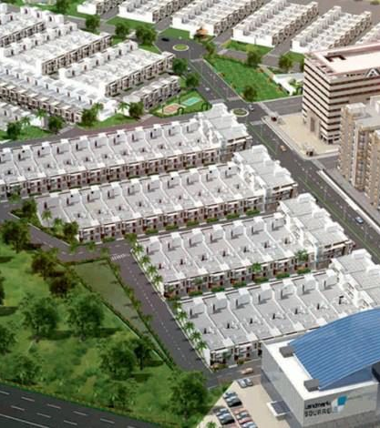
Landmark City
Complete road network for the coaching-hub township at Kota
22,675 cum excavation, 38,265 cum GSB, 15,675 cum WMM and CC
Masonry, PCC, hume pipe and 34,250 ferro covers
Work order value ₹10.64 Cr
Laddha Enterprises — Company Profile

Slide 8
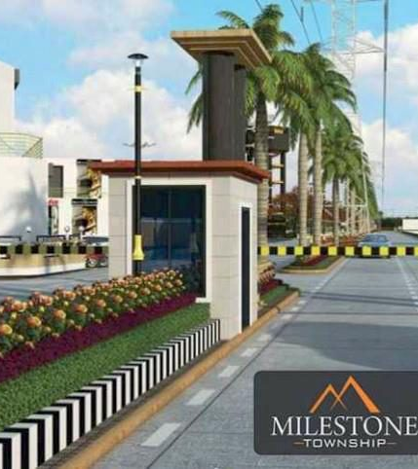
Milestone Township
Township road work: 9,900 cum excavation, 12,000 cum GSB
22,500 sqm primer and tack coat, 1,125 cum bituminous macadam
Work order value ₹3.85 Cr
Laddha Enterprises — Company Profile

Slide 9
Private works portfolio
PROJECT
SCOPE
CLIENT
VALUE
Coral Park, Kota
Township roads and drainage
Coaching hub
₹6.50 Cr
Hanging Bridge approach
Bituminous surfacing, 53,333 sqm
—
₹4.20 Cr
Prem Nagar housing, Kota
Affordable-housing road work
AHS
₹4.80 Cr
Gardenia villas, Bundi Road
Villa construction, 2023–24
Orilite Life Space
₹3.80 Cr
Royal Villa, Baran Road
25 row houses, 2022–24
Royal Prime Ltd.
₹9.40 Cr
Laddha Enterprises — Company Profile

Slide 10
03
Government works

Slide 11
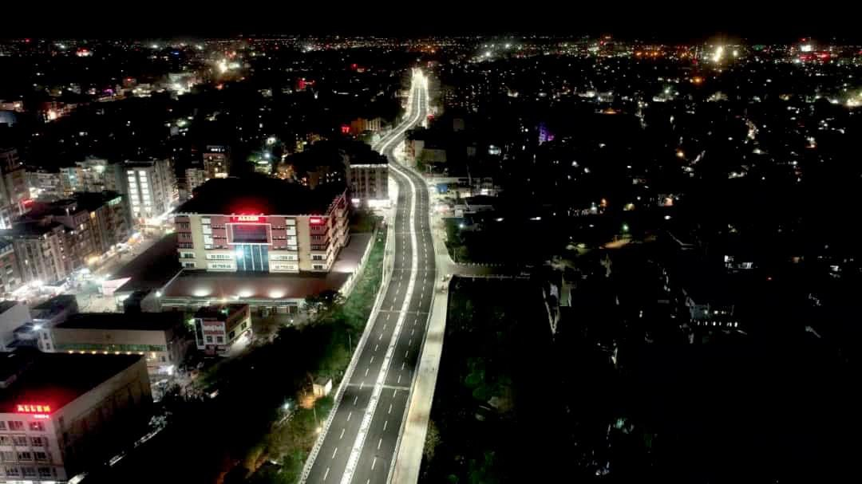
Keshavpura flyover, Kota
Bituminous work on the flyover corridor — 40,000 sqm tack coat, 2,000 cum DBM and 2,500 cum bituminous concrete, executed as a ₹4.5 Cr sub-contract.

Slide 12
Completed government works
PROJECT
YEAR
CLIENT
VALUE
Coal-yard concrete (M-35), Mangalam plant
2021–22
Mangalam Cement Ltd.
₹1.77 Cr
Roads at Talwandi and Jawahar Nagar
2021–23
UIT, Kota
₹3.73 Cr
Aerodrome underpass road work
2021–22
Vijay M Mistry Construction
₹3.50 Cr
Danbari–Keshavpura flyover, Rangbari Road
2020–22
Vijay M Mistry Construction
₹5.80 Cr
Indira Gandhi flyover
2021–23
Vijay M Mistry Construction
₹4.50 Cr
Laddha Enterprises — Company Profile

Slide 13
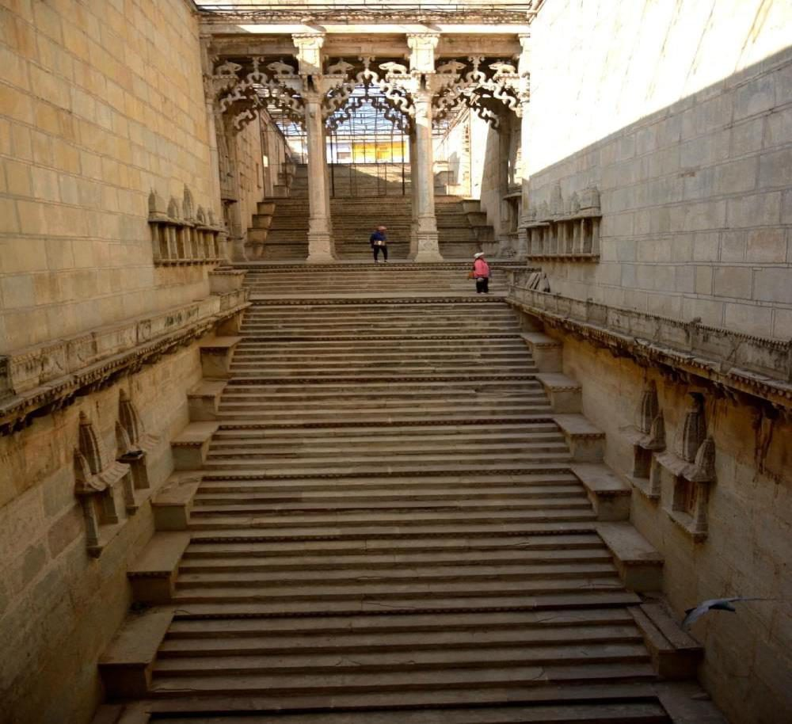
Heritage restoration
Restoration of historic bawaris — stepwells — at Bundi (₹1.70 Cr, Nagar Nigam) and across the Hadoti region (₹1.90 Cr, UIT), completed in 2024–25, with further bawaris now under restoration at Jaipur (₹4.50 Cr).
Laddha Enterprises — Company Profile

Slide 14
04
Capability and clients

Slide 15
04 · CAPABILITY AND CLIENTS
₹87.5 Cr
The current order book, across five ongoing works — roads, townships, industrial infrastructure and heritage restoration.
Laddha Enterprises — Company Profile

Slide 16
Ongoing projects
PROJECT
YEAR
CLIENT
VALUE
Ummedganj–Kaithun road (8 km)
2022–24
UIT, Kota
₹18.40 Cr
Gardenia township — gardens and roads
2022–24
Orilite Life Space
₹6.50 Cr
Urbana Techno Park, Mandana — industrial township
2025–27
Urbana Techno Park LLP
₹45.15 Cr
Industrial township development, Bhilwara
—
Golcha Group
₹13.00 Cr
Restoration of different bawaris, Jaipur
—
—
₹4.50 Cr
Laddha Enterprises — Company Profile

Slide 17
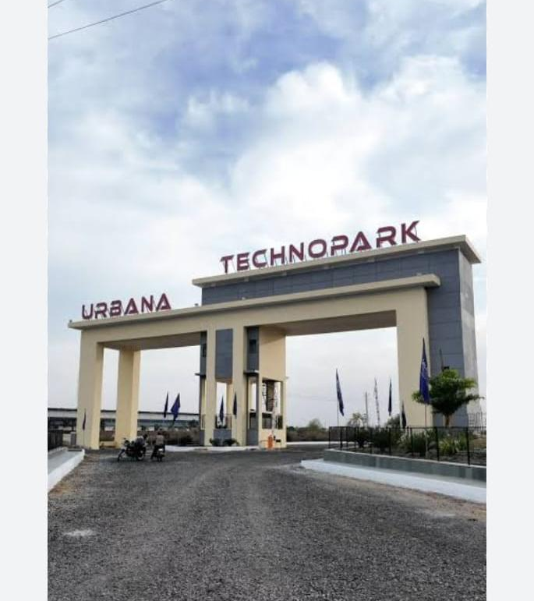
Urbana Techno Park
Development of an industrial township at Mandana
Roads, civil and water-supply infrastructure
Complete electrical works — overhead power line, 32 kV GSS and 33 kV feeder
Order value ₹45.15 Cr, 2025–27
Laddha Enterprises — Company Profile

Slide 18
Turnover, last three years
Annual turnover in crore rupees — a forty per cent rise over three financial years, with FY 2023–24 the strongest year to date.
Laddha Enterprises — Company Profile

Slide 19
Plant and machinery
Earthmoving
Compaction and paving
Bituminous and concrete
Three Poclain excavators, two JCB machines and one grader, supported by three tractors and five dumpers for haulage across sites.
Two paver finishers laid ahead of one vibratory roller, one tandem roller and three static rollers — a complete surfacing train.
Two bitumen plants of 60 and 55 TPH, two tar boilers, one compressor and three Ajax Fiori self-loading concrete mixers.
Laddha Enterprises — Company Profile

Slide 20
Major clients
Government
Private
PWD, UIT, Nagar Nigam, the Marketing Board and RIICO — road, flyover and restoration works delivered directly and as sub-contracts.
Bhatia Colonizer, Shubham Group, Suwalka & Suwalka, Multimetal Ltd., Orilite Life Space LLP and Urbana Techno Park LLP.
Laddha Enterprises — Company Profile

Slide 21
Thank you
Laddha Enterprises — civil construction services, Kota, Rajasthan. Established 2008.
ADDRESS
PHONE
EMAIL
A-491 Indra Vihar, Kota, Rajasthan
+91 98293 54600
laddha.ankit1986@gmail.com

