Slide 1
The Conveying Belt
- Sprint 1 Review
By: Aditya Das
Jehad Mehad
Jonathan Mallet
Poulomi Nandy

Slide 2
Sprint 1 Task(s)
Graphical User Interface 1 (GUI 1)
Graphical User Interface 2 (GUI 2)
Creation of Web Server

Slide 3
Web Server Creation
We have currently used Python Flask for the backend server creation. This has been attached to the frontend GUIs. Sample code used for the backend work is as follows and renders the following output:
from flask import Flask, render_template
app = Flask(__name__)
@app.route('/')
def index():
return 'Conveying Belt’
if __name__ == '__main__':
app.run(debug=True, host=‘0.0.0.0')

Slide 4
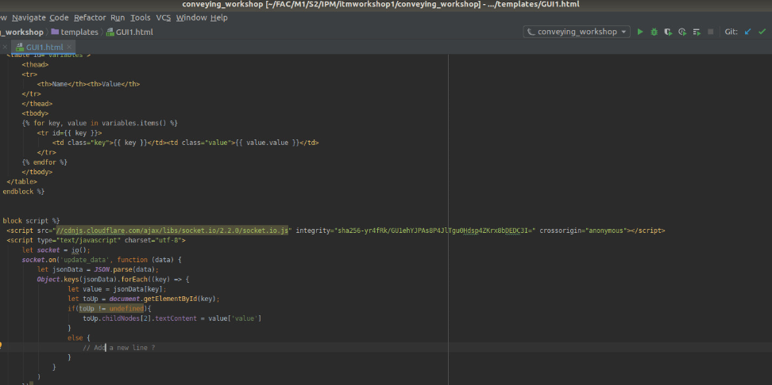
GUI 1
Graphical User Interface 1 (GUI 1) displays the parameters of the conveying belt and the necessary values for those parameter.

Slide 5
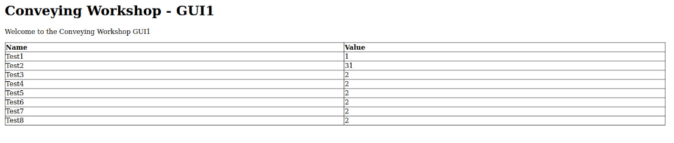
Interface GUI1

Slide 6
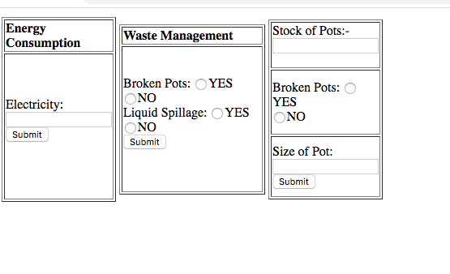
GUI 2
The Graphical User Interface 2 (GUI 2) appears this following way to its users:

Slide 7
Quick Pointers on GUI 2
It displays the various parameters for Energy Consumption System, Waste Management System and keeps count on the stock of pots.
Energy Consumption keeps track of electricity, while Waste Management System keeps track of liquid spillage and broken pots.

