Slide 1
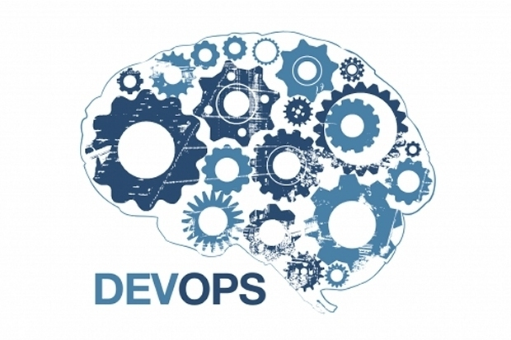
Credit: cio.com

Slide 2
Introduction To DevOps
FOR WEB DEVELOPERS
Rex Addiscentis
raddiscentis@addiscent.com
addiscent.com
github.com/addiscent

Slide 3
About
Rex Addiscentis
“Student and Practitioner
of Web Technology”

Slide 4
Rex's Technical Work History
SW Dev Team Manager
Web Browser developer (Navigator for Windows)
H.261 Video Conferencing – user interface dev
Computer-based Fax HW dev, SW dev
Systems Level Software – device driver dev
Real-time Device Control – co-inventor patent
SCADA - microprocessor hardware design and dev

Slide 5
Rex's Tech Skills
C and C++
Git and GitHub
Linux admin (networked hosts)
Light skills – Docker, Vagrant, AWS, PHP, Ruby/Rails, BASH, Smalltalk, Jenkins, HTML, CSS
Windows app dev (UX and infrastructure)
Microprocessor Assembly Languages

Slide 6
Rex's Current Technical Interests
Cloud – Amazon Web Services
DevOps – Docker, Kubernetes
Langs – Python, Golang, Ruby, PHP

Slide 7
Rex's Personal Interests
Digital Video Tech and Production
Digital Audio Tech and Music Production
Vacuum Tube circuits (guitar amps)
Blues “slide” guitar player
Metalworking and Woodworking
Mentoring

Slide 8
Introduction To DevOps
About the Presentation
“Just enough” DevOps for Demo context
Containerization of Developers' tools not detailed
Applicability - “it depends” on your project
    Enterprise vs Small Business
    Prototype vs MVP vs Mature Production
Presentation slide deck available online, (message post on meetup web site)

Slide 9
Introduction To DevOps
About the Demo
Simplest-possible Dockerized PHP app
Deployed to “Production in public cloud”
Please save questions and note slide number for post-presentation Q&A session

Slide 10
Credit: cio.com

Slide 11
Why DevOps?
“DevOps is a competitive advantage”

Slide 12
What is DevOps?
DevOps Is A Business Solution
“Regardless of the target market, your Company is a 'software company'. Producing high value services software efficiently is a fundamental part of its business model.”

Slide 13
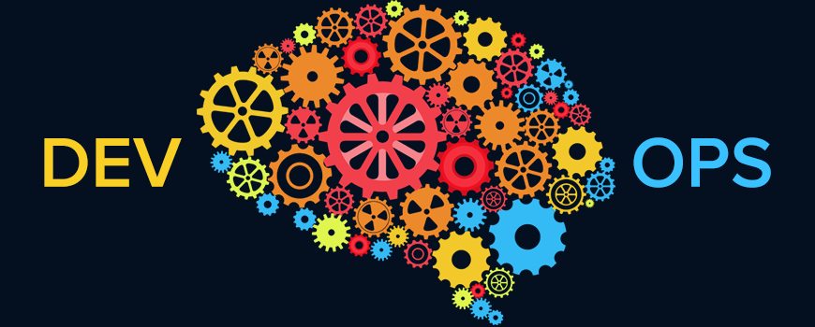
Credit: forbes.com
Strategies
and
Implementations

Slide 14
DevOps Strategies
”Strive to minimize the difference between how and what Developers produce, and how and what Operations deploys.”

Slide 15
Implementing DevOps
RESOURCES AND TECHNIQUES
Cloud – IaaS, PaaS
Virtualization - SDO
Containers – Virtual Machines (VMs), Docker
Microservices Architecture
“Standardized” Developer Environments
Continuous Deployment (with Continuous Integration)
Automated IT (Data-center Ops)

Slide 16
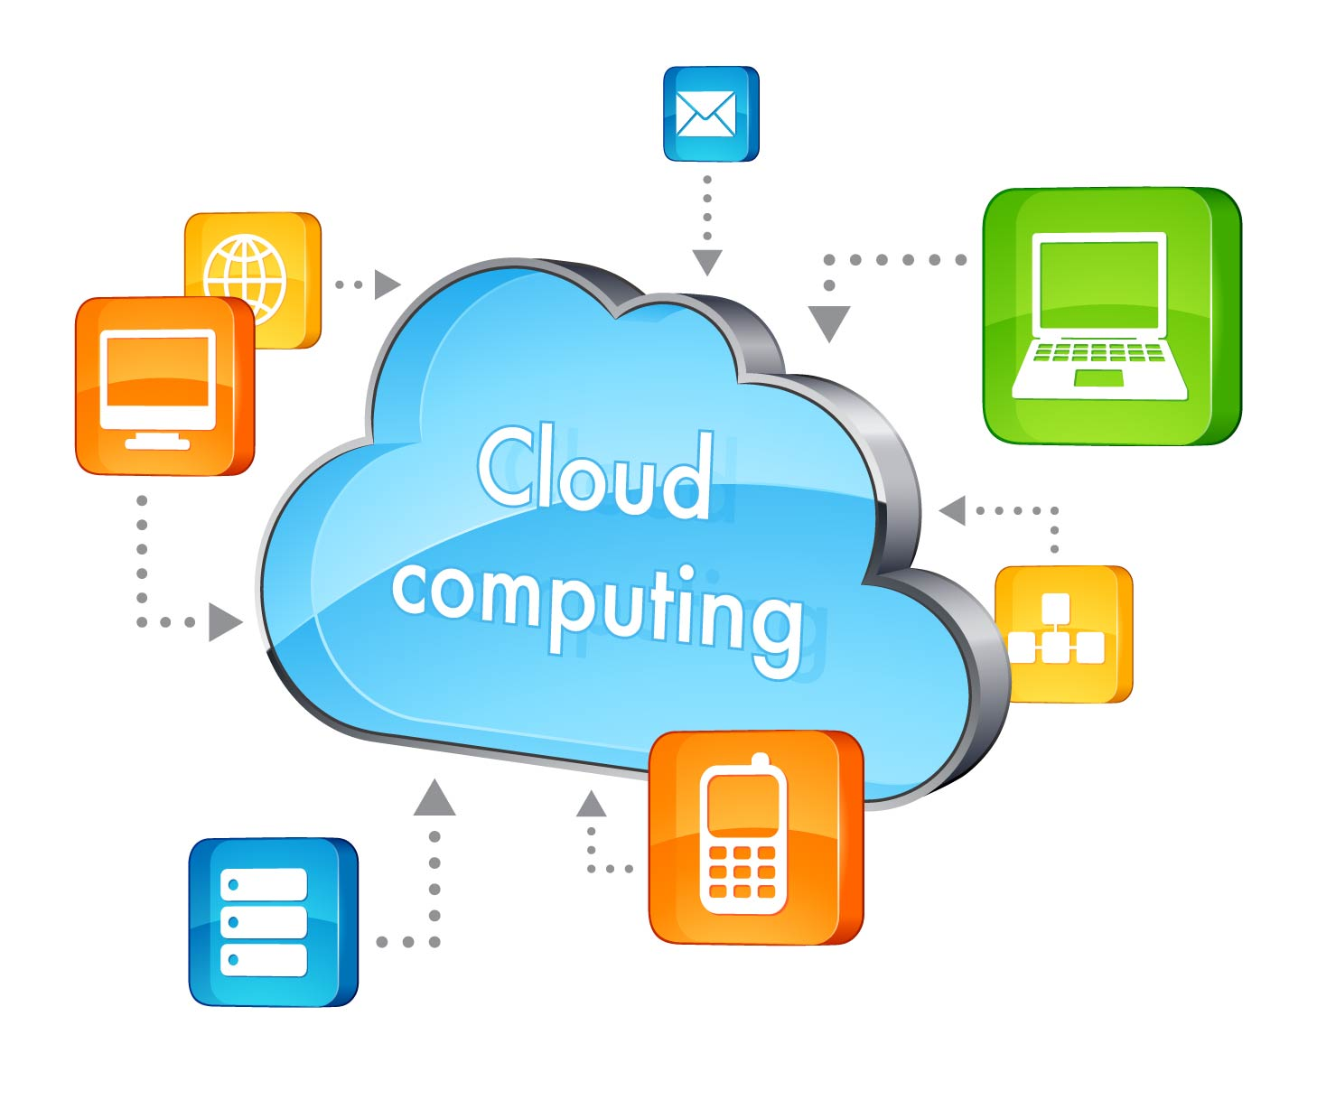
Credit: alvareztg.com

Slide 17
“Cloud Native” Advantages
Cloud Speed
Cloud Scale
Cloud Economics

Slide 18
XaaS
Service Categories
Infrastructure as a Service (IaaS)
Platform as a Service (PaaS)
Software as a Service (Saas)
Anything as a Service (Xaas)
  Monitoring as a Service (Maas)
  Communication as a Service (CaaS)
  Business Processes as a Service (BPaaS)
  … etc

Slide 19
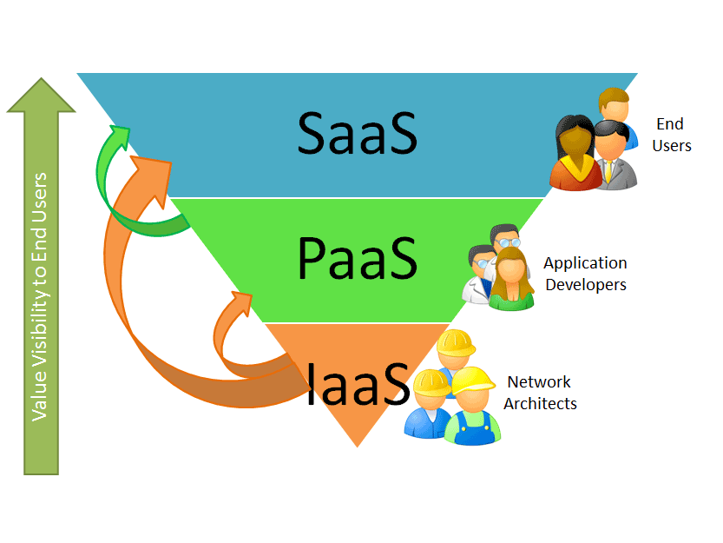
Credit: unknown

Slide 20
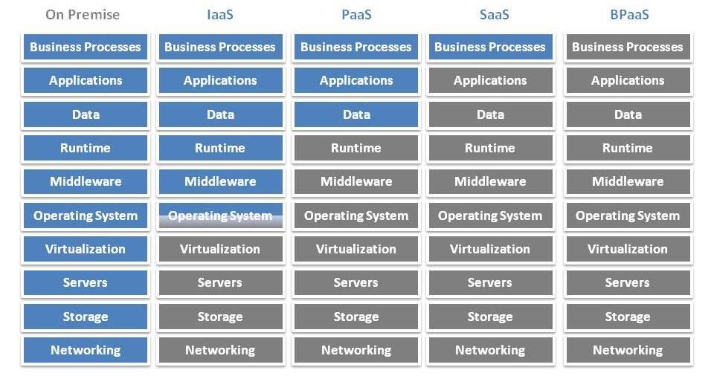
Cloud Service Categories
Credit: http://tecbizz.net/2012/10/everything-as-a-service-introduction/

Slide 21
Cloud IaaS
IaaS Computing Services
  Compute nodes
  Networking (incl VPC)
  Storage
  Containers

Slide 22
Cloud PaaS
PaaS Services
Automatically handles the deployment - capacity provisioning, load balancing, auto-scaling
Application health monitoring
Project run-times - PHP, Java, Node.js, Python, Ruby, Go, .NET, and Docker
Project environments - servers such as Apache, Nginx, Passenger, and IIS

Slide 23
Cloud Service Companies
PUBLIC
Amazon Web Services
Microsoft Azure
Google Cloud Platform
DigitalOcean
Heroku

Slide 24
Cloud Services
Open Source Software (OSS )
PRIVATE AND PUBLIC
OpenStack
OpenShift
Cloud Foundry

Slide 25
Noteworthy Terms
Quality of Service (QoS): Availability-Reliability
“NUMBER OF NINES”
99.999% == “Five Nines”
High Availability == Five Nines Or Greater

Slide 26
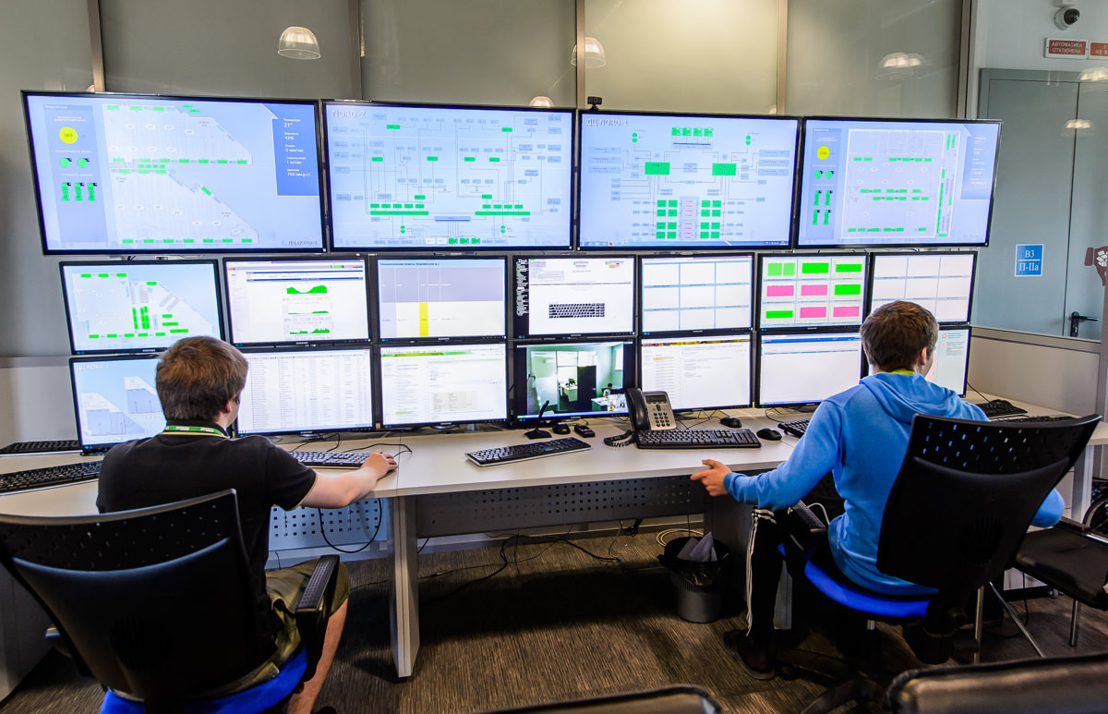
Credit: http://sysmagazine.com/posts/193306/
Operations

Slide 27
Operations Deliverables
Examples of Application Services Delivered
Online Merchant
Social Network
Media Provider
Online Banking
Publishers

Slide 28
Operations Deliverables
Generalization Of Application Functions
Customer application-specific
  Page Presentation (View)
  Page Controls (Controller)
  Function or Business Logic (Model)
Support company's business needs
  Marketing
  Sales
  Operating Expenses
Must be "reliable enough”

Slide 29
Operations Activities
DELIVER AND MANAGE PRODUCT-SERVICE
Deploy
Roll-out per constraints
Roll-back per necessity
Scale as needed
Phase out end-of-life instances

Slide 30
Operations Activities
DELIVER AND MANAGE PRODUCT-SERVICE
Monitor
Health
Performance
Cost

Slide 31
Operations
CATEGORIES OF FUNCTIONS AND UTILITY
Application Specific
Inventory Views
Accounts and Passwords
Purchases or other transactions

Slide 32
Operations
CATEGORIES OF FUNCTIONS AND UTILITY
Typical Infrastructure
HTTP service (web or app server)
Database service
Proxy-firewall
TLS-SSL encrypt-decrypt
Memcached
Redis
Load Balancer

Slide 33
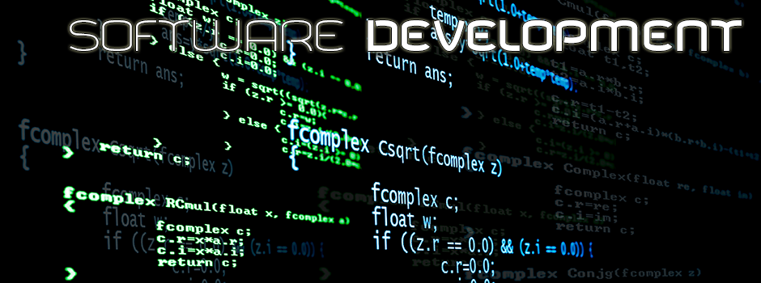
Credit: stories.rackspace.com/
In a DevOps Context

Slide 34
Development Activities
DevOps ANALYSIS and DESIGN
Design and Implement Software Product
Design and Implement Development Process
Define Operations deliverables, processes, and life-cycle management

Slide 35
Development Activities
DevOps ANALYSIS and DESIGN
Design and Implement Software Product
“Ops deliverables categories” can be used as design requirements
  Application-specific
  Infrastructure-specific
Define collections of "collaborating services", (Microservices Architecture)
Define in detail Operations Deliverables (components)

Slide 36
Development Activities
DevOps ANALYSIS and DESIGN
Design and Implement Development Process
Identify and implement “best” technologies
  Standardized development environment
  Continuous Delivery

Slide 37
Team Standardized Development Environment
Use Reproducible Workspaces and Shared tools
  Automate installation - containerized
  Collaboration-friendly – establish standards and conventions, limit “free-for-all” practice when important
Candidate tools for containerization
  Host system, text editor or IDE, programming language interpreter (run-time) or compiler-linker, libraries/components, package or dependency managers, build/test tools, repository tools

Slide 38
Continuous Delivery
SOFTWARE DELIVERY PIPELINE
“Always Shippable”
Continuous Integration
Automated Builds
Automated Testing, as possible
Manual Testing, as necessary
Marked according to Release Readiness

Slide 39
Continuous Integration
“Continuous integration (CI) is the practice, in software engineering, of merging all developer working copies with a shared mainline several times a day.”
- Wikipedia

Slide 40
Continuous Delivery
Workflow and Best Practices
Automate the build
Maintain a code repository
Everyone commits to the baseline “every day”
Every commit should trigger a delivery
Make the build self-testing
Test in a clone of the production environment
Make it easy to get the latest deliverables

Slide 41
CONTINUOUS DELIVERY
Automated Build
Typical CI Coverage
Coding Standards compliance
Unit Tests
...
Documentation generation
Reporting

Slide 42
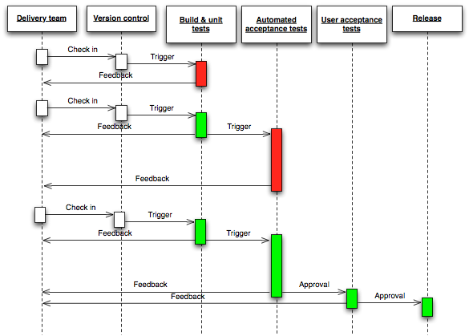
Continuous Delivery Flow
Credit: Continuous Delivery by Jez Humble and David Farley (2010)

Slide 43
Microservices Architecture
“OPPOSITE OF MONOLITHIC DESIGN”
Monolithic Design
Built as atomic unit
Deployed as atomic unit
“Single program” can perform all possible functions
Self-contained, independent from other platforms
COMPLEXITY IS HIDDEN, EXCEPT TO PROGRAMMERS

Slide 44
Microservices Architecture
NATURAL ATTRIBUTES
Partitioned Functionality
Services built as “Bounded Context” units
Services deployed as individual units
Collaborating entities, division of responsibilities
Often dependent on other services
COMPLEXITY IS EXPOSED

Slide 45
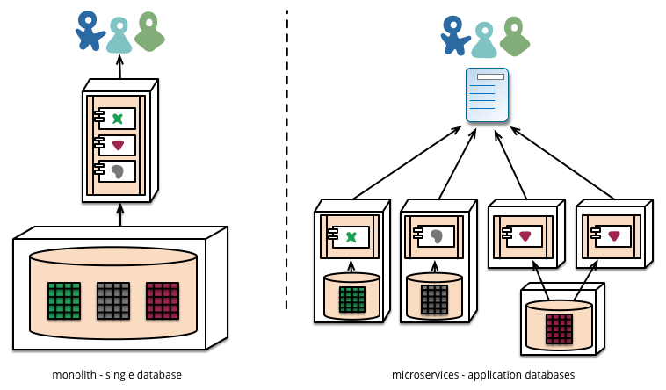
Monolithic vs Microservices
Credit: martinfowler.com/articles/microservices.html

Slide 46
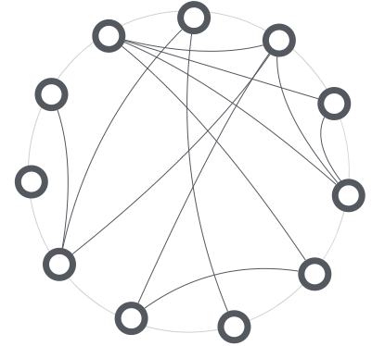
Collaborating Microservices
Credit: thoughtworks.com

Slide 47
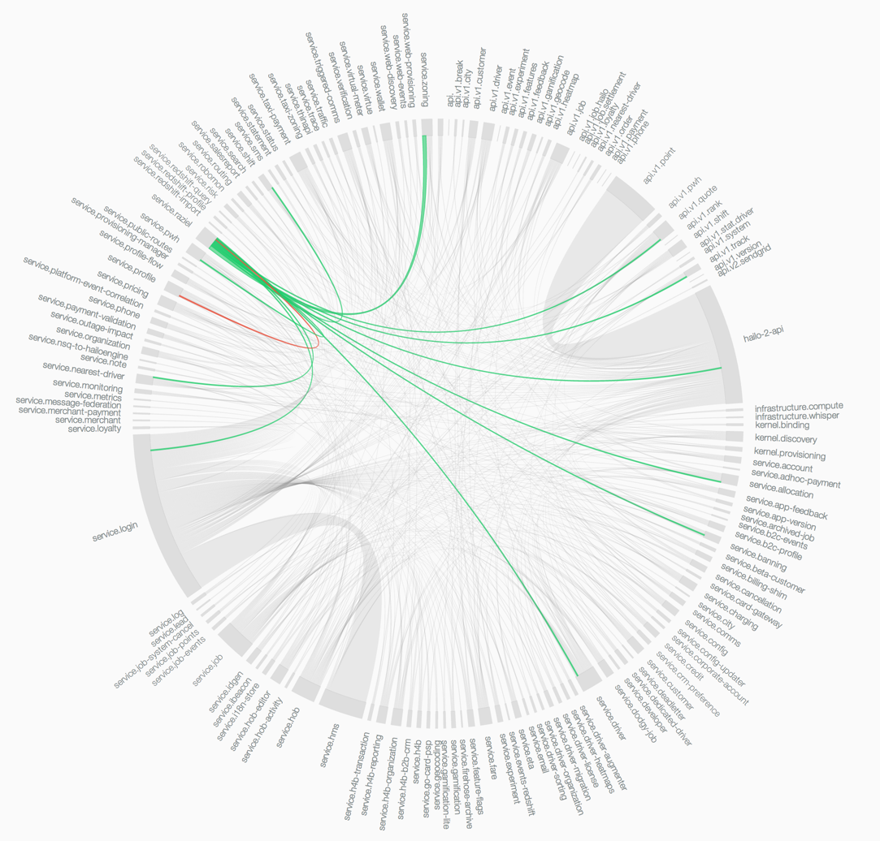
Wheel-of-Doom (Hailo)
Credit: Hailo Tech Blog - sudo.hailoapp.com

Slide 48
Microservices Architecture
IMPORTANT DESIGN CONSIDERATIONS
Common “Software Design Best Practices” apply to MA
Loose coupling, high cohesion
Object Oriented principles
Collaborating Classes
APIs – HTTP-RESTful
Stateless (preferred) and Stateful (when necessary)
Bounded Domains – DDD (Bounded Context)
“Rugged” design – Fault tolerant, (plan for system errors)
Constraints and Limits
Minimize inter-container N-way communication (fan-out)
Right-size – “two (four) pizza team”

Slide 49
Microservices Architecture
FLEXIBLE IMPLEMENTATION AND DEPLOYMENT CHOICES
Advantages
Polyglot
Development teams may be much smaller, (but more numerous)
A microservice may be released on a different schedule than others
Complexity is exposed and must be addressed explicitly, (internal "hidden" monolith complexity is revealed by split into microservices)

Slide 50
Microservices Architecture
NO SILVER BULLET
Disadvantages
Complexity of Services APIs
Complexity of Inter-Service Communication
Complexity of Inter-Service behaviors/dependencies
Network - Latency, unreliability, bandwidth limits
Single large database must be split – Data consistency and integrity much more complicated

Slide 51
Microservices Architecture
EXAMPLES – SERVICES AS DELIVERED BY OPS
Application domain-specific
  Service presentation
  Inventory-views
  Accounts
  Purchases or other transactions
  Passwords (authorization)

Slide 52
Microservices Architecture
IDENTIFY THE SERVICES DELIVERED BY OPS
Infrastructure-specific
  Database service
  HTTP service (web or app server)
  TLS/SSL encryption-decryption
  Memcached, Redis
  Proxy-Firewall-Load Balancer

Slide 53
Conway's Law
“Any organization that designs a system ... will inevitably produce a design whose structure is a copy of the organization's communication structure.”
-- Melvyn Conway, 1967

Slide 54
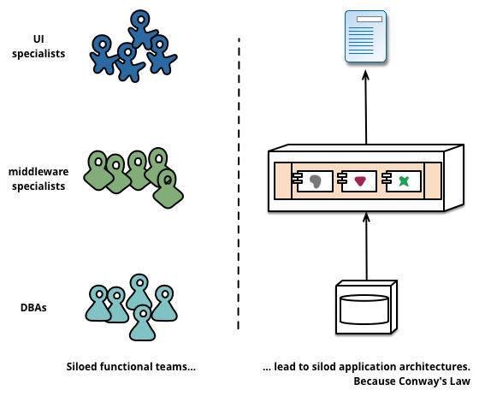
“Monolithic” Company Organization
Produces
Monolithic Architecture
Credit: martinfowler.com/articles/microservices.html

Slide 55
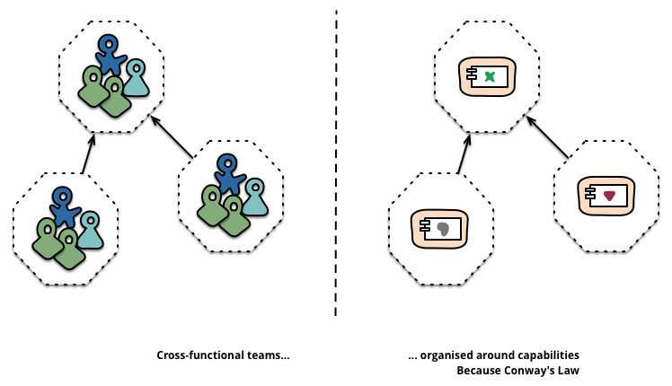
Microservices Architecture
Requires
Microservices Dev Dept Organization
Credit: martinfowler.com/articles/microservices.html

Slide 56
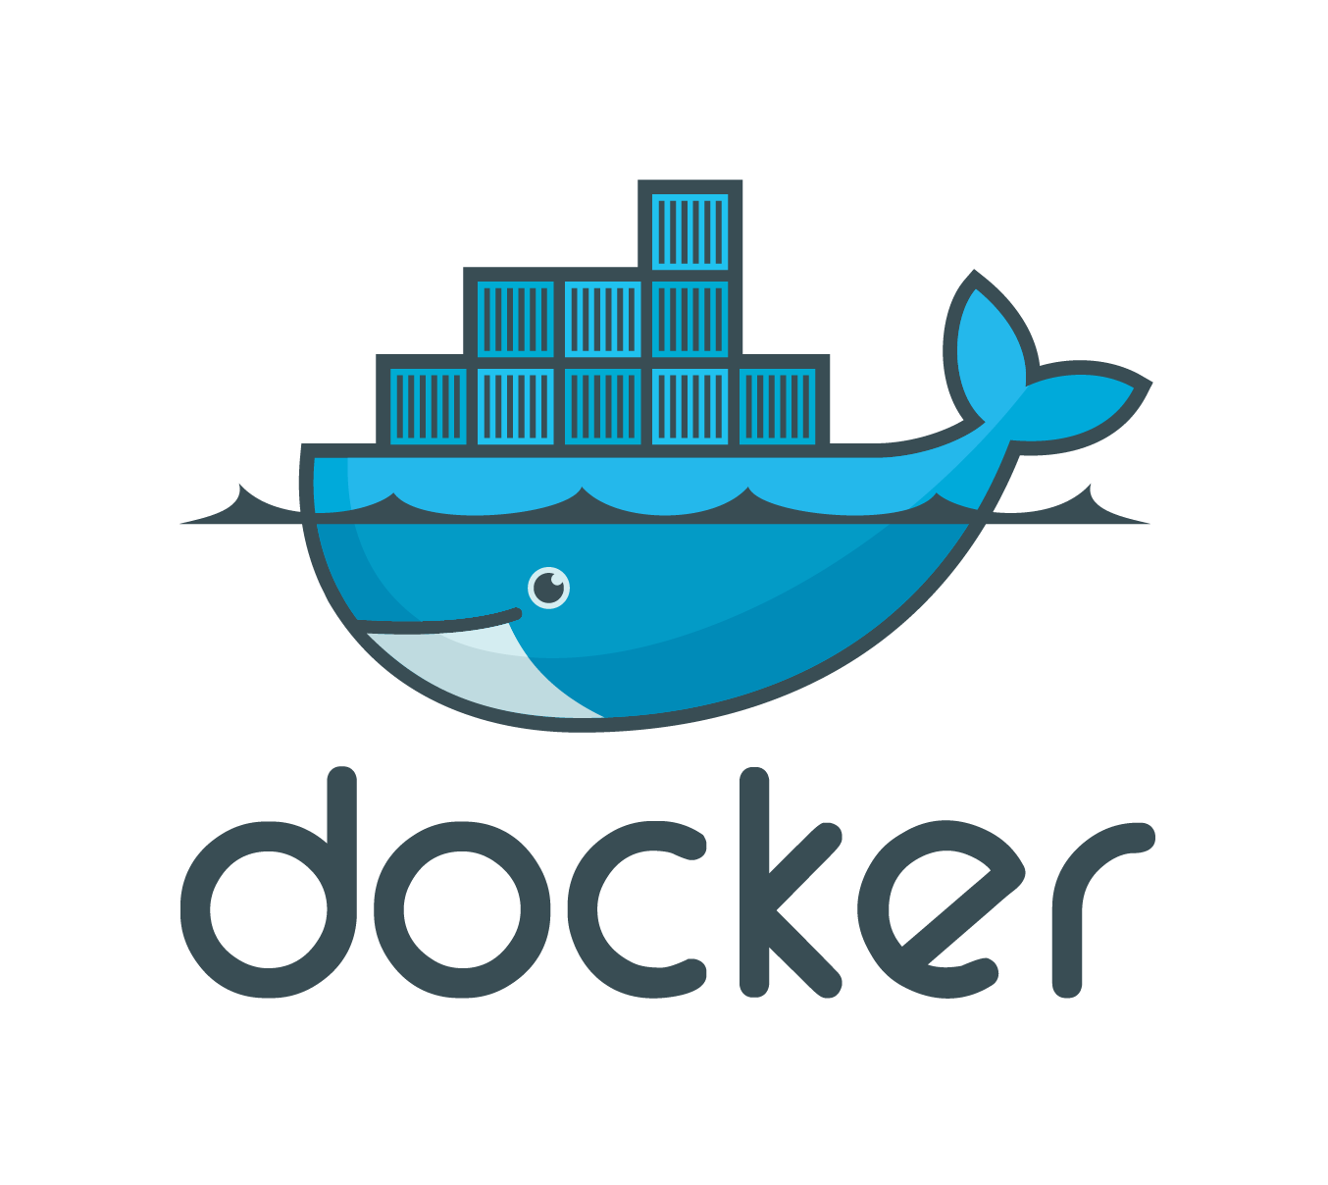

Slide 57
Docker
A WAY TO IMPLEMENT MICROSERVICES
"An open platform for distributed applications for developers and sysadmins."
-- docker.com

Slide 58
Docker
WHAT IS DOCKER?
Docker is a Company
docker.com
Docker is a Container Technology
Lightweight loadable binary image
Limited capabilities – make it compelling
Docker is an Ecosystem
Docker tools and education resources
Third party tools and education resources

Slide 59
Docker
AS A CONTAINER
Executable code
May be data only
Isolation of resources
Lightweight VM-type services
Built using Dockerfile directives

Slide 60
Docker
CONTAINER FEATURES
Namespace - its own PIDs, NAT, etc
Processes and memory are restricted
Files system - volumes may be bound to host fs
Network I/O - ports may be mapped
Container Linking - inter-container communication
Private network (VPC)

Slide 61
Docker
IS NOT JUST A CONTAINER
Client command line (CLI)
Daemon (Docker Engine) - container agent
Repository - allows public and private
Tools Suite

Slide 62
Docker
IS NOT JUST A CONTAINER
Toolset
Docker Engine – container agent
Docker-machine – wrangles a host upon which containers run
Docker-compose – wrangles “collaborating services” containers
Docker swarm - wrangles "swarm" of docker-machines, each running containers

Slide 63
Docker
ADVANTAGES
Native-portable deployment across LINUX-kernel machines
Application-centric
Automated builds - “trusted”
Tagging (Versioning)
Component re-use
Sharing
Tool ecosystem

Slide 64
Docker
ADVANTAGES
Native-portable Deployment Across LINUX Machines
Local Host – desktop, laptop
Amazon Web Services
Microsoft Azure Cloud
Google Cloud Platform
Digital Ocean
Heroku
Caveats for Mac and Windows hosts

Slide 65
Docker
ADVANTAGES
What A Docker
Container Is Good At
Image builds and loading can be fast, due to layers and caching on local host
Small memory and storage requirements
No processes overhead specific to container

Slide 66
Docker
MIS-USAGE
Base image which is unnecessarily “fat”
Too many processes in one container
  Anti-pattern: Dockerized LAMP stack is NOT a wise micro-services pattern for production

Slide 67
Container-related
Strategies and Techniques
“BEST PRACTICES” SUBJECTS FOR FURTHER STUDY
Immutable containers – Don't modify instances
  Don't ssh into production VMs or containers and modify their state or configuration
Ephemeral – “Design for Transience”
  Accomodate short lifespans
Tag (version) containers, build using tags
Use Load Balancers for rollout, rollback, canary cages, and scaling
Starting as Monolithic vs starting as Microservices - "It depends"

Slide 68
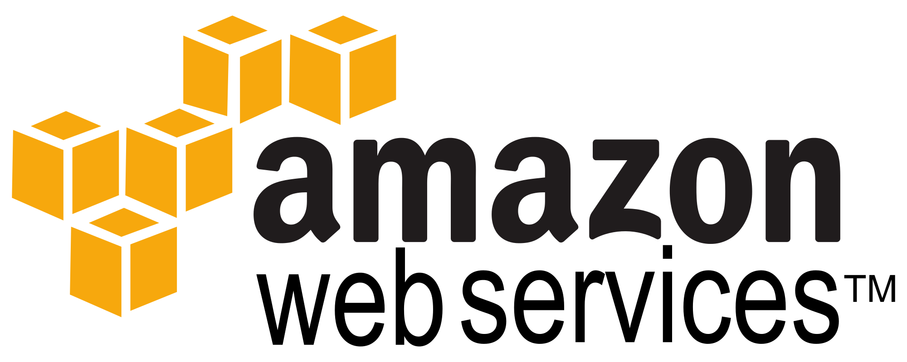

Slide 69
Amazon Web Services
aws.amazon.com
AWS Elastic Compute Cloud (EC2)
Compute nodes created/destroyed as needed
Compute nodes may be long-running, or short-lived
Spin-up time scale = ~minute(s)
An EC2 node has no storage – must use S3 or other AWS DB services, or other networked product

