Slide 1
{{timeline}}
{{heading}}
{{context}}

Slide 2
MARKET SEGMENTATION
{{heading_2}}
YEARS CONSIDERED :
{{hyear}} | {{byear}} | {{fyear}}

Slide 3








MARKET TAXONOMY
{{heading_2}}
YEARS CONSIDERED :
{{hyear}} | {{byear}} | {{fyear}}
NORTH AMERICA
EUROPE
ASIA PACIFIC
LATIN AMERICA
MIDDLE EAST & AFRICA
Mexico
GCC Countries
United Kingdom
China
Brazil
Canada
Germany
France
Japan
Spain
South Korea
United States
Italy
India
South Africa
United Kingdom
Germany
France
Spain
GCC Countries
South Africa
Rest of MEA
Italy
Rest of Europe
China
Japan
India
Brazil
Mexico
Rest of LATAM
United States
Canada
South Korea
Rest of APAC

Slide 4
TABLE OF CONTENTS-
{{heading}}-
{{timeline}}

Slide 5

TABLE OF CONTENTS

Slide 6
TABLE OF CONTENTS

Slide 7
TABLE OF CONTENTS

Slide 8
TABLE OF CONTENTS

Slide 9
TABLE OF CONTENTS

Slide 10
MARKET DEFINITION & SCOPE
{{heading}}-
{{timeline}}

Slide 11
MARKET DEFINITION & SCOPE

Slide 12
RESEARCH METHODOLOGY
Research Process
Secondary & Primary Data Methods
Market Size Estimation Methods
Market Assumptions & Limitations
{{heading}} -
{{timeline}}

Slide 13
RESEARCH METHODOLOGY
Research Objective
The process begins with clearly defining the research objective, which serves as the foundation for the study. This step identifies the specific goals, questions, or problems the research aims to address.
Research Objective
Secondary Research
Secondary research involves collecting existing data from credible sources to build a comprehensive baseline. This stage gathers relevant insights to contextualize the study and identify data gaps.
Data Modelling
Secondary Research
Data Analysis
Primary Research
Primary Research
Primary research directly gathers first-hand data to validate, complement, or update insights obtained during secondary research. It involves interacting with industry stakeholders to provide real-time insights and market perspectives.
Data Modelling
This step involves using data modeling techniques to forecast future trends and market behavior. Predictive modeling ensures informed decision-making by aligning results with economic, industry, and population metrics.
Data Analysis
Data collected through secondary and primary research is rigorously analyzed to uncover patterns, trends, and actionable insights. This step ensures that findings are relevant, consistent, and aligned with the research objectives
Data Reporting
The findings and insights are compiled into a detailed, well-structured report that aligns with the client's needs and objectives. The report provides actionable recommendations and data-driven conclusions.
Data Reporting

Slide 14

SECONDARY RESEARCH
The purpose of secondary research is to build a solid foundation for understanding the target market by leveraging existing data, reports, and publications. This step is essential to gaining an initial perspective on the market size, trends, competitive dynamics, challenges, and opportunities. Secondary research helps map out broad market insights that can guide further exploration and refinement of the research focus.
Analyst's Role:
Source information from industry reports, government data, trade publications, and online repositories.
Map out the competitive landscape, market challenges, and emerging opportunities.
Highlight data gaps and refine the focus for primary research.
Data Sources
Association and Organization | Research Paper and Journal | Competition Data | Paid Databases | SkyQuest Internal Database
{{org_1}} | {{paper_1}} | Annual Report | Factiva
{{org_2}} | {{paper_2}} | Investor Presentation | Bloomberg
{{org_3}} | {{paper_3}} | SEC Filling/ 10K Sizes | Hoovers
{{org_4}} | {{paper_4}} | Company Website | Morningstar
{{org_5}} | {{paper_5}} | Trade Data | Seeking Alpha

Slide 15
PRIMARY RESEARCH
The purpose of executing primary research is to gather firsthand insights that validate and complement the data gathered during secondary research. By directly engaging with market participants, primary research ensures that the findings are grounded in real-world market dynamics. This step provides fresh, up-to-date, and specific information that is essential to gain a more nuanced understanding of the market, uncovering insights that secondary sources may not capture.
Analyst's Role:
Develop interview guides and surveys tailored to the study's objectives
Engage with key industry stakeholders, such as business leaders, end-users, and experts.
Capture a blend of qualitative and quantitative data, ensuring diversity in perspectives.
Break up of Primary Interviews with Industry Experts
BY COMPANY
BY DESIGNATION
BY REGION

Slide 16
EXECUTIVE SUMMARY
{{heading}}-
{{timeline}}

Slide 17
EXECUTIVE SUMMARY
MARKET OUTLOOK
FIGURE 01. {{heading_2}}
{{mpara}}
Key Market Enablers
{{amount_2}}
{{para}}
{{amount_1}}

Slide 18
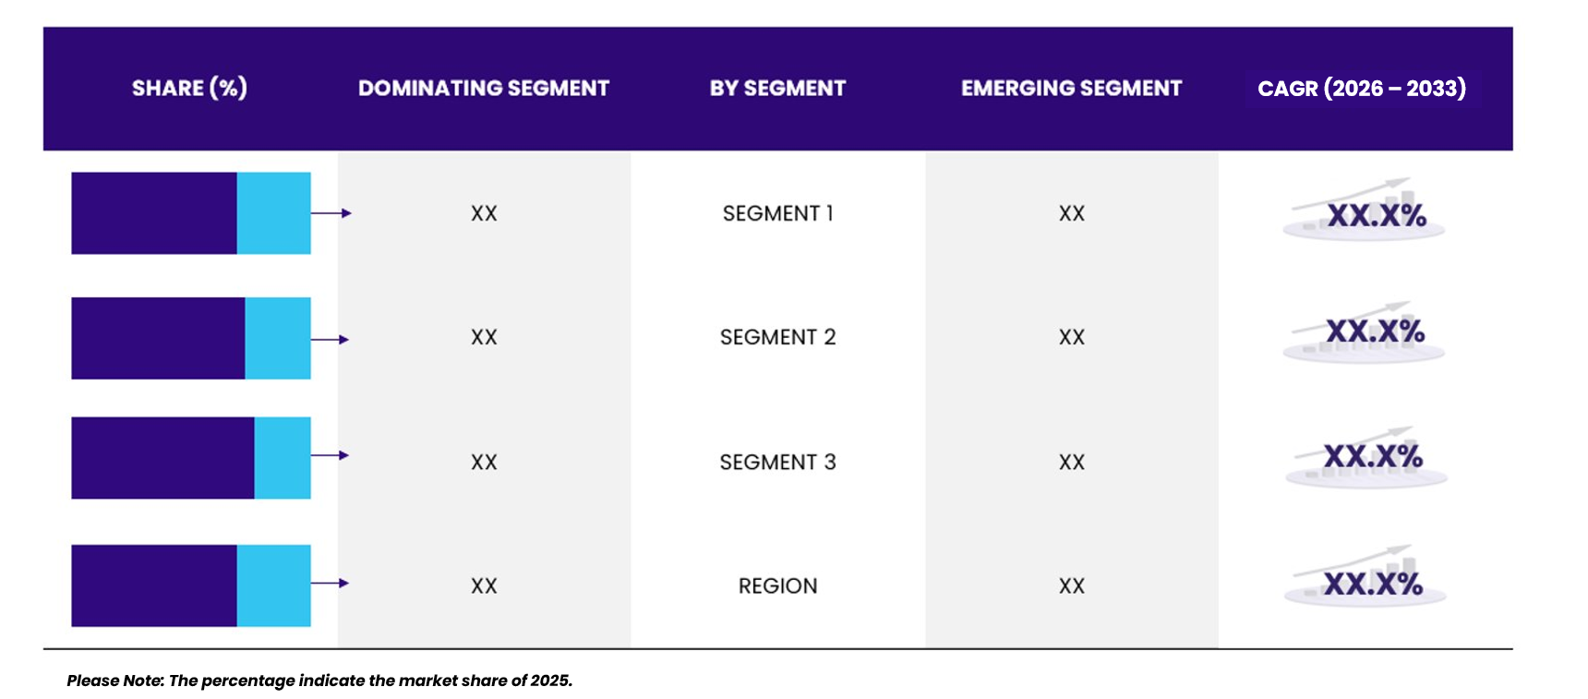
EXECUTIVE SUMMARY
SEGMENTAL OVERVIEW, 2025 (%)
{{heading}}
{{amount_1}}

Slide 19
MARKET DYNAMICS & OUTLOOK
Macro-Economic Indicators
Drivers & Opportunities
Restraints & Challenges
Supply Side Trends
Demand Side Trends
Porters Analysis & Impact
Threat of New Entrants
Bargaining Power of Suppliers
Bargaining Power of Buyers
Threat of Substitute
Intensity of Competitive Rivalry
{{heading}} -
{{timeline}}

Slide 20
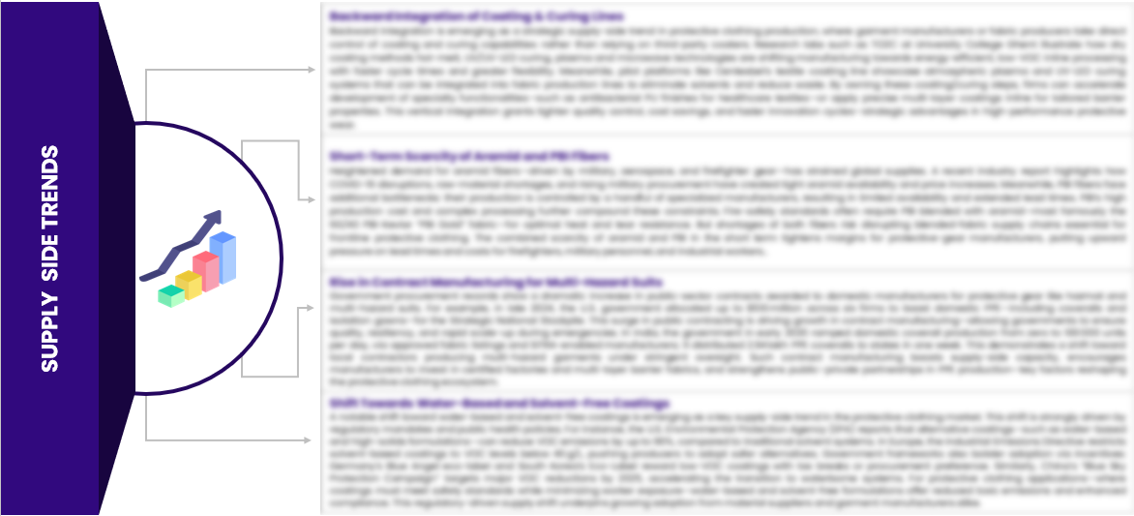
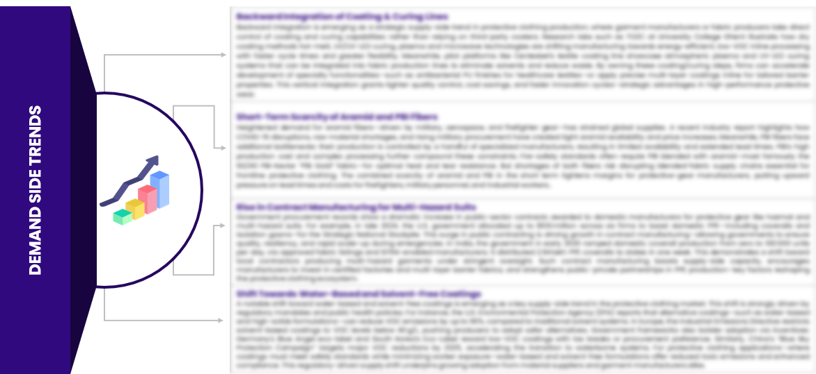
MARKET DYNAMICS & OUTLOOK
SUPPLY SIDE TRENDS
DEMAND SIDE TRENDS

Slide 21
MARKET DYNAMICS & OUTLOOK : MARKET DRIVERS & OPPORTUNITIES (1/X)
{{para}}
{{industry_title}}
*Please note that the drivers and opportunities mentioned here are only for representation purpose; a comprehensive analysis will be provided in the final report.

Slide 22
MARKET DYNAMICS & OUTLOOK : MARKET DRIVERS & OPPORTUNITIES (2/X)
{{para}}
{{industry_title}}
*Please note that the drivers and opportunities mentioned here are only for representation purpose; a comprehensive analysis will be provided in the final report.

Slide 23
MARKET DYNAMICS & OUTLOOK : MARKET RESTRAINTS & CHALLENGES [1/X]
{{para}}
{{industry_title}}
*Please note that the market restraints and challenges mentioned here are only for representation purpose; a comprehensive analysis will be provided in the final report.

Slide 24
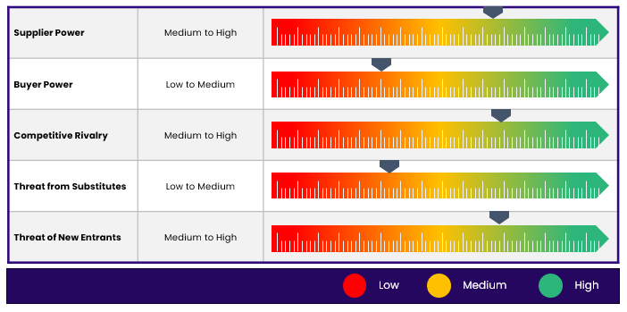
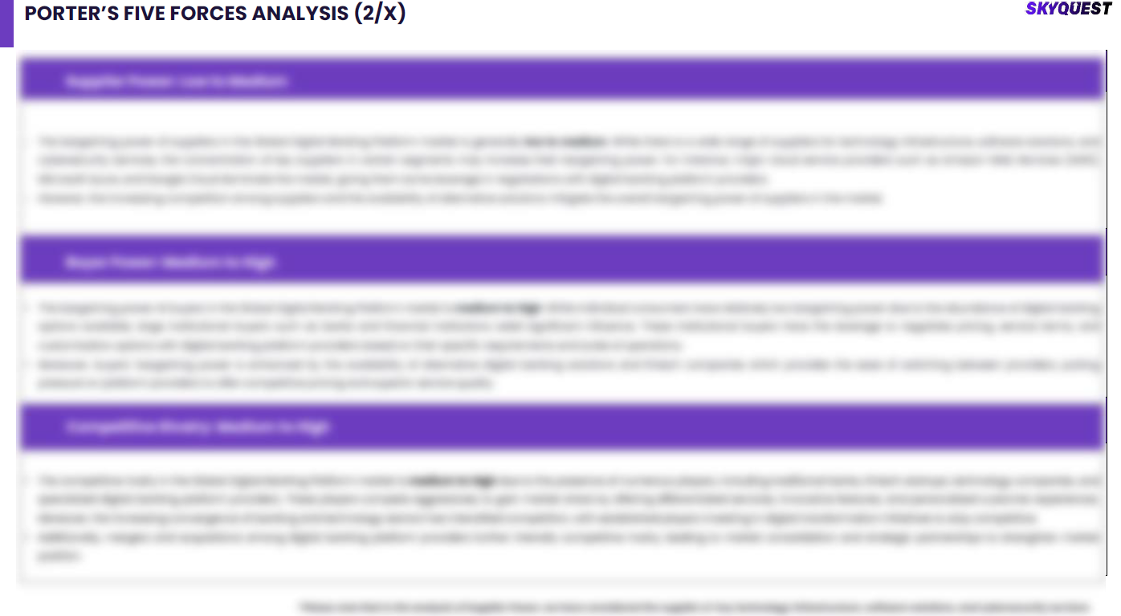


MARKET DYNAMICS & OUTLOOK

Slide 25
KEY MARKET INSIGHTS
{{default_kmi}}
{{user_kmi}}
{{heading}}-
{{timeline}}

Slide 26
MARKET IMPACTING FACTORS
{{headline}}
Market Parameters | Geography
 | North America | Europe | Asia Pacific | Latin America | Middle East & Africa
{{factor1}}
{{factor2}}
{{factor3}}
{{factor4}}
{{factor5}}
High
Medium
Low

Slide 27
KEY SUCCESS FACTORS OF THE MARKET
The above graph explains various features or characteristics of various success factors and their impact on the {{market_name}}
The key success factors of the market include : {{titles}}.
On a scale of 0-8, 1 is the lowest, and 8 is the highest rank.

Slide 28
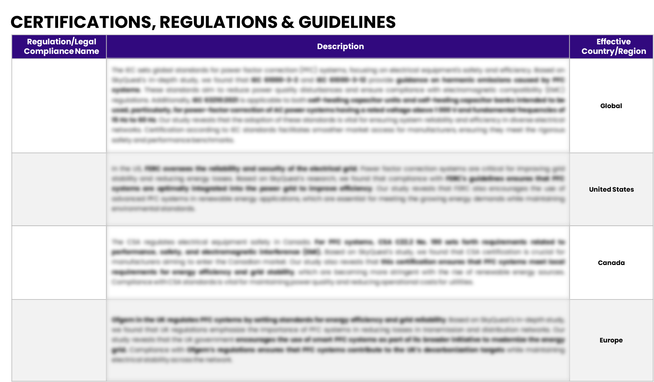
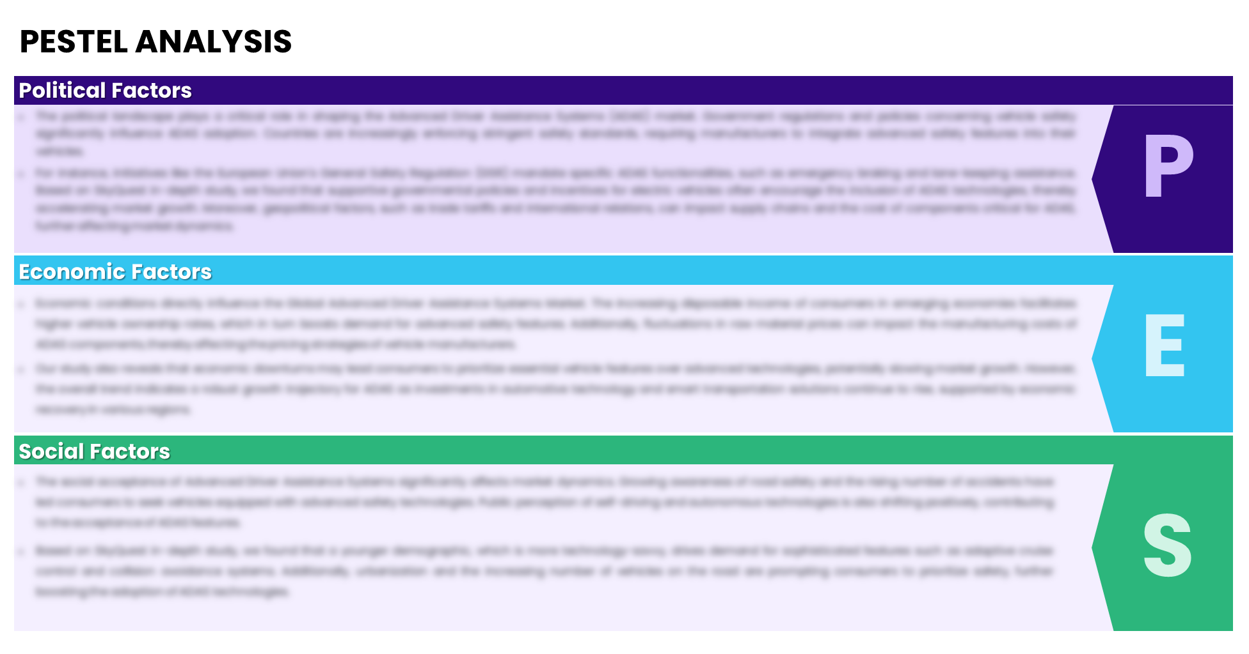
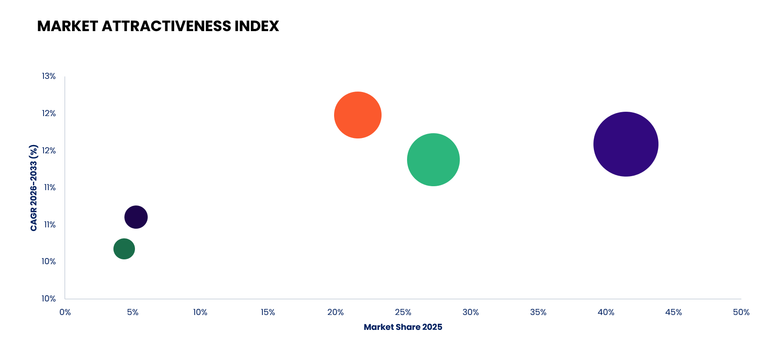

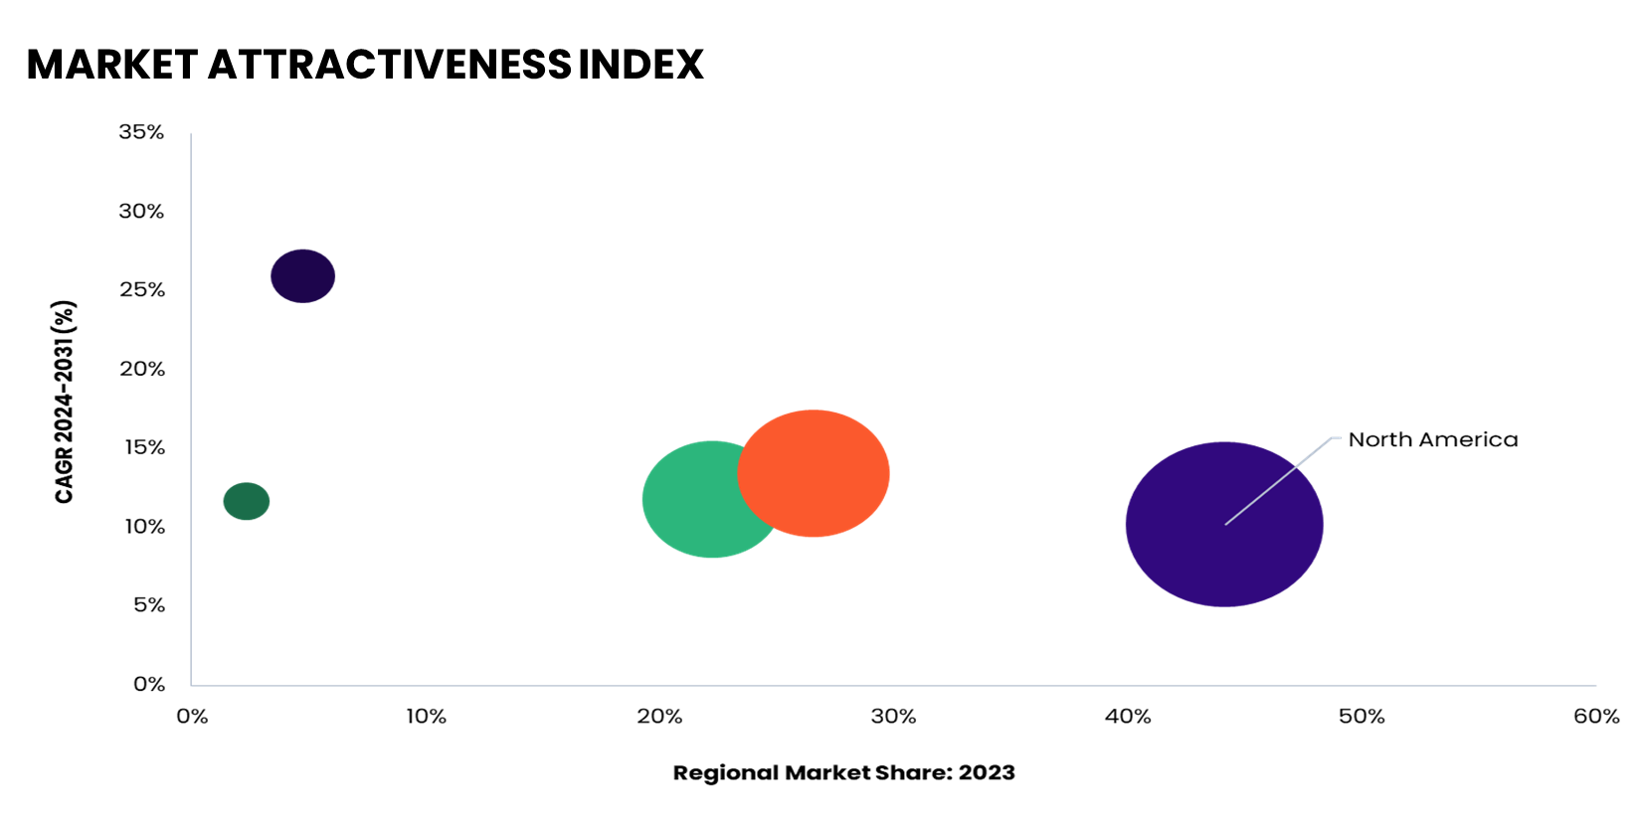
KEY MARKET INSIGHTS

Slide 29
GLOBAL MARKET ANALYSIS, SEGMENTAL ANALYSIS
{{types}}
{{heading}}-
{{timeline}}

Slide 30

GLOBAL MARKET ANALYSIS – BY {{type_1}}
{{heading}} SIZE, BY {{type_1}}, {{timeline}} ({{cur}})
Key Takeaways
*Please note that this slide represents an indicative segmentation overview. the complete level-2 segmentation analysis will be covered in the Final Report.

Slide 31
GLOBAL MARKET ANALYSIS BY REGION
{{heading}}-
{{timeline}}

Slide 32


GLOBAL MARKET ANALYSIS BY REGION
{{heading}}: REGIONAL ANALYSIS, {{timeline}} ({{cur}})
Key Takeaways
Europe
North America secured the foremost market share at 30.4%, and this dominance is projected to persist through the forecast period. This stronghold is attributed to the region's dense concentration of market competitors and an upsurge in cancer incidence rates. Notably, the U.S. witnessed approximately 1,806,590 new cancer diagnoses in 2020, as reported by the National Cancer Institute. The continuous integration of novel technologies, incorporating artificial intelligence, and the frequent launch of low-radiation CT scans are anticipated to further contribute to the region's market growth.
Conversely, Asia Pacific is poised for noteworthy growth, projected to experience a substantial Compound Annual Growth Rate (CAGR) over the forecast period. This surge can be attributed to the ongoing development of healthcare infrastructure, particularly in burgeoning economies such as India and China. The region's high adoption rate of advanced medical imaging devices, coupled with the increasing prevalence of chronic disorders, further fuels market expansion. Notably, local manufacturers in the region are gaining prominence, bolstering market growth.
North America
APAC
MEA
Latin America
Region | 2019 | 2020 | 2021 | 2022 | 2023 | 2024 | 2025 | 2026 | 2027 | 2028 | 2029 | 2030 | 2031 | 2032 | 2033 | CAGR (2026-2033)
North America | XX | XX | XX | XX | XX | XX | XX | XX | XX | XX | XX | XX | XX | XX | XX | XX%
Europe | XX | XX | XX | XX | XX | XX | XX | XX | XX | XX | XX | XX | XX | XX | XX | XX%
Asia-Pacific | XX | XX | XX | XX | XX | XX | XX | XX | XX | XX | XX | XX | XX | XX | XX | XX%
Latin America | XX | XX | XX | XX | XX | XX | XX | XX | XX | XX | XX | XX | XX | XX | XX | XX%
Middle East & Africa | XX | XX | XX | XX | XX | XX | XX | XX | XX | XX | XX | XX | XX | XX | XX | XX%
Total | XX | XX | XX | XX | XX | XX | XX | XX | XX | XX | XX | XX | XX | XX | XX | XX%

Slide 33
NORTH AMERICA MARKET ANALYSIS – BY {{type_1}}
NORTH AMERICA {{2_heading}} SIZE, BY {{type_1}}, {{timeline}} ({{cur}})
Key Takeaways

Slide 34
U.S. MARKET ANALYSIS – BY {{type_1}}
U.S. {{2_heading}} SIZE, BY {{type_1}}, {{timeline}} ({{cur}})
Key Takeaways

Slide 35
COMPETITIVE LANDSCAPE Competitive Dashboard Market Positioning of Key Players, 2025 Strategies Adopted By Key Market Players Recent Development Market Share Analysis, 2025
{{2_heading}} -
{{timeline}}

Slide 36
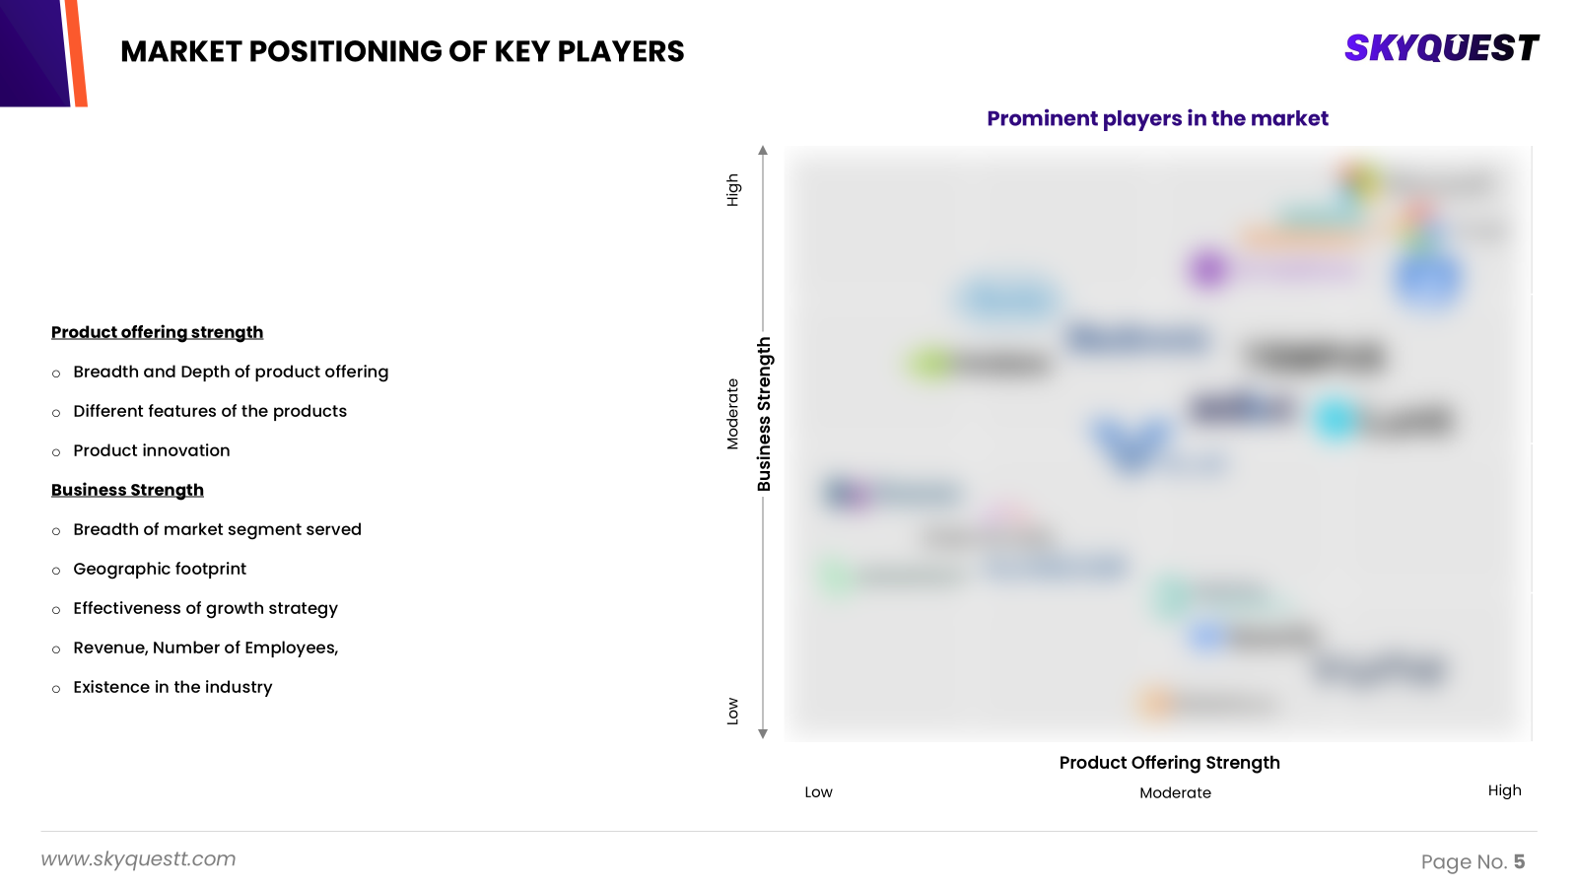
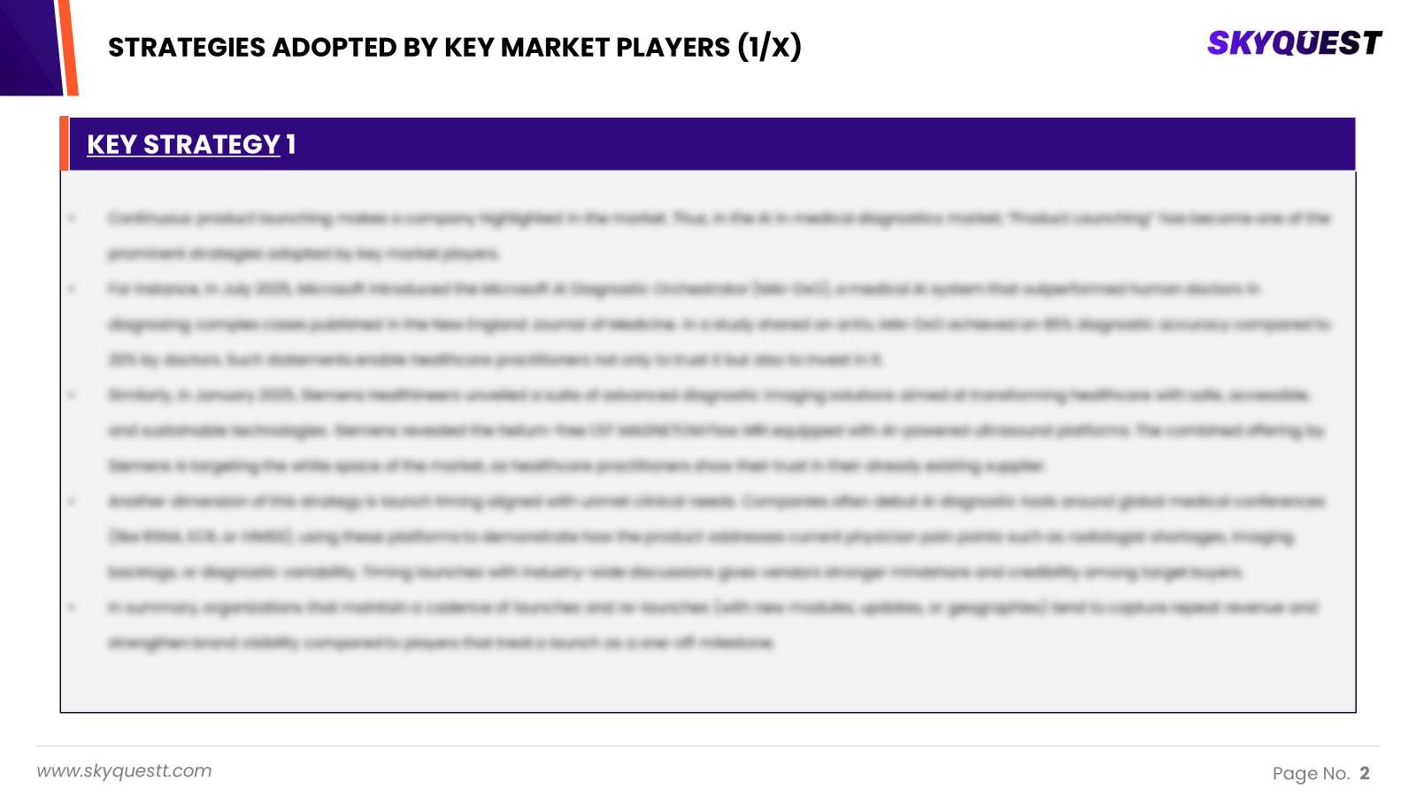
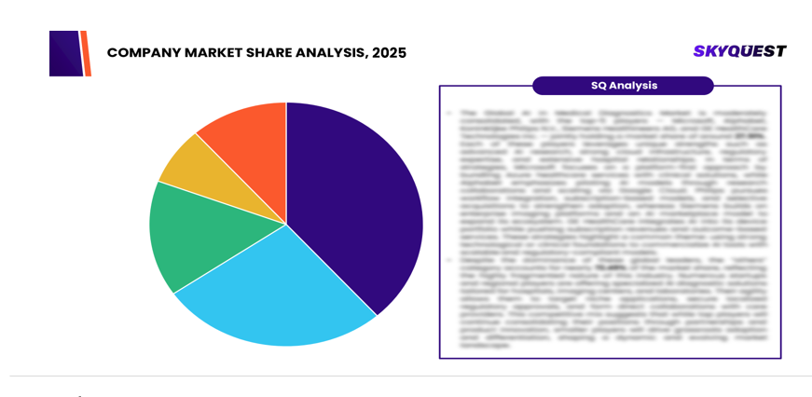
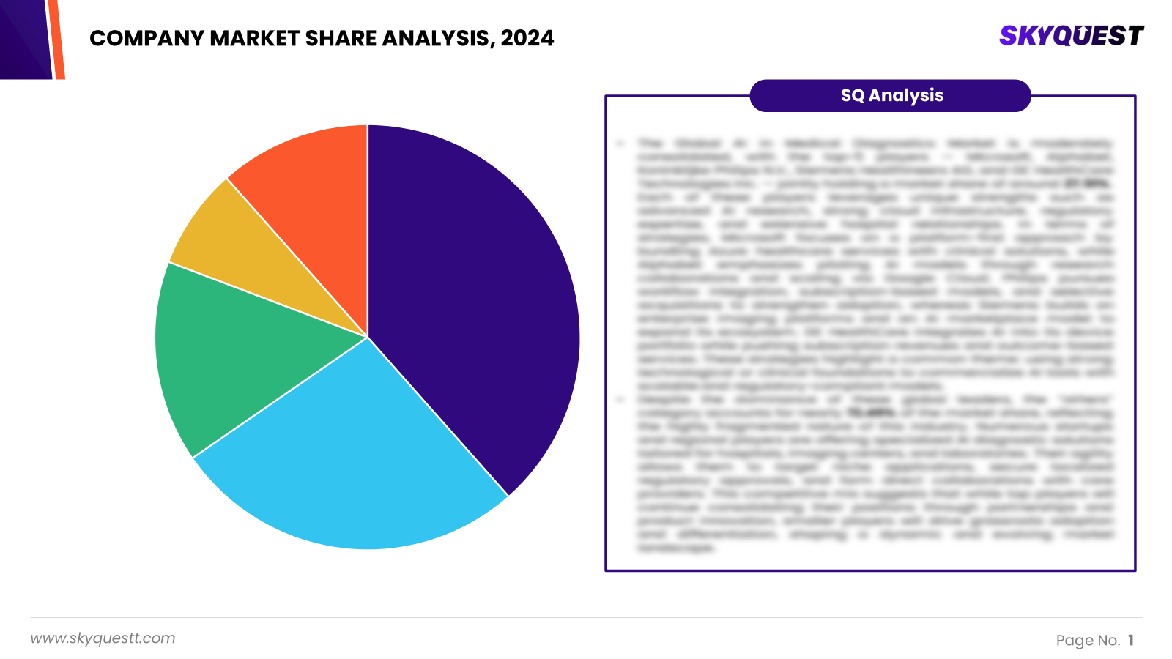
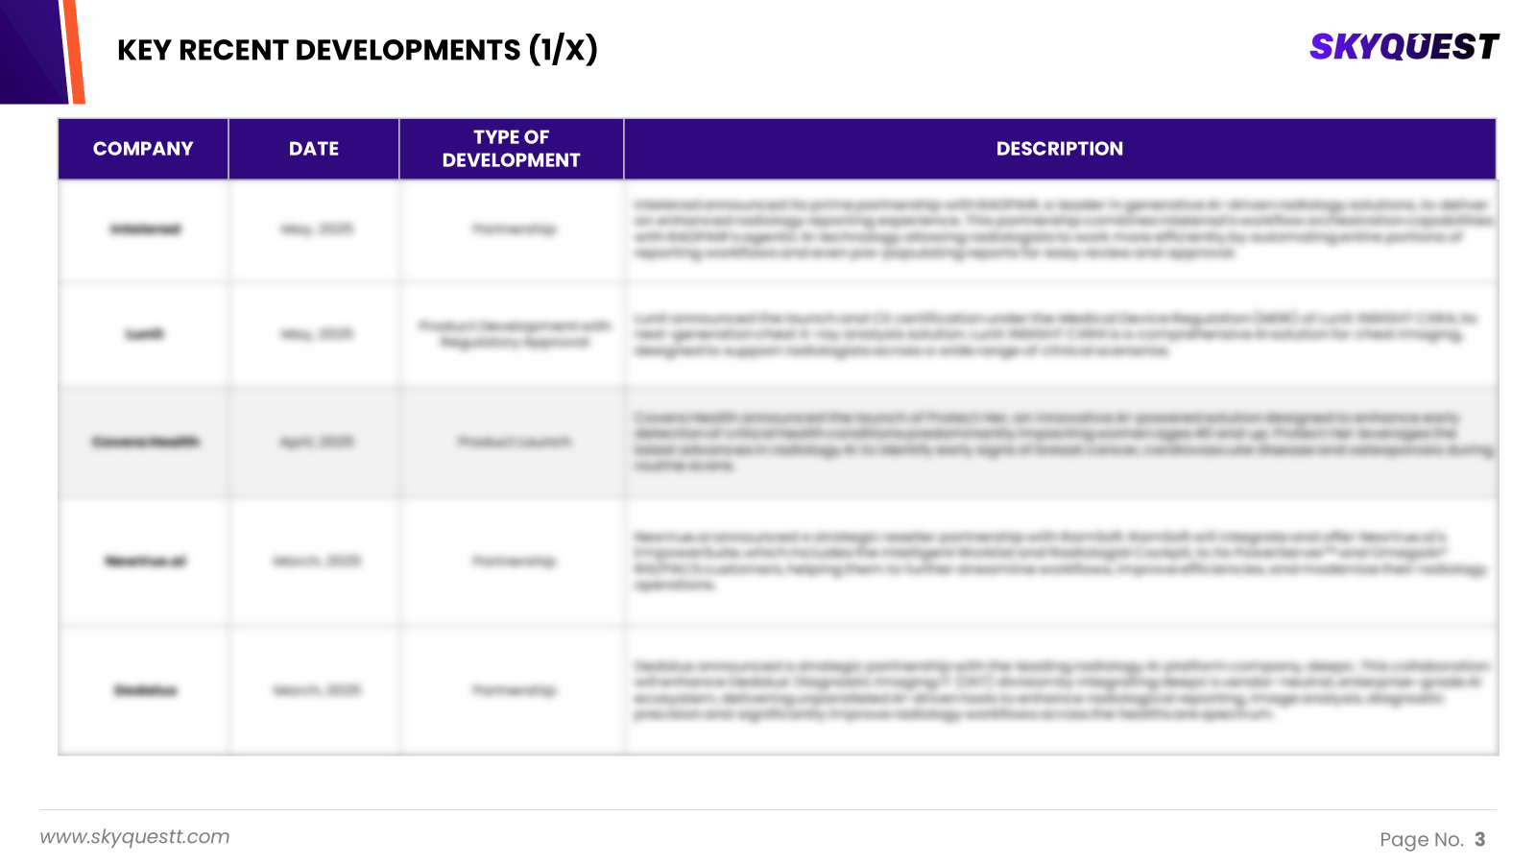
COMPETITIVE LANDSCAPE
The following figure represents the market positioning of {{heading}} players for the year 2025. The market positioning of the leading player is done considering the following points:

Slide 37
COMPETITIVE DASHBOARD
COMPETITORS | {{company}} | Company 2 | Company 3 | Company 4 | Company5
Headquarters | {{h}} | - | - | - | -
No of Employees(2025) | {{e}} | - | - | - | -
Revenue (USD) 2025 | {{rev}} | - | - | - | -
Industry Type | - | - | - | - | -
Geographic Presence | {{geo}} | - | - | - | -
Year of Establishment | {{es}} | - | - | - | -
Market Position | - | - | - | - | -

Slide 38
COMPANY PROFILES
{{2_heading}} -
{{timeline}}

Slide 39
{{company}} - COMPANY OVERVIEW
COMPANY AT A GLANCE
OVERVIEW
Established | {{es}}
Headquarter | {{h}}
Ownership | {{ownership}}
Revenue (USD)- 2025 | {{rev}}
No. of Employees (2025) | {{e}}
Website | {{website}}
{{para}}
PRODUCT/SERVICE PORTFOLIO
PRODUCT/SERVICE NAME | PRODUCT/SERVICE DESCRIPTION
{{description}}
{{product}}

Slide 40
{{company}} - FINANCIAL OVERVIEW
{{company}} - RECENT FINANCIALS IN USD {{unit}} (2023-2025) | {{company}}- BUSINESS REVENUE MIX, 2025 IN PERCENTAGE (%)
SKYQUEST'S TAKE ON THE COMPANY
{{revenue_analysis}} | {{segmental_analysis}}

Slide 41
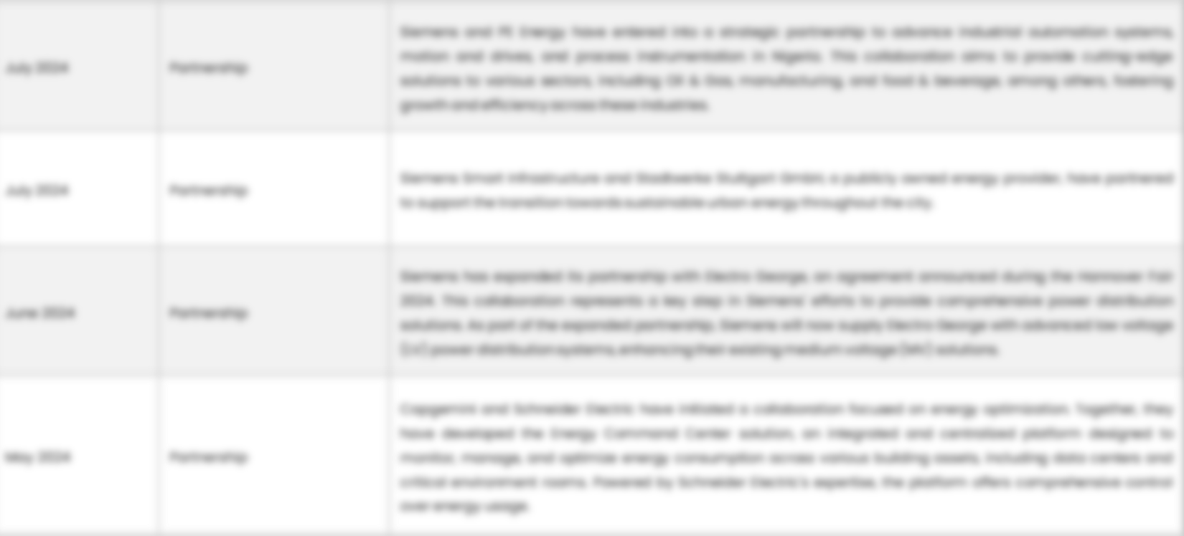
{{company}} – KEY DEVELOPMENTS
DATE | TYPE OF DEVELOPMENT | DESCRIPTION
October 2023 | Partnership | Microsoft and Siemens are deepening their partnership by bringing the benefits of generative AI to industries worldwide. As a first step, the companies are introducing Siemens Industrial Copilot, an AI-powered jointly developed assistant aimed at improving human-machine collaboration in manufacturing. In addition, the launch of the integration between Siemens Teamcenter software for product lifecycle management and Microsoft Teams will further pave the way to enabling the industrial metaverse.
May 2023 | Product launch | Microsoft Corp. announced a suite of new AI solutions and improvements to Microsoft Clumping Clay for Nonprofit that are designed to transform the nonprofit industry and how fundraisers engage with donors, manage campaigns and optimize operations. In addition, the company announced a limited private preview for nonprofits to experience a new AI-powered fundraising propensity model.

Slide 42
ABOUT US & APPENDIX

Slide 43

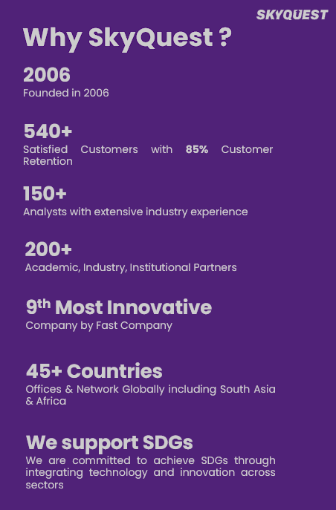









ABOUT US
Established in 2006, SkyQuest is a Global Market Intelligence, Innovation Management organization that connects innovation to new markets, networks & collaborators for achieving sustainable development goals.
SOME OF OUR CLIENTS
180+ Institutional Clients 125000+ Streaming Clients 500+ Workshops Organized
Sectoral Coverage
| Information Technology | Clean Tech | Marketing & Advertising | Water | Life Sciences and Social | Social | Energy and Power | Food & Beverage | Training & E-Learnings & Materials | Semiconductor & Electronics | Oil & Gas | Banking, Financial, Capital Markets, Insurance

Slide 44
OUR CUSTOMIZED RESEARCH CAPABILITIES
CUSTOMER, DISTRIBUTOR, SUPPLIER INTELLIGENCE
TYPE INTELLIGENCE SUPPORT
Identification of potential partners
Shortlisting/finalization of potential partners
Customer need analysis
Customer's purchase and usage behavior
Customer/partner feedback and satisfaction
Brand perception analysis
Import and Export Intelligence
Commodity pricing intelligence
Product pricing intelligence
Product Positioning Assessment
New product launch tracker
Product claims assessment
Product Concept Testing
COMPETITIVE DASHBOARD SUPPORT
MARKET INTELLIGENCE SUPPORT
Company profiling
Competition assessment incl. market share
Drilled down revenue estimations
Employer value proposition
Market size and segmentation
Growth opportunities
Market dynamics and new developments
Go to Market Strategies
DATA COLLECTION AND ANALYSIS SUPPORT
MARKET STRUCTURE ASSESSMENT
Data analytics and visualization
Data collection, manipulation incl. web scraping
B2B and B2C surveys and interviews
Macroeconomic analysis
Value Chain and Communication Analysis
Regulatory assessment
Coating layer scouting and assessment

Slide 45
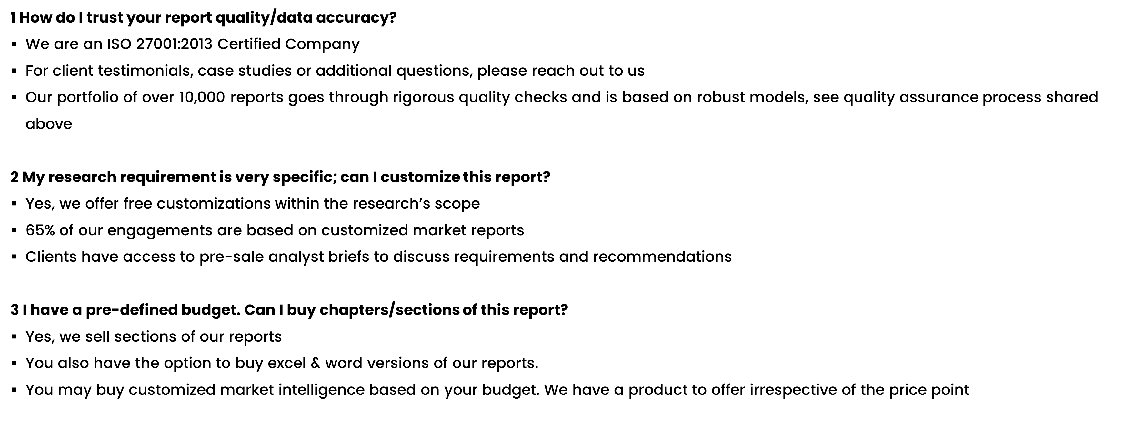
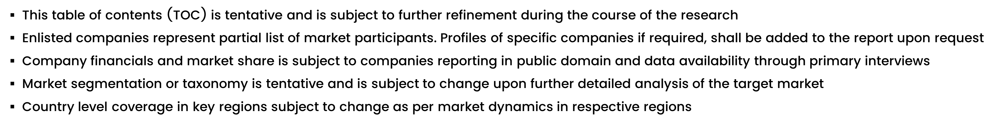
FAQs
NOTE

Slide 46






DISCLAIMER
SkyQuest provides strategic analysis to a select group of customers in response to orders. Our customers acknowledge when ordering that these strategic analysis for internal use and not for general publication or disclosure to any third party. SkyQuest does not endorse any vendor, product, or product type profiled in its publications. SkyQuest's strategic analysis constitutes estimations and projections based on secondary and primary research and are therefore subject to variations.
SkyQuest disclaims all warranties, expressed or implied, with respect to this research, including any warranties of merchantability or fitness, for any particular purpose. SkyQuest takes no responsibility for incorrect information supplied to it by manufacturers or users.
Trademarks, copyrights, and other forms of intellectual property belong to SkyQuest's respective owners and are protected by law. under no circumstance may any of these be reproduced, copied, or circulated in any form, without the prior written approval of SkyQuest's owner-as the case may be no part of this strategic analysis may be given, lent, resold, or disclosed to any third party, without express permission from SkyQuest team.
Reproduction and/or transmission in any form and by any means, including photocopying, mechanical, electronic, recording, or otherwise, without the permission of SkyQuest, is prohibited.
HEADQUARTERS
1 Apache Way, Westford, Massachusetts 01886, United States
APAC OFFICE
Room A & B, 2nd Floor, Lee Kee Commercial Building, 221-227, Queen’s Road Central, Hong Kong
GLOBAL DELIVERY CENTER
D-1001-1005, Swati Clover, Shilaj Circle, Sardar Patel Ring Rd, Thaltej, Ahmedabad, Gujrat-380054
WE ARE REACHABLE AT :-
info@skyquestt.com
+1-617-230-0741
www.skyquestt.com

Slide 47
THANK YOU
www.skyquestt.com

