Slide 1
Code Interpreter (for Data Analytics)
Generative AI and LLMs on their own (e.g., GPT-4) are not good at understanding large structured datasets, doing complex numerical calculations and performing data analytics
However, Code Interpreter in Azure AI Assistants can address these limitations of Gen AI and extend its capability to understand, interpret and analyze data, in the following areas:
Descriptive Analytics
Diagnostic Analytics
Predictive Analytics
Prescriptive Analytics
How can we make it happen?
Data Querying and Interpretation: Handle requests for data analysis, providing summaries and interpretations based on provided datasets
Predictive Analytics and Pattern Recognition: Leverage language model to identify trends in the historical data
Assisting in Data Visualization: Generate textual data trends descriptions and charts for visualization
What will happen?
Why did it happen?
What happened?
Generative AI
Analytical AI

Slide 2





Code Interpreter (for Data Analytics)
Code Interpreter allows the Assistants API to write and run Python code in a sandboxed execution environment
Below is a simple, conceptual representation of how this works. With Code Interpreter enabled:
AI Assistant can run code iteratively to solve more challenging code, math, and data analysis problems
Optimizes the number of tokens used, especially when handling large datasets
Better explainability for how the AI Assistant derived its responses, by reviewing the generated python scripts and intermediate results
User Prompt (Natural Language)
Write Python Code
Datasets
LLM
Response (Natural Language)
Analyze Results

Slide 3
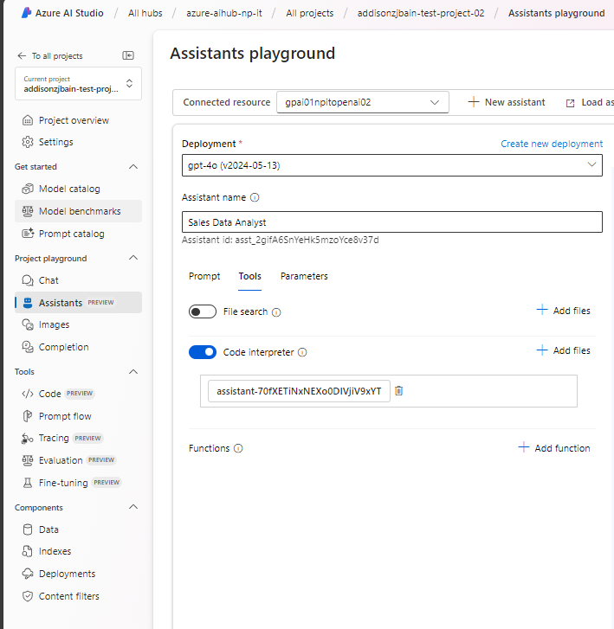
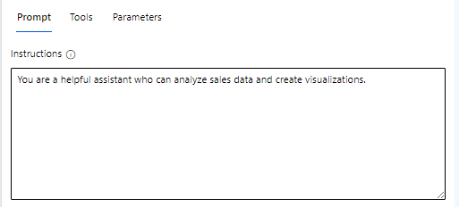
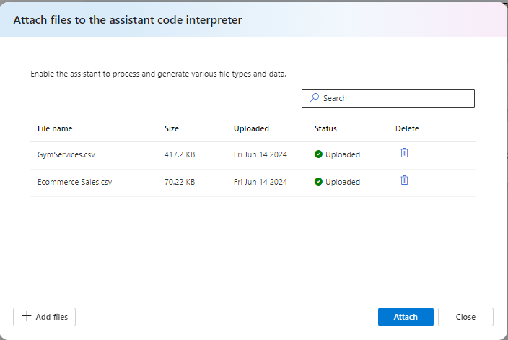
Code Interpreter in Azure AI Assistants
Go to your project in Azure AI Hub
Navigate to “Assistants” – Assistants Playground
Select an existing model deployment
Under Tools, enable “Code Interpreter”
Upload your datasets / files for analysis (if any) Note: You can upload up to 20 files, with a max file size of 512 MB each https://learn.microsoft.com/en-us/azure/ai-services/openai/how-to/assistant#supported-file-types
Enter your prompt in natural language and indicate clearly which dataset(s) to analyze
Notice how the AI model behaves like a data analyst: (1) Tries to understand and interpret your prompt (2) Writes the necessary Python code based on your prompt (3) Executes the Python code on the data (4) Analyzes and interprets the generated results (5) Provides a summarized response (with supporting visualizations if available)

Slide 4
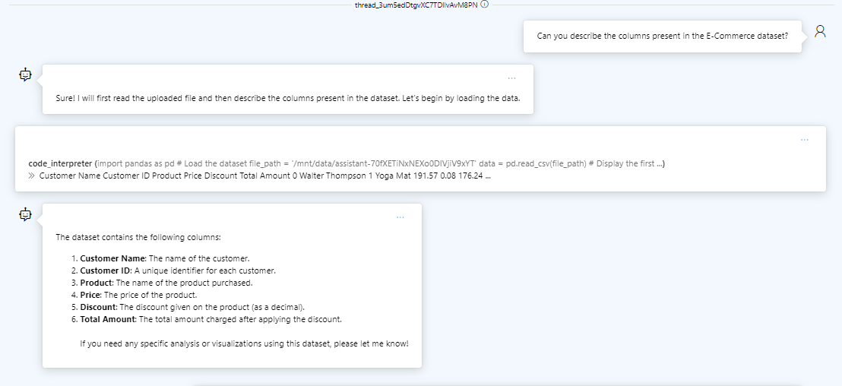
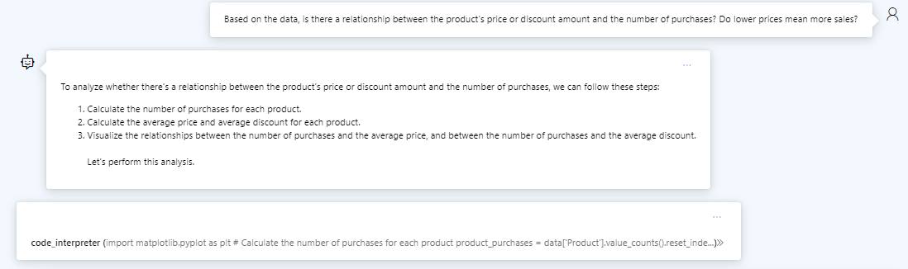
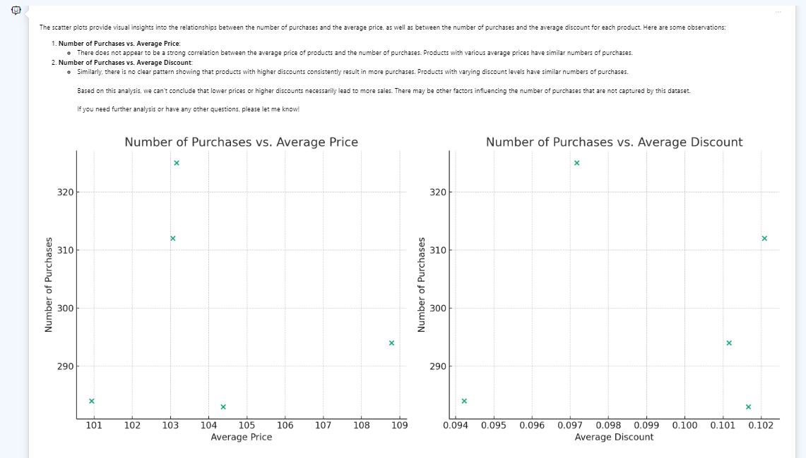
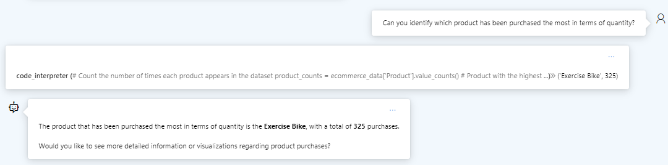
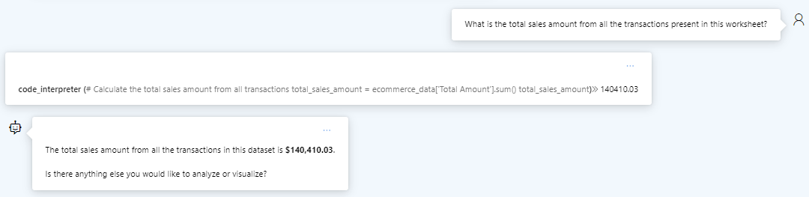
Ecommerce Sales.csv
Example: Code Interpreter in Azure AI Assistants
Interpret and analyze the dataset
Diagnostic Analytics - Find correlations / patterns
Perform aggregations & calculations

Slide 5
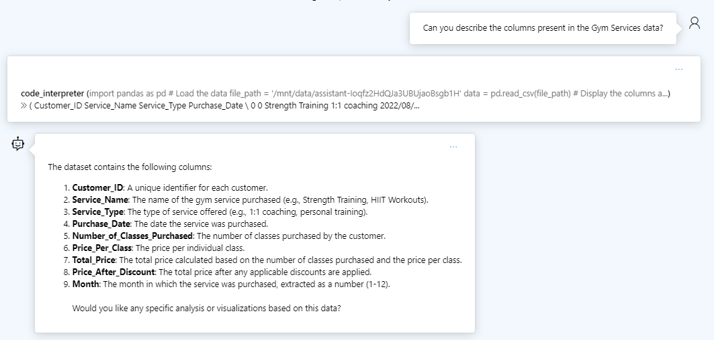
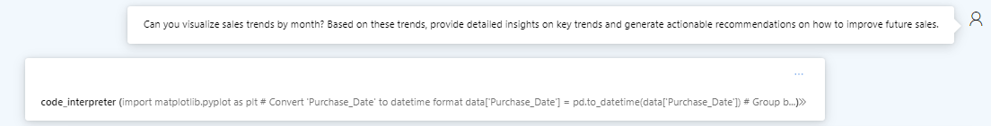
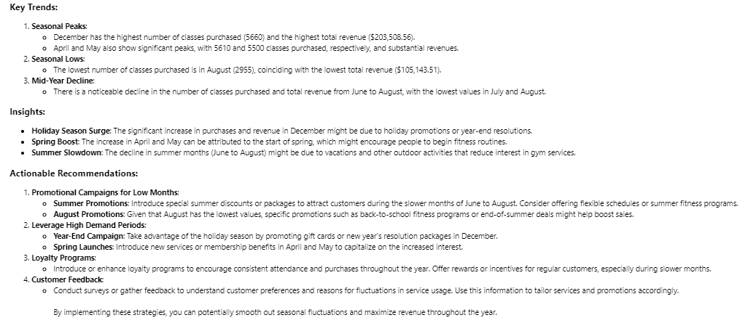
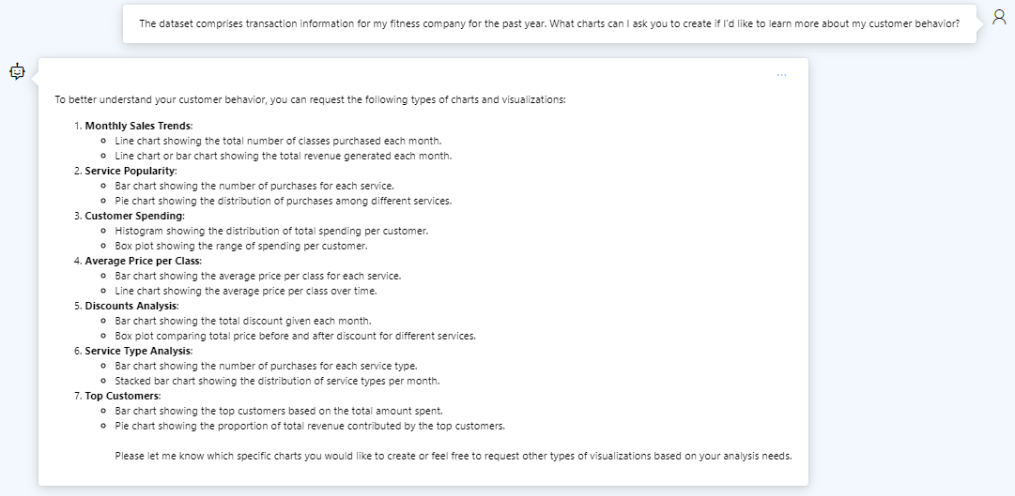
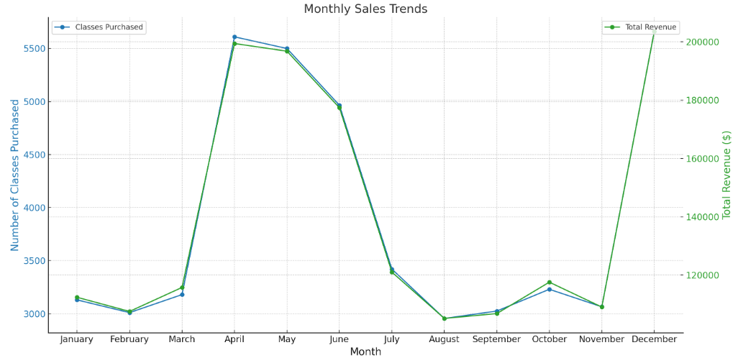
GymServices.csv
Example: Code Interpreter in Azure AI Assistants
Prescriptive Analytics
Exploratory analysis
Total Tokens used: 6315 (In: 4884, Out: 1431)

