Slide 1
DATABASE ASSIGNMENT
Student Management System
Database Design and Implementation using MySQL & MongoDB
GROUP 6
ADDIS ABABA SCIENCE AND TECHNOLOGY UNIVERSITY
Department of Software Engineering
Submitted to: Instructor Yaynshet Medhin | May 2025

Slide 2
Table of Contents
01
Introduction & Background
07
MySQL Queries & Operations
02
Problem Statement & Objectives
08
MongoDB Implementation
03
System Scope & Methodology
09
MongoDB Queries & Operations
04
Database Design — Entities & Relationships
10
System Testing & Results
05
Database Schema & Normalization
11
Bugs, Fixes & Improvements
06
MySQL Implementation
12
Conclusion

Slide 3
01 Introduction & Background
Context
Our Solution
Addis Ababa Science and Technology University (AASTU) manages vast academic information including student records, course enrollments, and teacher assignments.
As the institution grows, traditional manual systems become inadequate — causing data redundancy, inconsistencies, and slow retrieval.
A comprehensive Student Management System designed and implemented using:
MySQL — Relational Database
MongoDB — NoSQL Document Database
The system provides efficient storage, retrieval, and management of all academic records at AASTU.

Slide 4
02 Problem Statement & Objectives
Problems with Existing System
Project Objectives
Data duplication in records
Design & implement a Student Management System (MySQL + MongoDB)
Inconsistency during updates
Store student, course, instructor & department data efficiently
Slow search & retrieval
Manage student course enrollment & grades
Poor relationship management between students, courses & teachers
Reduce data redundancy via normalization
Risk of data loss with paper records
Demonstrate relational and NoSQL database operations

Slide 5
03 System Scope & Methodology
Scope Covers
Methodology & Tools
✓
Student Registration
1
Requirement Analysis
✓
Course Management
2
ER Diagram Design (Draw.io)
✓
Instructor Assignment
3
Database Normalization
✓
Department Management
4
MySQL Implementation
✓
Student Enrollment & Grading
5
MongoDB Implementation
Not In Scope: Graphical User Interface (GUI) and Online System Deployment

Slide 6
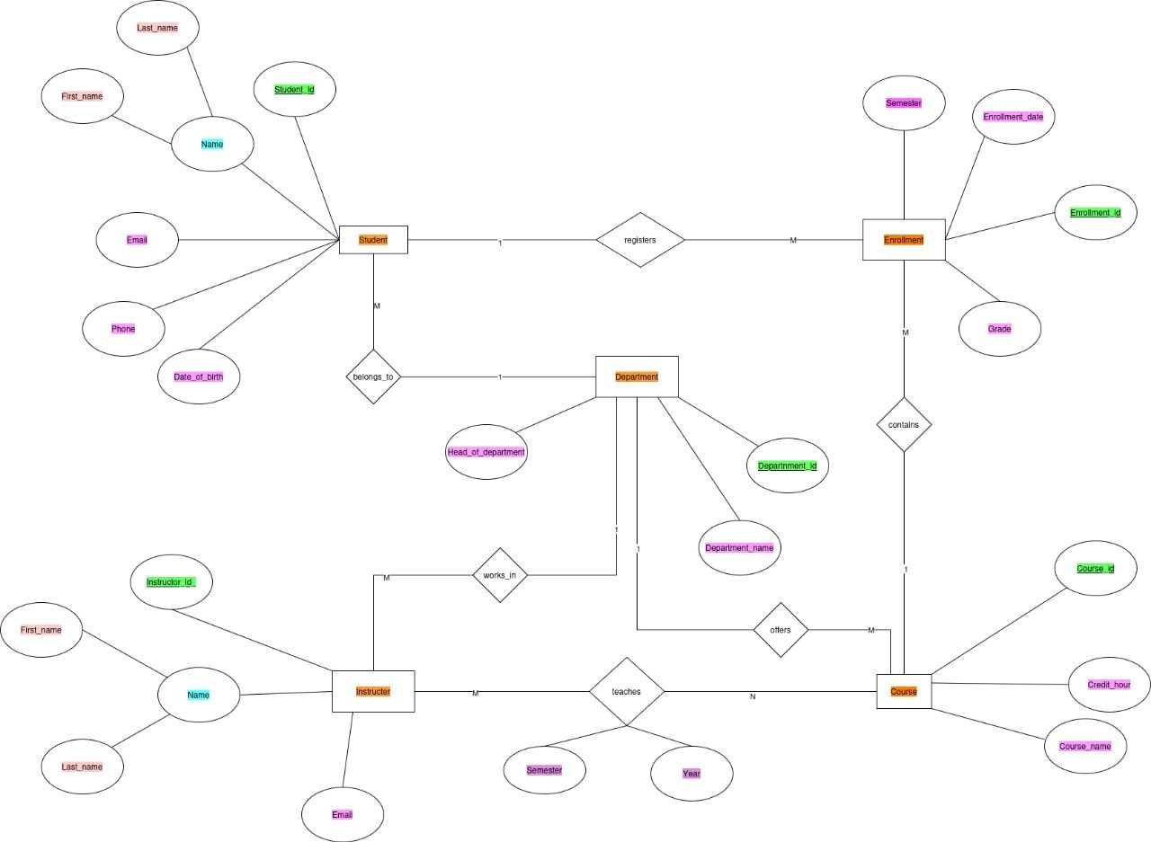

Slide 7
04 Database Design — Entities & Relationships
Student
Course
Instructor
Department
Enrollment
student_id (PK)
first_name, last_name
email, phone, DOB
department_id (FK)
course_id (PK)
course_name
credit_hour
instructor_id (FK)
instructor_id (PK)
first_name, last_name
email
department_id (FK)
department_id (PK)
department_name
enrollment_id (PK)
student_id (FK)
course_id (FK)
enrollment_date, grade
Entity Relationships
Department → Student
Instructor → Course
One department has many students (1:M)
One instructor teaches many courses (1:M)
Department → Instructor
Student ↔ Course
One department has many instructors (1:M)
Many students enrolled in many courses (M:N via Enrollment)

Slide 8
05 Database Normalization
UNF
1NF
2NF
3NF
BCNF
Unnormalized Form
First Normal Form
Second Normal Form
Third Normal Form
Boyce-Codd NF
Single large table with all data. Contains repeating groups, redundancy, update/insertion/deletion anomalies.
Atomic values only. No repeating groups. Each row is unique. Removes repeating course records per student.
1NF + no partial dependency. Decomposed into: Student, Course, Instructor, Department, Enrollment tables.
2NF + no transitive dependency. Non-key attributes depend only on the primary key. All 5 tables fully normalized.
Every determinant is a candidate key. All functional dependencies X→Y have X as a superkey. Final clean schema.
Final Result: 5 Fully Normalized Tables — Department, Student, Instructor, Course, Enrollment

Slide 9
06 MySQL Implementation
Relational Database — Structured, consistent data with foreign key constraints
CREATE TABLE Script
Tables Created
CREATE TABLE Department (
department_id INT PRIMARY KEY,
department_name VARCHAR(100)
);
CREATE TABLE Student (
student_id INT PRIMARY KEY,
first_name VARCHAR(50),
last_name VARCHAR(50),
email VARCHAR(100),
department_id INT,
FOREIGN KEY (department_id)
REFERENCES Department(department_id)
);
CREATE TABLE Enrollment (
enrollment_id INT PRIMARY KEY,
student_id INT, course_id INT,
enrollment_date DATE, grade VARCHAR(5),
FOREIGN KEY (student_id)
REFERENCES Student(student_id)
);
Department
department_id, department_name
Instructor
instructor_id, name, email, dept FK
Student
student_id, name, email, phone, DOB, dept FK
Course
course_id, name, credit_hour, instructor FK
Enrollment
enrollment_id, student FK, course FK, date, grade
5 students, 4 departments, 4 instructors, 4 courses, 6 enrollment records inserted

Slide 10
07 MySQL — Queries & Operations
JOIN: Students with Departments
JOIN: Enrollment Report
SELECT s.student_id, s.first_name,
s.last_name, d.department_name
FROM Student s
JOIN Department d
ON s.department_id = d.department_id;
SELECT s.first_name, s.last_name,
c.course_name, e.grade
FROM Enrollment e
JOIN Student s ON e.student_id=s.student_id
JOIN Course c ON e.course_id=c.course_id;
Aggregate: Count Records
Filter: Grade A Students
SELECT COUNT(*) AS Total_Students
FROM Student;
SELECT COUNT(*) AS Total_Courses
FROM Course;
SELECT * FROM Enrollment
WHERE grade = 'A';
SELECT * FROM Course
WHERE credit_hour > 3;
Also implemented: UPDATE, DELETE, COUNT, GROUP BY, ORDER BY, and subquery operations

Slide 11
08 MongoDB Implementation
NoSQL Document Database — Flexible JSON-like documents stored in collections
Insert Documents
MongoDB Collections
db.Student.insertMany([
{
student_id: 101,
first_name: "Abel",
last_name: "Tadesse",
email: "abel@gmail.com",
department_id: 1
},
{
student_id: 102,
first_name: "Meron",
last_name: "Ali",
email: "meron@gmail.com",
department_id: 2
}
]);
db.Enrollment.insertMany([
{ enrollment_id: 401,
student_id: 101,
course_id: 301,
grade: "A" }
]);
• db.Student
• db.Department
• db.Course
• db.Enrollment
• db.Instructor
MySQL vs MongoDB
Feature
MySQL
MongoDB
Data Model
Tables/Rows
Collections/Docs
Schema
Fixed
Flexible
Language
SQL
MQL / JSON
Best For
Structured data
Flexible data

Slide 12
09 MongoDB — Queries & Operations
Find All / By ID
Filter: Grade A
Update Record
db.Student.find()
db.Student.find({student_id: 101})
db.Course.find({course_name:
"Database Systems"})
db.Enrollment.find({grade: "A"})
db.Course.find({
credit_hour: {$gt: 3}
})
db.Student.updateOne(
{student_id: 101},
{$set: {
phone: "0911998877"
}}
)
Sort & Count
Delete Record
Schema (JSON)
db.Student.find()
.sort({first_name: 1})
db.Student.countDocuments()
db.Course.countDocuments()
db.Enrollment.deleteOne(
{enrollment_id: 406}
)
{
"student_id": 101,
"first_name": "Abel",
"email": "abel@gmail.com",
"department_id": 1
}

Slide 13
10 System Testing & Results
All 10 test cases passed successfully across MySQL and MongoDB implementations
10/10
PASS
#
Test Case
Operation
Status
1
Insert student
INSERT INTO Student
✓ PASS
2
Insert course
INSERT INTO Course
✓ PASS
3
Enroll student
INSERT INTO Enrollment
✓ PASS
4
Search by ID
SELECT WHERE student_id
✓ PASS
5
Update email
UPDATE SET email
✓ PASS
6
Delete enrollment
DELETE FROM Enrollment
✓ PASS
7
Display all students
SELECT * FROM Student
✓ PASS
8
Count students
SELECT COUNT(*)
✓ PASS
9
Credit hour filter
SELECT WHERE credit_hour>3
✓ PASS
10
Grade A retrieval
SELECT WHERE grade='A'
✓ PASS

Slide 14
11 Bugs Encountered & Future Improvements
Bugs Encountered & Solutions
Future Improvements
⚠ FK Constraint Error
→ Insert parent records first
Develop a Graphical User Interface (GUI)
Create a web-based version of the system
⚠ Duplicate PK Error
→ Use unique IDs for all records
Add login & authentication features
⚠ Query Syntax Errors
→ Corrected table/column names
Implement advanced report generation
⚠ Missing Field Values
→ Added all required fields
Add automatic backup & recovery
Implement role-based access control
⚠ Wrong Data Types
→ Corrected data type assignments
Add GPA calculation functionality
Integrate with online registration services

Slide 15
Key Features & Functionality Summary
👤 Student Registration
📚 Course Management
👨‍🏫 Instructor Management
Register students with personal info, DOB, email, phone & department assignment
Add courses with credit hours, assign instructors, manage course catalog
Store instructor profiles and link them to their respective departments
🏛 Department Management
📝 Enrollment & Grading
🔍 Search & Retrieval
Manage academic departments and associate students & instructors
Enroll students in courses, track enrollment dates and assign grades
Fast query operations: filter by grade, search by ID, join reports

Slide 16
12 Conclusion
This project successfully designed and implemented a Student Management System at AASTU using both MySQL (relational) and MongoDB (NoSQL) databases.
The system demonstrates how modern database technologies can solve real-world academic data management challenges.
Efficient storage of student, course, instructor & enrollment data
Full normalization from UNF → 1NF → 2NF → 3NF → BCNF
✓
✓
CRUD operations implemented in both MySQL and MongoDB
All 10 test cases passed with no critical errors
✓
✓
Dual-database architecture comparing SQL vs NoSQL
Clear data integrity via primary and foreign key constraints
✓
✓
"A foundation for a full-scale Academic Information System at AASTU"

Slide 17
THANK YOU
Student Management System — Database Assignment
GROUP 6 | Department of Software Engineering
Addis Ababa Science and Technology University
Submitted to: Instructor Yaynshet Medhin

