Slide 1
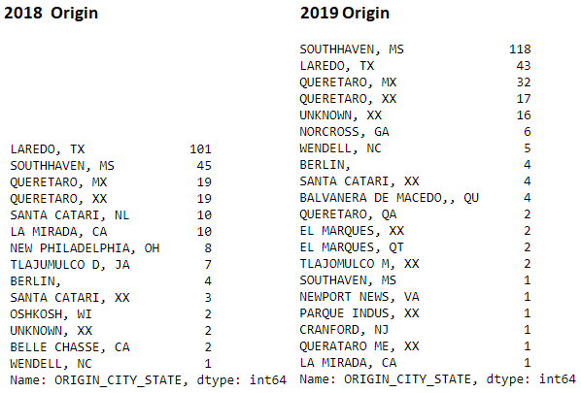
Laredo and Southaven reversed positions from 2018 to 2019

Slide 2
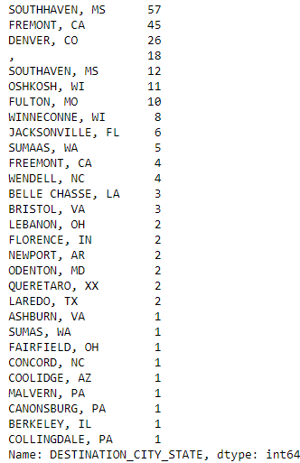
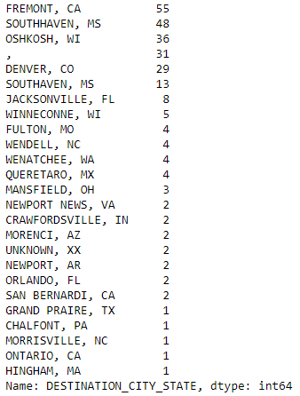
2018 Destination vs. 2019

