Slide 1
Part3
3. Layer-wise Analysis and Design of Deep Neural Networks
3.1 Two Data Complexity measures
Separation index (SI)
Smoothness index(SmI)
3.2 Layer-wise Analysis by Separation and Smoothness indices
Dataset evaluation, ranking and dividing (SI, SmI)
Subset Selection (SI, SmI)
Layer-wise Model evaluation (SI, SmI)
Pre-train Model ranking (SI, SmI)
Model Confidence and Guarantee (SI, SmI)
3.3 Layer-wise Design by Separation and Smoothness indices
Model Compressing(SI, SmI)
Forward learning in the first layer(SI, SmI)
Layer-wise forward learning(SI, SmI)
Layer-wise branching(SI, SmI)
Layer-wise Fusion(SI, SmI)
Forward Design(SI, SmI)
Forward Multi-Task Design(SI, SmI)
3.4 Related works in local Layer-wise learning
Indicator | Research (state)
SI | Initial studies have been done
SmI | Initial studies have been done
SI | There are some prepared/under-review works
SmI | There are some prepared/under-review works
SI | New idea
SmI | New idea
Notes:
قرمزها یک سری کار ها شده ولی نیاز به کارهای بیشتر است
کارهای خوبی شده و مقالات در حال داوری هست.
ایدهای نو (آبی)

Slide 2
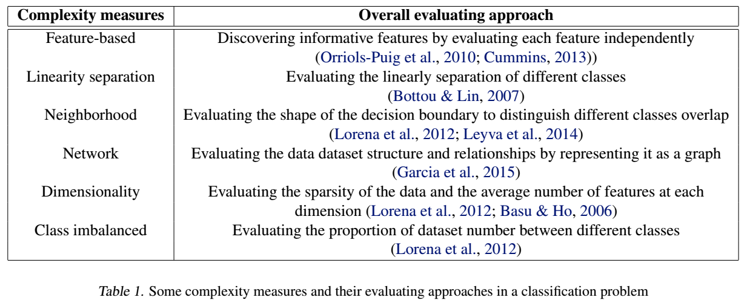
3.1 Two Data Complexity measures
Data Complexity measures
3.1.1 Separation index
First order SI
High order SI
High order soft SI
3.1.2 Smoothness index
First order SmI
High order SmI
High order soft SmI
√
√
√
√
√
Notes:
1- استخراج ویژگیهای حاوی اطلاعات با روشهای مبتنی بر دانش (ویژگی ها قابل تفسیر ) یا با کمک مدلها و یا شاخصهای یادگیری ماشین مثل آنالیز وابستگی و یا اطلاعات متقابل
2- میزان خطی بودن جدایی بین ویژگیهای متمایز دهنده کلاسها اگر از شبکه های خیلی ساده استفاده شود یا ابعاد فضا گسترده شود و مثلا از SVM استفاده شود.
3- مطالعه پیچیدیگی در هماسیگی و هم پوشانی بین داده های کلاسهای متفاوت مربوط به شبکه ها با لایه ها بیشتر جهت فیلتر کردن و ساخت مرزهای غیرخطی
4- ارزیابی ساختار نظم داده و بازنمایش آن بصورت گراف (علی بودن و کشف تاثیرات متقابل) با کمک روشهای بدون نظارت و با نظارت
5- کشف پوچی فضای داده ها و کاهش بعد داده ها و بازنمایی حداقل بعد از داده
6- عدام توازن در تعداد نمونه های بین کلاس ها و....

Slide 3
Two Complexity measures
A separation measure (in classification problems)
It shows that how much input data points separate the labels from each others.
An smoothness measure (in regression problems)
It shows that how much input data points make the output targets smooth
1
2
2
1
1
2
2
1
1
2
1
2
1
1
2
2
2
2
1
1
1
1
(More separated)
(Less separated)
(Less Smooth)
(More Smooth)
output
output
input
input

Slide 4
Separation index (SI) “SI” measures that how much input data points separate class labels from each others.

Slide 5
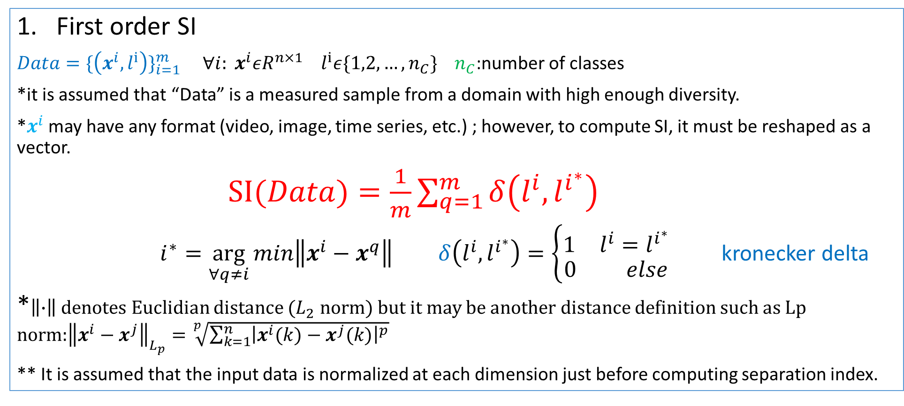
3.1.1 Separation index (SI)
First order SI
$Data=\{\left(x^{i},l^{i}\right)\}_{i=1}^{m}$ ${∀i: x}^{i}εR^{n×1}$ $l^{i}ε\{1,2,…,n_{C}\}{ n}_{C}$:number of classes
*it is assumed that “Data” is a measured sample from a domain with high enough diversity.
*$x^{i}$ may have any format (video, image, time series, etc.) ; however, to compute SI, it must be reshaped as a vector.
$SI(Data)=\frac{1}{m}\sum_{q=1}^{m}{δ\left(l^{i},l^{i^{∗}}\right)}$
$i^{∗}=\arg_{∀q≠i}{min\left\|x^{i}−x^{q}\right\| }δ\left(l^{i},l^{i^{∗}}\right)=\left\{\begin{aligned}\begin{matrix}1 & l^{i}=l^{i^{∗}}\end{matrix} \\ \begin{matrix}0 & else\end{matrix}\end{aligned}\right.$ kronecker delta
*$\left\|∙\right\|$ denotes Euclidian distance ($L_{2}$ norm) but it may be another distance definition such as Lp norm:${\left\|x^{i}−x^{j}\right\|}_{L_{p}}=\sqrt[p]{\sum_{k=1}^{n}{{\left|x^{i}(k)−x^{j}(k)\right|}^{p}}}$
** It is assumed that the input data is normalized at each dimension just before computing separation index.
Notes:
kronecker delta versus Dirac Delta

Slide 6
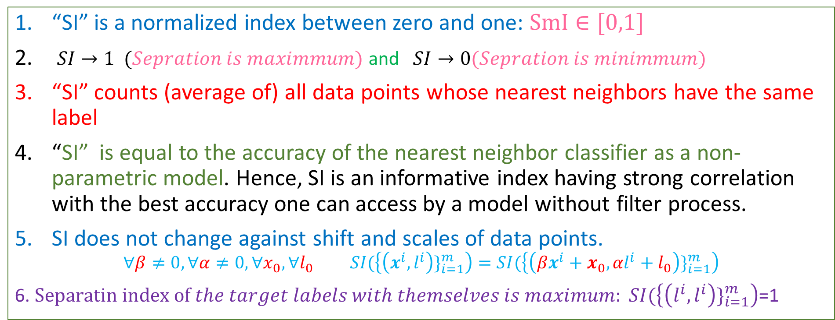
Some notes
“SI” is a normalized index between zero and one: $SmI∈[0,1]$
$SI→1 (Sepration is maximmum)$ and $SI→0(Sepration is minimmum)$
“SI” counts (average of) all data points whose nearest neighbors have the same label
“SI” is equal to the accuracy of the nearest neighbor classifier as a non-parametric model. Hence, SI is an informative index having strong correlation with the best accuracy one can access by a model without filter process.
SI does not change against shift and scales of data points.
$$∀β≠0,∀α≠0, ∀x_{0},∀l_{0} SI(\left\{\left(x^{i},l^{i}\right)\}_{i=1}^{m}\right)=SI(\left\{\left(βx^{i}+x_{0},{αl}^{i}+l_{0}\right)\}_{i=1}^{m}\right)$$
6. $Separatin index of the target labels with themselves is maximum: SI(\left\{\left(l^{i},l^{i}\right)\}_{i=1}^{m}\right)$=1

Slide 7
Two dimensional examples (binary classification)
1
1
2
1
1
2
2
1
2
1
1
2
1
1
1
2
2
2
2
2
1
1
SI=6/11
SI=11/11=1
2
2
2
1
1
1
1
1
2
1
2
2
1
2
1
2
1
1
1
2
1
2
SI=4/11
SI=11/11=1
Some notes
To have a high SI, It is enough that examples of each class become near and near together in some regions
The number of regions is not important but each region must have at least two members.
The shape of each region is not important.

Slide 8
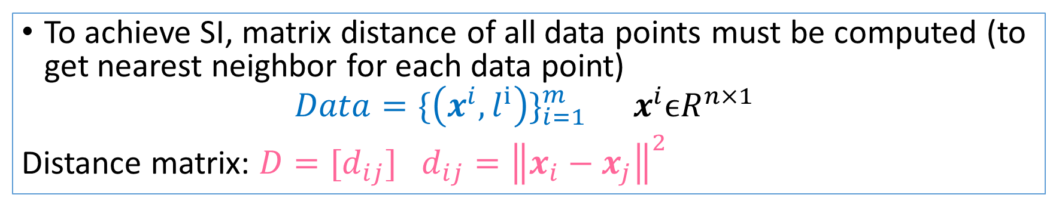
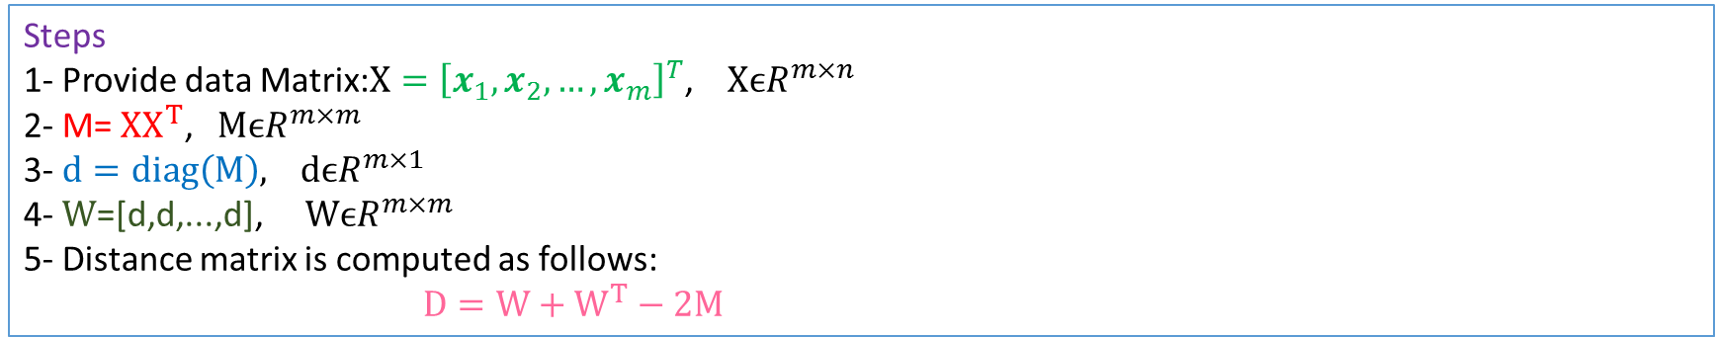
The distance matrix
To achieve SI, matrix distance of all data points must be computed (to get nearest neighbor for each data point)
$$Data=\{\left(x^{i},l^{i}\right)\}_{i=1}^{m} x^{i}ϵR^{n×1 }$$
Distance matrix: $D=[d_{ij}]$ $d_{ij}={\left\|x_{i}−x_{j}\right\|}^{2}$
Steps
1- Provide data Matrix:$X={\left[x_{1},x_{2},…,x_{m}\right]}^{T}$, $XϵR^{m×n }$
2- M= $XX^{T}\text{,} MϵR^{m×m }$
3- $d=diag\left(M\right),$ $dϵR^{m×1 }$
4- $W$=[d,d,...,d],$WϵR^{m×m }$
5- Distance matrix is computed as follows:
$D=W+W^{T}−2M$

Slide 9
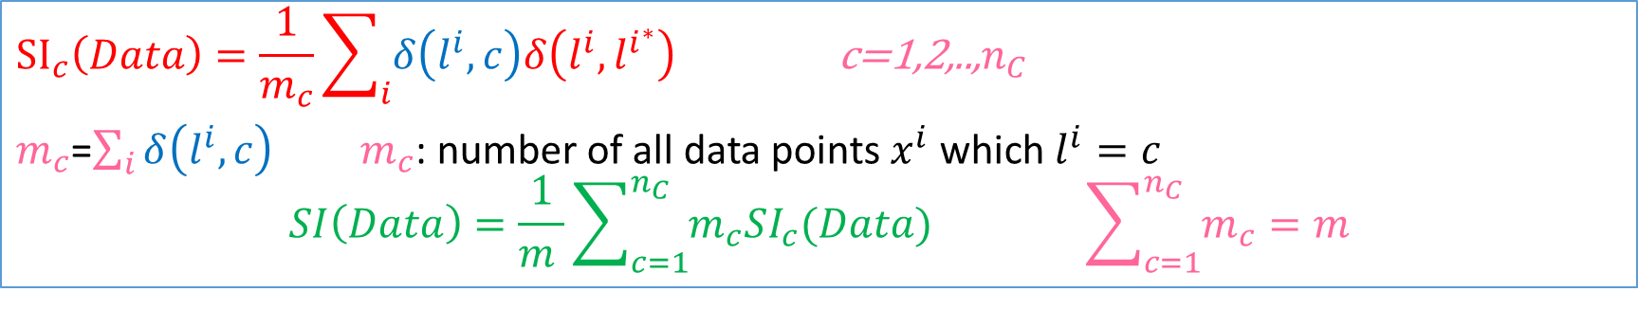
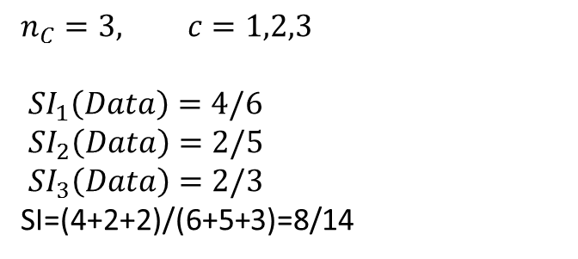
Separation index for Each Class
$${SI}_{c}\left(Data\right)=\frac{1}{m_{c}}\sum_{i}{δ\left(l^{i},c\right)δ\left(l^{i},l^{i^{∗}}\right) }\text{c}\text{=1,2,..,}n_{C}$$
$m_{c}$=$\sum_{i}{δ\left(l^{i},c\right) }$ $m_{c}$: number of all data points $x^{i}$ which $l^{i}=c$
$$SI\left(Data\right)=\frac{1}{m }\sum_{c=1}^{n_{C}}{m_{c}SI_{c}(Data) } \sum_{c=1}^{n_{C}}{m_{c}}=m$$
A two dimensional illustrative example
1
3
$$n_{C}=3, c=1,2,3$$
$SI_{1}\left(Data\right)=4/6$
$SI_{2}\left(Data\right)=2/5$
$SI_{3}\left(Data\right)=2/3$
SI=(4+2+2)/(6+5+3)=8/14
2
1
1
1
3
2
2
1
2
3
2
1
* For when for each class $c{ :m}_{c}=\frac{m}{n_{C}}$ and a sufficient high number of data points are distributed with a uniformly distributed random variable then it is expected that $SI→1/n_{C}$

Slide 10
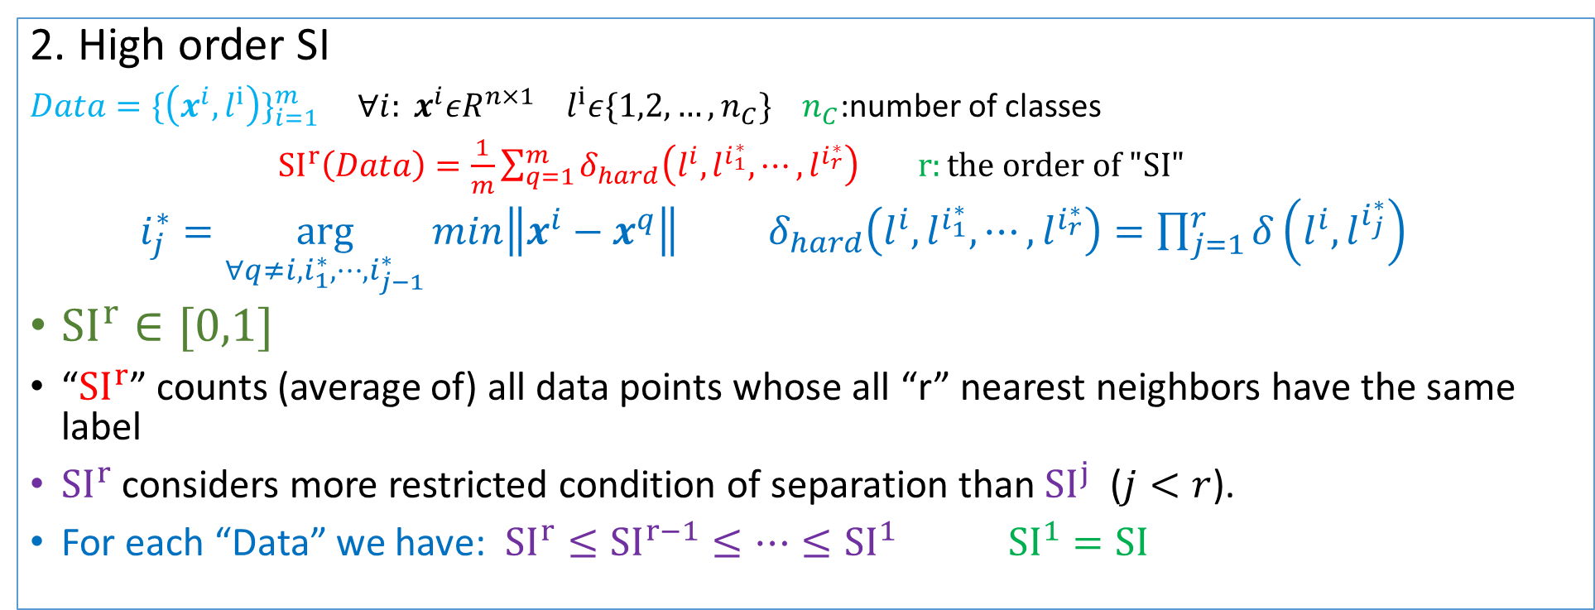
2. High order SI
$Data=\{\left(x^{i},l^{i}\right)\}_{i=1}^{m}$ ${∀i: x}^{i}εR^{n×1}$ $l^{i}ε\{1,2,…,n_{C}\}{ n}_{C}$:number of classes
${SI}^{r}\left(Data\right)=\frac{1}{m}\sum_{q=1}^{m}{δ_{hard}\left(l^{i},l^{i_{1}^{∗}},⋯,l^{i_{r}^{∗}}\right)} r:the order of "SI"$
$i_{j}^{∗}=\arg_{∀q≠i,i_{1}^{∗},⋯,i_{j−1}^{∗}}{min\left\|x^{i}−x^{q}\right\|} δ_{hard}\left(l^{i},l^{i_{1}^{∗}},⋯,l^{i_{r}^{∗}}\right)=\prod_{j=1}^{r}{δ\left(l^{i},l^{i_{j}^{∗}}\right)}$
${SI}^{r}∈[0,1]$
“${SI}^{r}$” counts (average of) all data points whose all “r” nearest neighbors have the same label
${SI}^{r}$ considers more restricted condition of separation than ${SI}^{j}$ ($j<r$).
For each “Data” we have: ${SI}^{r}≤{SI}^{r−1}{≤⋯≤SI}^{1}$ ${SI}^{1}=SI$

Slide 11
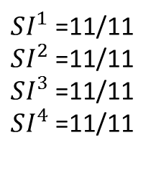
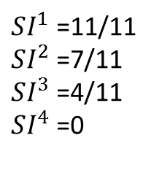
Two illustrative Examples
1
1
2
2
1
1
1
1
1
1
1
2
2
2
1
2
1
1
2
2
2
2
$SI^{1}$ =11/11
$SI^{2}$ =11/11
$SI^{3}$ =11/11
$SI^{4}$ =11/11
$SI^{1}$ =11/11
$SI^{2}$ =7/11
$SI^{3}$ =4/11
$SI^{4}$ =0

Slide 12
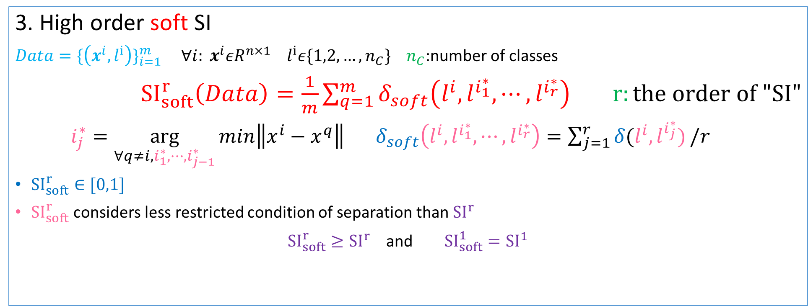
3. High order soft SI
$Data=\{\left(x^{i},l^{i}\right)\}_{i=1}^{m}$ ${∀i: x}^{i}εR^{n×1}$ $l^{i}ε\{1,2,…,n_{C}\}{ n}_{C}$:number of classes
${SI}_{soft}^{r}\left(Data\right)=\frac{1}{m}\sum_{q=1}^{m}{δ_{soft}\left(l^{i},l^{i_{1}^{∗}},⋯,l^{i_{r}^{∗}}\right)} r:the order of "SI"$
$i_{j}^{∗}=\arg_{∀q≠i,i_{1}^{∗},⋯,i_{j−1}^{∗}}{min\left\|x^{i}−x^{q}\right\|} δ_{soft}\left(l^{i},l^{i_{1}^{∗}},⋯,l^{i_{r}^{∗}}\right)=\sum_{j=1}^{r}{δ(l^{i},l^{i_{j}^{∗}})}/r$
${SI}_{soft}^{r}∈[0,1]$
${SI}_{soft}^{r}$ considers less restricted condition of separation than ${SI}^{r}$
${SI}_{soft}^{r}≥{SI}^{r}$ and ${SI}_{soft}^{1}={SI}^{1}$

Slide 13
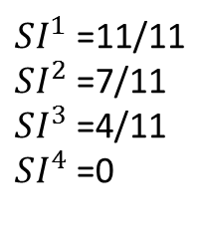
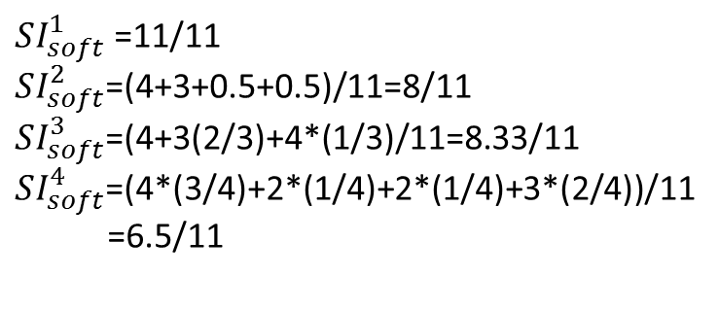
Two illustrative Examples
2
2
1
2
2
1
1
1
1
1
1
1
2
1
2
1
1
2
1
2
2
2
$SI^{1}$ =11/11
$SI^{2}$ =7/11
$SI^{3}$ =4/11
$SI^{4}$ =0
$SI_{soft}^{1}$ =11/11
$SI_{soft}^{2}$=(4+3+0.5+0.5)/11=8/11
$SI_{soft}^{3}$=(4+3(2/3)+4*(1/3)/11=8.33/11
$SI_{soft}^{4}$=(4*(3/4)+2*(1/4)+2*(1/4)+3*(2/4))/11
=6.5/11

Slide 14
Smoothens index (SmI) SmI measures how much input data points make the output targets smooth

Slide 15
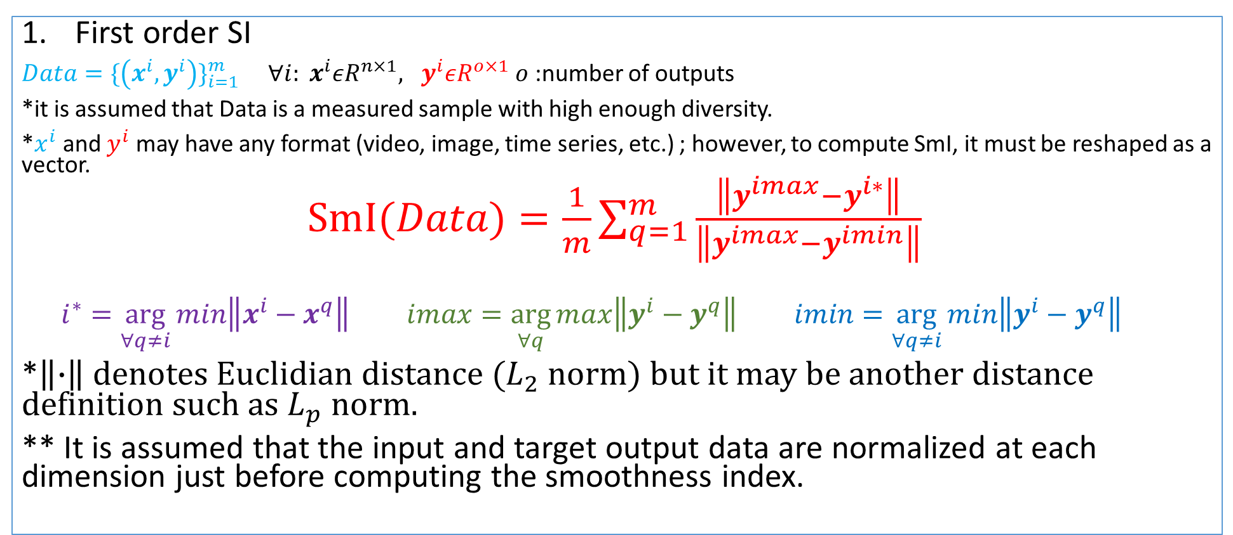
3.1.2 Smoothness index (SI) A smoothness measure for regression problem
First order SI
$Data=\{\left(x^{i},y^{i}\right)\}_{i=1}^{m}$ ${∀i: x}^{i}εR^{n×1}, y^{i}εR^{o×1}$ $o$:number of outputs
*it is assumed that Data is a measured sample with high enough diversity.
*$x^{i}$ and $y^{i}$ may have any format (video, image, time series, etc.) ; however, to compute SmI, it must be reshaped as a vector.
$SmI(Data)=\frac{1}{m}\sum_{q=1}^{m}{\frac{\left\|y^{imax}−y^{i∗}\right\|}{\left\|y^{imax}−y^{imin}\right\|}}$
$$i^{∗}=\arg_{∀q≠i}{min\left\|x^{i}−x^{q}\right\| }imax=\arg_{∀q}{max\left\|y^{i}−y^{q}\right\| }imin=\arg_{∀q≠i}{min\left\|y^{i}−y^{q}\right\| }$$
*$\left\|∙\right\|$ denotes Euclidian distance ($L_{2}$ norm) but it may be another distance definition such as $L_{p}$ norm.
** It is assumed that the input and target output data are normalized at each dimension just before computing the smoothness index.
Notes:
kronecker delta versus Dirac Delta

Slide 16
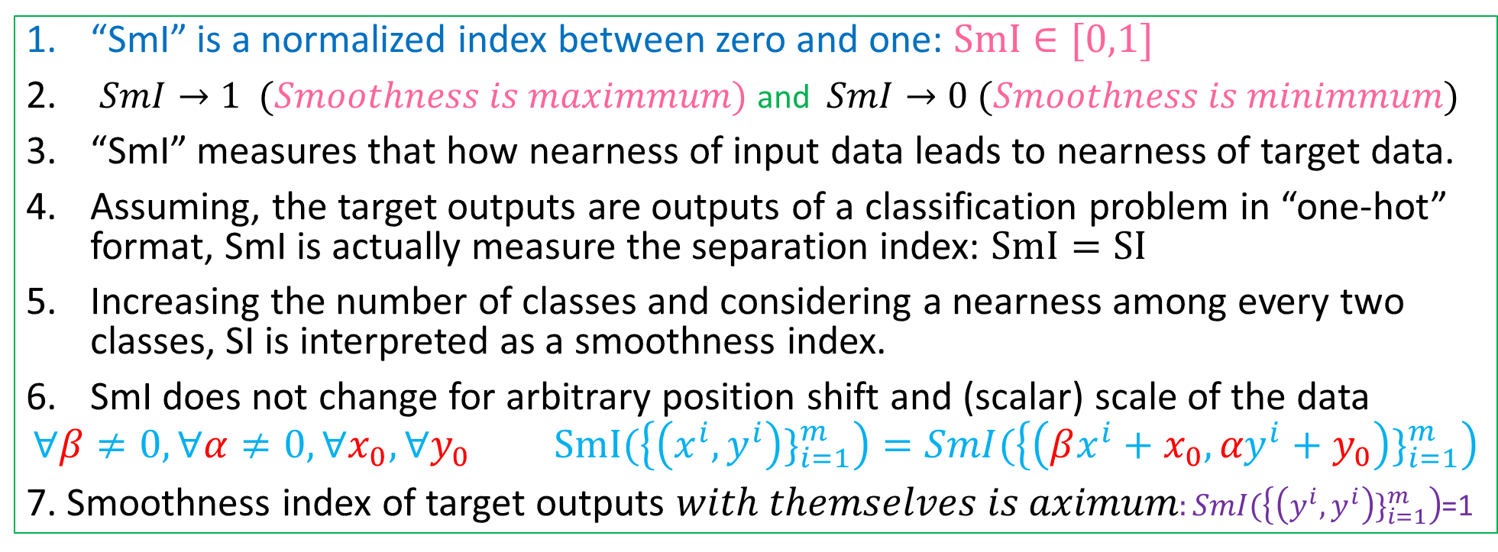
Some notes
“SmI” is a normalized index between zero and one: $SmI∈[0,1]$
$SmI→1 (Smoothness is maximmum)$ and $SmI→0 (Smoothness is minimmum)$
“SmI” measures that how nearness of input data leads to nearness of target data.
Assuming, the target outputs are outputs of a classification problem in “one-hot” format, SmI is actually measure the separation index: $SmI=SI$
Increasing the number of classes and considering a nearness among every two classes, SI is interpreted as a smoothness index.
SmI does not change for arbitrary position shift and (scalar) scale of the data
$$∀β≠0,∀α≠0, ∀x_{0},∀y_{0} SmI(\left\{\left(x^{i},y^{i}\right)\}_{i=1}^{m}\right)=SmI(\left\{\left(βx^{i}+x_{0},{αy}^{i}+y_{0}\right)\}_{i=1}^{m}\right)$$
7. Smoothness index of target outputs 𝑤𝑖𝑡ℎ 𝑡ℎ𝑒𝑚𝑠𝑒𝑙𝑣𝑒𝑠 𝑖𝑠 𝑎𝑥𝑖𝑚𝑢𝑚$:SmI(\left\{\left(y^{i},y^{i}\right)\}_{i=1}^{m}\right)$=1

Slide 17




One-dimensional illustrative examples
7
7
7
6
6
6
5
5
5
4
4
4
3
3
3
$$SmI=\frac{1}{5}\left(\frac{7−4}{7−4}+\frac{7−3}{7−3}+\frac{7−4}{7−4}+\frac{5−3}{5−3}+\frac{6−3}{6−3}\right)$$
$$SmI=\frac{1}{5}\left(\frac{7−4}{7−4}+\frac{7−3}{7−3}+\frac{7−4}{7−3}+\frac{5−3}{5−3}+\frac{6−3}{6−3}\right)$$
$$SmI=\frac{1}{5}\left(\frac{7−4}{7−4}+\frac{7−5}{7−3}+\frac{4−3}{5−3}+\frac{7−6}{7−4}+\frac{3−3}{6−3}\right)$$
$$SmI=1$$
SmI=0.95
SmI=.466

Slide 18
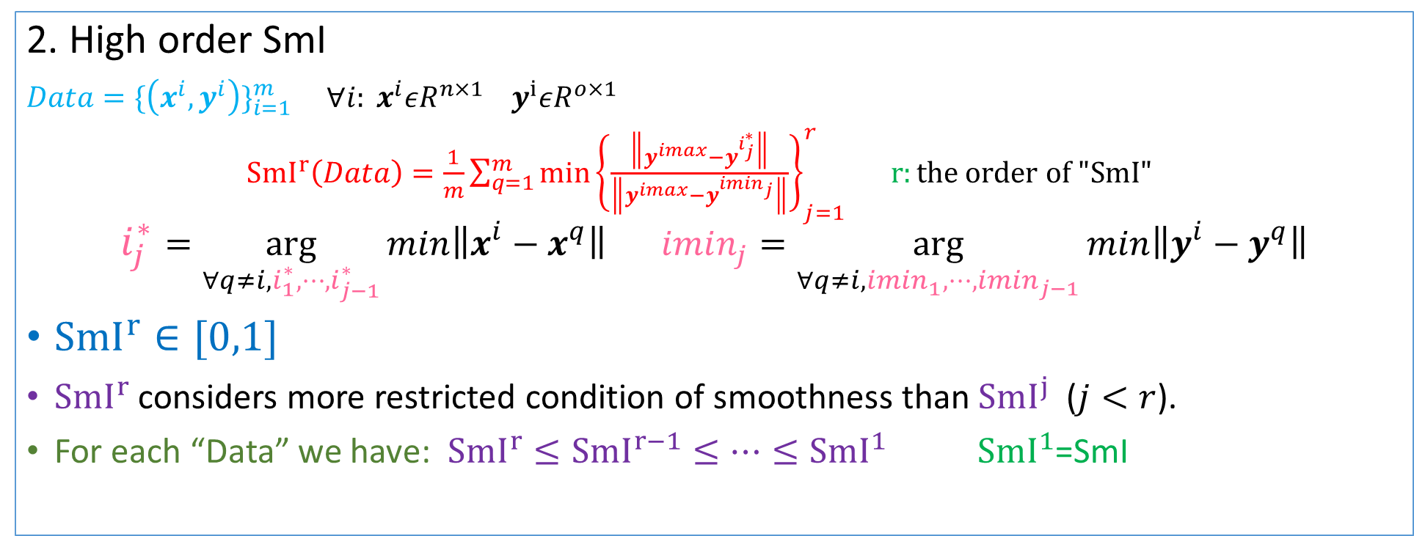
2. High order SmI
$Data=\{\left(x^{i},y^{i}\right)\}_{i=1}^{m}$ ${∀i: x}^{i}εR^{n×1}$ $y^{i}εR^{o×1}$
${SmI}^{r}\left(Data\right)=\frac{1}{m}\sum_{q=1}^{m}{min⁡{\left\{\frac{\left\|y^{imax}−y^{i_{j}^{∗}}\right\|}{\left\|y^{imax}−y^{imin_{j}}\right\|}\right\}}_{j=1}^{r}} r:the order of "SmI"$
$$i_{j}^{∗}=\arg_{∀q≠i,i_{1}^{∗},⋯,i_{j−1}^{∗}}{min\left\|x^{i}−x^{q}\right\|} imin_{j}=\arg_{∀q≠i,imin_{1},⋯,imin_{j−1}}{min\left\|y^{i}−y^{q}\right\|}$$
${SmI}^{r}∈[0,1]$
${SmI}^{r}$ considers more restricted condition of smoothness than ${SmI}^{j}$ ($j<r$).
For each “Data” we have: ${SmI}^{r}≤{SmI}^{r−1}{≤⋯≤SmI}^{1}$ ${SmI}^{1}$=SmI

Slide 19
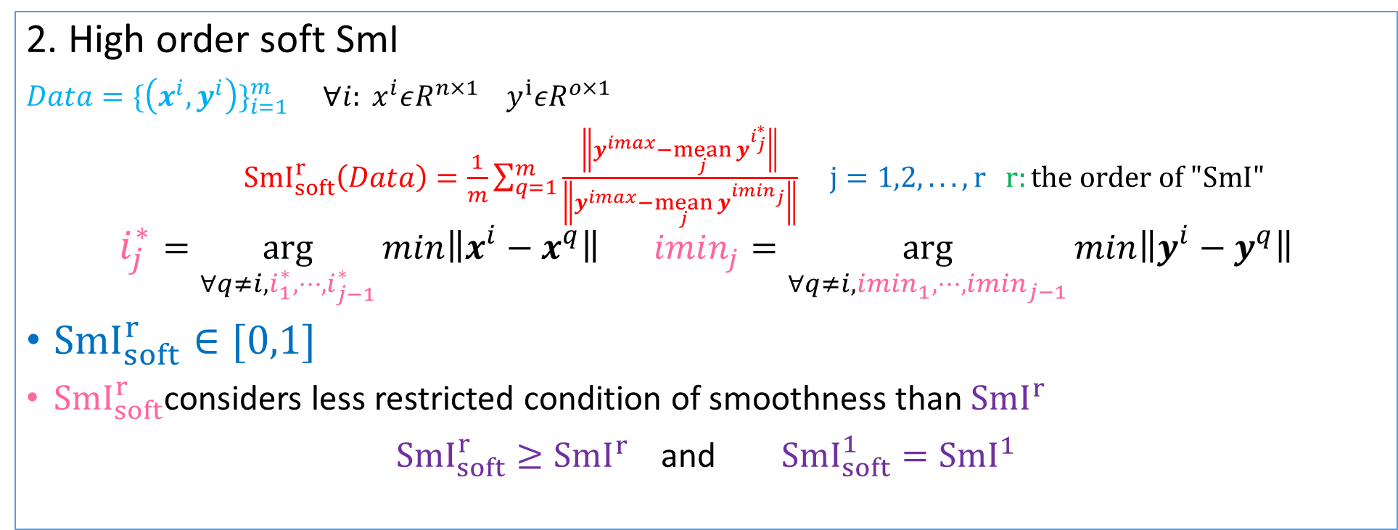
2. High order soft SmI
$Data=\{\left(x^{i},y^{i}\right)\}_{i=1}^{m}$ ${∀i: x}^{i}εR^{n×1}$ $y^{i}εR^{o×1}$
${SmI}_{soft}^{r}\left(Data\right)=\frac{1}{m}\sum_{q=1}^{m}{⁡\frac{\left\|y^{imax}−\underset{j}{mean}{y^{i_{j}^{∗}}}\right\|}{\left\|y^{imax}−\underset{j}{mean}{y^{imin_{j}}}\right\|}} j=1,2,.. .,r r:the order of "SmI"$
$$i_{j}^{∗}=\arg_{∀q≠i,i_{1}^{∗},⋯,i_{j−1}^{∗}}{min\left\|x^{i}−x^{q}\right\|} imin_{j}=\arg_{∀q≠i,imin_{1},⋯,imin_{j−1}}{min\left\|y^{i}−y^{q}\right\|}$$
${SmI}_{soft}^{r}∈[0,1]$
${SmI}_{soft}^{r}$considers less restricted condition of smoothness than ${SmI}^{r}$
${SmI}_{soft}^{r}≥{SmI}^{r}$ and ${SmI}_{soft}^{1}={SmI}^{1}$

Slide 20
3.2 Analysis by Separation and Smoothness indices
3.2.1 Dataset evaluation, ranking and dividing
3.2.2 Subset Selection
3.2.3 Layer-wise Model evaluation
3.2.4 Pre-train Model ranking
3.2.5 Model Confidence and Guarantee

