Slide 1
NIPS 2017 · GOOGLE BRAIN / GOOGLE RESEARCH · ARXIV:1706.03762
Attention Is All You Need
A guided tour of the Transformer, sequence transduction with attention only
Vaswani · Shazeer · Parmar · Uszkoreit · Jones · Gomez · Kaiser · Polosukhin
WMT14 · EN→DE 28.4 BLEU · EN→FR 41.8 BLEU · 8× P100 · 3.5 days
Notes:
Opening: in 2017, eight people at Google wrote this paper. Nearly every large model today is built on it. Let's take it apart.

Slide 2
01 · CONTEXT
Sequential computation caps RNNs
Serial by position
Distance hurts
Attention as sidekick
h(t) depends on h(t−1): no parallelism within a training example, long sequences stall.
In ConvS2S / ByteNet the ops linking two positions grow linearly or log with distance.
Attention already worked, but almost always on top of an RNN. The bottleneck stayed.
The move The Transformer drops recurrence and convolution entirely: any two positions connect in a constant number of steps.
Attention Is All You Need · NIPS 2017
2
Notes:
The problem first. RNNs compute position by position, so training can't parallelize; conv models parallelize but distant positions need many layers. Attention already worked well, but only as a sidekick on top of RNNs. The bold move here: make the sidekick the whole model.

Slide 3
02 · CLAIM
Attention only: faster, and better
The first sequence transduction model built entirely on attention. Far more parallel training, and higher translation quality.
28.4 BLEU
41.8 BLEU
3.5 days
WMT14 EN→DE, beats all prior models and ensembles by 2+ BLEU
WMT14 EN→FR, new single-model state of the art
on 8× P100 for the big model; base tops all published EN→DE models in 12 hours
Attention Is All You Need · NIPS 2017
3
Notes:
The claim in one line: attention only. Three numbers: 28.4 on EN-DE, over 2 BLEU above everything including ensembles; 41.8 single-model record on EN-FR; 3.5 days of training for the big model, and the base beats all published models after 12 hours.

Slide 4
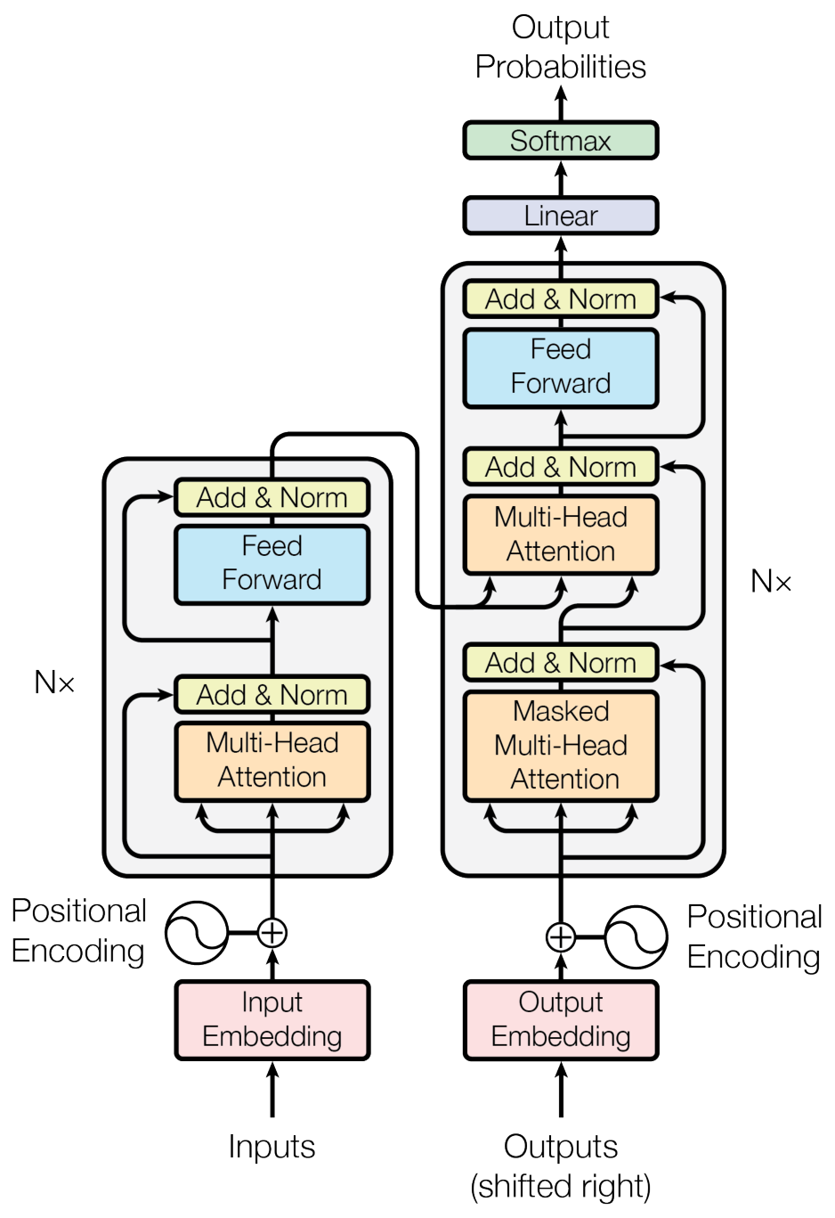
03 · ARCHITECTURE
Six encoder + six decoder layers
Encoder ×6: each layer = multi-head self-attention + position-wise feed-forward
Decoder ×6: adds encoder-decoder attention; self-attention is masked to the generated prefix
Residual + LayerNorm: every sub-layer is LayerNorm(x + Sublayer(x)); d_model = 512 throughout
Output: linear layer + softmax over the vocabulary
Paper Figure 1 (original)
Attention Is All You Need · NIPS 2017
4
Notes:
The architecture: encoder left, decoder right, six layers each. Two kinds of parts only: multi-head attention and position-wise FFN, wrapped in residual + LayerNorm. The decoder adds a sub-layer attending to the encoder, and masks its self-attention. d_model is 512 everywhere.

Slide 5
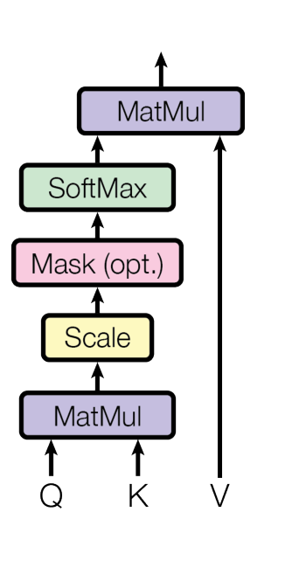

03 · ARCHITECTURE
One matmul computes all attention weights
Q·K sets weights: dot products of a query with all keys, softmaxed into weights over values V
Divide by √dk: large dims push softmax into tiny-gradient regions; scaling undoes it
Fast and lean: the whole sequence is packed into matrices, one highly-optimized matmul
Paper Figure 2, left
Attention Is All You Need · NIPS 2017
5
Notes:
The core operator. Dot products of the query with all keys, softmax into weights, weighted sum of values. The sqrt(dk) scaling is the key detail: with large dims dot products grow, softmax saturates, gradients vanish. Two matmuls in total, extremely fast.

Slide 6
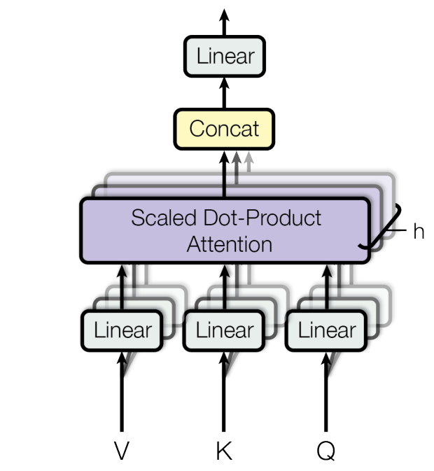
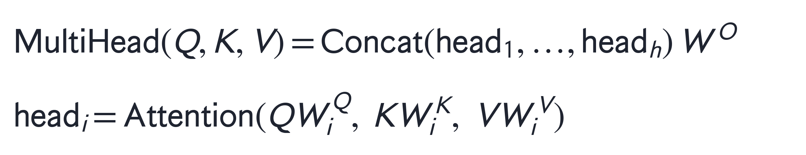
03 · ARCHITECTURE
Multi-head: 8 parallel subspaces
h = 8 heads: project Q, K, V eight times, attend in parallel, concat and project
dk = dv = 64 per head: dims shrink per head, total cost ≈ single-head full dimension
Why heads at all: one head averages information away; heads watch different subspaces
Paper Figure 2, right
Attention Is All You Need · NIPS 2017
6
Notes:
A single head averages information away, so use 8 heads in 64-dim subspaces and concat. Same total cost, but different heads learn different relation patterns.

Slide 7



03 · ARCHITECTURE
One mechanism, used in three places
Encoder self-attention
Masked decoder self-attention
Encoder-decoder attention
Q, K, V all come from the previous encoder layer. Every position sees the whole sentence.
Positions see only the prefix; illegal links get −∞ before softmax, keeping it auto-regressive.
Q from the decoder, K and V from the encoder. Every decoding step queries the full input.
Attention Is All You Need · NIPS 2017
7
Notes:
The same mechanism appears three times: encoder positions watch each other, decoder positions watch only the prefix (via the mask), and the decoder queries the encoder. Clean reuse.

Slide 8
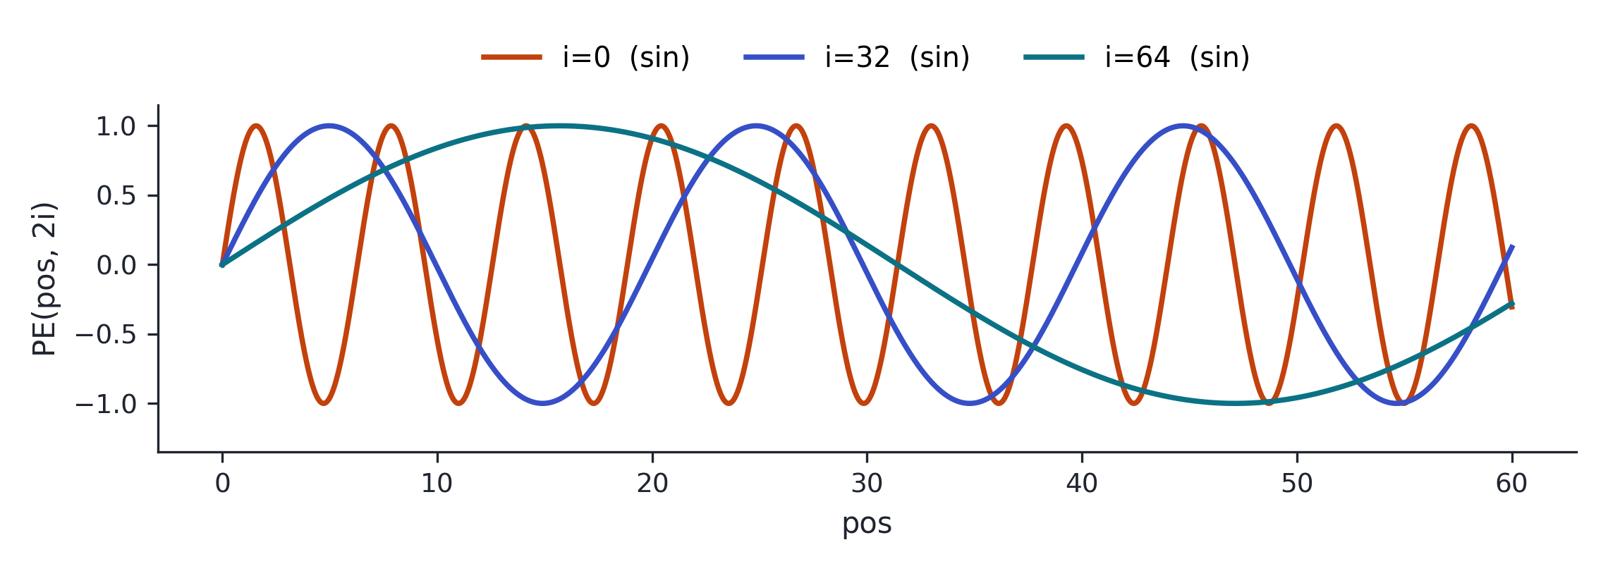
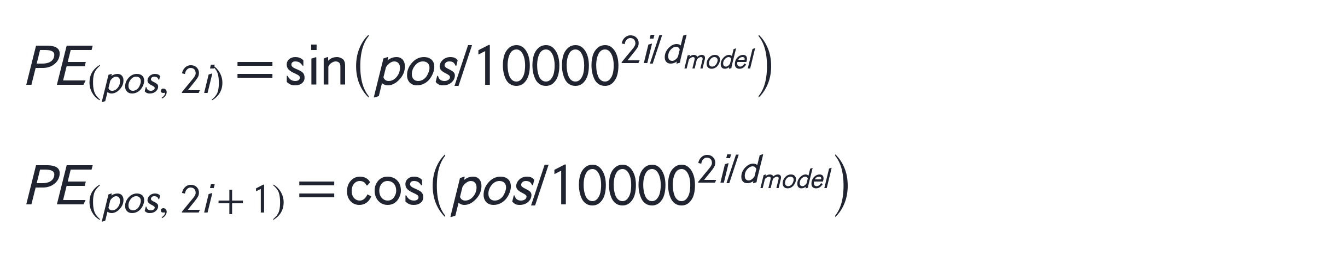
03 · ARCHITECTURE
The rest: FFN and positional encoding
Position-wise feed-forward
Each position passes through the same two-layer net independently; inner size d_ff = 2048.
FFN(x)=max(0, xW₁+b₁) W₂+b₂
Sinusoidal positional encoding
Order comes from sinusoids added to the embeddings, one wavelength per dimension (right). Fixed offsets are linear maps; learned embeddings do equally well.
Attention Is All You Need · NIPS 2017
8
Notes:
The two remaining parts. The FFN acts per position, inner size 2048. Order comes from sinusoids added to embeddings, one wavelength per dimension in geometric progression: fixed offsets become linear functions, which helps relative positions and may extrapolate to longer sequences. Learned embeddings score the same.

Slide 9
04 · WHY
Why self-attention: the shortest paths
Layer type | Complexity / layer | Sequential ops | Max path length
Self-attention | O(n² · d) | O(1) | O(1)
Recurrent | O(n · d²) | O(n) | O(n)
Convolutional | O(k · n · d²) | O(1) | O(log_k n)
Takeaway Any two positions connect in one step (O(1) path) with constant sequential ops; and since sentence representations usually have n < d, self-attention is cheaper per layer too.
Attention Is All You Need · NIPS 2017
9
Notes:
Why bet on self-attention: constant sequential ops and O(1) path length, both better than RNNs. The n-squared term looks scary but sentence length n is usually smaller than dimension d, so it's cheaper per layer in practice.

Slide 10
05 · TRAINING
Training recipe: 8× P100, at most 3.5 days
Data & tokenization
Hardware & optimization
EN→DE
WMT14, 4.5M sentence pairs
Hardware
one machine · 8× NVIDIA P100
EN→FR
WMT14, 36M sentences
Schedule
base 100K steps ≈ 12 h · big 300K steps ≈ 3.5 days
Tokens
BPE shared vocab 37K / word-piece 32K
Optimizer
Adam, warmup 4000 steps then inverse-sqrt decay
Batch
≈25K source + 25K target tokens per batch
Regularization
residual dropout 0.1 · label smoothing 0.1
Attention Is All You Need · NIPS 2017
10
Notes:
The recipe is plain: standard WMT14 data, one machine with 8 P100s, Adam with 4000-step warmup, dropout 0.1, label smoothing 0.1. No tricks.

Slide 11
06 · RESULTS
EN→DE: base beats all, big sets the record
AT WHAT COST?
1/7
Base needs ~1/7 of GNMT+RL's training compute (3.3 vs 23×10¹⁸ FLOPs) yet gains 2.7 BLEU; on EN→FR the big model hits 41.8 at a fraction of prior SOTA cost.
WMT14 EN→DE test BLEU (paper Table 2)
Attention Is All You Need · NIPS 2017
11
Notes:
Results. The bars are EN-DE BLEU: base at 27.3 already beats all prior single models and ensembles, big at 28.4 sets the record. And the cost: base uses a seventh of GNMT's training compute. Faster AND better, not a trade-off.

Slide 12
06 · RESULTS
Ablations: heads and dropout matter most
Configuration | dev BLEU
base (8 heads, dk=64) | 25.8
single head | 24.9
32 heads | 25.4
no dropout | 24.6
learned pos. embedding | 25.7
big (wider & deeper) | 26.4
Heads have a sweet spot: one head is 0.9 BLEU worse than best; 32 heads also degrade
Don't shrink dk: smaller key size hurts; compatibility is not trivial
Bigger + dropout: bigger models win; removing dropout costs 1.2 BLEU
PE choice is free: learned ≈ sinusoidal (25.7 vs 25.8)
Attention Is All You Need · NIPS 2017
12
Notes:
Ablations tell you what matters: heads have a sweet spot, one head loses 0.9 and 32 heads also degrade; don't shrink dk; bigger models plus dropout are decisive; positional encoding choice is basically free.

Slide 13
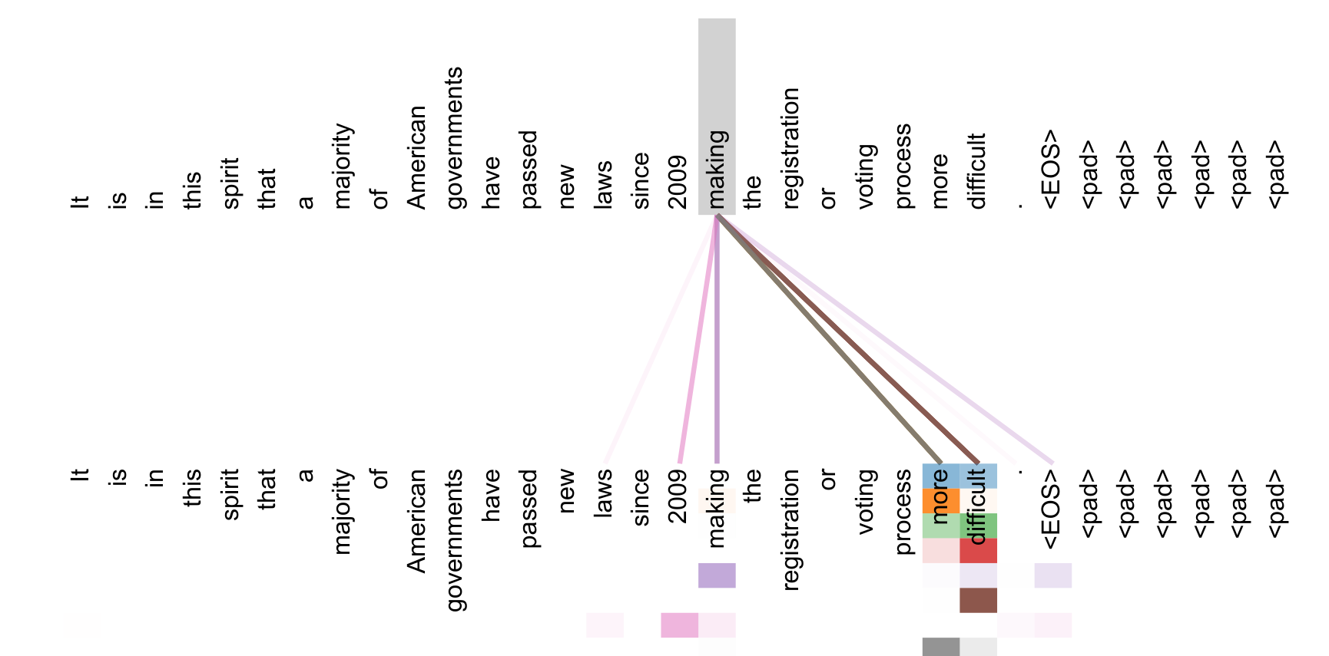
06 · RESULTS
It parses too, and attention is readable
F1 92.7 English constituency parsing (WSJ): F1 91.3 with only 40K training sentences, beating BerkeleyParser; 92.7 semi-supervised, above all prior work except RNNG.
An encoder head in layer 5: “making” attends across the phrase to “more difficult” (paper Figure 3, original).
Attention Is All You Need · NIPS 2017
13
Notes:
Two bonuses. Generalization: with almost no tuning it wins at constituency parsing, even in the small-data regime. And interpretability: this head links 'making' to 'more difficult' 14 tokens away. Long-range dependencies are actually learned.

Slide 14
07 · CONCLUSION
The first attention-only transduction model
Recurrence replaced: multi-head self-attention fully replaces the recurrent layers of encoder-decoder models
Faster + SOTA: trains much faster than recurrent/conv architectures; new records on EN→DE and EN→FR
Next (their words): extend to images, audio, video; local restricted attention; less sequential generation
Code released at tensorflow/tensor2tensor.
Attention Is All You Need · NIPS 2017
14
Notes:
Conclusion: first attention-only transduction model, trains faster, double SOTA. Their own future work: other modalities, local attention, less sequential generation. All of it happened.

Slide 15
BEYOND THE PAPER
It went on to change everything
2017
2018
2020
2022
today
Transformer
BERT / GPT
GPT-3 / ViT
ChatGPT
frontier models
this paper
encoder and decoder split up
scale, and vision too
chat for everyone
the LLM backbone
Presenter's extension. Not part of the paper.
Thanks · Q&A
Attention Is All You Need · NIPS 2017
15
Notes:
This slide is my extension, not the paper's: BERT took the encoder, GPT took the decoder, ViT took it to vision, and today virtually every frontier model descends from it. Thanks, questions welcome.

