Slide 1
PAPER DEEP-DIVE · READING GROUP
Attention Is All You Need
Transformer: the founding work that rewrote sequence modeling with attention
Google Brain · Google Research · University of Toronto — 8 authors
VASWANI ET AL. · NEURIPS 2017 · ARXIV:1706.03762
Notes:
To open: this is the 2017 paper that introduced the Transformer — the common ancestor of every large model today. In about fifteen minutes we'll read it closely: the problem it set out to solve, its central claim, the model architecture, the math of attention and positional encoding, then the results and its impact.

Slide 2



BACKGROUND · THE PROBLEM
Recurrence and convolution: one shared bottleneck
Long-range dependency: any two steps are O(n) apart
h1
hidden
h2
hidden
h3
hidden
h4
hidden
h5
hidden
Every step waits on the one before it — inherently sequential in time
No parallelism
Long range is hard
Convolution's limit
Length n sets the step count;
GPUs sit idle, training is slow
Farther-apart words mean
more steps, a weaker signal
Parallel, but needs
many layers to reach far
ATTENTION IS ALL YOU NEED · PAPER DEEP-DIVE
02 / 15
Notes:
Before this, sequence modeling was dominated by RNNs and LSTMs: the hidden state is passed forward one step at a time, and step t has to wait for step t−1. That creates two hard problems. First, computation is sequential in time and can't be fully parallelized. Second, between two distant words the gradient has to cross O(n) steps, so long-range dependencies are hard to learn. Convolutions parallelize, but covering long distances still takes many stacked layers.

Slide 3
THE CLAIM
Drop recurrence and convolution.
Attention alone is enough.
“The Transformer … relies entirely on self-attention to compute representations of its input and output.”
Fully parallel
All positions computed at once
Path length O(1)
Any two positions, one hop
Faster to train
As good or better, for less
03 / 15
Notes:
The paper's central claim is a single sentence: use no recurrence and no convolution — rely on attention alone to model the dependencies between any two positions in a sequence. That buys three things: every position can be computed in parallel; the path length between any two positions is a constant O(1); and training is faster and the results are better.

Slide 4
EVIDENCE · TABLE 1
Why attention parallelizes better
Layer type | Per-layer cost | Seq. ops | Max path length
Self-Attention | O(n²·d) | O(1) | O(1)
Recurrent | O(n·d²) | O(n) | O(n)
Convolutional | O(k·n·d²) | O(1) | O(logₖ n)
THE KEY DIFFERENCE
O(1)
Self-attention's sequential ops are constant — independent of sequence length, so it parallelizes for free; a recurrent layer is O(n), so doubling the length doubles the sequential steps.
n = sequence length d = representation dim k = kernel width
ATTENTION IS ALL YOU NEED · PAPER DEEP-DIVE
04 / 15
Notes:
Table 1 in the paper puts the three layer types side by side. Look at the two middle columns: self-attention's sequential ops are O(1) and its max path length is O(1) too; for a recurrent layer both are O(n). In other words, as the sequence grows, an RNN's sequential cost and long-range path grow linearly, while self-attention's stay flat. The price is a per-layer cost of O(n²·d), which gets expensive for very long sequences — and that's exactly what later work optimizes.

Slide 5
ARCHITECTURE · THE MODEL
Encoder–decoder: each a stack of 6 identical layers
Each sublayer wrapped in residual + LayerNorm
↑ Linear · Softmax · output probabilities
Encoder
× 6
Decoder
× 6
Masked Multi-Head Attention
Multi-Head Self-Attention
Encoder–Decoder Attention
Feed-Forward (FFN)
Feed-Forward (FFN)
Input embedding ⊕ positional encoding
Output embedding ⊕ pos. encoding (shifted)
ATTENTION IS ALL YOU NEED · PAPER DEEP-DIVE
05 / 15
Notes:
The whole thing is a classic encoder–decoder. On the left, the encoder is a stack of 6 identical layers, each with two sublayers: multi-head self-attention and a feed-forward network. On the right, the decoder is also 6 layers, but each has three sublayers — it adds a masked self-attention (so it can't peek at the future) and an encoder–decoder attention (the dashed link, which receives the encoder's output). Every sublayer is wrapped in a residual connection plus LayerNorm. At the bottom, inputs are embedded and positional encodings added; at the top, a linear layer plus Softmax produces token probabilities.

Slide 6
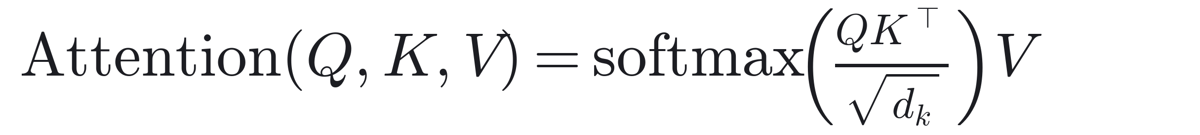
MECHANISM · SCALED DOT-PRODUCT
Scaled dot-product attention: weighting values by similarity
Q Query
K Key
V Value
The position being computed
Every position compared to
What's actually aggregated
QKᵀ score
similarity
÷ √dₖ scale
stable gradients
Softmax
weights
· V weight
output
ATTENTION IS ALL YOU NEED · PAPER DEEP-DIVE
06 / 15
Notes:
Scaled dot-product attention is four steps. First, take the dot product of the query Q with every key K to score relevance. Then divide by the square root of d_k to scale, which stabilizes the gradients. Next, Softmax normalizes those scores into a set of weights. Finally, use those weights to take a weighted sum of the values V, giving the output. In one line: use similarity as the weights, and take a weighted average of the content.

Slide 7
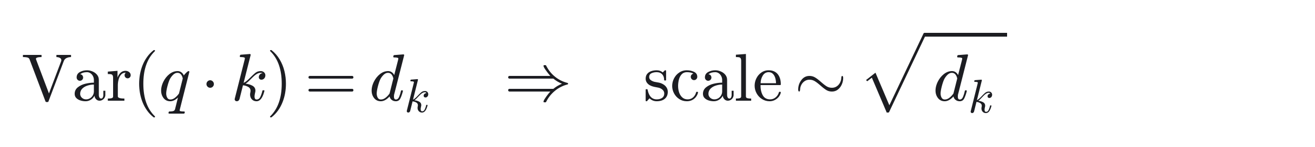
DESIGN DETAIL · WHY √Dₖ
Why divide by √dₖ: keeping Softmax out of saturation
Softmax weights for one set of scores (dₖ = 64 · reproduced on random inputs, not the paper's numbers)
1
The larger dₖ is
Q·K sums dₖ products, so its variance grows linearly with dₖ
2
Dot products blow up
Softmax slides into saturation and dumps nearly all weight on one key
3
Gradients vanish
Backprop can't learn — training stalls
÷ √dₖ, variance back to ~1
Unscaled, one key hogs almost all the weight (0.87); scaled, it flattens out — so gradients can flow.
4
Flatter distribution, healthy gradients, stable training
ATTENTION IS ALL YOU NEED · PAPER DEEP-DIVE
07 / 15
Notes:
Why divide by the square root of d_k specifically? Because Q·K is a sum of d_k products, so its variance is proportional to d_k. At d_k = 64 the dot products are already large, and Softmax saturates — the teal bars on the right give about 0.87 of the weight to a single key, the rest near zero, and the gradient near zero too, so nothing learns. Dividing by the square root of d_k pulls the variance back to about 1, the distribution flattens (orange), and the gradients stay healthy. The chart is computed from real random vectors.

Slide 8
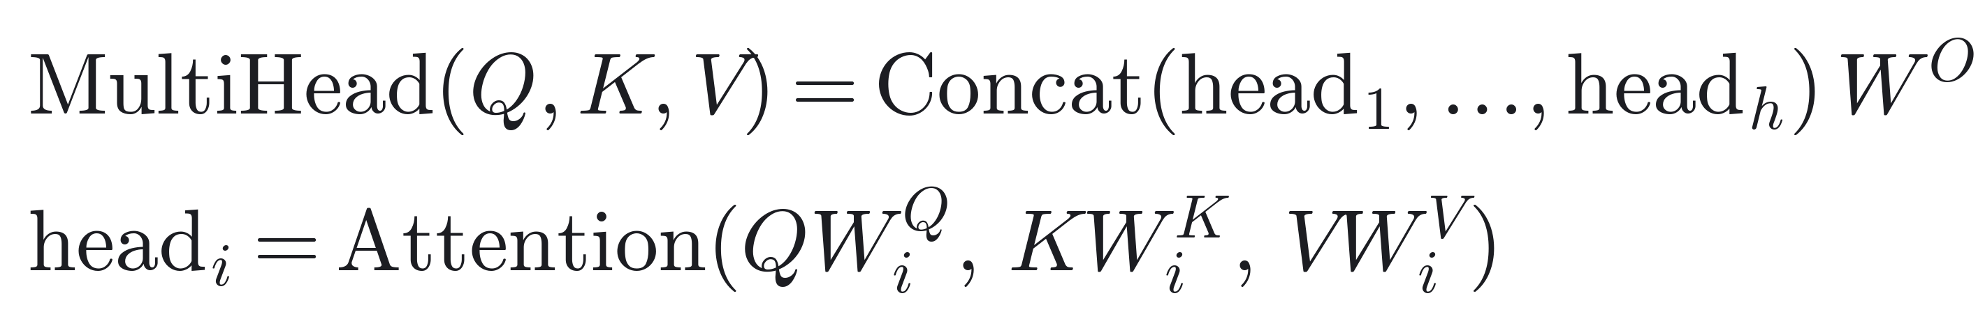
MECHANISM · MULTI-HEAD
Eight heads in parallel, each on a different relation
Head 1
Head 2
Head 3
…
Head 8
× 8
Each head runs scaled dot-product attention in its own dₖ = dᵥ = 64-dim subspace
↓ Concat → linear projection Wᴼ
One head averages
Relations dilute each other
Heads specialize
Syntax, coreference, position…
Same total width
h × 64 = 512, one full head
ATTENTION IS ALL YOU NEED · PAPER DEEP-DIVE
08 / 15
Notes:
Rather than one big 512-dim attention, split it into 8 heads, each doing attention independently in a 64-dim subspace, then concatenate and pass through a linear layer. The payoff is that different heads can attend to different kinds of relations — one tracks syntax, another coreference. Since 8×64 = 512, the total compute is about the same as a single full-width head.

Slide 9
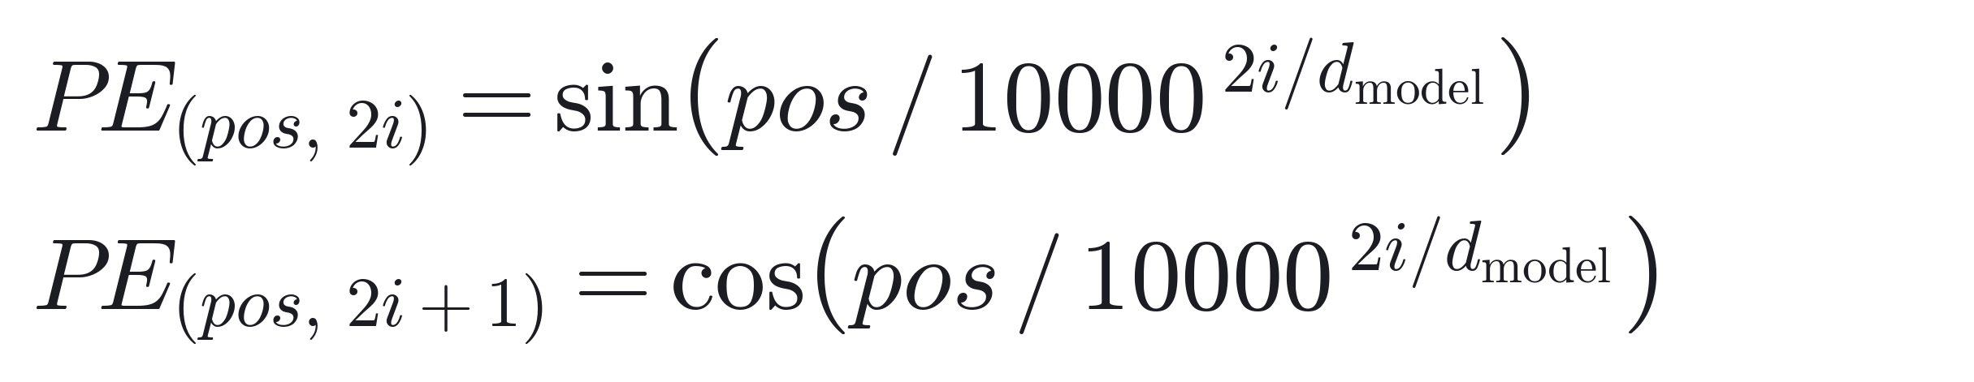
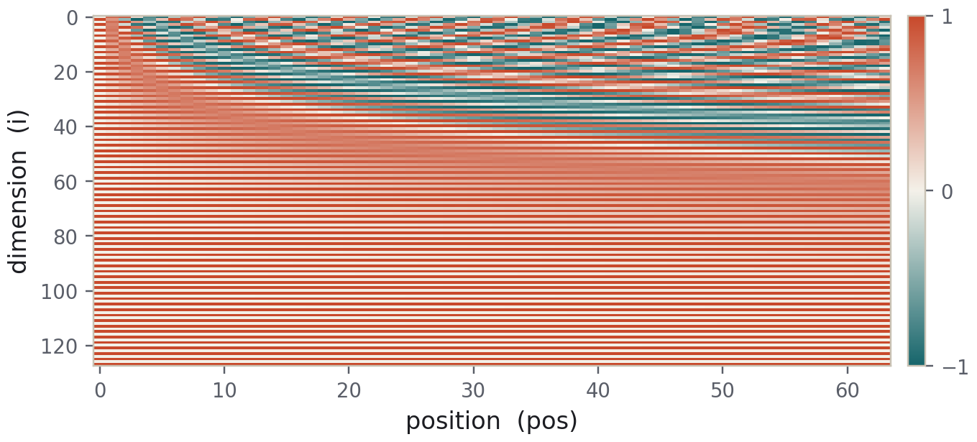
MECHANISM · POSITIONAL ENCODING
Attention is orderless: encode position with sinusoids
Positional encoding matrix (computed: position × dimension)
A different sine / cosine frequency per dimension
Relative position falls out of a linear transform
Extrapolates to sequences longer than seen in training
Low dims cycle fast, high dims drift slowly.
The clever bit No learned parameters — and relative position is just a linear transform away.
ATTENTION IS ALL YOU NEED · PAPER DEEP-DIVE
09 / 15
Notes:
Attention treats its input as orderless — shuffle the words and the result is unchanged — so we have to tell it position explicitly. The authors use sine and cosine functions at different frequencies to build an encoding vector for each position, one per dimension, and add it straight onto the word embeddings. The chart on the right is the actual computed matrix: low dimensions oscillate quickly with position, high ones change slowly, so every position has a unique fingerprint. This form also makes relative position easy to express and extrapolates to longer sequences.

Slide 10
CONFIGURATION · SETUP
Two sizes and their training setup: base and big
BASE
↑ SOTA config
BIG
MODEL DIM D_MODEL
512
MODEL DIM D_MODEL
1024
LAYERS N
6 + 6
LAYERS N
6 + 6
HEADS H
8
HEADS H
16
FFN DIM D_FF
2048
FFN DIM D_FF
4096
PARAMETERS
65 M
PARAMETERS
213 M
TRAINING
12 h · 100k steps
TRAINING
3.5 days · 300k steps
Shared training setup
Hardware
Optimizer
Dropout
Label smoothing
8 × NVIDIA P100
Adam β=(0.9, 0.98)
0.1
εₗₛ = 0.1
ATTENTION IS ALL YOU NEED · PAPER DEEP-DIVE
10 / 15
Notes:
Two configurations. Base uses d_model = 512, 8 heads, 6+6 layers, and 65 million parameters. Big doubles the dimension, the head count, and the feed-forward width, for 213 million parameters. Both train on 8 P100s: base for about 12 hours and 100k steps, big for about 3.5 days and 300k steps. The optimizer is Adam, with 0.1 dropout and label smoothing.

Slide 11
RESULTS · TRANSLATION
New high on WMT 2014 English→German BLEU
EN→DE · BIG
28.4
+3.2 BLEU over the best baseline, ConvS2S (25.16); base 27.3 beats them all too.
It tops En→Fr too:
big = 41.8 BLEU, a new single-model SOTA.
ATTENTION IS ALL YOU NEED · PAPER DEEP-DIVE
11 / 15
Notes:
For results, look at machine translation. On WMT 2014 English–German, Transformer big scores 28.4 BLEU — about 3.2 points above the best single model shown, ConvS2S at 25.16; the paper's own phrasing is that it beats the previous best, ensembles included, by more than 2 BLEU. Even base at 27.3 beats every system compared. On English–French, big reaches 41.8 BLEU, a new best for a single model. Note the y-axis starts at zero, so the bar lengths reflect the numbers honestly.

Slide 12
EFFICIENCY · COST
Not just more accurate — cheaper to reach the top
28.4 BLEU
3.5 days
< 1/4
En→De · big · new high
trained on 8 × P100
of the compute to top En→Fr
So On En→Fr, big reaches a new single-model SOTA with under 1/4 the training compute of the previous best.
En→Fr training compute, FLOPs (shorter is better)
Ours · big
2.3×10¹⁹
Prev. SOTA
1.5×10²⁰
ATTENTION IS ALL YOU NEED · PAPER DEEP-DIVE
12 / 15
Notes:
Efficiency is the other underrated contribution. With no recurrence, the whole sequence goes through in a single forward pass, so GPU utilization is high. On English–French, big reaches a new SOTA with under a quarter of the previous best model's training compute; base beats strong baselines in just 100k steps and 12 hours. More accurate and cheaper at once — that's the key to how quickly it was adopted.

Slide 13
IMPLICATIONS · LIMITS & LEGACY
Weak spot and legacy: from one model to a foundation
Limitations
WEAK SPOT
Legacy
LEGACY
Attention is O(n²)
Became the default architecture
Memory and compute grow quadratically — long text is costly
BERT, GPT and most others are built on Transformers
Positional encoding is hand-designed
Kicked off the era of large models
Extrapolation stays imperfect; later replaced by relative schemes
Parallel and scalable — it made large-scale training possible
Hungry for data and compute
Reach beyond NLP
Little edge on small datasets
Vision, speech, proteins… attention became a universal building block
ATTENTION IS ALL YOU NEED · PAPER DEEP-DIVE
13 / 15
Notes:
Being fair about the limits: self-attention is O(n²), so memory and compute grow quadratically on long sequences — this is the very starting point for later efficient-attention research. The positional encoding is hand-designed and doesn't extrapolate perfectly, and the edge on small data is thin. But the legacy is enormous: BERT and GPT are built almost entirely on it, its parallel, scalable nature directly enabled the large-scale training that followed, and its influence long ago spread past NLP into vision, speech, and nearly every field.

Slide 14
RECAP · FIVE LINES
Remember this paper in five lines
1
Attention only
No recurrence or convolution; attention does it all.
IN ONE LINE
2
Scaled dot-product at the core
Attention
is all
you need.
softmax(QKᵀ/√dₖ)·V — weight the values by similarity.
3
Multi-head + positional encoding
8 heads for different relations; sinusoids add order back.
4
Parallel, short paths
O(1) sequential ops, any two positions one hop — fast and stable.
5
Bedrock of large models
28.4 En–De / 41.8 En–Fr BLEU — the backbone of all that followed.
ATTENTION IS ALL YOU NEED · PAPER DEEP-DIVE
14 / 15
Notes:
Five lines to close. One: attention only. Two: scaled dot-product attention is the core formula. Three: multi-head attends to different relations, and positional encoding adds order back. Four: parallel with short paths, so training is fast and stable. Five: it's the bedrock of every large model since.

Slide 15
Attention changed everything.
Discussion · reading group | Q & A — interrupt anytime
SOURCE
Vaswani et al., NeurIPS 2017 · arXiv:1706.03762
15 / 15
Notes:
Thank you. The core is a single line: attention changed everything. Questions and discussion welcome.

