Slide 1
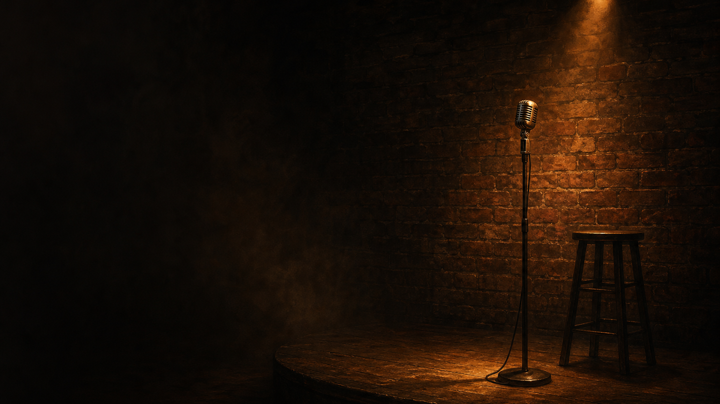
SLIDE-MAKER · GALLERY EXAMPLE
A Brief History of
Stand-Up Comedy
One person, a microphone, and the nerve to say it out loud.
ORIGINS → THE GOLDEN AGE → GLOBAL → TODAY
Notes:
Welcome. Stand-up is one of the youngest and most exposed art forms we have — and its history is shorter and stranger than most people assume. Let's trace it from the variety stage to the phone in your pocket.

Slide 2



THE FORM
One voice, no net
A single performer speaks directly to the room in their own voice — building an expectation, then breaking it for a laugh.
A person, not a role
A mic, a room
A point of view
The comic is the persona.
No sets, no scene partners.
Every joke makes an argument.
A Brief History of Stand-Up Comedy
02 / 13
Notes:
Strip stand-up down and it's almost nothing: a person, a microphone, a room. No set, no scene partner, no character to hide behind. The persona is the performer, and every joke is a small argument about how the world actually works.

Slide 3
1900s
ORIGINS · 1850S–1930S
Before it had a name
The solo comic surfaced slowly — one turn on the variety bill, heir to the humorists of the lecture hall.
1850s–1918
1880s–1930s
from 1860s
late 1800s
British music hall
American vaudeville
The lecture circuit
The solo monologue
Songs & patter
The variety circuit
Twain & platform wits
Charley Case, credited
Who counts as the first modern stand-up is disputed — the form has many parents.
A Brief History of Stand-Up Comedy
03 / 13
Notes:
It didn't arrive fully formed. Through the late 1800s and early 1900s the solo comic was just one turn on a crowded variety bill, and comic monologue also grew out of the lecture circuit — Mark Twain among its platform humorists. Who counts as the 'first' modern stand-up is genuinely disputed; the form has many parents.

Slide 4
THE MODERN FORM · 1950S
The nightclub changes everything
As vaudeville faded and TV arrived, comedy moved into the nightclub — where one comic could hold the stage alone.
BEFORE — THE VARIETY ACT
AFTER — THE SOLO VOICE
A slot on a crowded bill
One comic, the whole set
Rapid-fire gags & props
Longer, personal routines
A character or a costume
Speaking as themselves
THE SHIFT The unit of comedy stops being the joke and becomes the comedian.
A Brief History of Stand-Up Comedy
04 / 13
Notes:
The thing that changed everything was the room. As vaudeville died and television arrived in the 1950s, comedy moved into the nightclub, where a single comic could hold the stage for a whole set — and started speaking as themselves instead of doing bits.

Slide 5

THE GOLDEN AGE · 1950S–1960S
The thinking comedians
Literate, political, neurotic — a new wave turned the comedy LP into a hit format, and the routine into authorship.
from 1953
early 1960s
1960
Mort Sahl
Lenny Bruce
Bob Newhart
Political satire, delivered like a newspaper column.
Confessional, profane, arrested again and again.
First comedy album to win Album of the Year.
A Brief History of Stand-Up Comedy
05 / 13
Notes:
The 50s and 60s gave us the 'thinking comedians'. Mort Sahl did political satire; Lenny Bruce got arrested for pushing the limits; and Bob Newhart's debut record was the first comedy album to win the Grammy for Album of the Year. The routine became authorship.

Slide 6
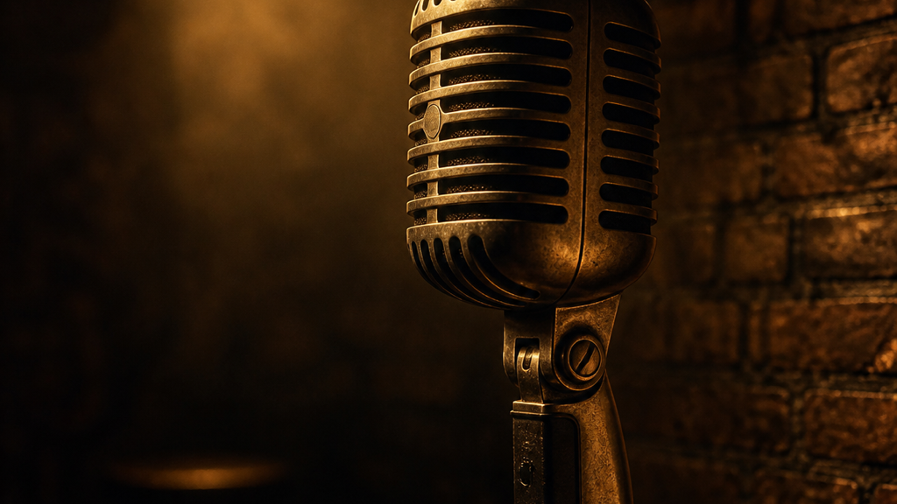
THE REVOLUTION · LATE 1960S–1970S
From joke-teller to truth-teller
A new generation made the act personal, confrontational and their own — comedy as autobiography and argument.
Richard Pryor
Confessional comedy drawn from his own life, race and pain.
George Carlin
Reinvented himself as a countercultural critic of language and power.
Joan Rivers
Broke barriers as a woman working the front line of the form.
A Brief History of Stand-Up Comedy
06 / 13
Notes:
Then the 70s blew it open. Richard Pryor turned his own life and pain into material, George Carlin reinvented himself as a critic of language and power, and Joan Rivers broke barriers as a woman on the front line. Comedy stopped being jokes and became autobiography and social argument.

Slide 7
THE BOOM · 1972–1992
The clubs, then the cameras
Dedicated comedy clubs gave comics a nightly stage; cable carried them into every living room.
1972
1979
1982
1983
1992
Comedy Store LA
Store, London
Comedy Cellar NYC
Murphy: Delirious
Def Comedy Jam
BOOM & BUST By the late 1980s the U.S. had hundreds of clubs; oversaturation caved the circuit in the early 1990s.
A Brief History of Stand-Up Comedy
07 / 13
Notes:
The 70s and 80s industrialized it. Dedicated clubs — the Comedy Store in LA and London, the Comedy Cellar in New York — gave comics a nightly stage, and cable carried them everywhere. Hundreds of clubs opened; then oversaturation burst the bubble in the early 90s.

Slide 8




STYLE · 1980S–2000S
The voice branches out
Once the comic's own view was the material, the form split into schools — each an answer to “how do I sound like myself?”
A single point of view
Observational
One-liners
Alternative
Storytelling
Everyday detail (Seinfeld)
Surreal & compressed — Wright
Anti-club experiment
Long-form, confessional
A Brief History of Stand-Up Comedy
08 / 13
Notes:
Once your own point of view is the material, the form branches. Observational comedy of the everyday, surreal one-liners, the anti-club alternative scene, and long-form confessional storytelling — all different answers to 'how do I sound like myself?'

Slide 9





◍
GOING GLOBAL
A form without borders
British alternative comedy rebooted the form in 1979; later it took root worldwide — often in a new language.
1979
United Kingdom
London's Comedy Store launches “alternative comedy.”
2010s
India
An English-language scene rises (Vir Das).
mid-2000s
Arab world
A touring circuit grows, English then Arabic.
2010s
South Africa
Trevor Noah takes the scene global.
2017 →
China
脱口秀 booms, stumbles in 2023, returns in 2024.
A Brief History of Stand-Up Comedy
09 / 13
Notes:
And it went global. British alternative comedy rebooted the form in 1979, and a generation later it took root across India, the Arab world, South Africa and China — usually reinventing itself in a new language. China's 脱口秀 scene boomed, hit a hard setback in 2023, and came back in 2024.

Slide 10



THE INDUSTRY TODAY
AS OF 2026
Three forces reshaping the mic
The special economy
The podcast stage
The clip machine
A marquee streaming release — reportedly eight-figure deals at the top.
Weekly shows now build a comic's audience directly.
A 40-second bit travels further than TV ever could.
STILL The core hasn't changed: one person, a microphone, and a room deciding whether to laugh.
A Brief History of Stand-Up Comedy
10 / 13
Notes:
Today three forces decide who gets heard: the streaming special economy, the podcast, and the short-form clip. The money at the very top is reportedly huge, but notice the core hasn't changed — it's still one person, a mic, and a room choosing whether to laugh.

Slide 11
THE CRAFT
Anatomy of a joke
Under every style sits the same machine: a setup that steers you, a punchline that breaks it.
SET-UP → PUNCHLINE
build the expectation
break it
Premise
Act-out
Tag
Callback
the idea a bit is built on
performing the moment, not describing it
a second laugh on the same punchline
a later joke paying off an earlier one
A Brief History of Stand-Up Comedy
11 / 13
Notes:
Under every style is the same machine. A setup steers you one way; a punchline breaks it. Around that sit the tools — premise, act-out, tag, callback — but it always comes back to building an expectation and then breaking it.

Slide 12

WHY THE CRAFT MATTERS
“
One person, unarmed except for a point of view, can say the thing the room was afraid to say out loud.
— the enduring bargain of stand-up
1961–64
Lenny Bruce is jailed for obscenity again and again — pardoned by New York in 2003.
1978
George Carlin's routine reaches the Supreme Court — the FCC v. Pacifica case.
A Brief History of Stand-Up Comedy
12 / 13
Notes:
Why does it matter? Because one person, armed only with a point of view, can say the thing the room was afraid to. That's not small — Lenny Bruce was jailed for it, and Carlin's routine went all the way to the Supreme Court.

Slide 13
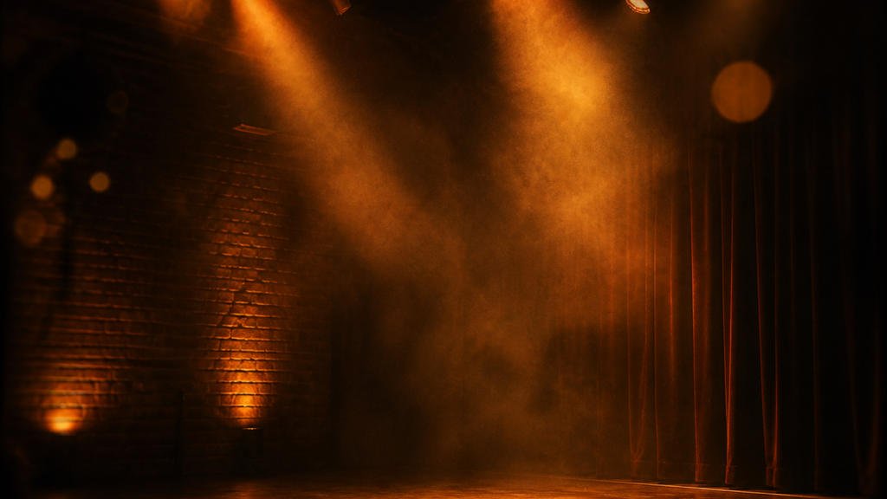
CURTAIN CALL
The lights come up.
Someone steps to the mic.
It begins again.
SOURCED FROM Britannica · Wikipedia · GRAMMY.com · press & archival reporting
MADE WITH slide-maker · a “Lights Down” editorial template
13 / 13
Notes:
The history keeps repeating in miniature every night: the lights come up, someone steps to the mic, and it begins again. Thank you.

