Slide 1
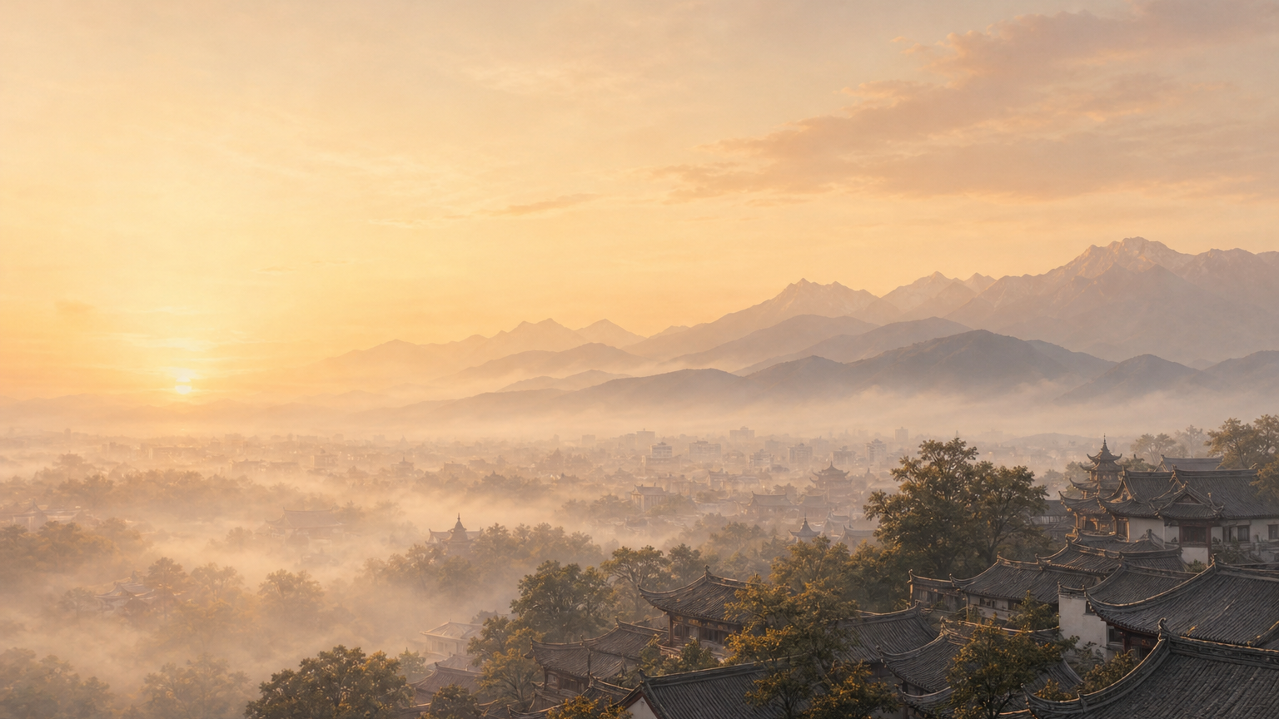

蓉
C H É N G D Ū
LAND OF ABUNDANCE · THE BROCADE CITY
Chengdu
A city you'll never want to leave
CITY GUIDE · TRAVEL FEATURE | CHENGDU CITY GUIDE

Slide 2

I
CITY PROFILE
Twenty Million, Two Trillion
Capital of Sichuan · sub-provincial city · a core of the Chengdu–Chongqing economic circle
21.47 million
2.35 trillion
14,335 km²
80.8 %
Permanent residents · 2024
GDP · CNY
Municipal area
Urbanization rate
Hibiscus City
Brocade City
Land of Abundance
The 'furong' hibiscus, planted city-wide under the Later Shu, gave 'Rongcheng' its name
Han-era Shu brocade was famed nationwide; a 'Brocade Officer' oversaw it
Watered by the Dujiangyan, its fertile plains defy drought and flood
02 / 14

Slide 3



I
CITY PROFILE
A Mild Basin, an Easy Life
In the western Sichuan Basin, at the heart of the Chengdu Plain
Humid subtropical climate
Location at a Glance
Four clear seasons, mild winters; often cloudy and misty, so harsh sun is rare and the air feels gentle.
A city of water
Position
Western Sichuan Basin · heart of the Chengdu Plain
Ringed by the Min, Fu and Jin; the dam-free Dujiangyan tames drought and flood across the plain.
Elevation
~500 m on the plain; higher west, lower east
Hibiscus & ginkgo
Late autumn lines the banks with hibiscus and the streets with golden ginkgo — the city's colours.
Rivers
Min & Tuo river systems; the Jin runs through the city
03 / 14

Slide 4
II
HISTORY & CULTURE
Same Name, Same Site
Three thousand years unbroken — from the Jinsha Sun Bird to the still-flowing Dujiangyan
c. 1200 BCE
256 BCE
Qin · Named
2000 CE
Jinsha · Sun Bird
Dujiangyan · Li Bing
The name 'Chengdu'
Qingcheng–Dujiangyan
Ancient Shu capital, unearthed 2001; the gold ornament is 94.2% pure
Dam-free irrigation, still in use; the Land of Abundance begins here
For 2,300+ years the name and the site have never changed
Inscribed as a World Heritage Site — and still in service
Sanxingdui and Jinsha are the twin stars of ancient Shu; Chengdu is an ancient city still alive and growing.
04 / 14

Slide 5


II
HISTORY & CULTURE
Three Kingdoms & the Poet-Sage
Half the Three Kingdoms saga plays out in Shu; one cottage holds the Tang's poetry
Wuhou Shrine
Du Fu Cottage
China's only shrine honouring a ruler and his minister together — Zhuge Liang and Liu Bei. Red walls and bamboo shade sit a wall away from Jinli, the bustling 'First Street of West Shu'.
Fleeing the An Lushan rebellion, the poet Du Fu lived here nearly four years and wrote 240+ poems — putting Chengdu on the map of Tang poetry.
“At dawn, where the red lies wet, blossoms weigh down the Brocade City.” — Du Fu, 'Delighting in Rain on a Spring Night'
05 / 14

Slide 6



II
HISTORY & CULTURE
A Needle, a Thread, a Face
Turning daily life into craft — another Chengdu gift
Brocade & Embroidery
Opera & Face-Changing
Kuanzhai Alleys · Jinli
One of China's 'Four Great Brocades', with embroidery to match — and the city's earliest export.
Fire-spitting, face-changing, lamp-balancing — a new face in a blink. The stage is the teahouse itself: sip a bowl of tea and watch.
Grey brick and dark tile, old Chengdu in miniature: tea, ear-cleaning, opera, strolling — street life itself is the liveliest culture.
06 / 14

Slide 7
III
CUISINE
Flavour Lives in Chengdu
In 2010, UNESCO named Chengdu Asia's first 'City of Gastronomy'
2010
A great cuisine of China · every dish its own character
Hot Pot
Skewer Hotpot
Mapo Tofu
Twice-Cooked Pork
Kung Pao Chicken
Dan Dan Noodles
Asia's first · City of Gastronomy
UNESCO Creative Cities Network
Zhong Dumplings
Long Wonton
Fuqi Feipian
Beyond numbing, spicy, fresh and fragrant hides a quiet sweetness and depth.
07 / 14

Slide 8




IV
GIANT PANDAS
The Largest Panda Home on Earth
Chengdu Research Base of Giant Panda Breeding: from 6 rescued animals to the world's largest ex-situ population
of the global captive population (~757)
~34%
Largest ex-situ group
Captive giant
pandas · end-2024
The world's largest captive breeding group for both giant and red pandas.
260
From rescue to thriving
From 6 to 260 — the patience of a city
From 6 rescued animals in 1987 to a world-famous 'panda factory' today.
08 / 14

Slide 9
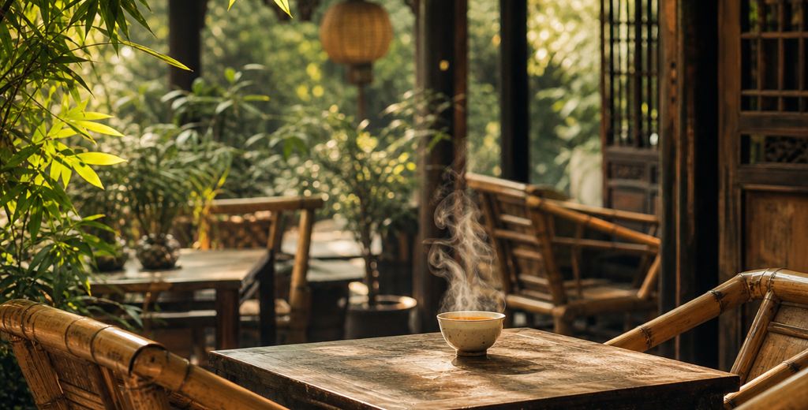



V
WAY OF LIFE
Time, Steeped in Tea
'Bāshì' and 'ānyì' — Chengdu's own two words for a life well lived
The three-piece gaiwan
Lid, bowl and saucer — one covered bowl brews a city's ease; the old teahouse is Chengdu at its most real.
Ear-cleaning & tall tales
The ear-cleaner's brass picks and streetside gossip weave leisure into the grain of daily life.
A bowl of tea,
a whole afternoon.
Nightlife that never closes
Bamboo chairs, old tea, idle chatter — slow is a kind of productivity.
From Jiuyanqiao to Yulin Road, hot pot and little bars fuel China's most vibrant nights.
09 / 14

Slide 10


V
WAY OF LIFE
A Park City Below Snow Peaks
In 2018, the 'Park City' concept was first proposed in Chengdu's Tianfu New Area
Birthplace of the idea
Green at every window
Snow peaks in view
First proposed in Tianfu New Area in 2018; approved in 2022 as a national Park City demo zone.
The Xinglong Lake eco-ring and the Tianfu Greenways lace parks through the city's fabric.
On clear days, spot Gongga and Siguniang from downtown — a 'park city below the snow mountains'.
10 / 14

Slide 11




VI
INDUSTRY & TECH
Beyond the Ease, a Hard Core
China's top-ranked 'new first-tier city' for years — a city of leisure and of industry alike
Electronics & IT industry (trillion CNY)
Twin trillion-CNY clusters
Mainland's 3rd dual-airport city
Both top a trillion CNY in scale
Tianfu Int'l Airport opened in 2021
4th-longest metro in China
Birthplace of a hit mobile game
~673 km · as of end-2024
Honor of Kings, built by a Chengdu team
Passed one trillion in 2020 — the first trillion-CNY industry in Chengdu and Sichuan.
11 / 14

Slide 12



VII
TRAVEL GUIDE
How to Do Chengdu
Three things to know before you come
When to go
What to see
Getting around
Spring (Mar–May) for blossoms, autumn (Sep–Nov) for ginkgo
Panda Base · meet the national treasure
Two international airports; high-speed rail nationwide
Mild, near-snowless winters; add Xiling Snow Mountain
Kuanzhai Alleys · Jinli · Wuhou Shrine · Du Fu Cottage
600+ km of metro reaches most sights directly
Skip muggy midsummer and holiday peaks
Dujiangyan–Qingcheng · Chunxi Rd & Taikoo Li
Shared bikes plus walking are the sweetest way
12 / 14

Slide 13
VII
TRAVEL GUIDE
Three Days in Chengdu
Go slow — it's the only way to match the city's pace
DAY 1
DAY 2
DAY 3
Cute & Local
Old & New
Peaks & Water
AM
Giant Panda Base
AM
Wuhou Shrine · Jinli
AM
Dujiangyan Waterworks
PM
Jinsha Site Museum
PM
Du Fu Cottage · park
PM
Mt. Qingcheng
EVE
Kuanzhai Alleys · tea
EVE
Chunxi Rd · Taikoo Li
EVE
Home · pack peppercorns
13 / 14

Slide 14
蓉
Easy to arrive,
hard to leave.
Chengdu · a city that turns daily life into poetry
Sources: Chengdu 2024 Statistical Communiqué on National Economic and Social Development, UNESCO, Chengdu Research Base of Giant Panda Breeding,
Ministry of Transport, Xinhua, Sichuan Provincial Government and other public records; data as of 2024 (some updated to 2025) · compiled July 2026.

