Slide 1
Introduction to Docker, Docker Compose, Pandas, Numpy, Sklearn
Lab 1 - CSCI 5901
TA Information:
Vishal Rakesh Jaiswal: vs928999@dal.ca

Slide 2
Tutorial Objectives
Search for an image, pull and execute the image
Write a Docker container using a specific image and connect their volumes
Use Docker Compose to build image for more than one service
Get familiar with Numpy, Pandas, Sklearn
Perform exploratory Data Analysis on a dataset

Slide 3
Searching for an image
Go to docker hub to search for a docker image;
Enter the image name for eg: Tensorflow in the search box on docker hub
Look for the docker pull command and enter the command in your terminal
TASK : Search for tensorflow, psql and jupyter images on docker hub and pull them

Slide 4
Pulling docker image for Mongo
We build a small image for mongodb by using docker pull
Command:
docker pull mongo
TASK : Use docker pull to create containers for Tensorflow, PSQL and Jupyter notebook

Slide 5
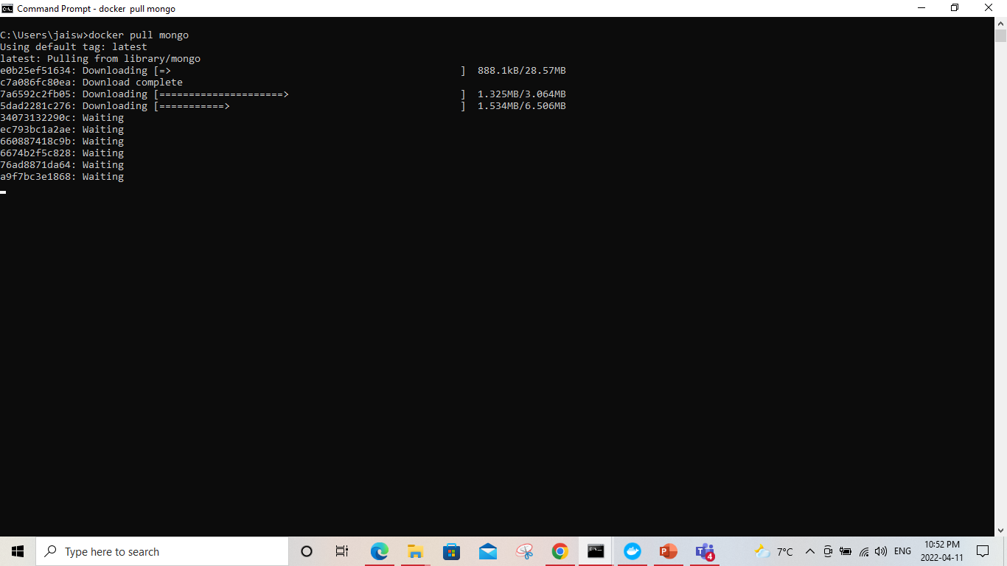
Pulling docker image for Mongo(contd)

Slide 6
Executing the docker image
To execute the docker image pulled by the previous command. Note the image name created at the end of pull completion. Use the following command to execute the image:
docker run -d -p 80:80 docker.io/library/mongo:latest
Here the docker.io/library/mongo:latest is the path to docker image mongo:latest.
-d – run container in background
-p – publish container's ports to host
In the above command container port 80 is published to host port 80

Slide 7
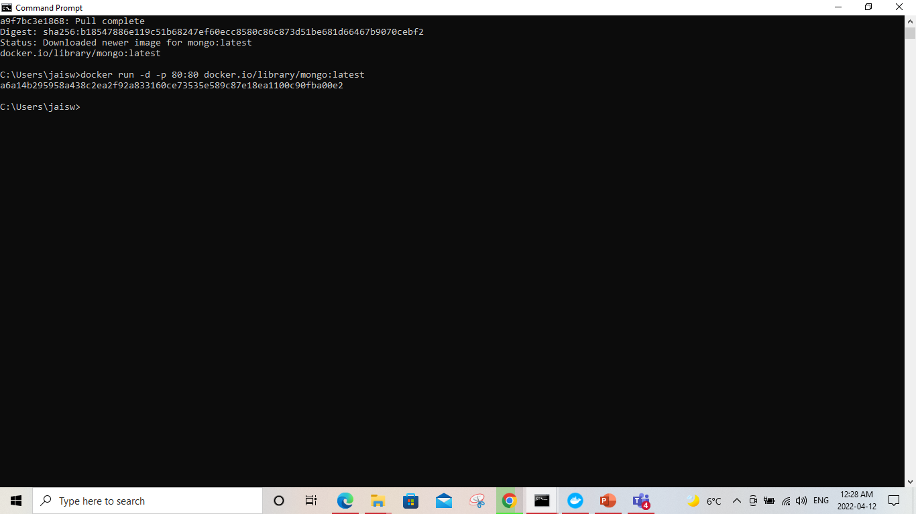
Executing the docker image (contd)

Slide 8
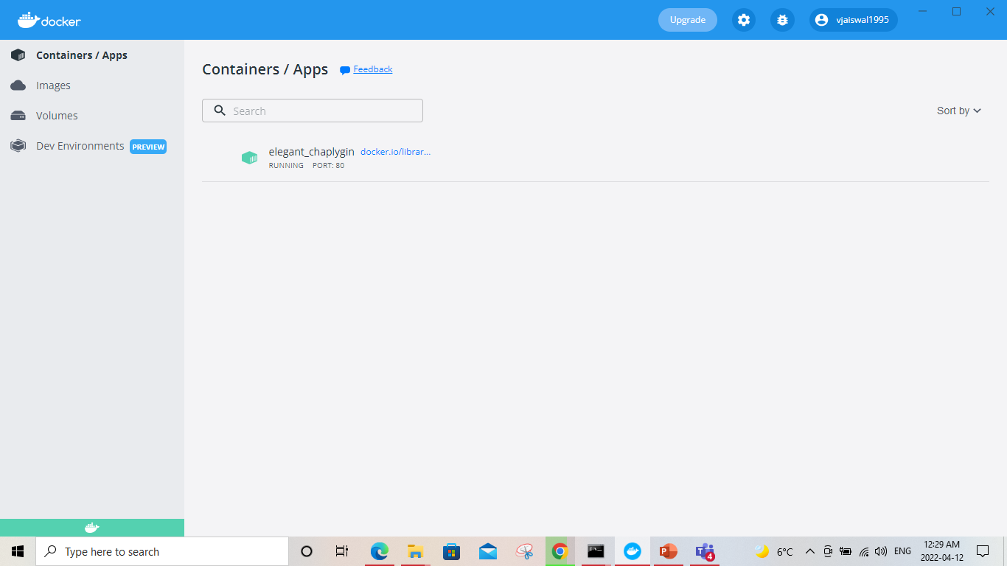
Docker container for the pulled image

Slide 9
Creating volumes and defining networks for the docker container
To create a volume the following command is written:
docker volume create <volumename>
To start a container with the volume attached:
docker run –d -name devtest -v <volumename>:/app <dockerimagename>
To create your own bridge network:
docker network create –d bridge <bridgename>
To add your container to this network:
docker run –d –net=<bridgename> --name <docker-image>

Slide 10
Difference between Docker image and container
Docker Image | Docker Container
It is a container blueprint | It is an instance of a docker image.
It is immutable | The docker container is writable.
It can exist without a docker container | We need to execute a docker image to create a container
It does not need computing resources to operate. It can be though of as a static file which is not still not deployed. | It needs computing resources to run. You need to mention the container’s port and host port. These containers run as Docker virtual machines.
It can be shared. Just like we pulled the image from docker hub. | There is no need to share a running docker container
It is created only once. | Multiple containers can be created from a single image which can be stopped and started.

Slide 11
Using Docker Compose
Using Docker compose comprises of three steps:
Define the app environment with a Dockerfile
Define the services in your app in the docker-compose.yml so they can run together
Running docker compose up and the docker compose command starts and runs your application. You can also execute the docker-compose up using the docker-compose binary.

Slide 12
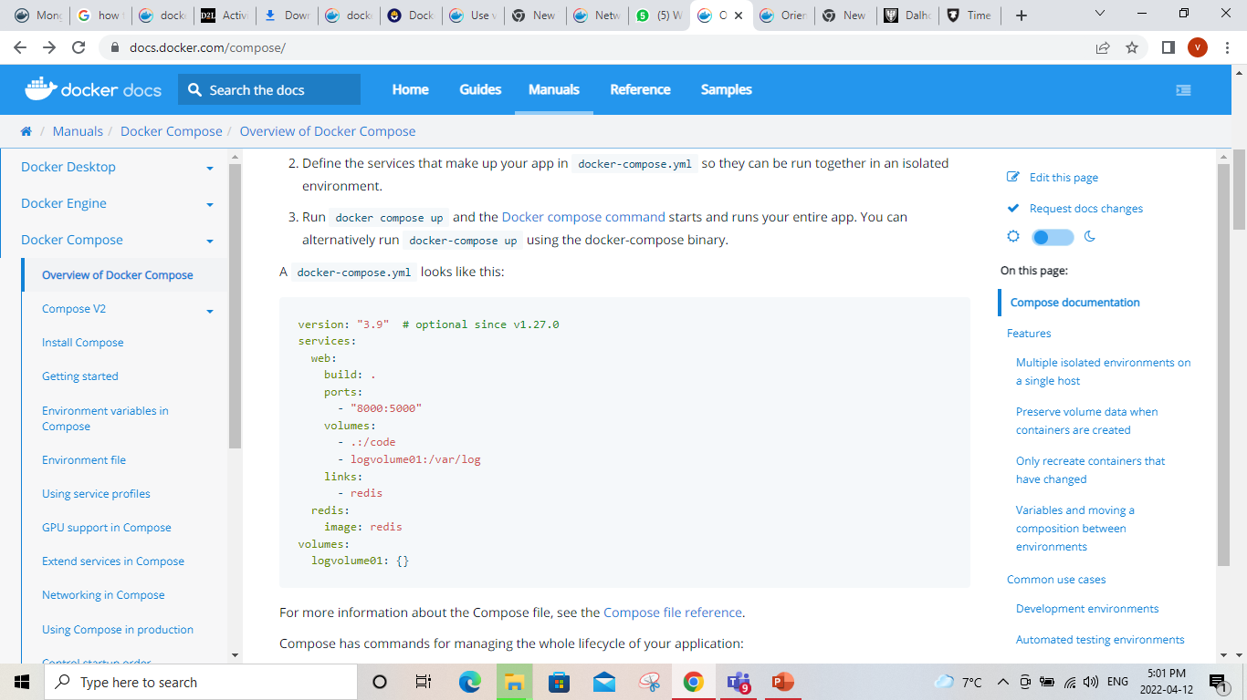
Using Docker Compose(contd)
A simple docker-compose.yml looks like this

Slide 13
Using Docker Compose(contd)
A simple docker-compose.yml looks like this

Slide 14
Thank you!

