Slide 1
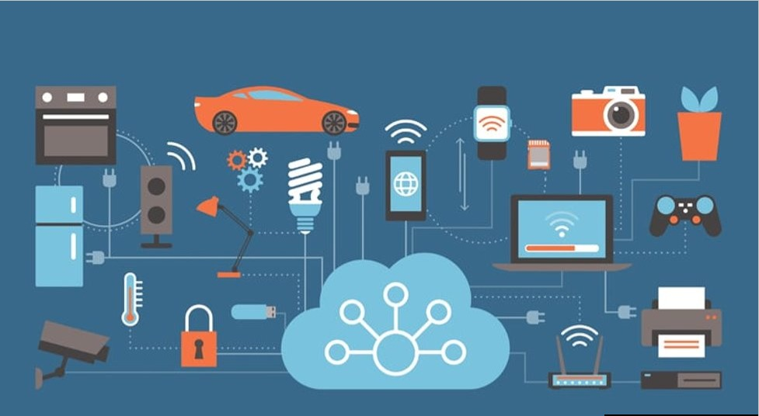
IoT & Cloud Integration

Slide 2
IoT & Cloud Integration
Introduction
Why Cloud Computing in IoT?
Provides Remote Services
Allows Scalability
Provides Security
Facilitates Collaboration
Trends in Cloud Computing and IoT
Conclusion

Slide 3
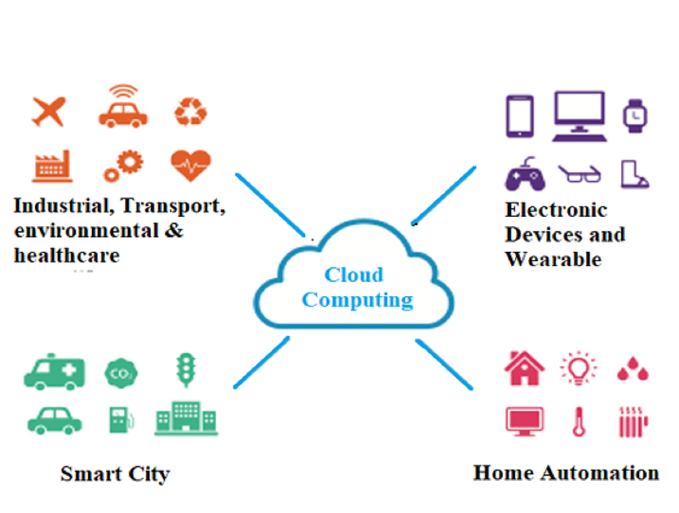
IoT & Cloud Integration
Integration of Cloud Computing and Internet of Things
Cloud computing offers Data storage, Processing and Analysing
Cloud computing platforms: Microsoft Azure, AWS, GCP, IBM Watson, etc
IoT devices such as: Smart home security systems, Wearable health monitors, Smartwatches, etc

Slide 4
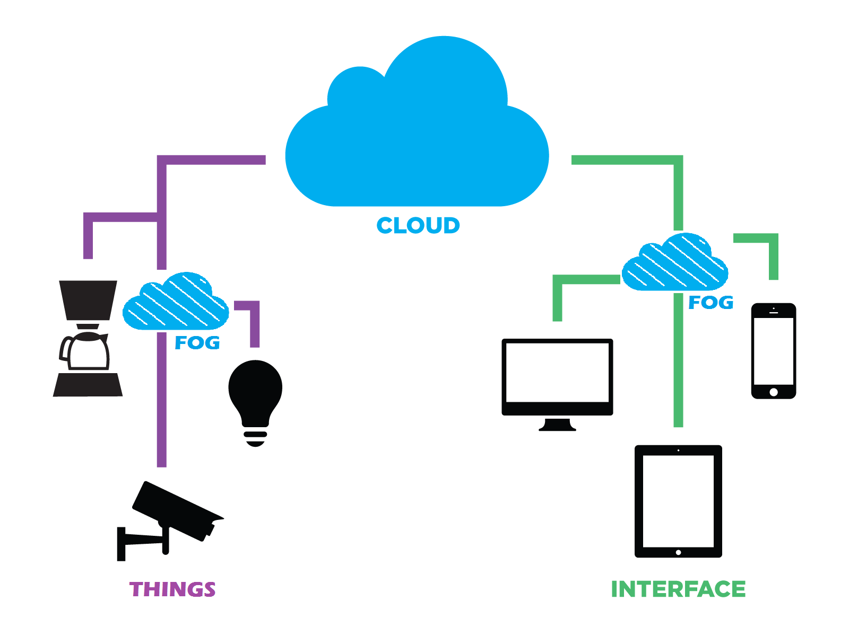
IoT & Cloud Integration
1. Provides Remote Services
Access remotely from any place on the planet as long as there is internet access.
Cloud delivery models, i.e., (IaaS), (PaaS) & (SaaS).

Slide 5
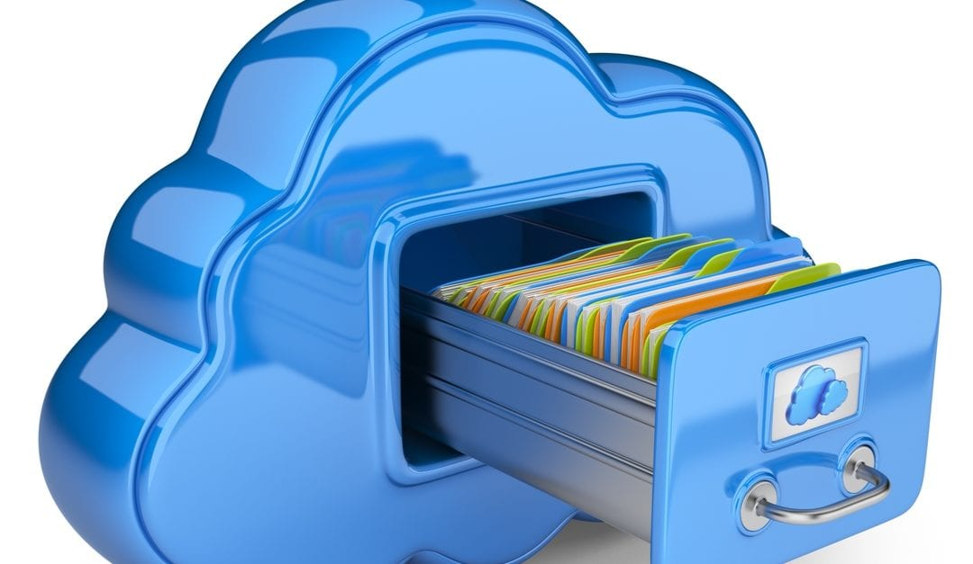
IoT & Cloud Integration
2. Allows Scalability
Scale up or down IoT devices and applications
Lease more storage space
Flexibility

Slide 6
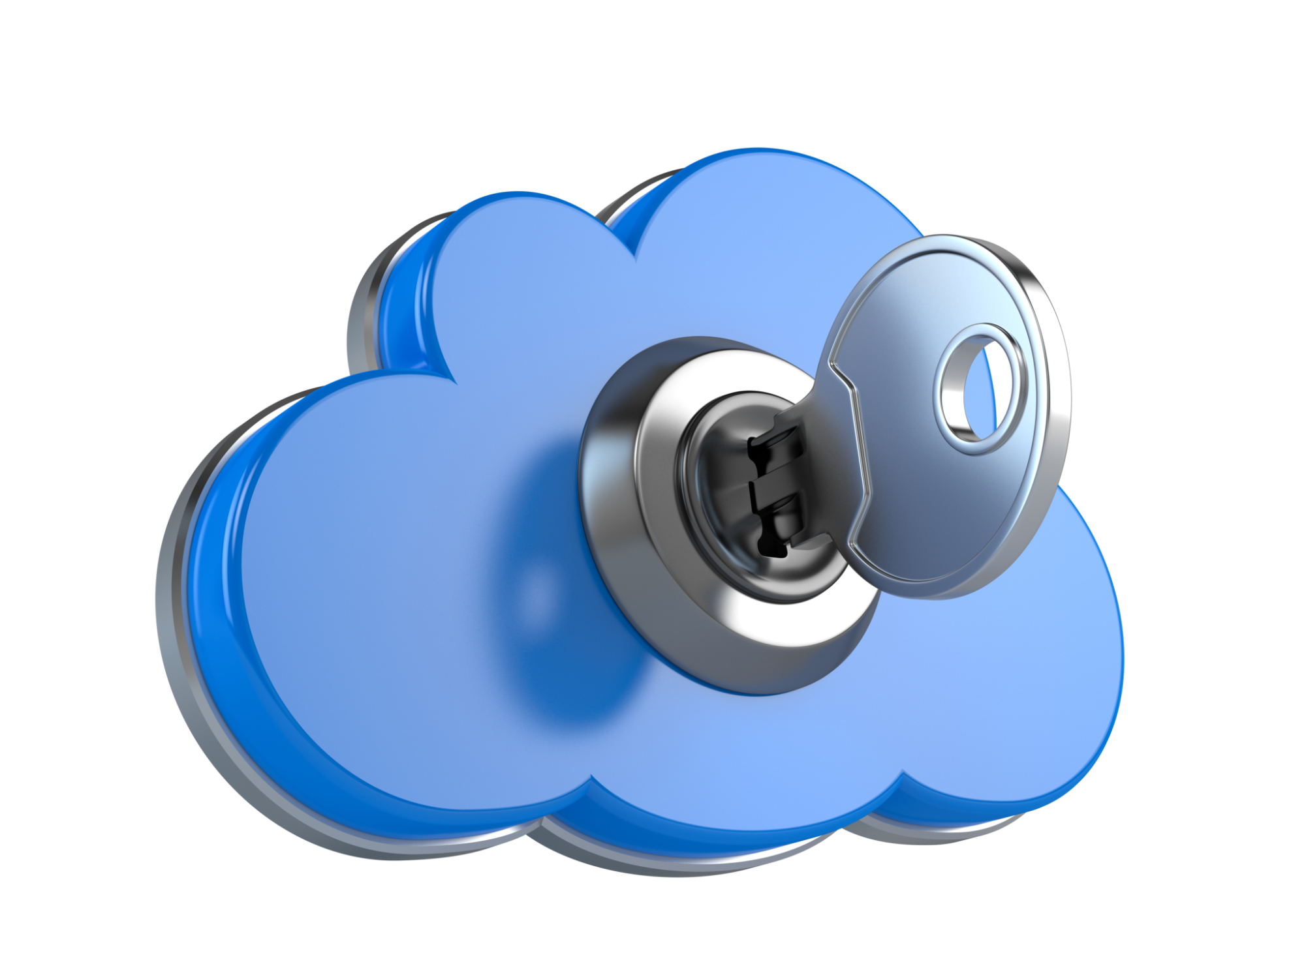
IoT & Cloud Integration
3. Provides Security
Data Collection related to Health, Finance and Personally Identifiable Information (PII), etc.,
Secure storage environment

Slide 7
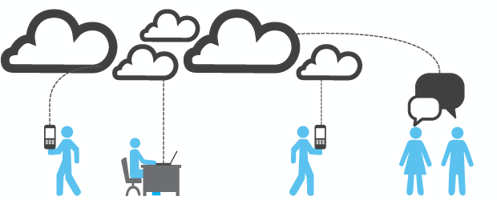
IoT & Cloud Integration
4. Facilitates Collaboration

Slide 8
IoT & Cloud Integration
Latest Trends in
Cloud Computing
Provides Remote Services
Allows Scalability
IoT
Provides Remote Services
Allows Scalability

Slide 9
IoT & Cloud Integration
CONCLUSION

