Slide 1
Building a Ruby on Rails application with DB2 Express-C 9
Introduction to Ruby
Markham Oct 17, 2006
Antonio Cangiano
Alex Pitigoi
IBM Toronto Lab

Slide 2
Agenda
The basics of Ruby
Introducing the Ruby on Rails Web Framework
Building a Ruby on Rails application Part 1
Break
Building a Ruby on Rails application Part 2

Slide 3
What’s Ruby?
A programmer’s best friend
Ruby is a free and open source interpreted scripting language for quick and easy object-oriented programming
Released to the world in 1995 in Japan by Yukihiro Matsumoto, a.k.a matz
Stable version is 1.8.5
Used to build and program with the Ruby on Rails Web Framework

Slide 4
Main features 1/3
Purely object-oriented: everything is an object
Dynamically typed
Exception handling
Iterators and blocks
Native regular expressions

Slide 5
Main features 2/3
Principle of least surprise
Operator overloading
Automatic garbage collecting
Classes, methods, Modules, mixins
Highly portable

Slide 6
Main features 3/3
Large Standard Library
I18n support (UTF-8)
Continuations, generators, introspection, reflection and meta-programming
Extensible in C

Slide 7
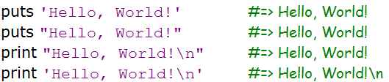
The mandatory Hello World!
puts positions the cursor on the next line, print doesn’t
Single or double quotes delimit strings. Double quotes strings allow for special characters and variable substitution

Slide 8
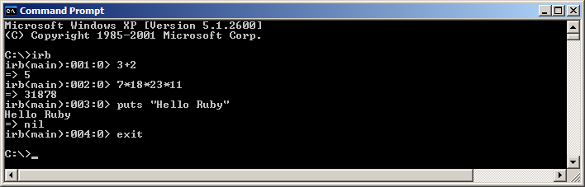
IRB: Interactive Ruby Shell
irb is an interactive shell, excellent for trying out snippets of code, learning more about how Ruby works and cut down on the development cycle

Slide 9
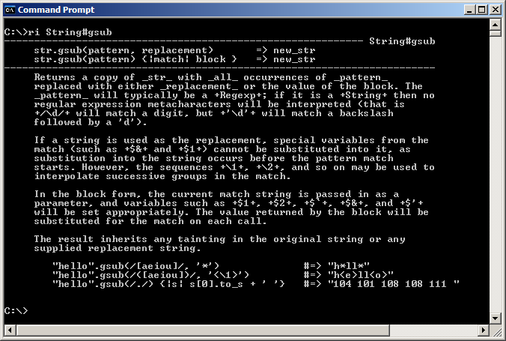
RI: Ruby Interactive

Slide 10
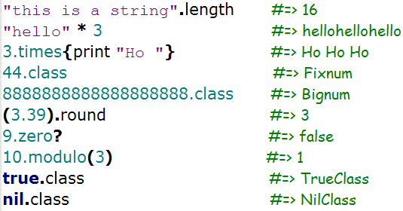
Everything is an object… even numbers

Slide 11
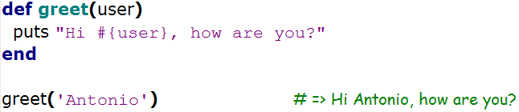
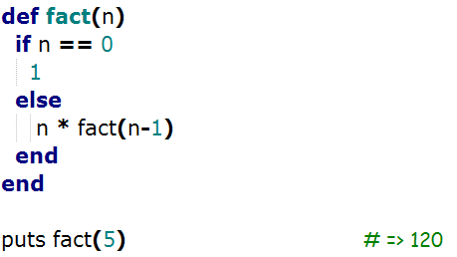
Creating methods 1/2
Methods are created through the use of the def keyword
Methods start with a lowercase letter and should use the snake_case
The return keyword is optional, as the last evaluated expression is implicitly returned

Slide 12
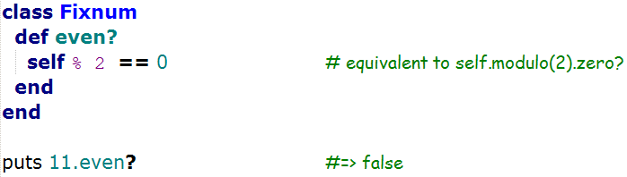
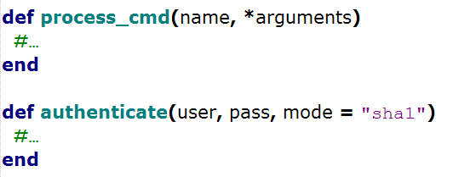
Creating methods 2/2
Methods that answer a question, usually end with a ‘?’, while ‘destructive’ methods with a ‘!’
We said that numbers are objects… not special ‘primitive’ types. We can even define our own methods for them.
Arbitrary number of arguments, and default values are also allowed:

Slide 13
Access modifier 1/2
Methods are public by default
Access modifiers are methods that enable us to define the scope of other methods (public, private, protected)
Access modifiers continue to modify every following method within the current scope or until another access modifier is met.
Passing symbols to the access modifiers allows us to specify the methods independently from the order within the scope

Slide 14
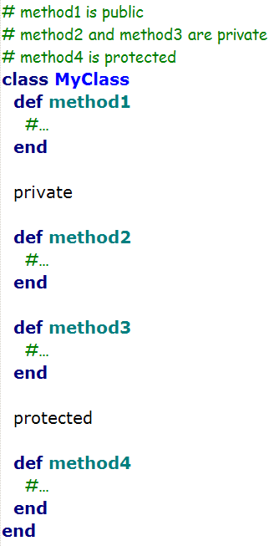
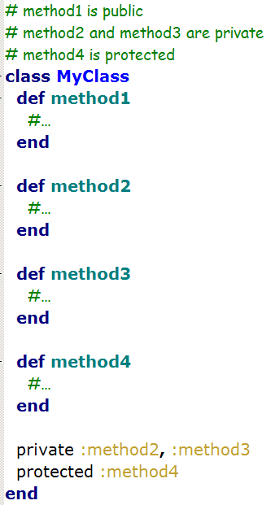
Access modifier 2/2

Slide 15
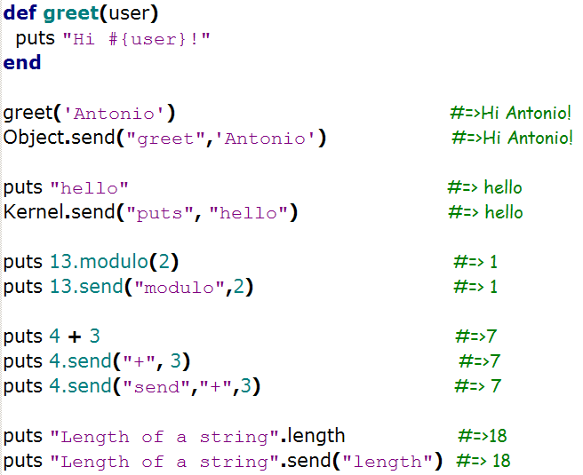
Calling methods
We call methods through the dot ‘.’ operator: MyObject.my_method (sometimes dot is omitted because the caller is implicit). Methods can be concatenated: MyObject.my_method(a,b).another_method(d).another_one
Parenthesis after the method name are currently optional, but recommended in most cases
Calling a method means sending a message to the calling object: MyObject.my_method(a,b) is actually syntax sugar for MyObject.send(“my_method”,a,b)

Slide 16
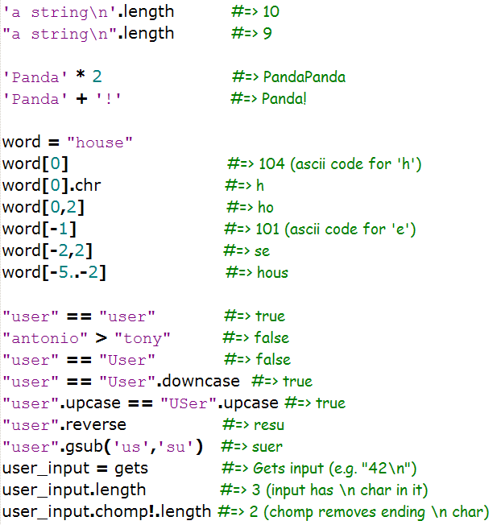
Strings

Slide 17
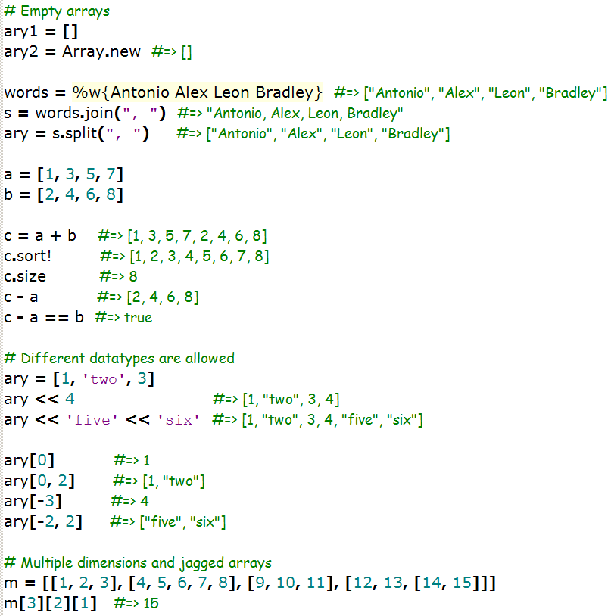
Arrays

Slide 18
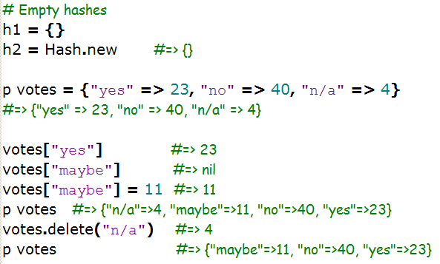
Hashes
Hashes are dictionaries composed of key/value pairs.
Hashes are associative Arrays that have keys as indexes.
The keys are often strings or symbols.

Slide 19
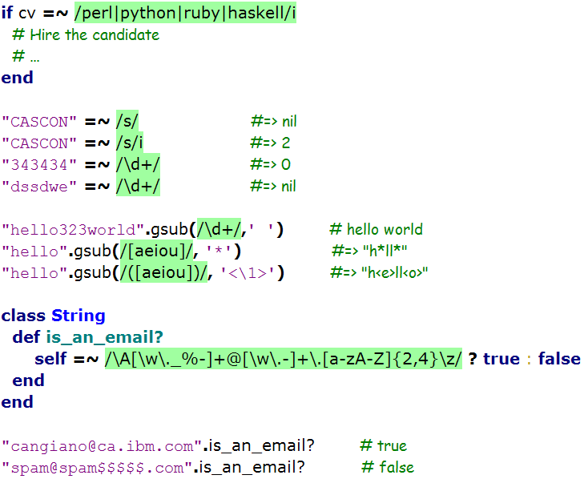
Regular Expressions
Using Regular Expressions
you can work on strings
through patterns
Regexp are efficiently
implemented in Ruby and
natively accessible.
Create Regexp with %r{}, / / or
Regexp.new()

Slide 20
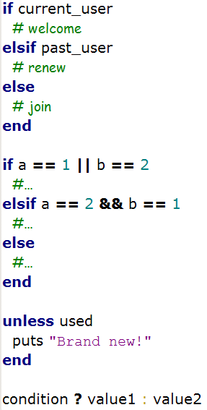
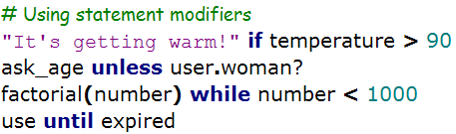
Common Control Structures 1/3
Any expression, except false and nil, is
evaluated as a true condition
|| and && are the logical OR and AND with
short-circuit evaluation. (and, or, &, | are the
always-evaluated versions)
Statement modifiers allow the usage of
conditions after the actual statement,
improving readability

Slide 21
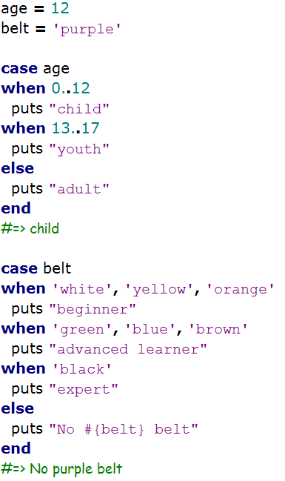
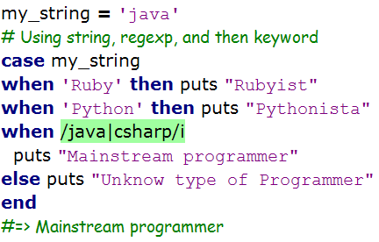
Common Control structures 2/3
case uses the === operator to evaluate the condition. === is object specific and allow us to evaluate strings and regexp in the same case statement.

Slide 22
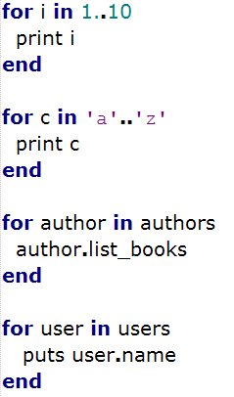
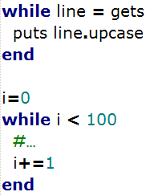
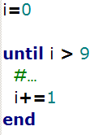
Common Control structures 3/3

Slide 23
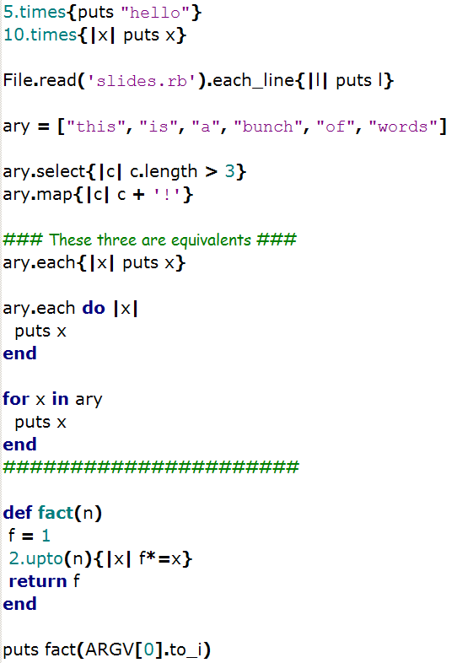
Iterators and blocks 1/2
Blocks are nameless/anonymous
functions that capture the container
environment.
Variables used within a block need
to be previously declared in order
to use their values outside the block.
Iterators are a convenient way for
accessing info stored in Array, Hashes,
and any collections of data.

Slide 24
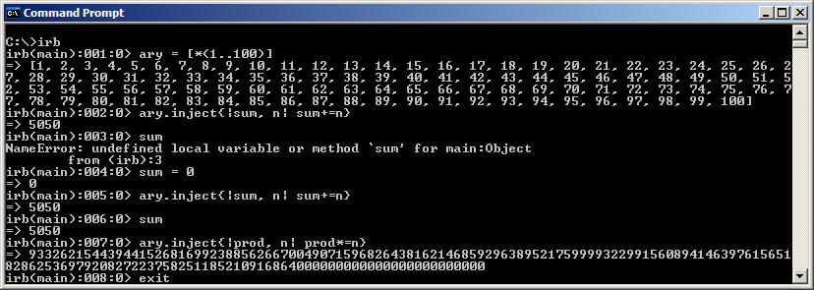
Iterators and blocks 2/2

Slide 25
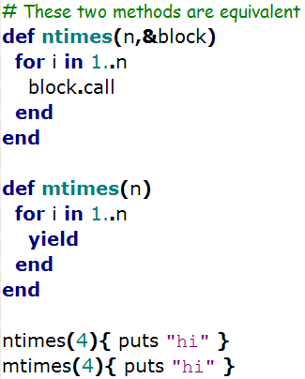
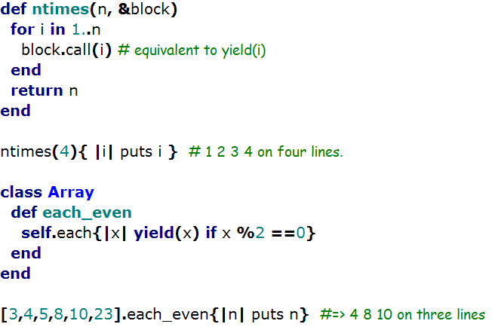
Creating iterators

Slide 26
Naming conventions
local_variable
CONSTANT_NAME / ConstantName / Constant_Name
:symbol_name
@instance_variable
@@class_variable
$global_variable
ClassName
method_name
ModuleName

Slide 27
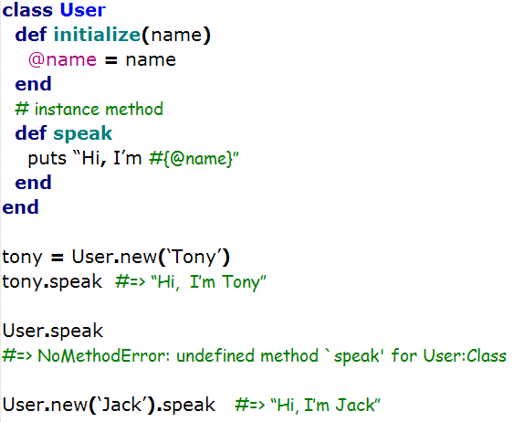
Classes 1/2

Slide 28
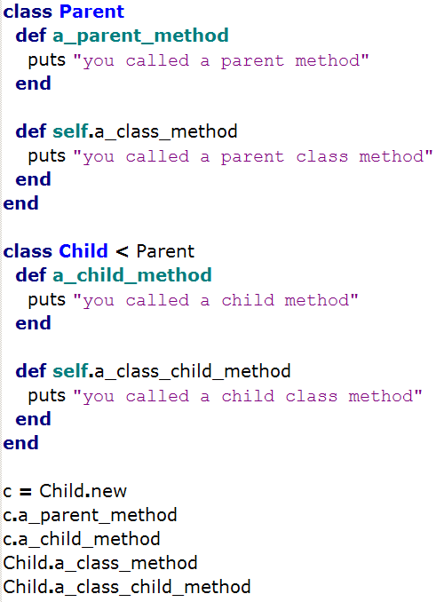
Classes 2/2

Slide 29
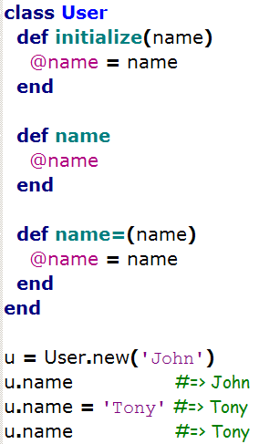
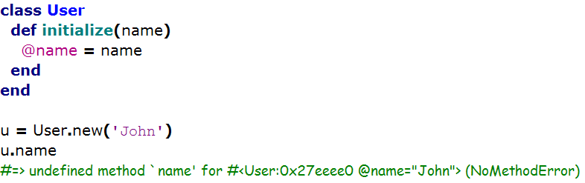
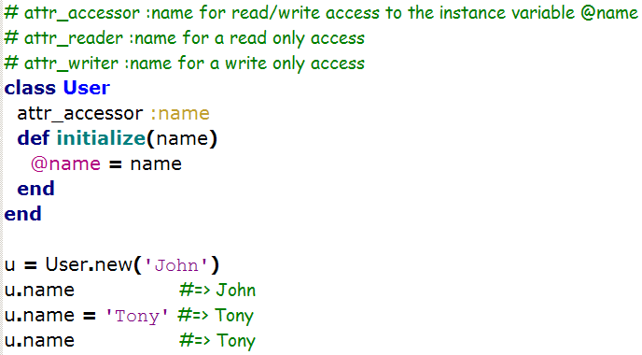
Accessors

Slide 30
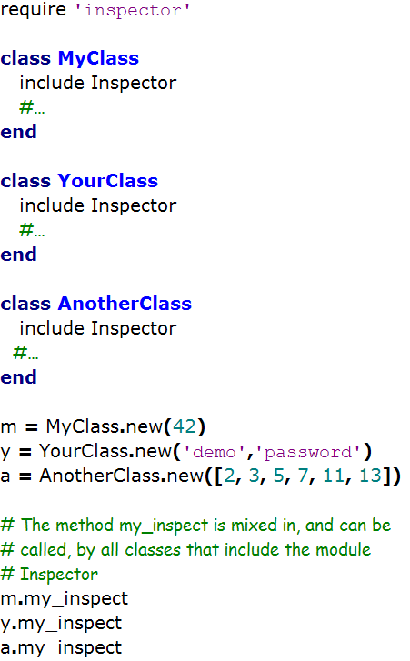
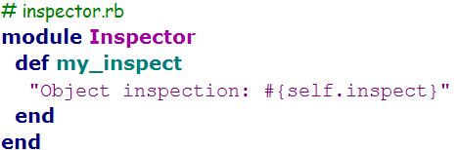
Modules 1/2
Modules provide a namespace system
Modules allow the possibility to use mixins

Slide 31
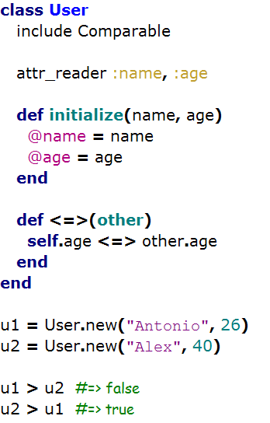
Modules 2/2

Slide 32
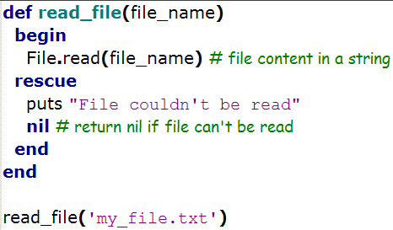
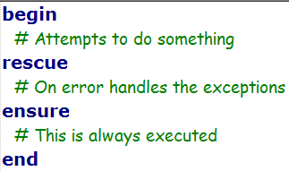
Exceptions handling
Note: Check the documentation for raise, retry, catch and throw

Slide 33
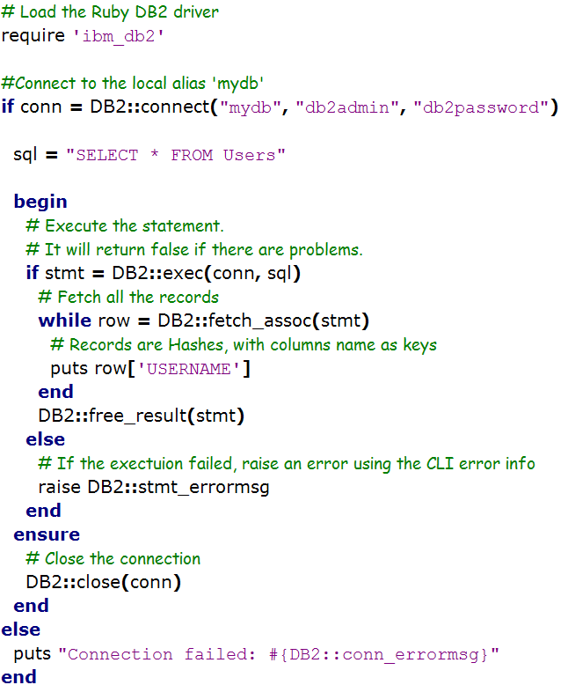
Querying DB2

Slide 34
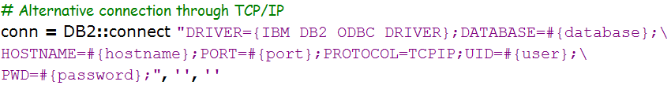
Querying DB2

Slide 35
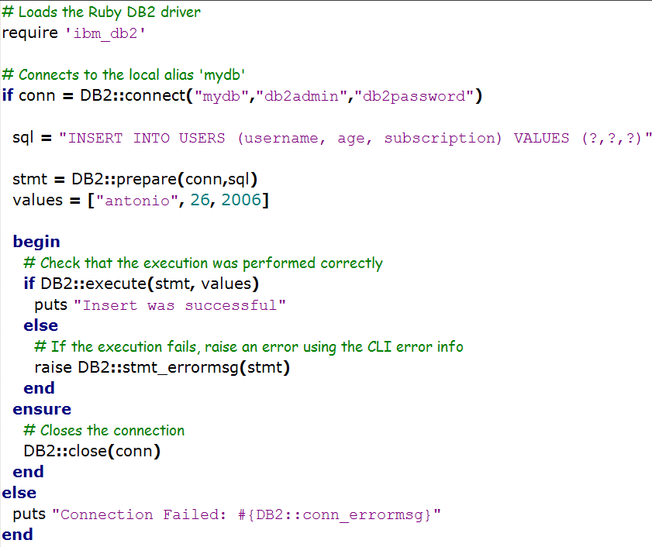
Querying DB2 with parameterized queries

Slide 36
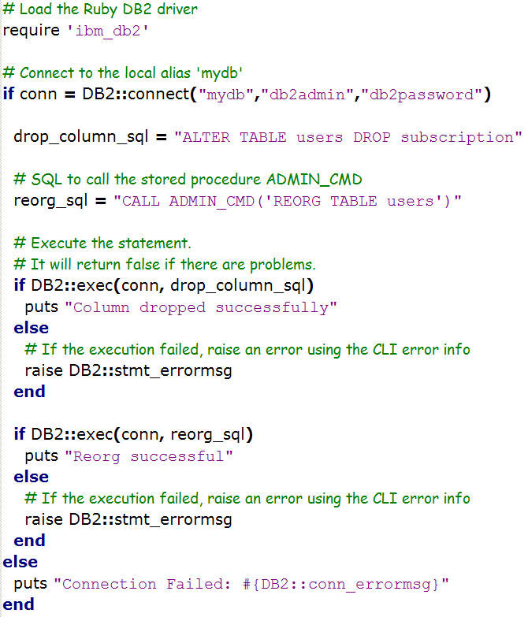
Calling DB2 Stored Procedures 1/2

Slide 37
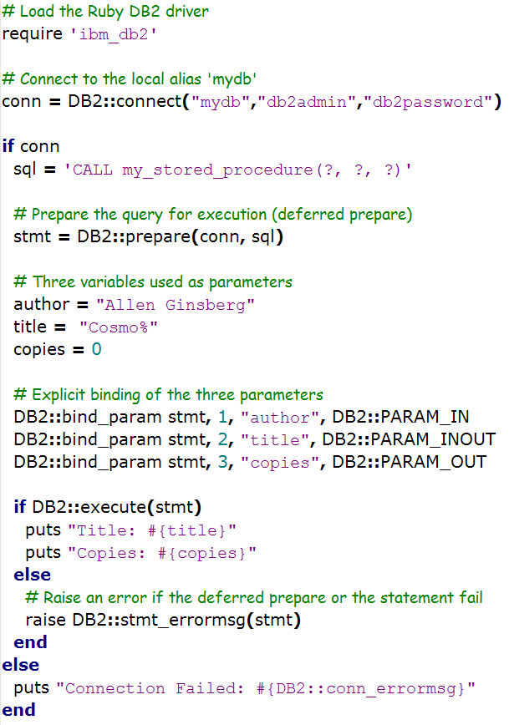
Calling DB2 Stored Procedures 2/2

