Slide 1
Scientific Calculator using Tkinter
Explanation and Steps used for creating Calculator using GUI Application in Python

Slide 2
Introduction
We extend the basic calculator into a Scientific Calculator.
It includes standard arithmetic and scientific functions such as:
√, x², log, sin, cos, tan.

Slide 3
Project Overview
Features of Scientific Calculator:
• Equation display area (screen)
• Clickable buttons (numbers, operators, functions)
• Core operations: +, -, ×, ÷
• Scientific operations: sqrt, square, log, sin, cos, tan
• Result (=) and Clear (C)

Slide 4
System Requirements
• Python 3.x
• Tkinter Library
• Visual Studio Code [IDE]

Slide 5
Implementation Steps
1. Import Tkinter and math library
2. Create main window
3. Add equation display (Entry widget)
4. Add standard buttons (+, -, *, /, =, C)
5. Add scientific buttons (sqrt, x², log, sin, cos, tan)
6. Define functions for operations
7. Run mainloop()

Slide 6
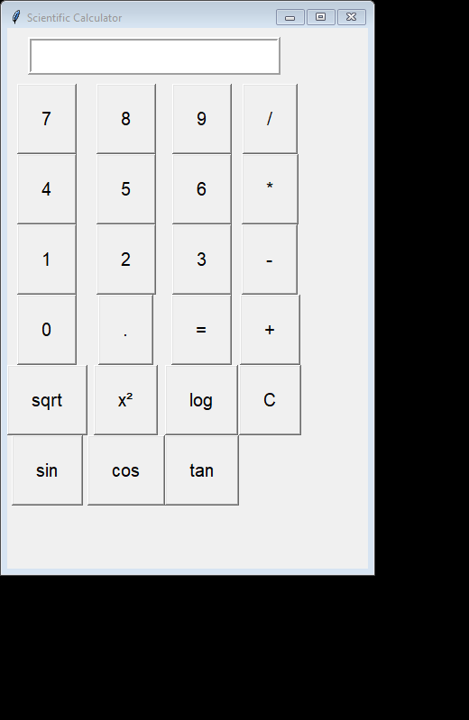
Demo GUI Layout
Screenshot of the Scientific Calculator running here.

Slide 7
Learning Outcomes
1. Core Python programming
2. GUI development using Tkinter
3. Handling scientific operations in Python
4. Application development with VS Code
5. Using GitHub for project sharing

Slide 8
Conclusion
I successfully built a Scientific Calculator GUI using Tkinter.
This project demonstrated arithmetic & scientific functions,
GUI event handling, and application development skills.

