Slide 1
Inception of Robotics

Slide 2
1920
The idea of a robot is not new. For thousands of years man has been imagining intelligent mechanised devices that perform human-like tasks. He has built automatic toys and mechanisms and imagined robots in drawings, books, plays and science fiction movies.

Slide 3
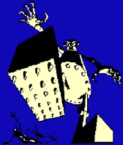
What is the definition of a 'robot'?
"A reprogrammable, multifunctional manipulator designed to move material, parts, tools, or specialised devices through various programmed motions for the performance of a variety of tasks" Robot Institute of America, 1979
Where did the word 'robot' come from?
In fact, the term "robot" was first used in 1920 in a play called "R.U.R." Or "Rossum's universal robots" by the Czech writer Karel Capek. The plot was simple: man makes robot then robot kills man! Many movies that followed continued to show robots as harmful, menacing machines.

Slide 4
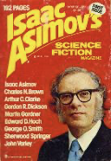
Robotics Terminology
The term 'robotics' refers to the study and use of robots. The term was coined and first used by the Russian-born American scientist and writer Isaac Asimov (born Jan. 2, 1920, died Apr. 6, 1992). Asimov wrote prodigiously on a wide variety of subjects. He was best known for his many works of science fiction.
The most famous include I Robot (1950), The Foundation Trilogy (1951-52), Foundation's Edge (1982), and The Gods Themselves (1972), which won both the Hugo and Nebula awards. He also wrote the three “Laws of Robotics for which he is also famous.

Slide 5
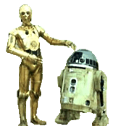
More recent movies, however, like the 1977 "star wars", portray robots such as "C3PO" and "R2D2" as man's helpers. "Number five" in the movie "short circuit" and C3PO actually take on a human appearance. These robots,
which are made to look.
human are called "androids".

Slide 6
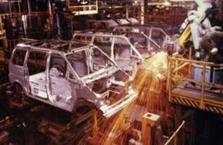
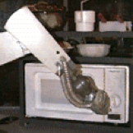
However, robots of today are not exactly the walking, talking intelligent machines of of movies, stories and our dreams. Today, we find most robots working for people in factories, warehouses, and laboratories. In the future, robots may show up in other places: our schools, our homes, even our bodies.

Slide 7
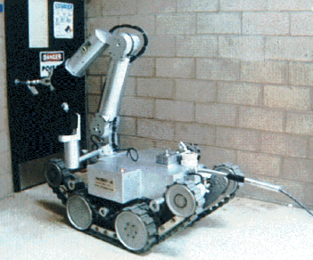
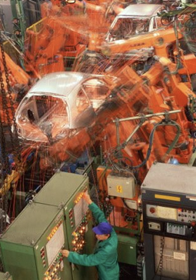
Robots have the potential to change our economy, our health, our standard of living, our knowledge and the world in which we live. As the technology progresses, we are finding new ways to use robots.
Each new use brings new hope and possibilities, but also potential dangers and risks.

