Slide 1
Hardware of iMOSS
Zengyou Ye
https://www.github.com/addy9908/iMOSS
Updated on 05/13/2026

Slide 2

iMOSS workflow
TST
Chamber
Synchronized
Acquisition
Offline
Analysis
Load Cell
Amplifier
Bonsai-RX
(Monitor & save)
iMOSS-AS
Arduino Uno
iMOSS-MV
White Noise
TTL

Slide 3
Material list
Category | Item Description | Catalog # | Unit Price | QT
Box (canalplastic) | White Opaque Acrylic Sheet: 5.5 x 5 x 1/8” (stage) |  | $3.60 | 4
 | White Opaque Acrylic Sheet: 22 x 5 x 1/8” (divider) |  | $7.20 | 5
 | White Opaque Acrylic Sheet: 24 x 10 x 1/4” (base) |  | $24.00 | 1
 | White Opaque Acrylic Sheet: 24 x 22 x 1/4” (back) |  | $48.00 | 1
Stage holder (Amazon) | 16U Vertical Server Rack Rail |  | $27.98 | 1
Electronic (sparkfun) | Mini Load Cell - 100g | 14727 | $9.95 | 4
 | Load Cell Amplifier - HX711 | 13879 | $10.95 | 4
 | Arduino Uno R3 | DEV-11021 | $27.60 | 1
3D parts (self-printed) | Load cell holder: base |  |  | 4
 | Load cell holder: top |  |  | 4

Slide 4
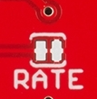
iMOSS-AS hardware module
RED
VDD
5V
Load
Cell AMP
Arduino
Uno
R3
Load Cell
BLK
VCC
5V
WHT
DAT
Pin2
GRN
CLK
Pin3
YLW
GND
GND
RED
VDD
5V
Load
Cell AMP
Load Cell
BLK
VCC
5V
WHT
DAT
Pin4
GRN
CLK
Pin5
YLW
GND
GND
RED
VDD
5V
Load
Cell AMP
Load Cell
BLK
VCC
5V
WHT
DAT
Pin6
GRN
CLK
Pin7
YLW
GND
GND
RED
VDD
5V
Load
Cell AMP
Load Cell
BLK
VCC
5V
WHT
DAT
Pin8
GRN
CLK
Pin9
YLW
GND
GND
CUT AMP for 80 Hz
Note: To archive 80Hz sampling rate, we need to cut the back of load cell amplifier

Slide 5
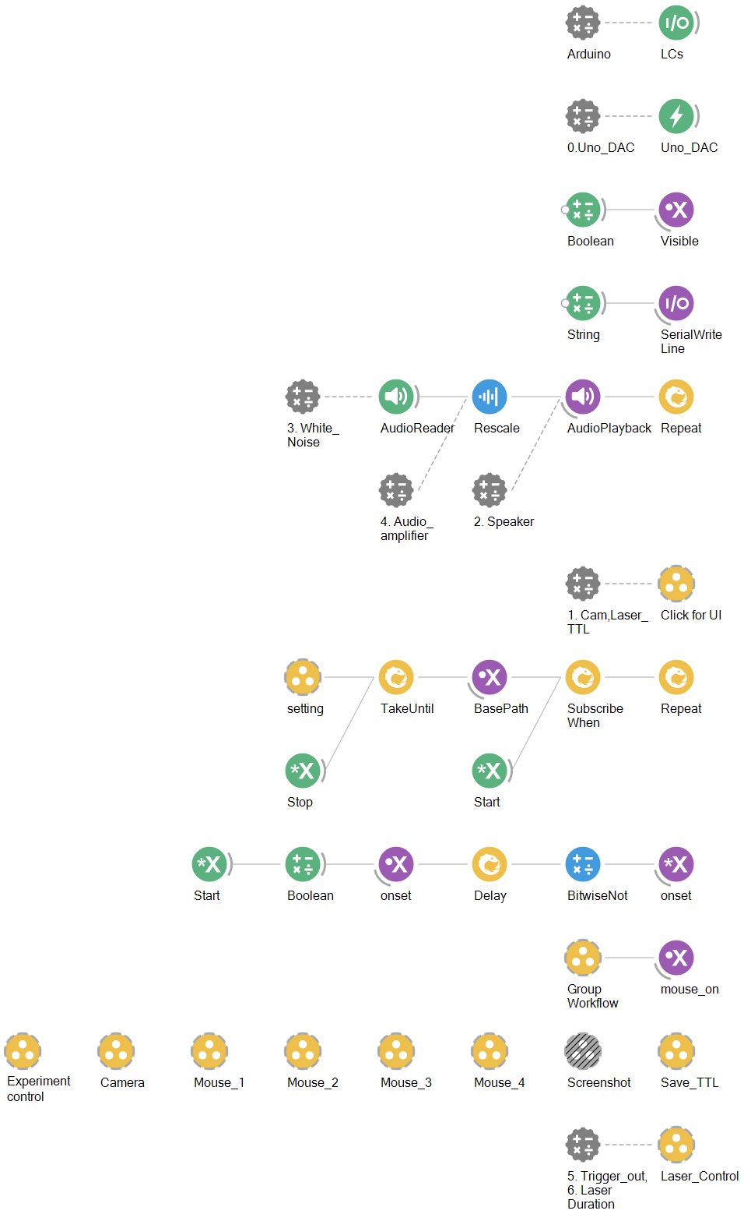
Bonsai workflow

