Slide 1
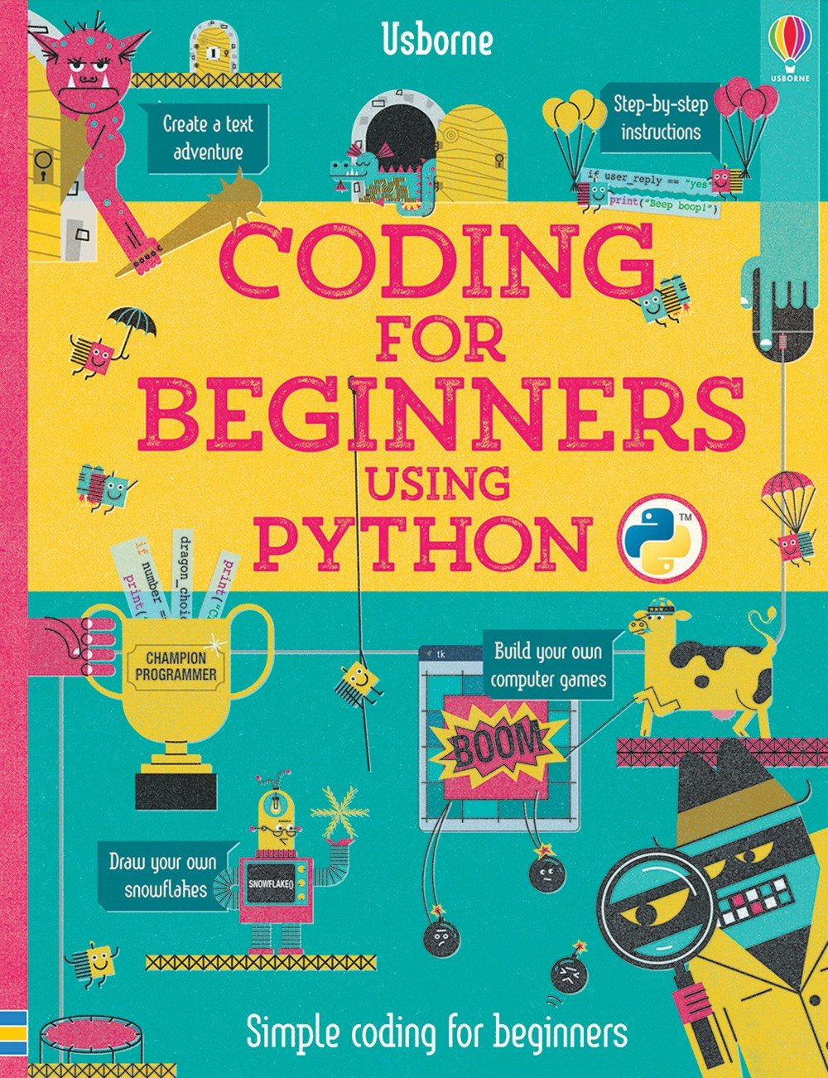

Slide 2
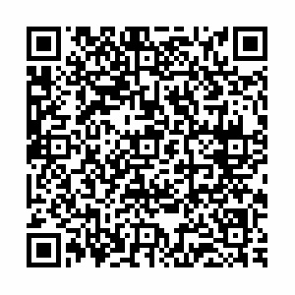
Coding for Beginners using Python
ISBN 978-0-7945-3950-4

Slide 3
Do it for the children...
Download and Install
Simple Arithmetic
Planning Programs
Question and Answer Games
Structures like lists and dicts

Slide 4
Drawing Elements
Turtle Drawing
Tkinter UI Elements
Minesweeper Clone
Breakout Clone

Slide 5
Quick... to PyCharm!

Slide 6
Age Appropriate
Written for kids 7 to 12
Best pair programming you’ll ever do
Help that kid in your life understand what it is you do.

Slide 7
Fair Warning
The book uses python 3.5
The code in the book doesn’t follow PEP8
don’t RAGE
The code makes heavy use of globals
don’t RAGE

